Slide 1
Digital Marketing
Module 9

Slide 2
“
Welcome to DETOUR’s Wellbeing Tourism online training course.
”

Slide 3
The roadmap
I. Introduction to Wellness and Wellbeing
II. Wellbeing in a New Era
III. The Experience Economy
IV. Engineering Wellbeing Experiences
V. Customer Journey Mapping
VI. Storytelling in Culinary Tourism
VII. Setting up a Wellbeing Business
VIII. Branding for Wellbeing
IX. Digital Marketing

Slide 4
Module Introduction
The digital environment is being especially fueled by social media and user generated-content, bringing new challenges for all the brands and for their messaging. But digital marketing entails much more than social media. This is very visible in the tourism sector, where technology and new web-based services, like TripAdvisor or peer-to-peer platforms (e.g., Airbnb), have increased brand exposure. Looking to its main benefits and challenges, this module will be showing why businesses must take digital marketing seriously to remain competitive nowadays. Digital marketing strategies will also be under the spotlight, including inbound marketing, content marketing and the sales funnels, aiming to make brands shine online.

Slide 5
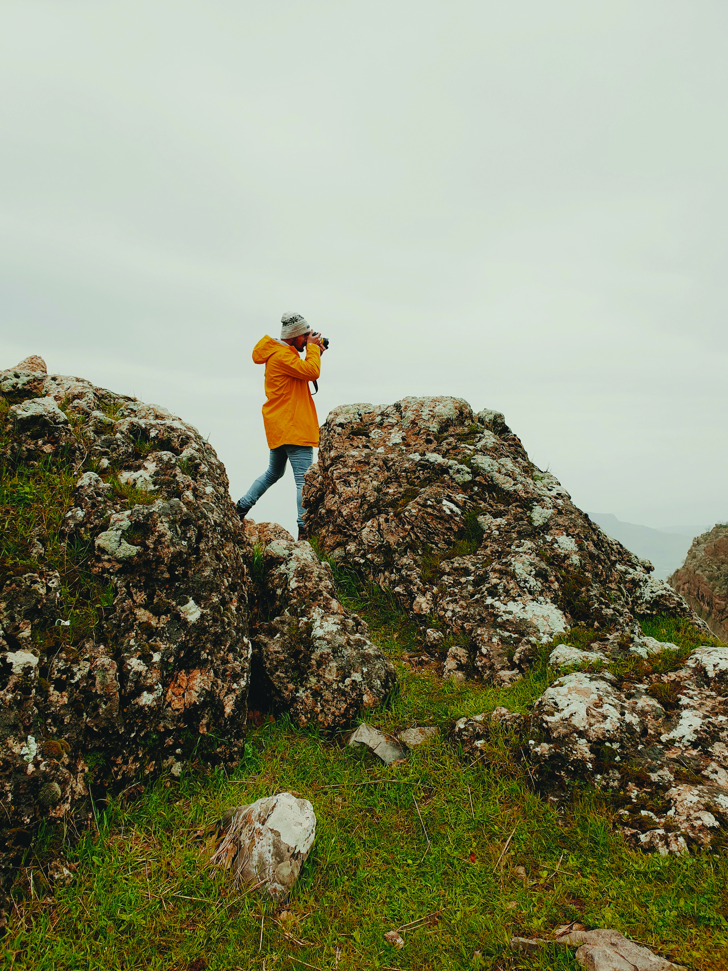
Learning Goal
To understand the increasing complexity and benefits of digital marketing in today’s tourism business environment.

Slide 6
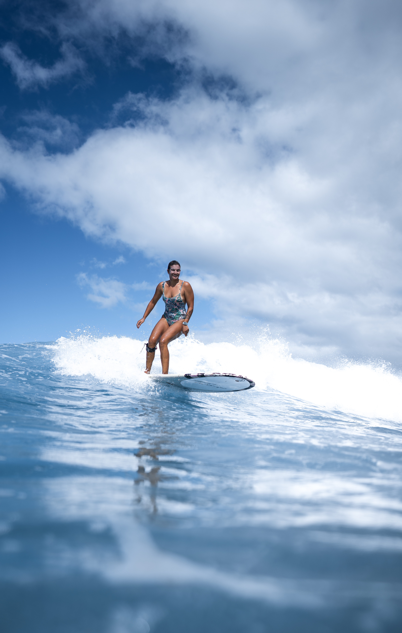
Learning Objectives
To acknowledge the main benefits and challenges of digital marketing.
To create a digital marketing strategy.
To distinguish outbound from inbound marketing.
To recognize the importance of content marketing.
To interpret sales funnels.
To choose the appropriate digital marketing tools.

Slide 7
Content & Resources
Content
9.1. Benefits and Challenges
9.2. Digital Marketing Strategy
9.3. Digital Marketing Tools
Resources
a. 7 support videos
b. 5 case studies
c. 8 articles for additional reading
d. 1 assignment

Slide 8
9.1.
Benefits and Challenges

Slide 9
a. Digital Marketing – Benefits
Fast
Cost-effective
Easy tracking and measurement
Precise targeting
Competitors
Operations &
Management
Everyone is online
Consumers
Widespread exposure
Strong word-of-mouth
Direct interaction with customers
Many opportunities for promotion
Businesses
Communication
Notes:
Digital marketing has been reported to be a fundamental part of the success of the bigger brands nowadays. It has revolutionized the way brands and consumers interact, bringing a whole new world of opportunities for both ends. The travel and tourism sector has especially benefited from this paradigm. However, small companies and entrepreneurs have also benefited a lot with digital marketing. With a few clicks, any small business can be online side-by-side with big brands, dramatically increasing its international exposure. Still, the use of digital marketing is becoming more professional and complex, making “the digital game” more competitive than ever before. Even for small entrepreneurs it is important to understand some of the intricacies of its functioning in order to leverage all their investment in this area and gain efficacy in their efforts.

Slide 10
Support Video #1
South African Tourism explains Digital Marketing!
https://youtu.be/QudH93m8gmg

Slide 11
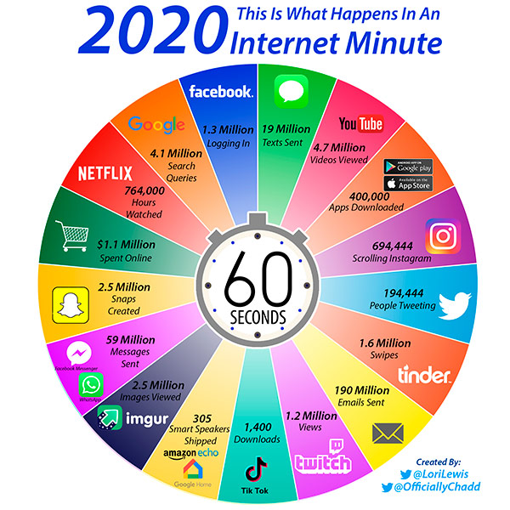
Digital Marketing – Challenges
Everything happens very fast.
Change is a constant.
Nothing stops.
Increasingly more people and more businesses are online.
People look for convenience and quick solutions.
Notes:
The worst thing you can do is not doing something. Digital marketing is not just the future, it is the present and it will get tougher and more complex as time goes by. It changes everyday and new trends have deep impacts in all the system, sometimes is very short timeframes. It is vital for international businesses, such as tourism companies, to remain up-to-date and navigate the rapid changing digital environment. Look at what happens online every single minute!

Slide 12
9.2.
Digital Marketing Strategy

Slide 13
b. Digital Marketing – Strategy
WHY
?
Objectives
e.g., promote low season
WHEN
?
Execution Calendar
e.g., monthly
BUDGET
Cost
e.g., man-hour
WHO
?
Target
e.g., buyer persona
WHERE?
Channels
e.g., website
TRACK
KPIs
e.g., conversion rate
WHAT
?
Resources
e.g., content or advertising
HOW
?
Tools
e.g., blog post or display ads
Notes:
To make the most o your online activity, the first thing to do should be developing a digital marketing strategy. It should be in line with your branding strategy. This might seem an academic exercise, but it is definitely not the case. This will guide you in your journey through a very tough, fast-changing and confusing world. If you know what to do beforehand, digital marketing will be some much easier and you will see tangible results much faster.
There are many ways to develop this kind of strategy, but if you are able to answer these 6 critical questions, and then convert them into numbers (quantitative data), namely in what regards budgeting and KPIs, you are on the right track.

Slide 14
Case Study – Tourism New Zealand
How Tourism New Zealand invited the world to PLAY NZ
https://youtu.be/4PpnIw2lqEo
Notes:
You can learn more here: https://campaignbrief.com/how-tourism-nz-tbwa-sydney-invited-the-world-to-an-open-world-gaming-experience-on-youtube/

Slide 15
Components of an Online Strategy
Website and content management system
Search Engine Optimization
Online marketing and social media
Graphic Design
Initial keyword research and search engine optimisation of content
Email marketing
Programming of website
Online advertising
Online distribution
Copywriting
Regular development of new content
Facebook, Twitter, Instagram, Pinterest
Integration into a content management system
Regular assessment of search engine rankings, google analytics, referring traffic sources, online bookings and enquiries and any other digital activity
Photo and video sharing
Hosting
Paid search
Domain name
Online reviews
Online booking system
Other online marketing
Notes:
As you can see, there are a lot of tools and details to be attentive when designing a digital marketing strategy. Every decision should be aligned with your brand strategy, but also with your goals. Depending on your business model as well as on your sales process, you may need to be using different tools, content, means and channels online.
Tourism & Events Queensland (2015). Digital Marketing. Available at: https://cdn2-teq.queensland.com/~/media/7717acc41c054edaae353a413f3374ee.ashx?vs=1&d=20151210T185732

Slide 16
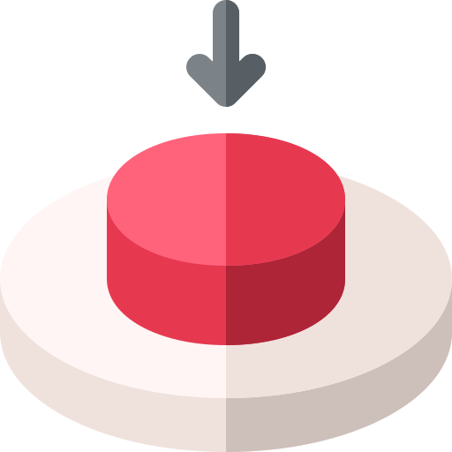
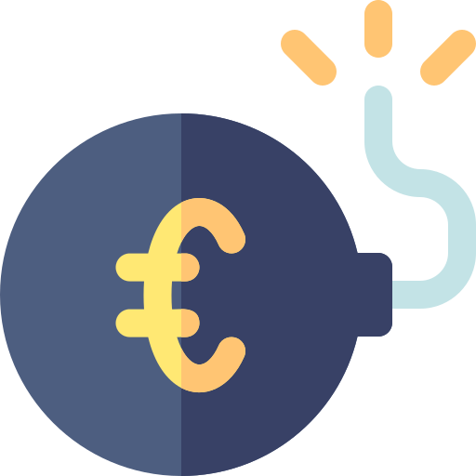
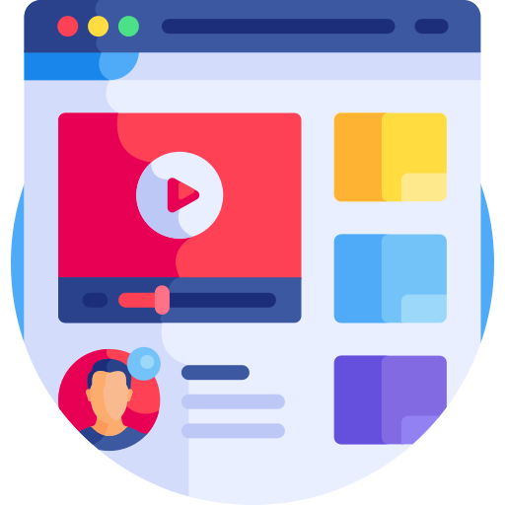
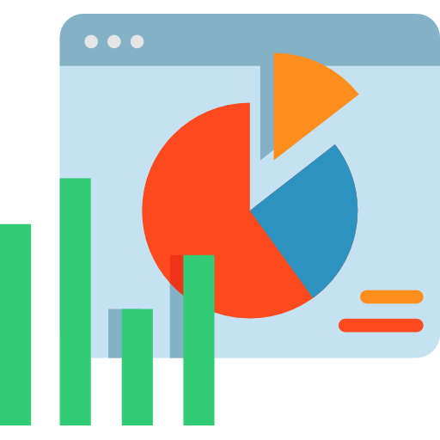
Digital Marketing Techniques
Outbound marketing
Inbound marketing
TV, Press, Radio, cold calls, display ads, prints, tradeshows, email spam
Blog posts, social media posts, SEO, webinars, e-books, newsletters
Means
Company imposes information
Trigger
Customer looks for information
General
Target
Precise
High
Cost
Low
Immediate
Results
Long term
Short term
Engagement
Long term
Brand-centric; induce sales
Info
Costumer-centric; educate for purchase
Unprecise KPIs measurement
Tracking
Accurate KPIs measurement
Notes:
When designing your digital marketing strategy, it is vital do have a clear notion of what you are doing in each moment, with each tool and with each resource. When using outbound marketing, you are “pushing” information to your target (i.e., sending messages) that will cause an immediate effect and increase short-term conversion limited to the object of your communication. Conversely, with inbound marketing, you are “pulling” potential customers to your “ground” (e.g., website, social media, blog) and educating them on how to use and choose your products, which will increase empathy and relatability with your brand. Both techniques have their uses and can be applied in different stages of the customer journey and of the sales process. Inbound marketing is particularly relevant in the digital world. There is so much content being developed everyday and so many competitors doing it, that every business needs to “play the game” to keep a place in the consumers’ mind.

Slide 17
Support Video #2
Inbound vs. Outbound Digital Marketing Strategy (EXPLAINED)
…

Slide 18
Content Marketing
In digital marketing
Content is the king
Social media is the queen
Boosts performance in search engines
Builds brand trust and loyalty
Highlights the brand personality
Educates the consumer
Fuels social media
Shares your content
Increases exposure
Faster and easier interaction
Highlights the brand’s personality
Leverages word-of-mouth
Notes:
With the evolution of the consumer behaviour and digital marketing, traditional marketing approaches are becoming obsolete. Content marketing is a type of inbound marketing and a way of showcasing your business and highlighting your brand’s value proposition. It is based on the planning, creation and publication of information that is useful and relevant to your potential customers. It does not need to be (and many times it should not be) about your brand/product specifically, but instead about the problem your product addresses or the environment you operate in. For instance, being a wellbeing tourism business, you can have a blog entry about how to meditate in plane travels.
Content can come in many ways and will always depend on the type of target and the goals you have. You can create blog articles or vlogs, videos, podcasts, social media posts, tutorials, white papers, guides, testimonials, infographics, newsletters, etc.
Content marketing is great to attract prospects to your website and retain them, leading to faster e stronger conversion. However, one of the best ways to leverage you content is to share it as much as possible and social media is great for that purpose. In fact, the content you create is a great way to have dynamic and interesting pages.
And, creating new content can be very cheap. Having a blog and creating articles that address your targets’ interests does not cost you anything else then your own time (or someone in your team).

Slide 19
Support Video #3
EHL Hospitality Insights - #Content Marketing​ Strategy at Choice Hotels
https://youtu.be/ArcgcFfGPSU

Slide 20
Case Study – Six Senses
Fresh from the Chef’s Garden with Chef Justin at Six Senses Uluwatu
https://youtu.be/7gkc9wQ7Xc0
Notes:
Strongly built around sustainable practices and wellbeing, Six Senses produces short Youtube videos to showcase amazing healthy dishes created by their hotel chefs and made from vegetables from their organic gardens. An interesting content for their target audience and one that highlights the values and the personality of the brand without enforce sales.

Slide 21
The Sales Process – Sales Funnel
What to do
Top of Funnel
Increase brand awareness.
Reach as much people as possible.
Educate about the problem.
Middle of Funnel
Generate qualified traffic to the website.
Triger engagement & interaction with interested people.
Bottom of Funnel
Increase traffic in the booking section of the website.
Increase conversion and sales
Notes:
Sales funnels are typical representations of sales processes. Understanding your sales funnel is particularly useful in digital marketing, because it will aid in choosing the type of channels, tools and resources to use. You can do this whenever you see fit and it really helps to decide where to invest and what to do in each step.
On the “Top of Funnel” (or TO-FU) your priority is working the brand awareness and reach as many potentially interested people as possible. The potential customers (i.e., leads) are still unqualified (i.e., they haven’t become interested in your product yet and you still don’t know if they fit your ideal buyer persona) and are looking for information about a certain product category or a potential solution. In this process, they become aware of your brand/product. How to do it: blog articles, videos, infographics, microsite, newsletter, social media, print ads, press release…
On the “Middle of Funnel” (or MO-FU) the potential customers have become interested in your brand/product and want to investigate more about it in order to be able to decide (they are now qualified prospects, because they can really represent a sales opportunity). They will be comparing your solution with those from your competitors. You will need to be educating your potential customers and building trust. How to do it: webinars, case studies, reviews, testimonials, product video, buyer guide, FAQ, opt-in form, live chat,…
The the “Bottom of Funnel” (or BO-FU) represents the transaction. Your qualified prospect chooses your solution and becomes a customer. You might have to negotiate during the process. Your priority will be leading qualified prospects to your booking areas and demonstrate that, in fact, your product creates more value than your competitors’ products. You want them to convert into customers. Customer retention and brand loyalty are also part of the “Bottom of Funnel”. How to do it: Free trial, demo, negotiation, quotation, consultation, promos, giveaways, detailed itineraries,…

Slide 22
9.3.
Digital Marketing Tools

Slide 23
Digital Marketing Tools
Pay per click
Display ads
Retargeting
Paid Influencers
Social media ads
Mentions
Shares
Reviews
Recommendations
Influencers (free)
Media coverage
Earned Media
Paid Media
Owned Media
Website
Blog
Social media profiles
Email
Mobile apps
Notes:
There are many forms to explore the possibilities of digital marketing. The different elements and tools should be combined according to your audience as well as your goals, as sales funnels and the customer journey maps show you.
Owned media is the tools and channels that you directly control. They are unique to your brand and extensions of it. Owned media can be identified as the destination where you want your prospects to arrive.
Earned media is basically your digital word-of-mouth. It is free and highly valuable for consumers. It is the “vehicle” to lead people into your “owned media”.
Paid media is the digital promotional resources you pay for. It serves both to drive earned media and owned media.

Slide 24
Website
Primary means for:
Communicating your audience
Converting into bookings
Showcase your business
Highlight your brand personality
Be alert to:
Graphic design
Copywriting
Programming
Optimization for Mobile
Content Management Systems
Online Booking System
Quick hint!
You can use solutions such as Wix, Weebly, Squarespace or Wordpress that have ready-to-use website templates and simple content management systems.
Notes:
Graphic design: appealing and impactful first impressions; navigation; functionality and the brand’s look & feel.
Copywriting: simple, short, and informative text to highlight key information.
Programming: search-engine friendly code.
Optimization for Mobile: leverage the use of mobile devices during travel.
Content Management Systems: update the content whenever you need.
Online Booking System: facilitate conversion and eliminate intermediaries.
Hosting: the service that stores your website and makes it available online.
Domain name: simple, easy-to-remember and brand related name that will serve as your main identifier online.

Slide 25
Case Study – Six Senses
In 2019, Six Senses launched a new website as an extension of the brand on www.sixsenses.com. It incorporates an empathetic design (this is careful graphic design), story-inspired layout (graphic design for user experience), the best-kept local secrets (content for the inbound marketing) and an enhanced reservation process (conversion).
Notes:
According to Six Senses, the website aims to enhance the core values, vision and unique positioning of the brand. So, the concept of the new website is deeply aligned with its brand, which supports what has been discussed in Module 8 – Brading for Wellbeing.
Check the new concept here: https://www.sixsenses.com/en/corporate/media-center/press-releases/2019/six-senses-launches-a-new-website

Slide 26
Website – SEO vs. SEM
Search Engine Optimization
Pay nothing (organic)
General audience
Results take time
Requires technical skills to optimize content
Search Engine Marketing
Pay per click
Targeted audience
Immediate results
Requires money to invest
How to do it?
Improve the content of your website
Usage of specific keywords (e.g., wellbeing)
Improve backend structure (technical)
Getting links from other websites to yours
Ads are placed when specific keywords are searched.
You pay for each time a user clicks on those ads.
Notes:
Appearing well positioned in search engine (Google, Bing, Yahoo!, …) results is vital in digital marketing. The way to do is to optime Search Engine Results Pages (SERP).
SEO is very good to increase trust in your brand as well as brand loyalty. To an extension, you can do it yourself. SEM is more suited to increase leads and induce sales, but you will have to resort to special services for that, like Google Ads. All in all, search ads are very useful in middle of funnel stages.

Slide 27
Support Video #4
Authority, Relevance & Trust (The 3 Pillars Of SEO)
https://youtu.be/yHTUsvSNk5k

Slide 28
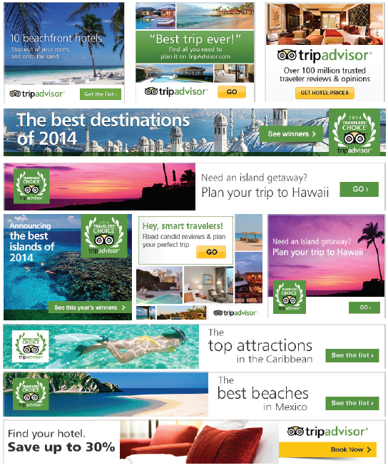
Display Ads
Means for:
Attracting audience to a digital medium (e.g., landing page)
Encourage click through and specific actions (e.g., purchase)
Increasing brand awareness.
Benefits:
Diversity (banner, videos, rich media, etc.)
Reach (many people very quickly)
Targeting (specific people)
Measurement (control)
Source: AdClarity (2016)
Quick hint!
A display ad should be linked to a landing page with a very specific goal!
Notes:
AdClarity (2016). Display Advertising Industry Report 2016: US Travel: https://www.slideshare.net/AdClarityBIScience/display-advertising-report-2016-travel-edition-report-ad-clarity-bisicence-linkedin
Display ads appear in websites and other digital media in a great variety of formats. The Google Display Network offers a huge potential to reach many people and websites. Display ads fall into the paid media category and are very useful for creating brand awareness, but also for brand loyalty and repetition (i.e., top of funnel and bottom of funnel stages).
Although their display ads are very powerful tools, their efficiency hindered by inappropriate targeting (you responsibility); the usage of ad blockers (your audience responsibility); and “banner blindness”. Retargeting (i.e., retarget the same audience that has seen the ads or has been on the website to encourage their return) can aid with some of these issues.

Slide 29
Support Video #5
What is display advertising?
https://youtu.be/4T6Ia20D-T8

Slide 30
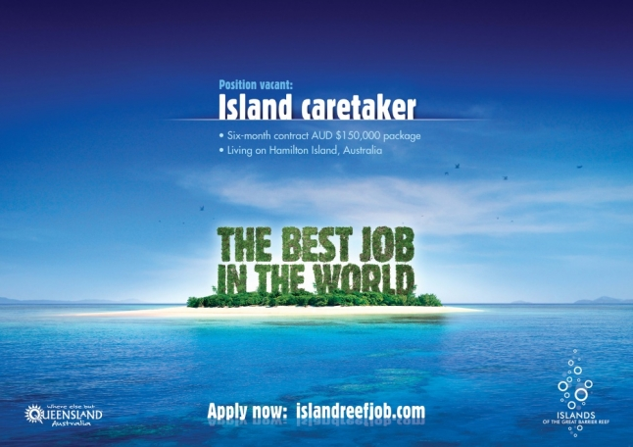
Landing Page
Have just one specific goal.
Show off the benefits of the product.
Remove navigation.
Only necessary information.
Have a clear and compelling call-to action.
Match the copy with the message on the ad.
High quality visuals and media.
Quick hint!
A landing page may include simple form fields to collect data from prospects or opt-in email marketing.
Notes:
Landing pages are webpages created specifically for a given campaign. That is why they are usually liked to display ads. The landing page is where the visitor of your website “lands” after clicking on an ad other linked content, like email or social media links. Since the landing page is designed to be simple and straight to the point (with no navigation and usually just one link), it is highly valuable and useful for conversion, be it to collect data on forms, opt-in newsletters, bookings, etc.

Slide 31
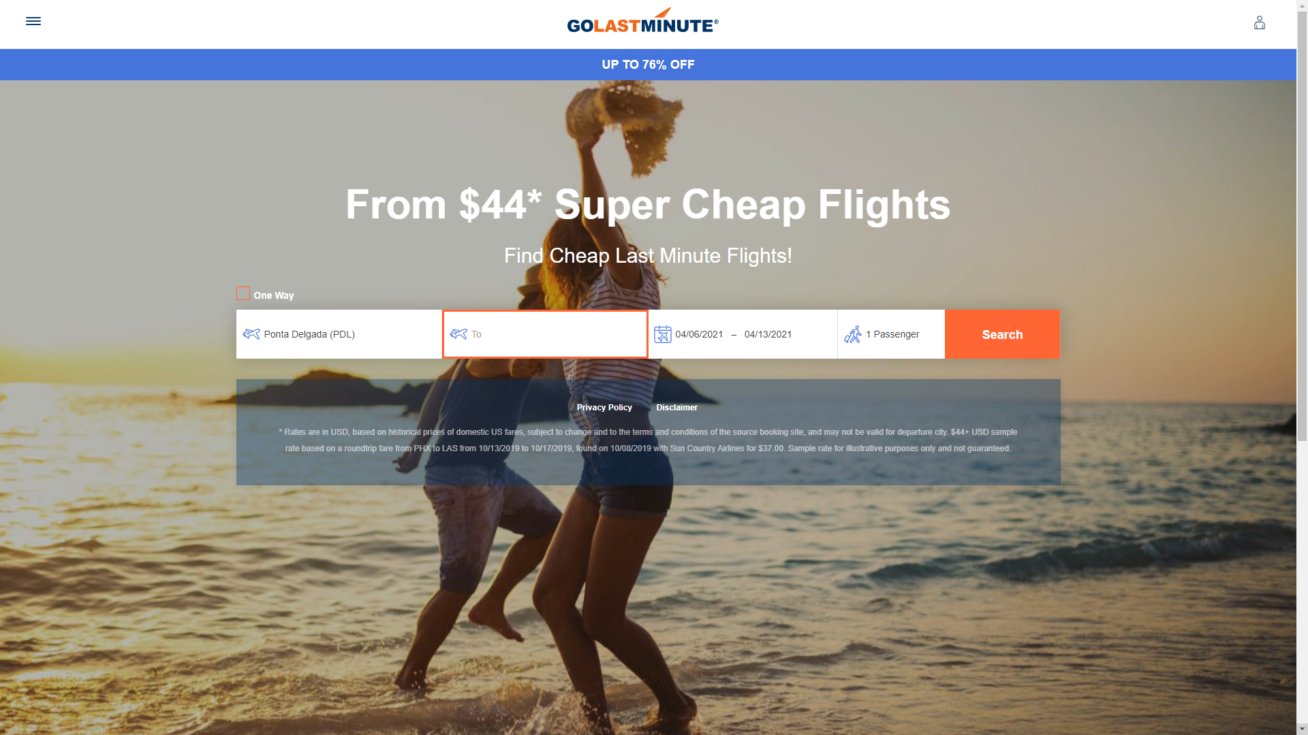
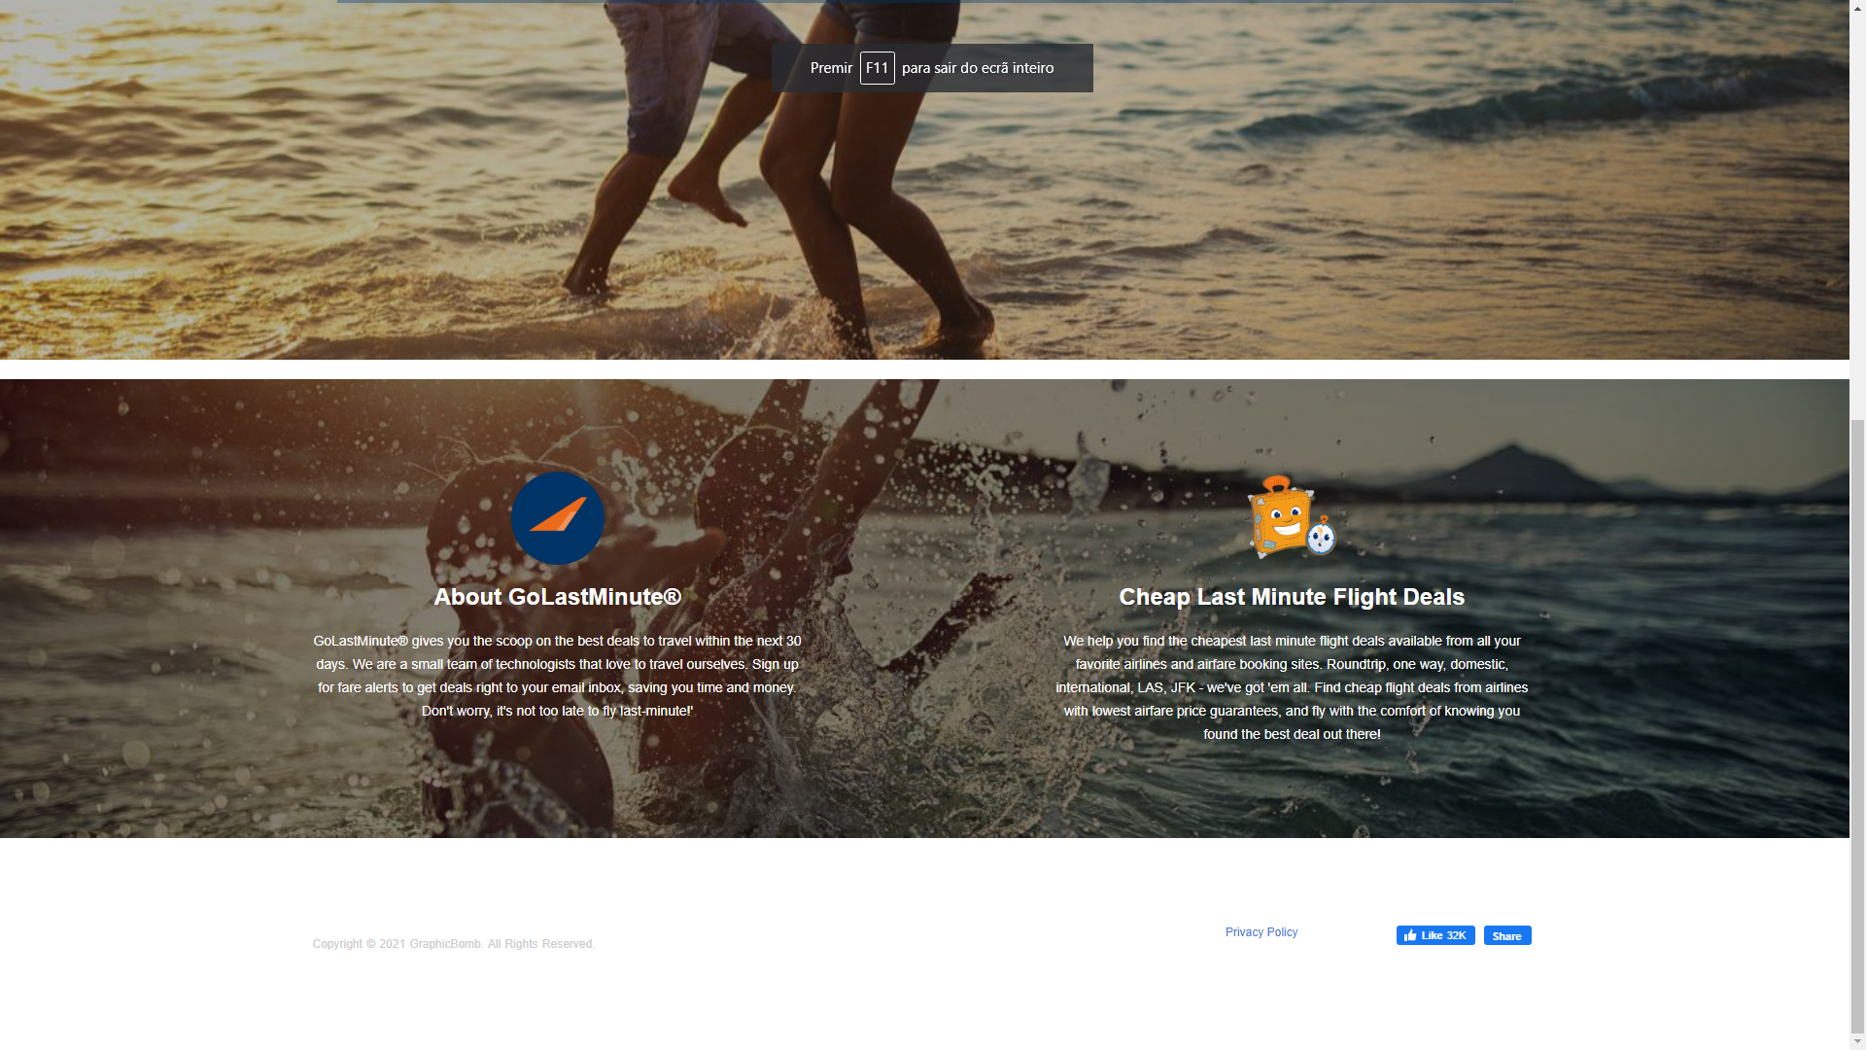
Case Study – Golastminute.com
golastminute.com presents daily deals landing pages directed to last minute bookers. These landing pages have very little information, no navigation options and are simple and focused on a specific goal: quick search and booking. Eye catching headlines to highlight promotions and opportunities convey powerful messages that help customer conversion (i.e., buying the ticket).
Promo info (from the ads)
Headline and sub-headline
Call to action
Hero image
(high quality photo)
Reinforcement statement
Benefits

Slide 32
Support Video #6
What is a Landing Page?
https://youtu.be/nQ2f79bi_QE

Slide 33
Email Marketing
Developing relationships potential customers.
Keep customers informed.
Tailor the message to audiences or even personalize.
It is inexpensive and easy to apply.
There are automated possibilities (e.g., MailChimp)
Quick hint!
When using email marketing, you should comply with the General Data Protection Regulation (GDPR).
!
Different from spam
Reaching only those interested in the information.
There is opt-in/opt-out features
Notes:
Newsletters are typical and very effective forms of email marketing. They can include updates, new, catalogues, promotions, special deals for subscribers… They should follow a schedule and keep interesting content for the receiver.

Slide 34
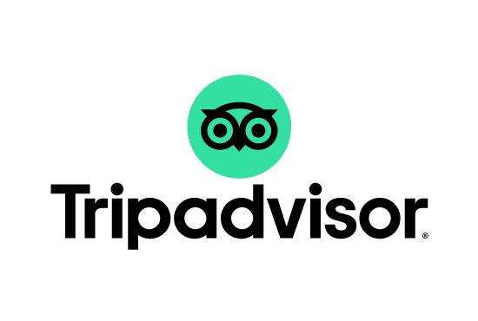
Social Media
Do
Post frequently
Engage with customers
Content consistency
Keep it short and sweet
Be authentic
Schedule your posts.
Create new content.
Adapt the content to platforms.
Monitor and measure.
Don’t
Be quiet and idle
Ignore customers
Publish Irrelevant content
Spam
Always sell
Quick hint!
Facebook, Instagram, Twitter, LinkedIn and Snapchat are important platforms for tourism, but Tripadvisor has a huge influence in the purchase decision.
Notes:
Digital 2021: Global Overview Report: https://datareportal.com/reports/digital-2021-global-overview-report
Previously, we have seen the main benefits of social media [slide 59] why it is the “Queen” of digital marketing. So here’s how to leverage it.
It is part of our daily lives, a powerful means for word-of-mouth (good or bad!) and a source of data for consumer decision. Still, it should not be used exclusively for selling, but instead for educating the consumers and building the brand’s personality. The general “unspoken” rule is 80% content and 20% selling.
Tripadvisor is a very interesting case. It has been considered a social media platform (among other functions), since it enables the direct and unfiltered exchange of information and interaction between people. Tripadvisor is: 1) very important for consumer decision; 2) a great means for getting customer feedback; and 3) very helpful to monitor competitors. When used correctly, this one is a very powerful tools for building brand reputation and conversion.

Slide 35
Support Video #7
Hotel Social Media Marketing – Simplified!
https://youtu.be/nYB8veSmNm0

Slide 36
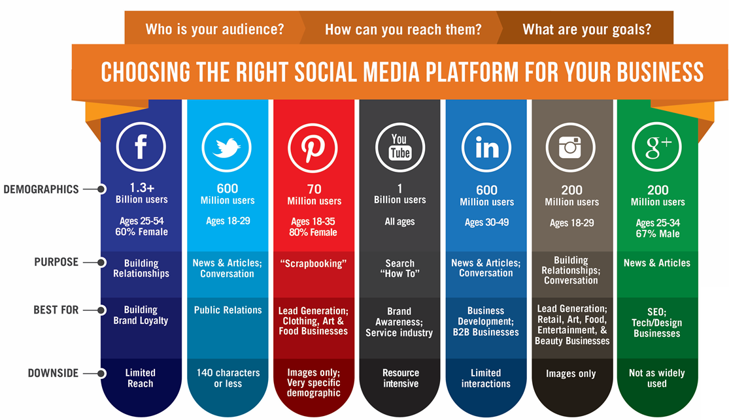
Source: https://us.accion.org/resource/choosing-right-social-media-platform-your-business/
Notes:
Each social media platform has its own audience and purpose. Choosing the right platform for your type of business is vital to your success and efficiency. Besides, each platform demands specific types of content, so it is important to be able to acknowledge, understand and answer those demands.

Slide 37
Case Study – Obermutten
Jung von Matt/Limmat: Obermutten. A little village goes global.
https://youtu.be/e91c0mWP960
Notes:
Find out more: http://www.digitaltrainingacademy.com/casestudies/2015/03/social_tourism_case_study_the_little_village_that_went_global.php

Slide 38
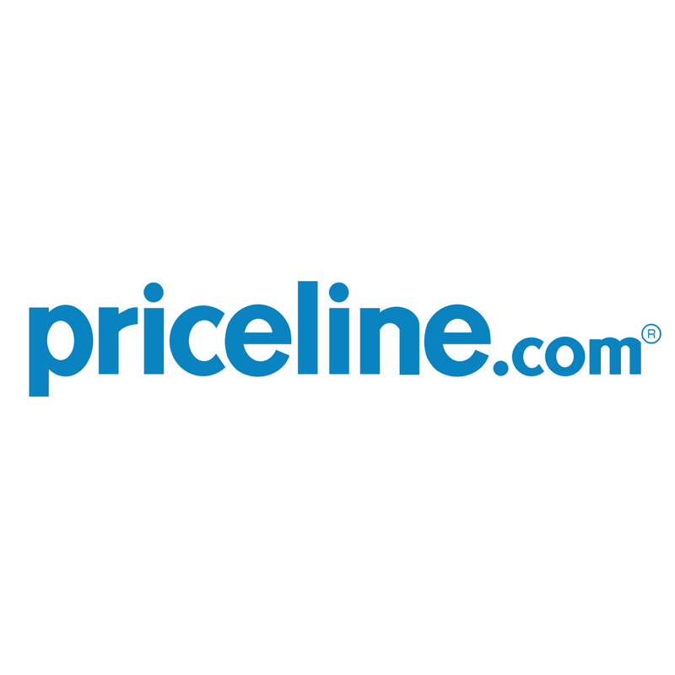
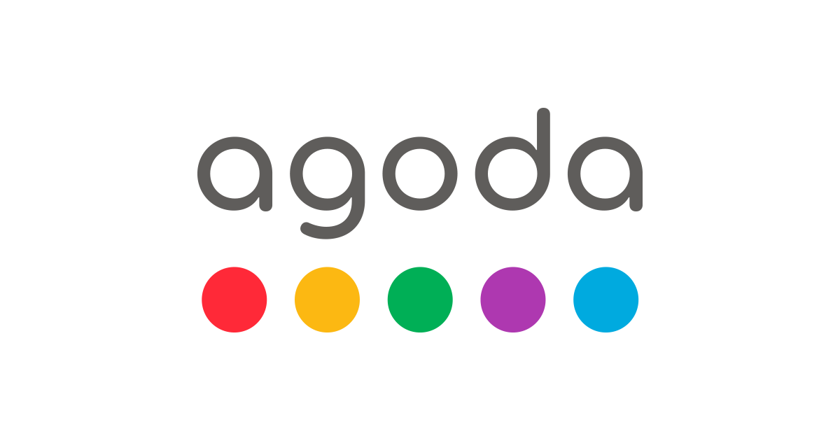
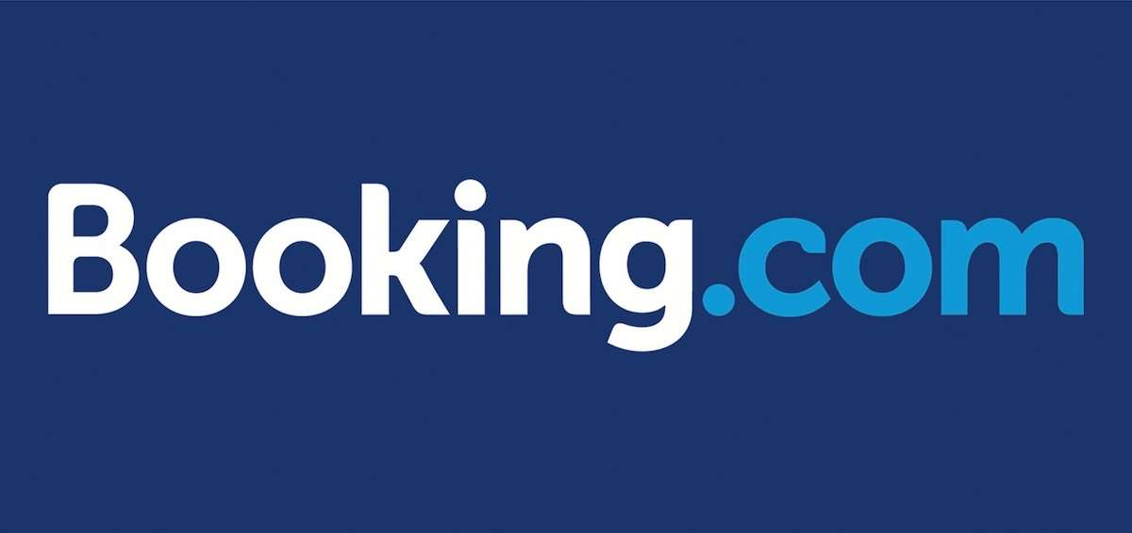
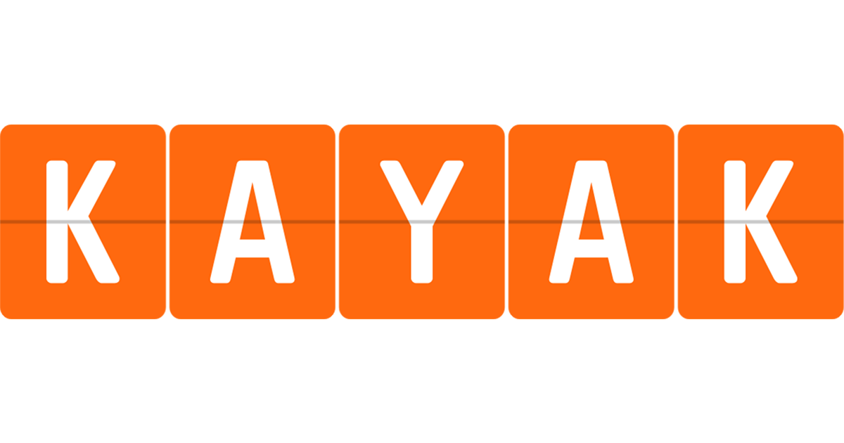
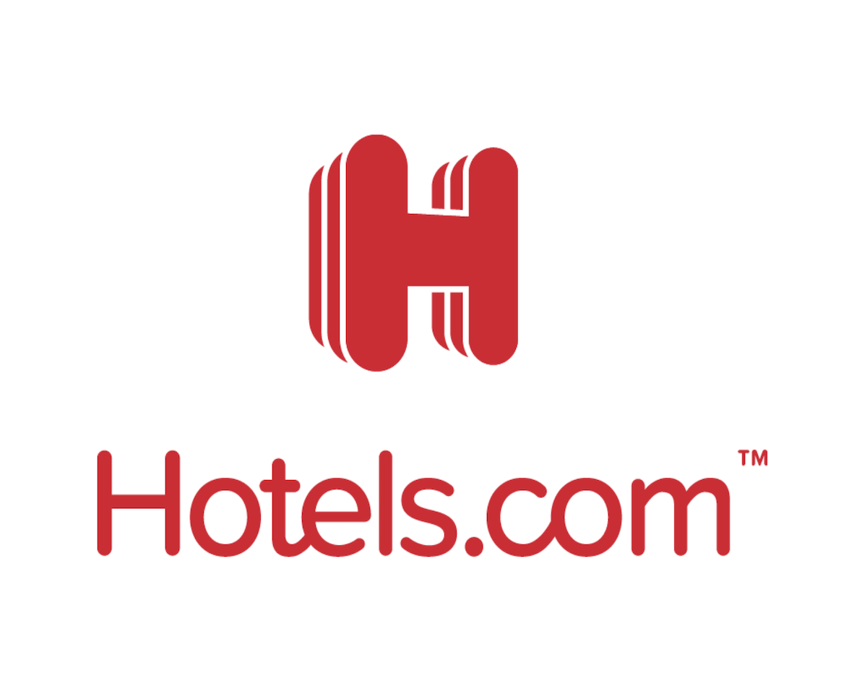
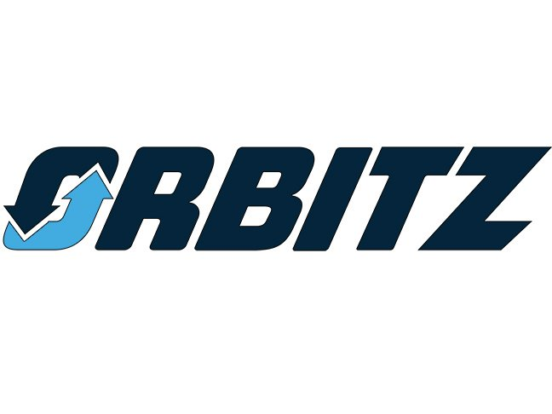
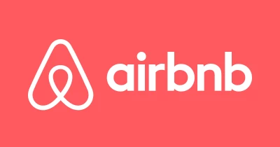
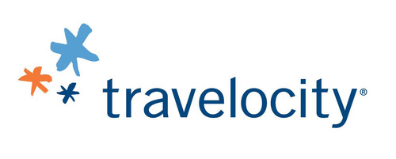
Online Travel Distribution
Businesses become more visible online.
Generates trust and reliability.
Allows for comparison (rates, reviews, availability).
Easy and fast booking.
Self-service features (customization).
Quick hint!
Different OTAs might appeal to different customer segments and serve different needs. Be sure to pick correctly.
Notes:
OTAs are basically selling points without human interaction. They are third parties that sell transportation, accommodation, experiences and tours to travellers on behalf of other companies. They are the intermediaries of the transaction, so a commission is charged on every sale. Additionally, cancelation terms are usually very restrictive. Each platform has its own politic and rates. They invest great sums in digital marketing and, therefore, generate a lot of traffic increasing the exposure of the businesses that are selling through them.

Slide 39
Digging Deeper

Slide 40
Further Reading
What Is Email Marketing?
[CLICK HERE]
What Is a Landing Page? [CLICK HERE]
A Guide to Improving Your Tripadvisor Ranking
[CLICK HERE]
How SEO Fits Into An Inbound Marketing Strategy
[CLICK HERE]
The Beginner’s Guide to a Sales Funnel
[CLICK HERE]
10 Tips To Increase Your Hotel Bookings Through OTAs
[CLICK HERE]
What Are Display Ads? The Complete Guide [CLICK HERE]
The Role of Social Media in Tourism Marketing
[CLICK HERE]

Slide 41
Assignment #2
How is your digital marketing?
First of all, write down all the digital platforms that you are using right now, including website, blog, social media and online distribution. Can you understand how are they connected and how they improve your brand?
After this warm-up, create a new digital marketing strategy based on those channels and on your resources. Don’t forget to answer to its main elements: why, who, what, when, where, how, budget and tracking.
How will you fit content marketing in this strategy and what media will you use?

Slide 42
Module Summary
Module IX. Digital Marketing

Slide 43
In this module we have…
… become aware of the huge benefits and great challenges that digital marketing brings to brands and business today.
… comprehended how to develop a digital marketing strategy, integrating several features and media.
… explained how inbound and outbound marketing explore different forms of engaging with customers throughout the sales funnel and how content marketing is a key piece in this distinction.

Slide 44
In this module we have…
… studied several digital marketing tools and how they can be useful in different stages if sales funnels, including websites, SEO & SEM, display ads, landing pages, email marketing, social media and online distribution platforms.

Slide 45
The roadmap
I. Introduction to Wellness and Wellbeing
II. Wellbeing in a New Era
III. The Experience Economy
IV. Engineering Wellbeing Experiences
V. Customer Journey Mapping
VI. Storytelling in Culinary Tourism
VII. Setting up a Wellbeing Business
VIII. Branding for Wellbeing
IX. Digital Marketing

Slide 46
Thank You
Any Questions?
www.detourproject.eu
Detour on Facebook
@WellbeingTourismDestinations
#detourdestinations #erasmusplus #detour #wellbeing
Icons: www.flaticon.com

