Slide 1
Branding for Wellbeing
Module 8

Slide 2
“
Welcome to DETOUR’s Wellbeing Tourism online training course.
”

Slide 3
The roadmap
I. Introduction to Wellness and Wellbeing
II. Wellbeing in a New Era
III. The Experience Economy
IV. Engineering Wellbeing Experiences
V. Customer Journey Mapping
VI. Storytelling in Culinary Tourism
VII. Setting up a Wellbeing Business
VIII. Branding for Wellbeing
IX. Digital Marketing

Slide 4
Module Introduction
Brands are everywhere these days and some of them are inherently built around powerful wellbeing concepts. But why are some of them more impactful and successful than others?
Interestingly, even though branding is not a recent concept, people and businesses still seem to have big misconceptions. This module will dive into the world of brands and reveal that a brand is much more than a simple logo or a strong tagline. Starting from the concept that each brand should be constructed based on a core idea, the module will follow a streamlined process to show how successful brands come to life and express distinct personalities. A case study based on Six Senses will be exemplifying each step of the process for wellbeing tourism brands.

Slide 5
Learning Goal
To understand the role of branding and its increasing complexity, from the conceptual to the visual dimension.

Slide 6
Learning Objectives
To recognize the importance of brands and the branding process.
To interpret the power of a brand’s core idea.
To distinguish the concepts of brand identity, brand personality and brand voice.
To understand what a brand tagline is all about.
To criticize the construction of brand’s visual identity.

Slide 7
Content & Resources
Content
8.1. Brands & Branding
8.2. Brand Identity and Personality
8.3. Brand Visual Identity
Resources
a. 5 support videos
b. 10 case studies
c. 8 articles for additional reading
d. 1 assignment

Slide 8
8.1.
Brands & Branding

Slide 9
Brands & Branding
How can different companies provide the same experience (e.g., hiking in the woods) but still convince tourists to purchase their product instead of the one from the competition?
A brand is a name, term, design, symbol or any other feature that identifies one seller’s goods or service as distinct from those of other sellers.
American Marketing Association
Brands
Notes:
They serve to identify and distinguish you from competition. Branding (as marketing aims) at winning people’s “hearts and brains” long before they make the decision of choose a specific product or company over others. It is all about creating your own special space inside the consumers’ world.

Slide 10
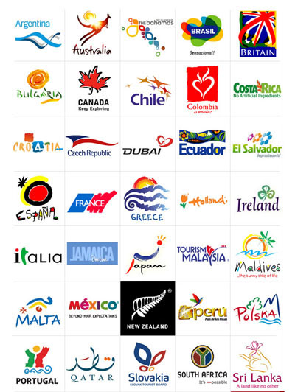
Brands & Branding
But a brand is much more a symbol, logo or visual identity.
It is:
a promise.
the sum of all experiences with a product/organization.
A mental image made of rational and emotional elements.
a coherent, cohesive and consistent identity.
The instinctive perception (the gut feeling) the market has about you.
Source: https://www.managingip.com/article/b1kbp7pyg3nbbc/protecting-nation-brands-and-country-names
Notes:
When idealizing their holidays and looking to book their accommodation, travel and experiences, people are looking for emotional triggers that inspire them and promise the perfect experience. This is the job of a well structured and developed brand!
Everything is branded nowadays. Either you consciously manage a brand or not, it always exists in someone’s mind. It is better to properly manage the brand and create the desired image and perception on your audience than let that audience create its own spontaneous perception (that might hinder or even destroy the brand’s potential and core identity).

Slide 11
Case Study – Six Senses
It’s time for the next chapter! Come Away With Six Senses
https://youtu.be/zr029rH74UM
Notes:
Six Senses is one of the most successful luxury wellness tourism brands in the world. It has been selected has the best Hotel Brand in the World by Travel+Leisure in 2017, 2018 and 2019 (https://www.travelandleisure.com/worlds-best/hotel-top-brands-2019). The brand as placed in the 7th place in 2020. This will be main case study throughout the module and will be referenced multiple times.

Slide 12
Brands & Branding
Promise
BRAND
Expectation
Public
Organization
Your brand is what other people say about you when you’re not in the room.
Jeff Bezos (Amazon)
Notes:
The brand lives at the intersection between the promise the organization formulates and the expectations the audience creates in its mind. The management of this balance works as a conversation between the organization – that learns what the brand must deliver to fulfil the expectations – and the public – that learns what to expect from the brand. It requires consistency and coherence, in order to provide a seamless experience that carries a clear message and a purposeful meaning.
Everything that you do you counts: from aesthetics to social media posts; from the amenities in the room to the way your guides interact; from the way you speak to the way you defend the environment. Every single aspect contributes to your brand messaging.

Slide 13
Support Video #1
What is a brand?
https://youtu.be/sQLlPC_alT8

Slide 14
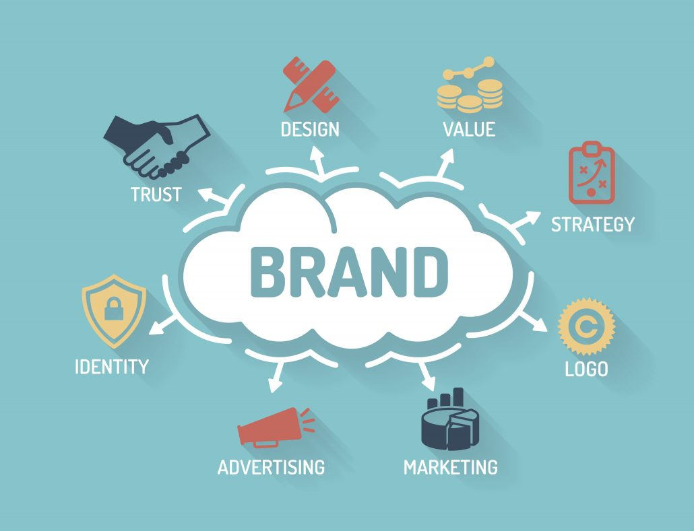
Brands & Branding
What is branding and how to do it?
Create and shape…
… a strong, positive and meaningful perception…
Source: www.veriday.com/blog/consistent-branding-finance
… of an organization, product/service or even a person…
… in the consumers’ minds.
Notes:
Branding is a process. In fact, it is a never-ending process. It starts with the market study, it comprises the definition of the brand’s strategy and personality, it then needs a creative process, finally, it is continuously nurtured with the brand’s management. This a sequential and cumulative process, meaning that each stage is dependent from the quality and the inputs that come from the previous stages. How can you design a brand’s visual identity if you don’t even now its core values, business sector or consumers?

Slide 15
How?
Brands & Branding
What is branding and how to do it?
What?
Who?
1.
Conduct Research & Analysis
2.
Define the Strategy & Personality
3.
Create the Visual Identity
4.
Execute Brand Management

Slide 16
Brands & Branding – a streamlined process
Visual Identity
(LOOKS)
FEELS
Secret Potion
CONSISTENCY
Voice
Audience
Personality
(BEHAVES)
(SOUNDS)
PROMISES
Purpose
(WHY)
Notes:
With your audience (in particular your customers) at the heart of the brand, its development should be based on finding a purpose for doing what it does. Then define how the brand behaves and communicates. That’s right, give it a “human touch”. Then create the visuals and show it to the world. What is the secret in all this? Consistency! Everything has to be consistent with everything else.

Slide 17
Brands & Branding – The Audience
Market → How does it work? How is the sector and the business?
Trends → What is going on? What will happen?
Competition → Who and how are they working?
Consumers → What are their needs? What do they think of you?
External
Research
&
Analysis
Purpose → Why do you do what you do?
Vision → Where to you want to go?
Mission → What to you want to achieve?
Values → What defines you?
Internal
Notes:
To understand your audience, it is important to conduct a little research and analyse your surroundings, as well as your internal environment. Your brand will be communicating with multiple targets, from customers to employees, from suppliers to partners. All of them have a mental image of your brand, but they also have their own aspirations and goals.

Slide 18
Brands & Branding – The Audience
Brands serve to satisfy needs of people… so you need to understand people.
Who they are
How they think
How they behave
How is their speech
What they want
What are their pains
Customers should be at the heart of a brand.
Satisfy real needs
Connect with people
Build trust, loyalty & advocacy
Secure efficacy
Focus communication
+
Evolution & trends
Notes:
KNOW YOUR CONSUMERS: that is the best advice for someone who wants to create a business and a brand. Brands exist because of customers. To satisfy their needs, but also to relate with them it is vital to know and understand them. The most successful brands are those that have identified and detailed their audience. They know how to reach and to engage with them. Consumers relate to brand because they represent something they want to be, believe in or identify with. That is what you need to discover to create a powerful brand.
One additional aspect to have in consideration is that people are not all rational in their decisions. The emotional level is a vital part of the decision process and the “gut feeling” can be decisive many times. Brands needs to engage emotionally with people and, for that, they need to really know how they think and feel, how they speak and behave.

Slide 19
Brands & Branding – The Audience
Market Segmentation
Buyer Personas
Mood boards
Use specific criteria that make sense for the brand:
Age
Travel style
Region
Hedonic/Eudaimonic
Fictional portrait to represent a specific group of people.
Generate empathy.
Help focus on real needs of real people.
Understand behaviours, expressions, actions, places, experiences, moods.
Find inspiration for graphic design colours, typography, symbols.
Notes:
There are many ways to understand your consumers. The way we choose to gather data and analyse it depends on our resources and goals.
Market segmentation, for instance, can be done through simple desktop research using official or technical reports or infographics. But it can also be extremely more complex, using demographic, geographic and psychographic data.
On module #5 we have covered how to create Buyer Personas. They represent your ideal customer
Mood boards can be easily generated using, for instance, Pinterest search bar. They are a collection of images about a certain topic, showing colours, letter fonts, facial and body expressions, symbols, etc. They serve to bring inspiration and the right mood of your target and of your brand essence.

Slide 20
8.2.
Brands Identity and Personality

Slide 21
Identity & Personality
A brand is like a person!
Brand Persona
How is the brand’s personality?
It has values, a personality and a way to express itself.
It needs to relate with other people and generate empathy.
Brand Voice
How does the brand communicate?
Brand Identity & Values
What does the brand stand for?
Core Idea
What is the purpose of the brand?

Slide 22
Brand Identity and Brand Personality
The brand’s core idea
Brand values
Brand personality
Promise & Tagline

Slide 23
The Golden Circle
What have you created based on your beliefs?
People don’t buy what you do, they buy why you do it.
Simon Sinek
WHAT?
HOW?
How do you put your purpose into practice?
WHY?
Why you do it?
What is your purpose?
Notes:
The construction of a brand should start from the inside out of the Golden Circle. Brands with a purpose:
Are more relatable
Share values with customers
Build credibility and trust

Slide 24
Support Video #2
TED Simon Sinek The Golden Circle Clip
https://youtu.be/7dAaWweraQ4

Slide 25
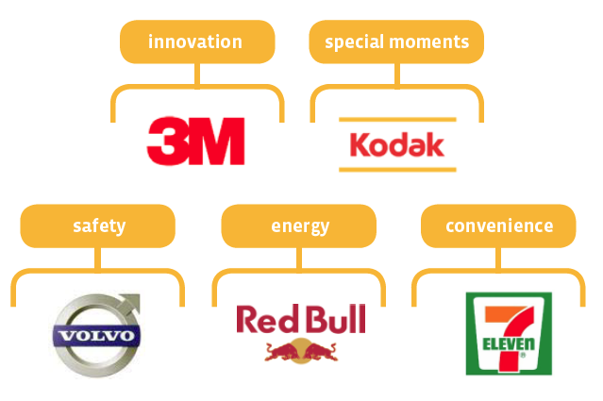
Core Idea
The fundamental idea behind the brand is that in everything the organization does, everything it owns, and everything it produces it should project a clear idea of what it is and what its aims are.
Source: https://www.labbrand.com/brandsource/issue-article/brand-identity-decoded
The purpose that drives the organization
Represents its beliefs and what it stands for.
Expressed with very few words (or only one).
Core Idea
Notes:
Olins, W. (2008). Waly Olins: The Brand Handbook. London (UK): Thames & Hudson.
The brand’s core idea should be clear and simple – it is what makes the brand unique. It should, however, powerfully “energize” the brand and grant it its purpose.
Everything about the brand is developed around the core idea.

Slide 26
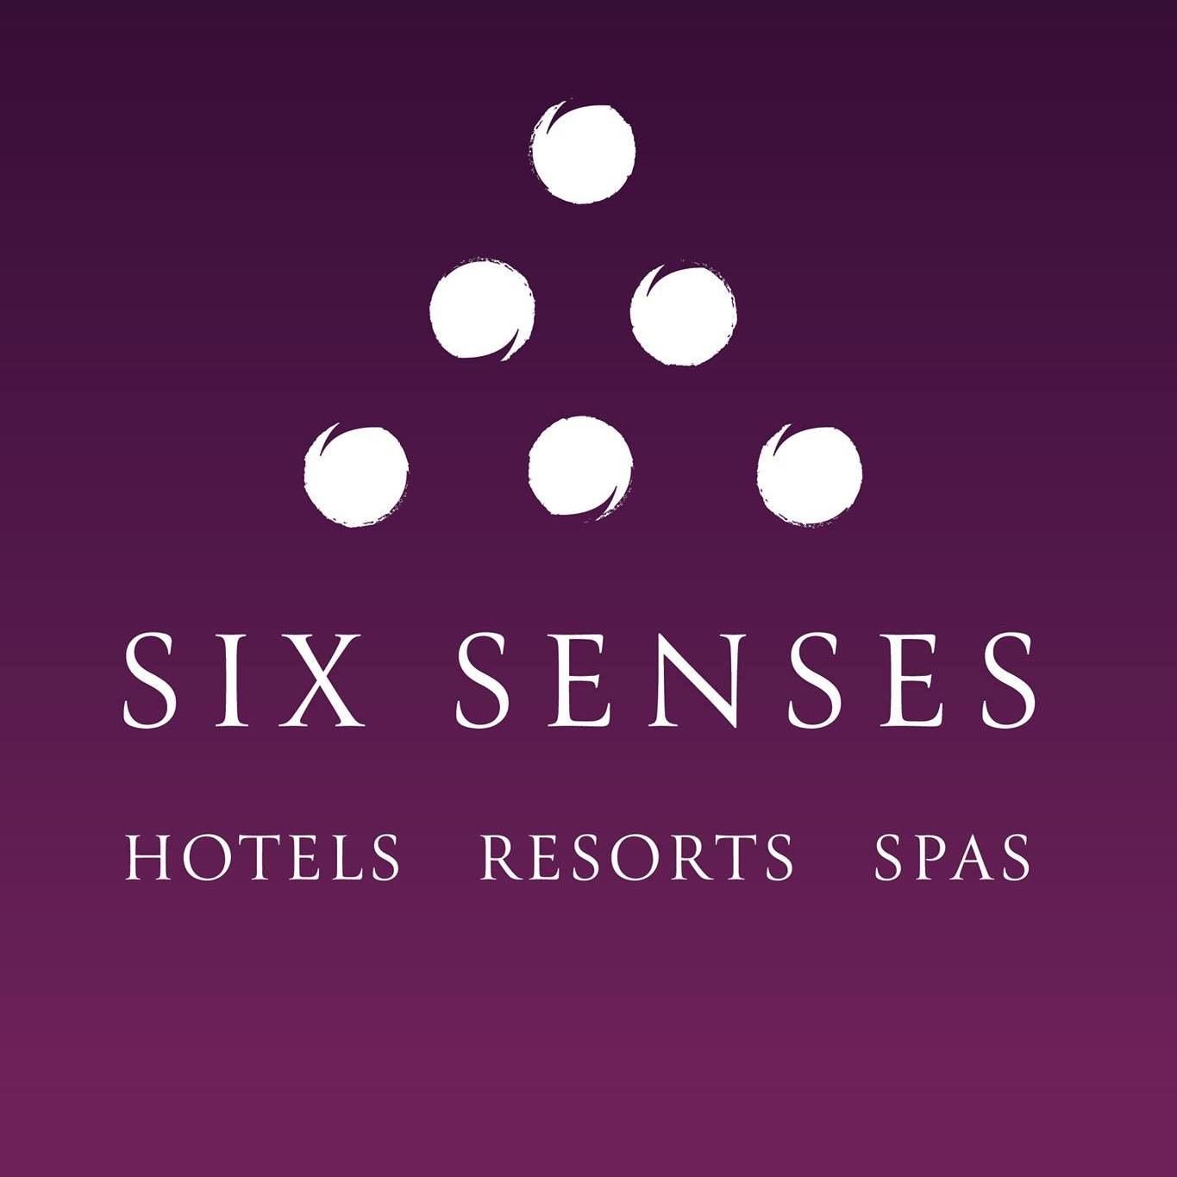
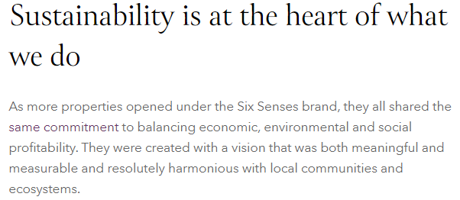
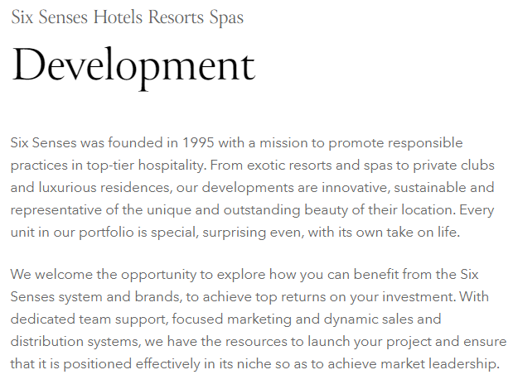
Case Study – Six Senses
www.sixsenses.com
Considering these samples from Six Senses’ website, would you agree that the brand’s core idea is “Sustainability”?
Notes:
In www.sixsenses.com you can read:
A meaningful brand is at the heart of any thriving business. It is what people connect to more than any product. So, this win is a huge tribute to all our hosts and owners around the world and the way they continue to offer our loyal guests exceptional experiences that help them reconnect mentally, physically and spiritually. It also gives us the courage to push beyond the boundaries, to be bold and different, act on our imagination, create more than just places to stay and stand for something.

Slide 27
Core Idea
Product
Environment
What the organization sells (products, services, experiences) and its characteristics.
How the physical and digital environments (e.g., store, website, massage room, social media) of the brand looks like and functions.
Core Idea
How the brand interacts with its audiences, tells what is going on, and describes itself: channels, content, brand voice, …
How people (and the brand) behave, relate with each other and with the outside world: leadership, organizational culture, …
Communication
Behaviour
Notes:
The core idea is reflected in all the brand’s touchpoints:
The most significant way in which this can be done is by making everything in and around the organization — its products, environment, communication and behavior — consistent in purpose and performance and, where this is appropriate, in appearance too (Olins, 2008).

Slide 28
Case Study - Disney
Product
Environment
Films; DVDs; Merchandising; Disney Chanel; Disney+; Soundtracks; Franchising (e.g., Star Wars) – all of them filled with magical moments.
Own stores; Theme Parks; Resorts; Cruise Ships – all of them have their own carefully designed magical worlds and ambience.
MAGIC
Characters and fantasy; multimedia; multi-channels – magic brings all of them to life.
Language for children; fun activities; theme park users are treated as guests, while the staff are cast members (roleplay) – magic is for everyone, all the time.
Communication
Behaviour
Notes:
Look here: https://www.forbes.com/sites/allenadamson/2014/10/15/disney-knows-its-not-just-magic-that-keeps-a-brand-on-top/?sh=36411a625b26
Now, Disney’s core promise, the simple idea on which it was launched, hasn’t changed since Walt Disney made clear that it was to create happiness through magical experiences. As Boyles told his audience, “Disney Parks and Resorts exist to make magical experiences come alive.”

Slide 29
Brand Identity and Brand Personality
The brand’s core idea
Brand values
Brand personality
Promise & Tagline

Slide 30
Brand Values
What a brand is all about
The brand’s specific and unique attributes
The brand’s fundamental values
Creates the
“Picture” of the speaker:
the brand
Builds the
Image of the recipient:
the consumer
Communication
Behaviour
Culture
---
Looks
Sounds
Feels
Promises
How the brand is perceived
How the consumer wants to be perceived
Notes:
Brands can only exist if they communicate (J.-N. Kapferer, 2008)
Defines how the brand relates with the world, how it behaves, what it provides. It is what makes it unique and stand out from the others. Its what it represents, but also how it looks and sounds. In the end, constructing a brand is creating a strong, unique and compelling message.

Slide 31
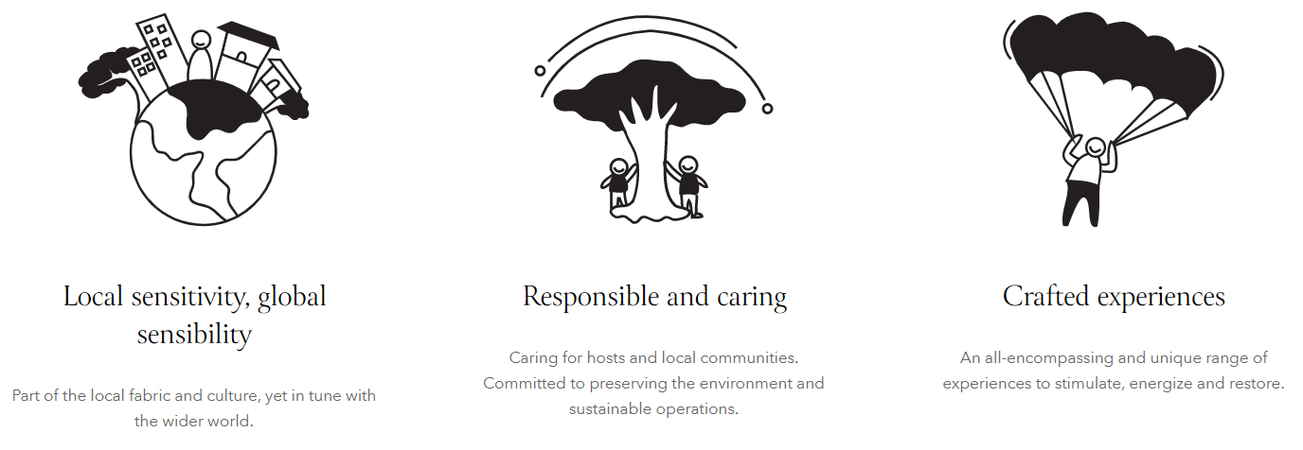
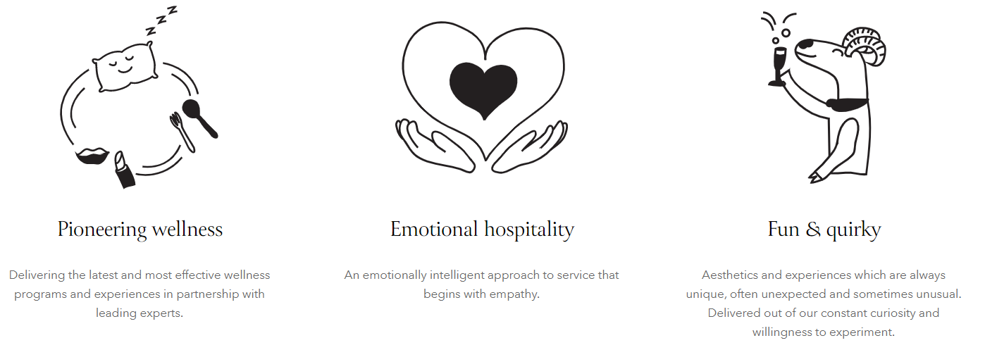
Case Study – Six Senses
www.sixsenses.com
Our values
This is our how: how we deliver on our promise of our name and reawaken your senses with wellness offerings and experiences that are out of the ordinary.

Slide 32
Brand Identity and Brand Personality
The brand’s core idea
Brand values
Brand personality
Promise & Tagline

Slide 33
Brand Personality
We form relationships with people, not products – hence the notion of brand personality.
J.-N. Kapferer
Incarnates the brand’s values
Reveals human personality traits
Who?
How?
Brand Persona
Brand Voice
How the brand BEHAVES
How the brand SOUNDS
Why?
Building enduring relationship between the consumers and the brand.
Notes:
Like a person, the brand’s personality is its character! This is a critical piece to stimulate the emotional triggers that will establish the relationship between the customers and the brand! It highlights the FEEL (how is it instantly perceived?; what does it transmit to others?) of the brand and how it SOUNDS and BEHAVES.

Slide 34
Support Video #3
How to Create and Showcase Brand Personality
https://youtu.be/NI2JEzzfosY

Slide 35
Brand Personality – Brand Persona
Advantages:
Consistency in communication
Humanization
Differentiation and positioning
Increased interactions
Trust & loyalty
What is this?
Who would your brand be if it was person?
How do you want the market to perceive your brand?
Brand Persona
How to create?
Similar to Buyer Persona (module #5), but based on the brand’s values.
“Listen” to the market and audit your brand.
Triggers:
Brand values
Brand personality
Brand voice
Notes:
You can either create a perfectly outlined persona (age, appearance, occupation, etc.) or a broader perspective (man; middle 30s; outdoor fanatic; dreamer).
Some brands create a fictional character, like a mascot, to help with this process and make the brand persona more tangible.
You can also resort to celebrities or fantasy characters to trigger immediate associations with your brand. Remember George Clooney and Nespresso?
This is the basis of the brand’s communication. We know “who” it is, so we expect a certain type of behaviour and mindset when talking to customers, partners and everyone else.

Slide 36
Brand Personality – Brand Voice & Tone of Voice
The way the brand communicates with the audience, so it:
influences how people perceive the brand’s message.
remains consistent through time.
represents the brand personality and its values.
Brand Voice
The way the brand expresses its message, so it:
is the feeling behind the message;
changes depending on the situation: matter, who the brand is talking to, what needs to be said.
Tone of Voice
Notes:
Finding your brand voice means developing a “human-like” voice that reflects your brand while being consistent with its personality over time. It makes the brand persona come alive! For example, the “cool” behaviour of the persona will be elicited and made visible by how it interacts with others.
This is particularly important in today’s digital world. It can easily leverage social media reach and engagement rate, resulting in increased brand exposure and brand-consumer connection. It can make or break the brand/consumer relationship. In the same way, all your employees should be imbued in the same spirit to keep consistency when interacting with customers. It is particularly critical for guides, receptionists, waiters or any other job function that deals directly with customers (be it in person, by telephone or whatever of means of interaction).

Slide 37
Brand Personality – Brand Voice & Tone of Voice
Brand Voice
Tone of Voice
Make the brand’s core values stand out.
Identify what the brand “is” / “is not”.
Define the purpose of communication.
Select the type of language, words, multimedia and emojis.
Clarify how the brand should communicate in each situation, using 4 dimensions:
Funny
Serious
Formal
Casual
Irreverent
Respectful
Enthusiastic
Matter of fact
Notes:
Brand voice establishes a strong brand personality, sets the ground and is consistent over time. Tone of voice is how the brand voice adjusts to each situation. For example, when presenting a wellbeing holiday program, you will certainly adjust how you “speak” to someone who is a novice at meditation or to an expert at it. Another example: if your brand voice is mainly enthusiastic and humorous, you might need to tone down your funny side to address complex issues like racism, sexual orientation discrimination or other human rights issues.

Slide 38
Support Video #4
Is Your Brand Voice Lacking a Personality?
https://youtu.be/NxLb-kvoJxU

Slide 39
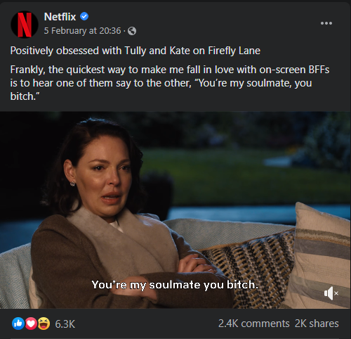
Case Study – Netflix
In 2015, Netflix undertook a rebranding process and started the transition to a new brand voice. It is now informative about new releases and trends, but also very entertaining and engaging. This is accomplished by using humorous and casual language, while using funny memes and pop-culture references that easily go viral, albeit keeping consistency across multiple accounts and languages, as well as over time.
Netflix’ striking brand voice has been a huge success and a reference case study. Laura Wong, a social media blogger, lists four reasons for the brand’s success: 1) it developed its voice with its audience in mind; 2) it sounds like a real person with an authentic personality; 3) its brand voice is ownable; 4) it keeps its voice consistent.
Notes:
See more here: https://schoolofsocial.substack.com/p/netflix-brand-voice

Slide 40
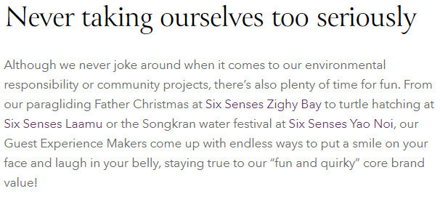
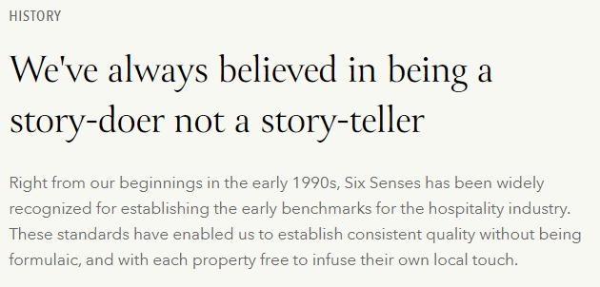
Case Study – Six Senses
www.sixsenses.com
Notes:
Six senses is a sincere brand. It defines itself as fun and quirky, honest and genuine, but is also cheerful (loves smiles and laughs) yet sophisticated (loves sustainable design). It is deeply purpose-driven and does not joke around its core values. Although playful, the brand also keeps a deep sense of responsibility, not only towards its guests but also towards local communities.

Slide 41
Brand Identity and Brand Personality
The brand’s core idea
Brand values
Brand personality
Promise & Tagline

Slide 42
What the brand PROMISES
The Promise and the Tagline
Your brand has a purpose and personality…
… what will consumers gain by using it?
… but…
Attributes
Functional or economic characteristics of the product.
Benefits
Emotional rewards that the consumer will have by using the brand.
Tagline
A short sentence that brings forth what the brand is all about.
Notes:
Compelling, credible, authentic.

Slide 43
Case Study – 100% Pure New Zealand
100% Pure Welcome - 100% Pure New Zealand
https://youtu.be/TqhfNh8mQCk
Notes:
Tourism New Zealand created a brand that is a tagline in itself. “100% Pure New Zealand” is deeply connected with the country’s reputation as clean and green. It is one of the most successful destination branding initiatives ever, because it really brings the power of the brand’s value to the surface. You can learn more here: https://placebrandobserver.com/origins-success-pure-new-zealand-destination-brand/

Slide 44
8.3.
Brand Visual Identity

Slide 45
Visual Identity
How the brand LOOKS
It is like a preview of the brand and the experience it conveys.
It gives clues on what to expect when engaging with the brand.
It serves to persuade potential customers.
Logo
Colour Palette
Typography
Iconography
Graphic Style
All elements work together to achieve consistency and show what the brand is all about.
Notes:
It is strongly advised to resort to graphic designers to develop your visual identity. It can make all the difference and leverage the brand’s look & feel.

Slide 46
Support Video #5
Beginning Graphic Design: Branding & Identity
https://youtu.be/l-S2Y3SF3mM

Slide 47
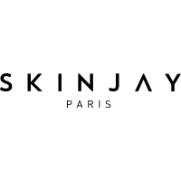
Visual Identity
Logo
A symbol that concisely represents and identifies a brand.
Can include words or images or both.
Is simple, distinctive and appropriate.
Is affected by:
Colour palette;
Font type and size;
Imagery.

Slide 48
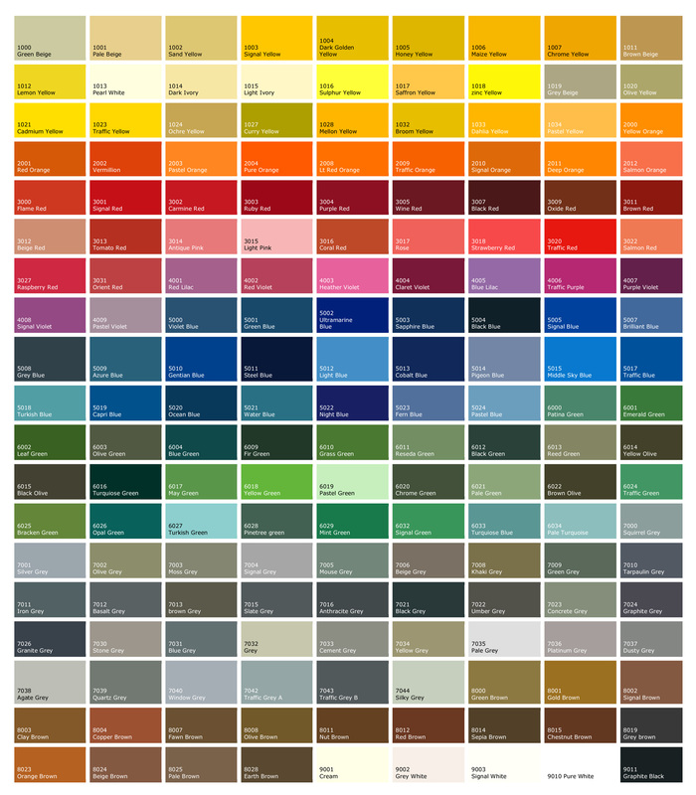
Visual Identity
Colour Palette
1 to 3 primary colours (brand’s essence).
Supported by secondary colours (expand style and personality).
Brings a sense of unity across multiple materials and channels.
Colour impact consumers’ perceptions and behaviour.
Source: http://decentshopfrontshutters.com/colour-chart.html
Notes:
Colours affect first impressions and elicit emotions and feelings. Colours are even reported to have meanings (Colour Psychology), but it depends on the context: for instance, red may symbolize love (Valentine’s day), but it can also mean danger (traffic signs).

Slide 49
Visual Identity
Typography
Serif fonts: classic, elegant, high-end
↘ Garamond
Express the mood of the brand
Choose 2 or 3 different fonts to use everyday with specific objectives:
Headlines
Sub-header
Body copy
Logo
Correspondence
Sans serif fonts: modern and clean
↘ Helvetica
Script fonts: elegant individual appeal
↘ Brush Script MT
Decorative fonts: stylized and eye-catching
↘ Jokerman

Slide 50
Case Study – 100% New Zealand
Evolving the 100% Pure New Zealand identity
https://youtu.be/DvZ9x6lOPCQ

Slide 51
Visual Identity
Images & Iconography
The images and symbols used in the brand’s communication materials.
They can convey ideas and meaning without using words.
It includes the type of images to use on the website and the social media posts.
Notes:
Iconography is a set of conventional images associated with a specific subject. It helps illustrate that subject. Benneton’s iconic images have many colours (“United Colours of Benneton”), young people, gender and racial diversity, the brand’s iconic symbol… You can almost immediately recognized a Benneton’s image without the brand’s name on it.

Slide 52
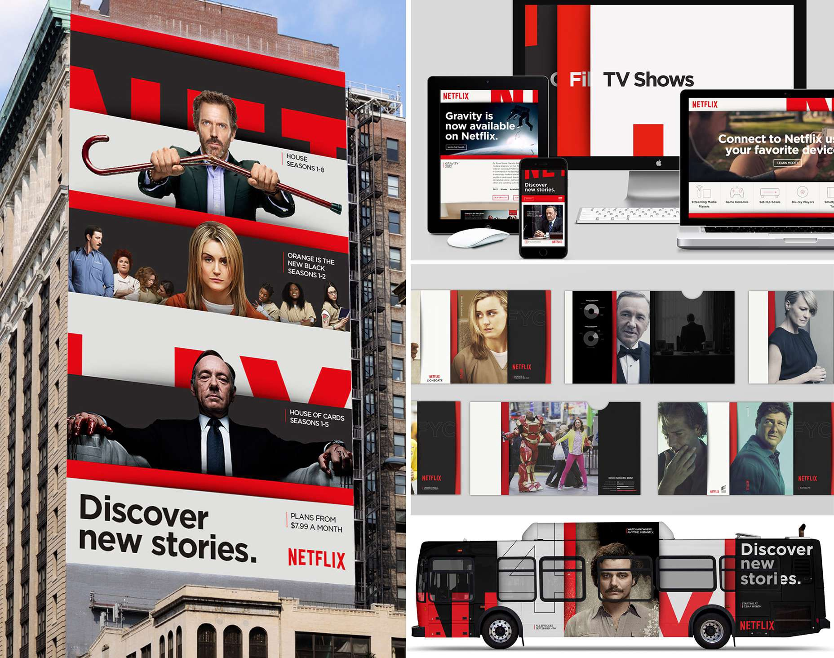
Visual Identity
Graphic style
Create instant (visual) impressions of the brand.
Use familiar references and identity elements, but make the brand distinctively unique.
Produce a distinct feel to the brand that keeps consistency across multiple platforms, channels and material.
Source: https://medium.com/@WebdesignerDepot/what-netflix-s-rebrand-teaches-us-about-responsive-design-6a6801db1764
Notes:
To keep consistency, the graphic style should be used in very touch point, including busines cards, letterheads, envelopes, billboard banners, social media, merchandise (t-shirts, caps, key-rings, etc.), uniforms, website, product packaging, vehicle decoration, etc.

Slide 53
Case Study – Visit Portugal
Story of a brand for Portugal as a tourism destination
https://youtu.be/DbNI_eeLxjM

Slide 54
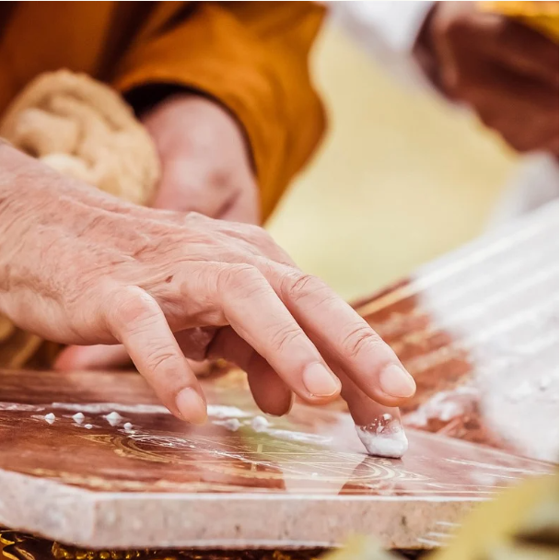
Case Study – Six Senses
The history of the logo: The logo originates from the blessing marks made by the fingers of Buddhist monks on auspicious occasions in Thailand. The three primary senses of sight, sound, touch are positioned at the base of the pyramid. The second tier represents the harmony of taste and smell. The apex represents the sixth sense - intuition.
The Six Senses symbol, the highly recognised graphic of a six-sphere pyramid has been streamlined. It is now reproduced in purple, channelling the colour's association to dignity, wisdom, spirituality, vision, power and passion.
Source: www.sixsenses.com
Source: www.hospitalitynet.org/news/4059902.html

Slide 55
Digging Deeper

Slide 56
Further Reading
Brand Imagery; What it does to us.
[CLICK HERE]
Brand Building 101: How to Build a Brand
[CLICK HERE]
A Brand New Brand: Your Graphic Style
[CLICK HERE]
6 elements of successful brand management
[CLICK HERE]
Branding Process Guide
[CLICK HERE]
How to Define Your Brand’s Tone of Voice: Infographics & Examples
[CLICK HERE]
Knowing your audience is critical to your brand
[CLICK HERE]
How to Create a Brand Strategy
[CLICK HERE]

Slide 57
Assignment #1
Consider your business’ brand (or a completely new brand) and describe the following brand elements:
Core idea
Values
Brand Persona
Brand Voice
Now, create a mood board with images that represent the brand’s essence and visual identity. Don’t forget to include the logo, typography and colour palette.

Slide 58
Module Summary
Module VIII. Branding for Wellbeing

Slide 59
In this module we have…
… acknowledged what are brands and how they are created and developed based on their target-audience.
… learned that brands should be strongly built based on a core idea that incorporates the fundamental purpose for its existence.
… understood how brand identity and brand personality are constructed, nurtured and presented to the world, integrating brand values, purpose, voice and tone of voice.

Slide 60
In this module we have…
… explored how a tagline should express what the brand is all about and convey what are the benefits consumers will have by using that brand.
… acknowledged the main components of a brand’s visual identity, including its logo, typography, colour palette, imagery and graphic style.

Slide 61
The roadmap
I. Introduction to Wellness and Wellbeing
II. Wellbeing in a New Era
III. The Experience Economy
IV. Engineering Wellbeing Experiences
V. Customer Journey Mapping
VI. Storytelling in Culinary Tourism
VII. Setting up a Wellbeing Business
VIII. Branding for Wellbeing
IX. Digital Marketing

Slide 62
Thank You
Any Questions?
www.detourproject.eu
Detour on Facebook
@WellbeingTourismDestinations
#detourdestinations #erasmusplus #detour #wellbeing
Icons: www.flaticon.com

