Slide 1
SETTING UP A WELLBEING BUSINESS

Slide 2
“
What does it mean to be an entrepreneur? It's more than being a business owner; it's a perspective and a lifestyle.
Max Freedman
”

Slide 3
The roadmap
I. Introduction to Wellness and Wellbeing
II. Wellbeing in a New Era
III. The Experience Economy
IV. Engineering Wellbeing Experiences
V. Customer Journey Mapping
VI. Storytelling in Culinary Tourism
VII. Setting up a Wellbeing Business
VIII. Branding for Wellbeing
IX. Digital Marketing

Slide 4
Module Introduction
The road to entrepreneurship is often a treacherous one filled with unexpected detours, roadblocks and dead ends. There are lots of sleepless nights, plans that don't work out, funding that doesn't come through and customers that never materialize.
It can be so challenging to launch a business that it may make you wonder why anyone willingly sets out on such a path. Despite all of these hardships, every year, thousands of entrepreneurs embark on this journey determined to bring their vision to fruition and fill a need they see in society. They open brick-and-mortar businesses, launch tech start-ups or bring a new product or service into the marketplace.
As the future entrepreneur you must therefore have a desire to start your own business and be prepared assume the risk associated with this business.
There are risks that entrepreneurs take when deciding for their entrepreneurial path. But you can reduce it with good preparation and by possessing and mastering certain skills that will help you deal with the risks that arise in doing business.

Slide 5
Learning Goals
Understand entrepreneurship
Plan the steps of setting up your own business
Use tools that can help you plan (business canvas, SWOT analysis, USPs)
Understand the 2021 wellness and wellbeing trends
Check-out the global examples
Take a look at regional wellbeing business ventures

Slide 6
Content& Resources
Content
a. How to become an entrepreneur
b. Challenges of setting up your own business
c. Business model canvas
d. SWOT analysis
Resources
a. 6 support videos
b. 6 case studies (with videos)
c. 7 articles for additional reading
d. 3 assignments

Slide 7
HOW TO BECOME AN ENTREPRENEUR
WE WILL GET YOU THERE…

Slide 8
ENTREPRENEUR AND ENTREPRENEURSHIP
ENTREPRENEUR (according to the Cambridge dictionary):
a person who attempts to make a profit by starting a company or by operating alone in the business world, esp. when it involves taking risks.
An entrepreneur is an individual who creates a new business,
bearing most of the risks and enjoying most of the rewards.
The process of setting up a business is known as entrepreneurship.
The entrepreneur is commonly seen as an innovator, a source of
new ideas, goods, services, and business/or products.
https://www.investopedia.com/terms/e/entrepreneur.asp

Slide 9
STARTING YOUR OWN BUSINESS
Believe in yourself
Believe in your vision
Follow your idea

Slide 10
WHAT DO I NEED TO START MY OWN BUSINESS?
As an entrepreneur, you need to have and master certain skills and qualities that you have listed below. Some are innate to you, some you will have to learn, to be able to run your business successfully.
The most important are:
the ability to recognize opportunities,
the ability to create values,
creativity,
problem solving and
imagination.
Notes:
Whatever the initial reason for starting your own business, what counts is not "why" or "how" you started your own business. What matters is your enthusiasm and dedication to doing business in order to succeed.
Everyone defines success in their own way. For someone, success is having a company in which they manage to sell a service for e.g. € 10,000. For someone else it will be a success if the company sells products in the amount of € 1 million EUR. Someone will measure success by how many people he employs, others again by presence in foreign markets, while for someone it might be how much profit it generates.

Slide 11
“
Entrepreneurship is the ability to recognize the bigger picture, find where there’s an opportunity to make someone’s life better, design hypotheses around these opportunities, and continually test your assumptions. It’s experimentation: Some experiments will work; many others will fail. It is not big exits, huge net worth, or living a life of glamour. It’s hard work and persistence to leave the world a better place once your time here is done.
Konrad Billetz, co-founder and co-CEO of
Offset Solar
”

Slide 12
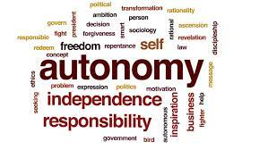
WHY WOULD YOU WANT TO BECOME ENTREPRENEUR? AND START YOUR OWN WELLBEING BUSINESS?
Autonomy:
Entrepreneurs want to be their own bosses, set their own goals, control their own progress and run their businesses how they see fit. They recognize that their business's success or failure rests with them, yet they don't view this responsibility as a burden but, instead, as a marker of their freedom.

Slide 13
WHY WOULD YOU WANT TO BECOME ENTREPRENEUR? AND START YOUR OWN WELLBEING BUSINESS?
Purpose:
Many entrepreneurs have a clear vision of what they want to accomplish and will work tirelessly to make that happen. They genuinely believe they have a product or service that fills a void and are compelled by a single-minded commitment to that goal to keep pushing ahead. They abhor stagnation and would rather fail while moving forward than languish in inactivity.

Slide 14
WHY WOULD YOU WANT TO BECOME ENTREPRENEUR? AND START YOUR OWN WELLBEING BUSINESS?
Flexibility:
Not everyone fits into the rigidity of traditional corporate culture. Entrepreneurs are often looking to free themselves from these constraints, find a better work-life balance or work at times and in ways that may be unconventional. This doesn't mean they are working fewer hours – often, especially in the early stages of growing a business, they work longer and harder – but, rather, they're working in a way that is instinctual for them.

Slide 15
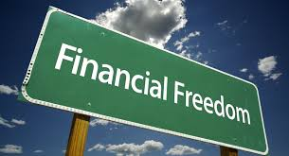
WHY WOULD YOU WANT TO BECOME ENTREPRENEUR? AND START YOUR OWN WELLBEING BUSINESS?
Financial success:
Most entrepreneurs realize they aren't going to be overnight billionaires, but that doesn't mean they aren't interested in the potential of making a ton of money from a hugely successful business over which they have full control. Some want to establish a financial safety net for themselves and their families, while others are looking to make a huge profit by creating the next big thing.

Slide 16
WHY WOULD YOU WANT TO BECOME ENTREPRENEUR? AND START YOUR OWN WELLBEING BUSINESS?
Legacy:
Entrepreneurs are often guided by a desire to create something that outlasts them. Others want to create a brand that has longevity and becomes an institution. Another group wants to pass on a source of income and security to their heirs. There are also those entrepreneurs who hope to make a lasting impression on the world and leave behind an innovation that improves people's lives in some tangible way.

Slide 17
HEALTH AND WELLNESS BUSINESS IN 2021

Slide 18
CHALLENGES OF
SETTING-UP YOUR OWN BUSINESS
You have more potential than you think, but you will never know your full potential unless you keep challenging yourself and pushing beyond your own self-imposed limits.
Notes:
Especially in the early stages, at the beginning of the business, there are no customers, no established deals, often no one knows you even exist.
You have to go step by step, find the first customer, do the work well, at the same time organize the team, gain trust, get confirmation of the idea and implementation on the market.
There is also competition that the market already knows, that has an already established business and is a step ahead of you in in terms of business volume and brand.

Slide 19
TAKE ON THE CHALLENGE – START YOUR OWN BUSINESS
Entering the market today means entering a saturated environment where ads are screaming from hundreds of online pages, networks, mobile devices, where each product is immediately compared in price. Everything is moving fast.
People refresh the news on the phone on average every four hours, no longer waiting for the evening to log-in, this is a six times shorter information retrieval cycle. There are many events, providers, networking, promotion, digital marketing as well.
When you enter a market that is saturated, where there is a lot of competition, how will you sell your products?

Slide 20
STICK TO YOUR CONCEPT
Case: https://www.scandinave.com/blue-mountain/en/experience-blue-mountain/

Slide 21
TAKE ON THE CHALLENGE – START YOUR OWN BUSINESS
BRAINSTORMING QUESTIONS:
1) What are the entrepreneurial pitfalls and risks on starting to run your business ideas?
2) What are the entrepreneurial pitfalls and risks you recognize in your environment and what they are those that are likely to be affected to start your business?
3) How would you rate whether you are interesting as entrepreneur for the market or how you could become interesting?

Slide 22
HOW TO START YOUR OWN BUSINESS?

Slide 23
BUSINESS MODEL CANVAS
The Business Model Canvas (BMC) is a strategic management tool to quickly and easily define and communicate a business idea or concept.
It is a one-page document which works through the fundamental elements of a business or product, structuring an idea in a coherent way.
The business model canvas helps you with the execution steps requirement to take your idea to market.
Connecting the dots between your value proposition + customer segments + revenue streams, is a good input to your marketing strategy, positioning statement as well as your Sales strategy

Slide 24
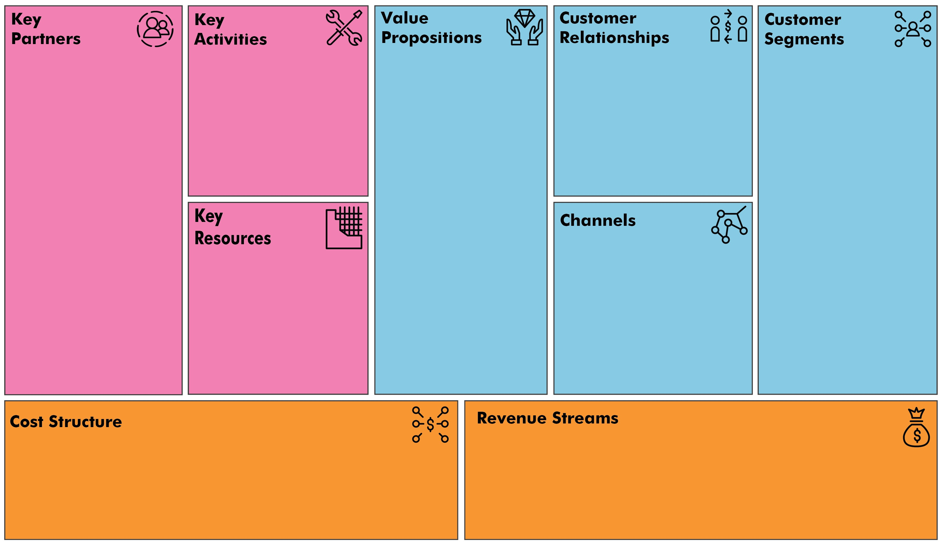
BUSINESS MODEL CANVAS
KEY PARTNERS
KEY ACTIVITIES
VALUE PROPOSITION
CUSTOMER RELATIONSHIP
CUSTOMER SEGMENT
KEY RESOURCES
DISTRIBUTION CHANNEL
COST STRUCTURE
REVENUE STREAM

Slide 25
BUSINESS MODEL CANVAS

Slide 26
BUSINESS MODEL CANVAS
KEY PARTNERS
Who are your key partners/suppliers?
What are the motivations for the partnerships?
KEY ACTIVITIES
What key activities does your value proposition require?
What activities are the most important in distribution channels, customer relationships, revenue stream…?

Slide 27
BUSINESS MODEL CANVAS
VALUE PROPOSITION
What core value do you deliver to the customer?
Which customer needs are you satisfying?
CUSTOMER RELATIONSHIP
What relationship does the target customer expect you to establish?
How can you integrate that into your business in terms of cost and format?

Slide 28
BUSINESS MODEL CANVAS
CUSTOMER SEGMENT
Which groups are you creating values for?
Who is your most important customer?
KEY RESOURCES
What key resources does your value proposition require?
What resources are the most important in distribution channels, customer relationships, revenue stream…?

Slide 29
BUSINESS MODEL CANVAS
DISTRIBUTION CHANNELS
Through which channels that your customers want to be reached?
Which channels work best? How much do they cost? How can they be integrated into your and your customers’ routines?
COST STRUCTURE
What cost groups will be required in your business?
Which key resources/ activities are most expensive?
REVENUE STREAM
What are they willing to pay for? Product? Service?

Slide 30
MAKE YOUR CASE
CREATE YOUR OWN BUSINESS CANVAS
VALUE PROPOSITION
KEY PARTNERS
KEY ACTIVITIES
CUSTOMER RELATIONSHIP
CUSTOMER SEGMENT
KEY RESOURCE
DISTRIBUTION CHANNEL
COST STRUCTURE
REVENUE STREAM

Slide 31
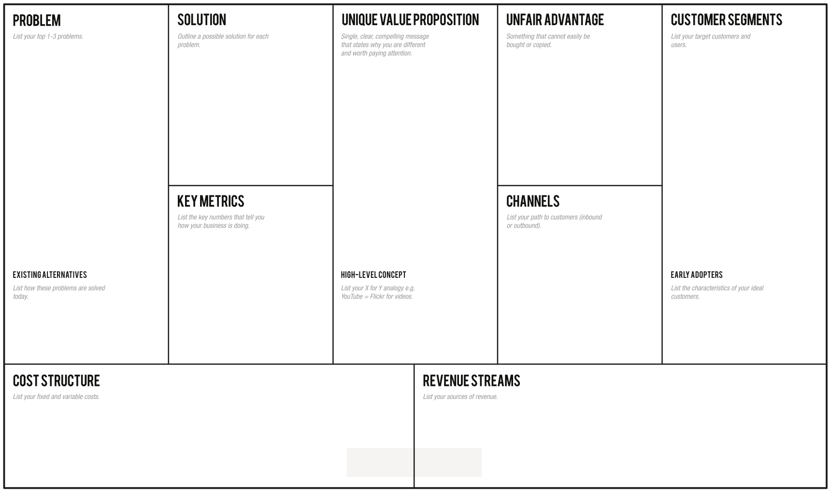
YOUR CASE: MY OWN BUSINESS MODEL CANVAS

Slide 32
LOOKING FOR ADDITIONAL IDEAS TO CREATE YOUR OWN BUSINESS MODEL?
TRY THESE…

Slide 33
CUSTOMER SEGMENTATION
BRAINSTORMING
Which ones are your most important customer segments?
Do you want to reach the general public, the mass market or the very a specific niche market?
The mass market is a large group of consumers with similar needs and problems. Niche markets are specialized, specific segments. Segmented market means different supply of value to slightly different market segments, a diversified market means market diversity, different market segments that have nothing in common.

Slide 34
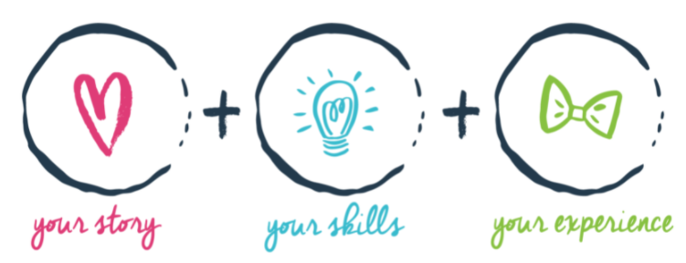
USP – UNIQUE SELLING PROPOSITION
A unique selling proposition refers to the unique benefit exhibited by a company, service, product or brand that enables it to stand out from competitors.
The unique selling proposition must be a feature that highlights product benefits that are meaningful to consumers.
A Unique Selling Proposition is a unique selling point or slogan that differentiates a product or service from its competitors. A USP may include words such as the "lowest cost," "the highest quality," or "the first-ever," which indicates to customers what your product or service has that your competitors do not.
WHAT WILL BE YOURS ?

Slide 35
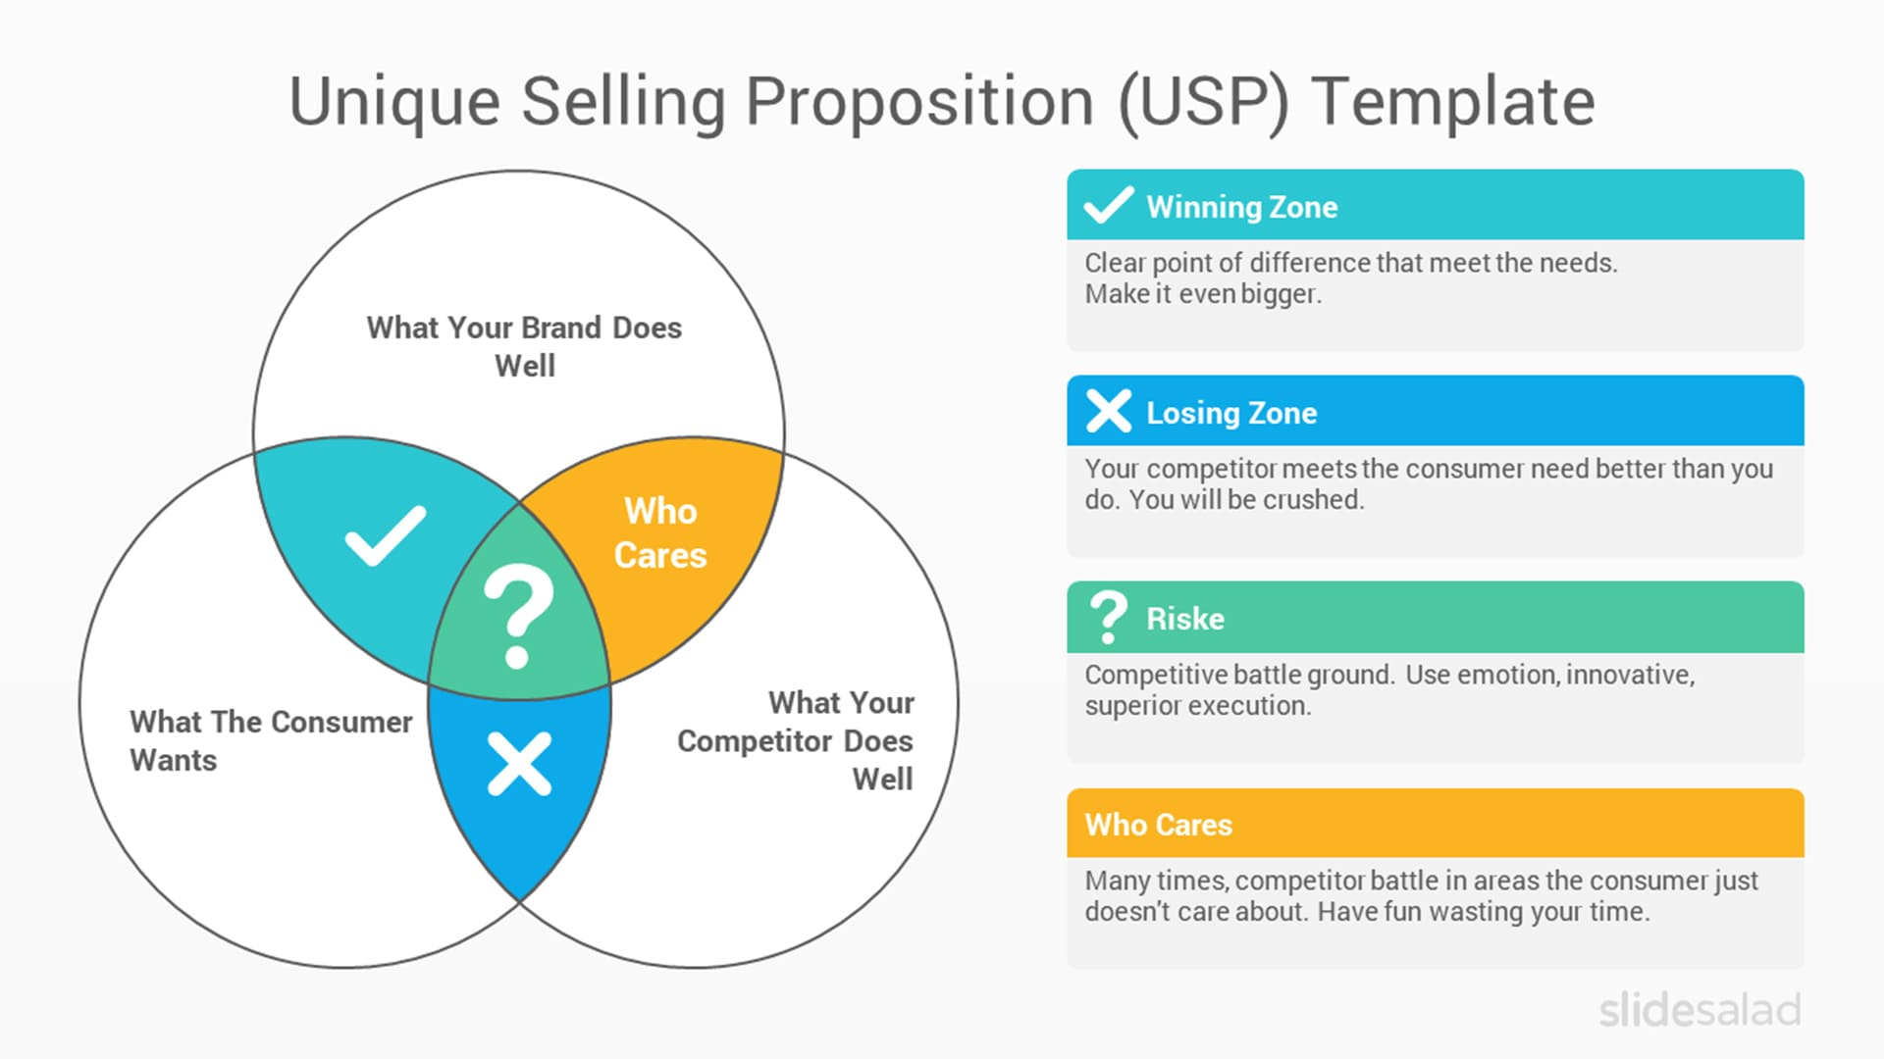
MY USP‘s: BUILD YOUR CASE

Slide 36
SWOT ANALYSIS
Learn how to apply a SWOT analysis to your business and position yourself ahead of competitors. A SWOT simply stands for: Strengths, Weaknesses, Opportunities and Threats.
A SWOT can provide multiple benefits to your small business:
Insight into where your business can focus to grow
Increased understanding of the industry
Focus on advertising and marketing that give you a competitive advantage in the marketplace
Foresight to see looming threats and react proactively
WHAT WILL BE YOURS ?

Slide 37
SWOT ANALYSIS

Slide 38
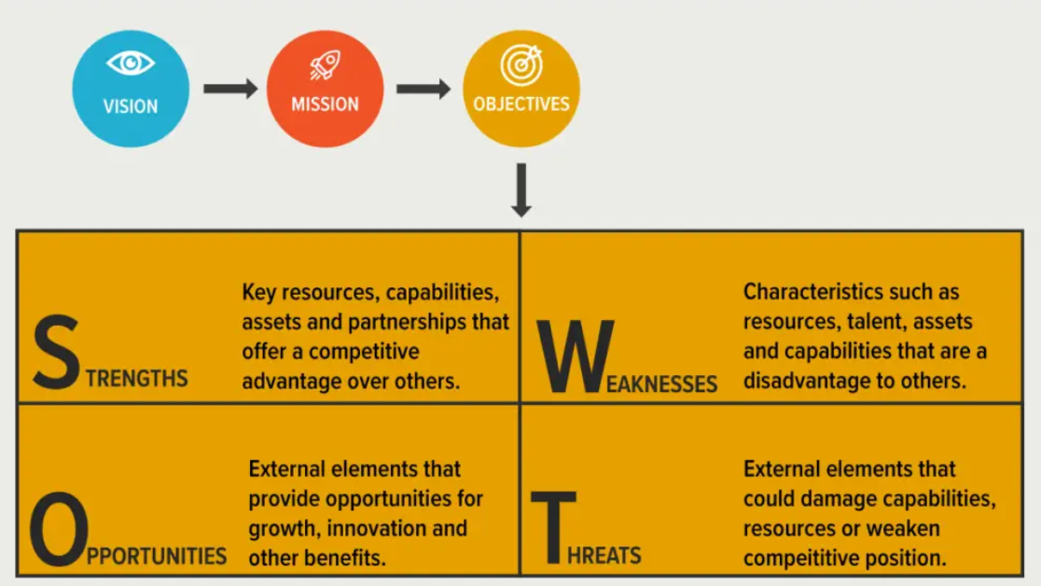
SWOT ANALYSIS – THINK AND PLAN

Slide 39
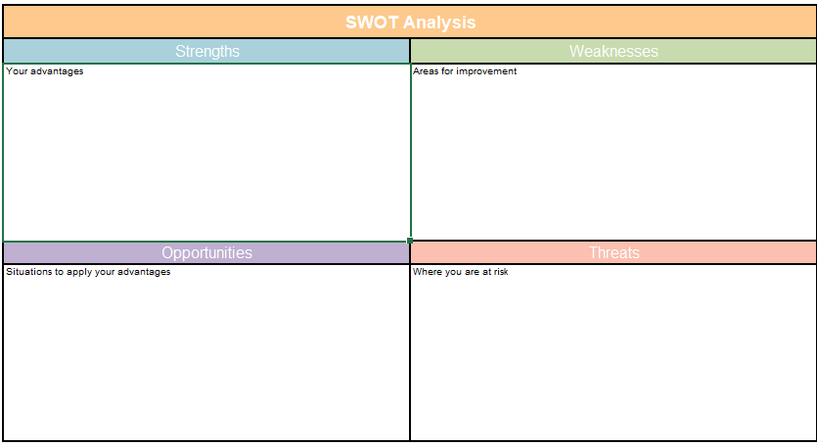
YOUR CASE: CREATE YOUR OWN SWOT ANALYSIS

Slide 40
NOTES AND REMARKS

Slide 41
ARE YOU THERE YET?

Slide 42
A FEW MORE STEPS
GET TO KNOW YOUR CUSTOMERS DESIGN AN ATTRACTIVE OFFER
MAKE A PLAN

Slide 43
ALMOST THERE…
Find out who needs your product and when. Focus on the problem your product solves. Obtain permission to communicate, combine knowledge from different sources and contact points.
If you don’t have clearly defined goals, you’ll have a hard time finding the right path. Only then design a customer acquisition and retention strategy, incorporate tools and activities to create closer customer relationships
Ask yourself, where can you add value, exceed customer expectations? What can you do better, differently, faster, easier than the competition? Why should someone decide to buy right now?
Don't talk about yourself, your product, your company - the customer is not interested in that at all. Talk about the customer, his problem and how your product solves his problem (better than the competition).
GET TO KNOW YOUR CUSTOMERS
MAKE A PLAN
DESIGN YOUR OFFER
COMMUNICATE

Slide 44
Further Reading
Dare to be an entrepreneur
[CLICK HERE]
Peter Thiel on “Success in Business“
[CLICK HERE]
Why become an entrepreneur?
[CLICK HERE]
SWOT ANALYSIS – How to?
[CLICK HERE]
8 TIPS FOR STARTING A WELLNESS BUSINESS
[CLICK HERE]
REINVENT YOUR MARKETING TO COMPETE IN A CONTENT-DRIVEN WORLD
[CLICK HERE]
HOW TO REACH YOUR TARGET CUSTOMERS?
[CLICK HERE]

Slide 45
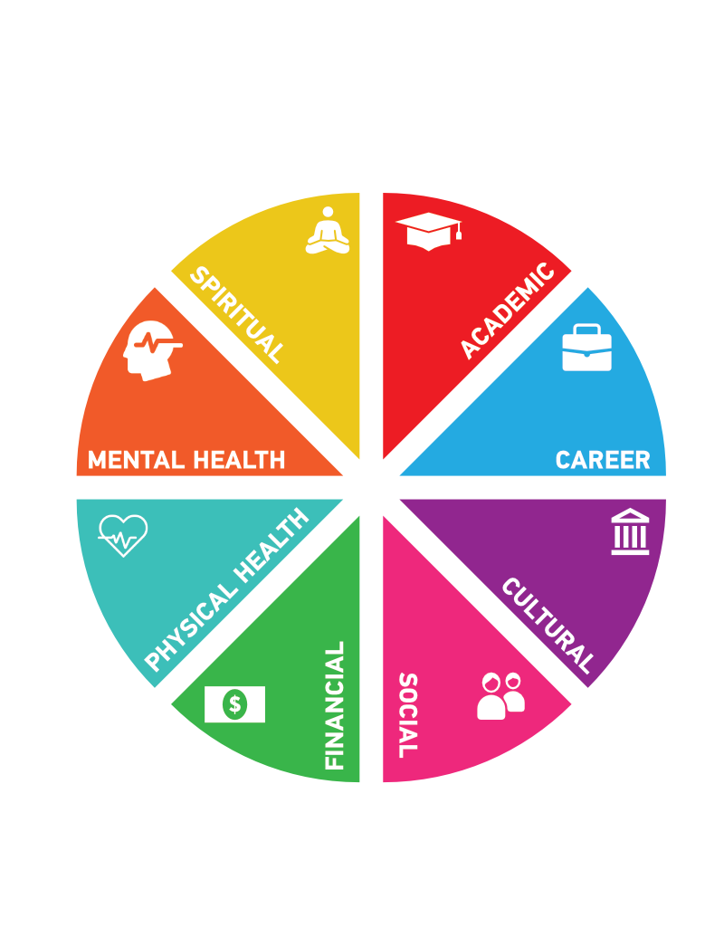
SUCCESSFUL WELLNESS
AND
WELLBEING BUSINESSES
5 STUNNING WELLNESS RETREATS

Slide 46
CASE – CANYONRANCH
https://www.canyonranch.com/

Slide 47
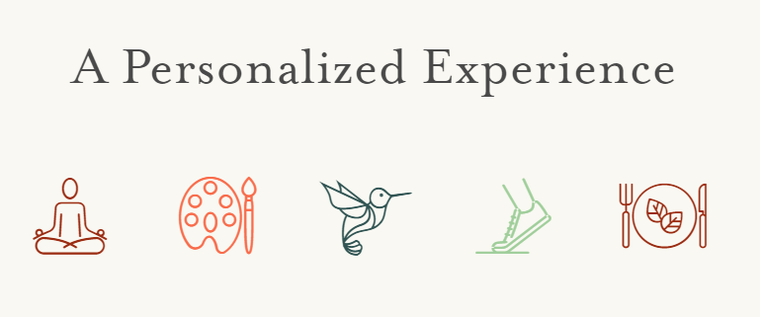
CASE: RANCHO LA PUERTA
https://rancholapuerta.com/

Slide 48
CASE:
KRIPALU
https://kripalu.org/

Slide 49
CASE: SENSEI
https://sensei.com/

Slide 50
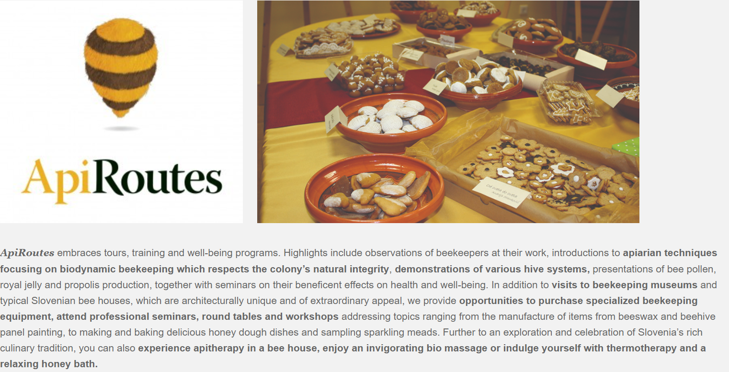
WELLBEING DESTINATION SLOVENIA
SOMETHING
DIFFERENT

Slide 51
CASE: CULINARY WELLBEING IN
sLOVEnia
https://www.sloveniaeat.com/tours-wellness-in-slovenia/

Slide 52
Module Summary
Module VII. SETTING UP YOUR OWN WELLBEING BUSINESS

Slide 53
In this module we have…
… looked at entrepreneurship
… defined steps in setting up your own wellbeing business
… looked at characteristics of an entrepreneur
… looked at health and wellbeing business ideas
… looked at challenges when setting up a business
… prepared a business model canvass
… made a SWOT analysis for our business

Slide 54
“Action is the foundational key to all success.”
~Pablo Picasso
“
”

Slide 55
The roadmap
I. Introduction to Wellness and Wellbeing
II. Wellbeing in a New Era
III. The Experience Economy
IV. Engineering Wellbeing Experiences
V. Customer Journey Mapping
VI. Storytelling in Culinary Tourism
VII. Setting up a Wellbeing Business
VIII. Branding for Wellbeing
IX. Digital Marketing

Slide 56
Thank You
Any Questions?
Other ?
Email ?
Website ?

