Slide 1
STORYTELLING IN CULINARY TOURISM
Module VI

Slide 2
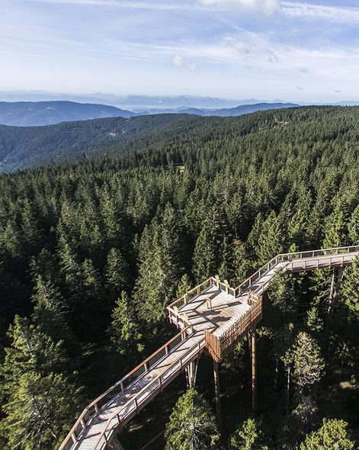
The roadmap
I. Introduction to Wellness and Wellbeing
II. Wellbeing in a New Era
III. The Experience Economy
IV. Engineering Wellbeing Experiences
V. Customer Journey Mapping
VI. Storytelling in Culinary Tourism
VII. Setting up a Wellbeing Business
VIII. Branding for Wellbeing
IX. Digital Marketing

Slide 3
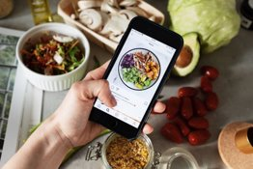
Learning Objectives
Getting to know basic characteristics of gastronomy tourism
Analysing the customer expectation
Trends in gastronomy tourism
Understanding the specifics of wellness cuisine
Detecting crucial providers and operators of regional cuisine
The importance and techniques of storytelling in gastronomy tourism

Slide 4
Content & Resources
Content
a. Understanding culinary tourism
b. Specifics of wellness cuisine
c. Implementing storytelling in culinary tourism
Resources
a. 5 videos
b. 2 case studies
c. 4 articles for additional reading
d. 1 assignment

Slide 5
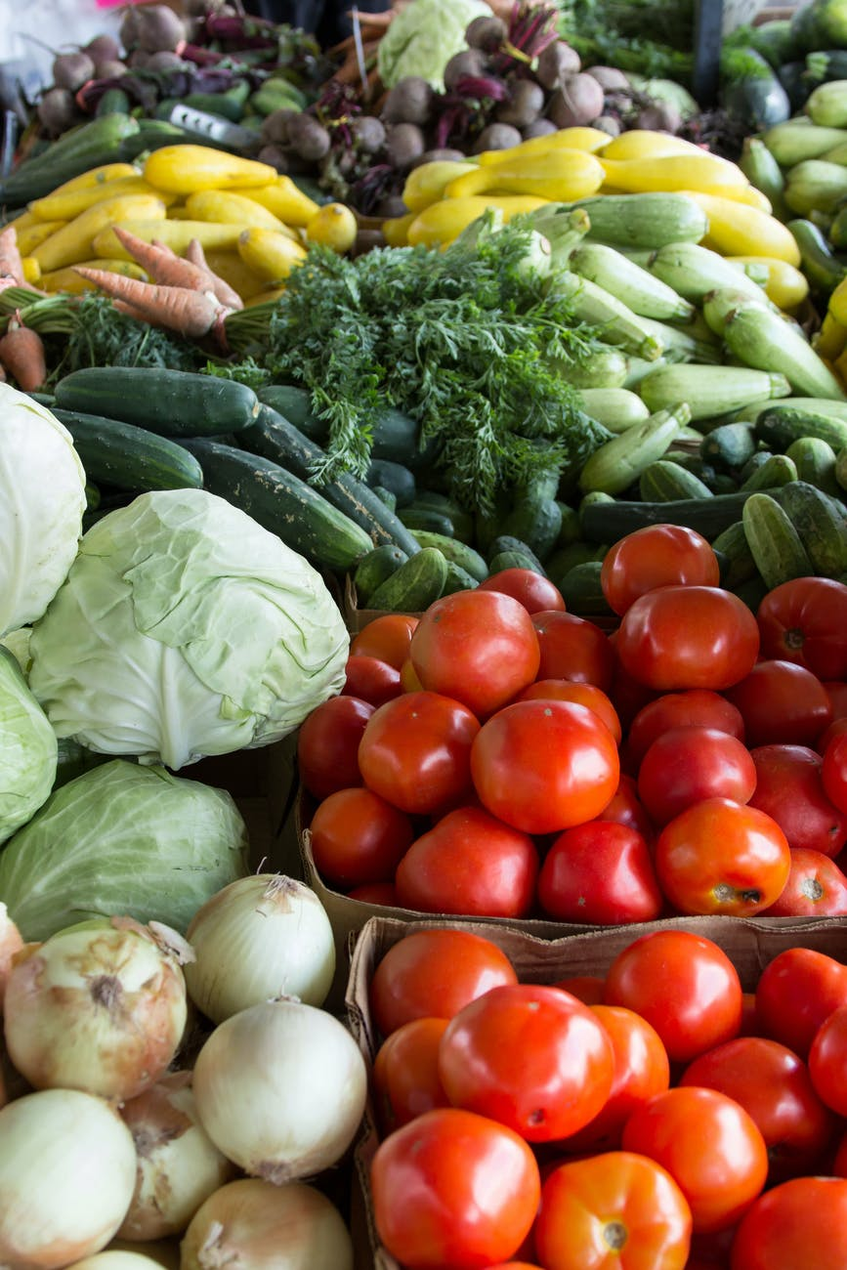
INTRODUCTION TO MODULE VI
Gastronomy tourism or food tourism as experiential
travel to a food production region for recreational or
entertainment reasons which includes visits to primary
and secondary food producers, food festivals, food fairs, events, marketplaces, cookery demonstrations, tasting of high-quality produce and products, visits to
restaurants or any other activity related to food (Hall and Sharples, 2003)

Slide 6
INTRODUCTION TO MODULE VI
Additionally, this experiential travel relates to a certain
lifestyle that involves experimenting, learning from
other cultures, obtaining new knowledge and
understanding the characteristics of tourism products as well as the gastronomic specialties of a region.

Slide 7
1.1.
CULINARY
TOURISM
Eating your way around the world.

Slide 8
Defining culinary tourism
Food tourism - an example of culinary tourism - has been defined as “visits to food producers, food festivals, restaurants and specific locations where the taste of food and/or experience of the specificity of typical food products are the main reasons for the trip” ( Hall & Mitchell, 2001 ).
Synonyms for gastronomy tourism also include:
Food tourism
Culinary tourism
Foodie tourism

Slide 9
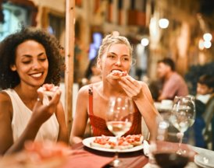
Culinary tourism in
numbers

Slide 10
Food tourism is the act of traveling for a taste of place in order to get a sense of place.
(World food travel association)

Slide 11
Analysing of customer expectation in culinary tourism beside food
HARD CORE FOODIES MOTIVES
shopping
art & culture
natural attractions, parks and gardens ​
festivals and casinos
horse riding (Hall, 2003)
ALTERNATIVE FOODIES MOTIVES
specific diet plans
organic food
raw food
wild food
LCHF...
organic farming

Slide 12
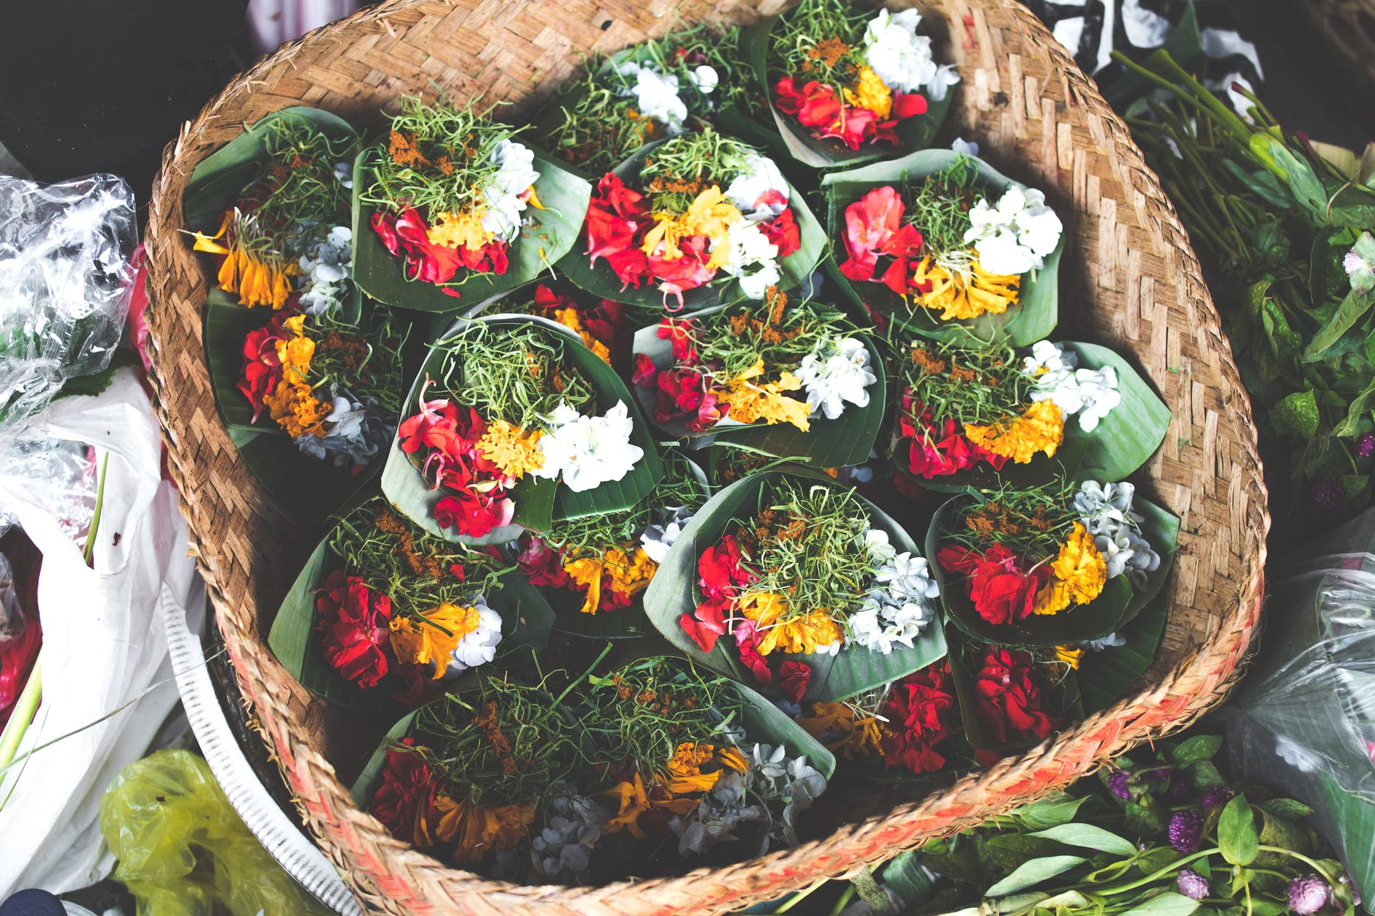
Why is investing in culinary tourism paying off?
Hall and Sharples (2008) highlight the importance and role of culinary tourism because it:
increases the visibility of the destination
stabilizes the economic and social conditions of the destination
strengthens the reputation of the destination
promotes social responsibility and the connection between stakeholders and the public
strengthens the added value of the local products and services involved

Slide 13
Case study – Culinary tourism in Italy, Catania
Travel to culinary destination has surged in the past few decades. Culinary tourism is increasingly important for world travelers, and Italy is at the top in Europe owing to many aspects related to an experiential type of tourism that people really like. The paper aims to give insight especially into the relevance of Italian food. It also presents the case study of the city Catania, Sicily. Sicily is one of the most important Italian regions due to its landscape, nature and beauty, and is characterized by quality and richness in local cuisine. Culinary tourism is an opportunity to revive and diversify tourism, promote local economic development, develop new uses of materials in the primary sector and to strengthen the image of Italian food.
More at: http://www.geography.and.tourism.ukw.edu.pl/artykuly/vol8.no1_2020/G-T-2020-01_09_20200809.pdf

Slide 14
Food is not only culture, it's a diplomacy:

Slide 15
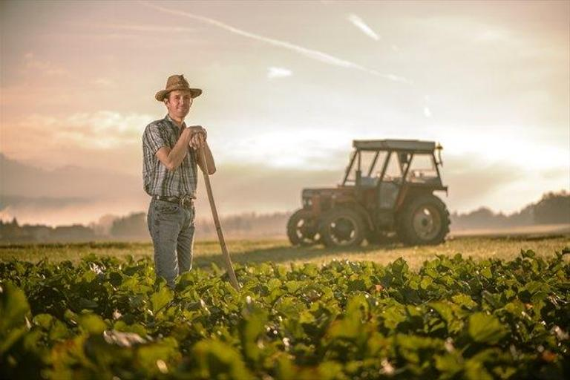
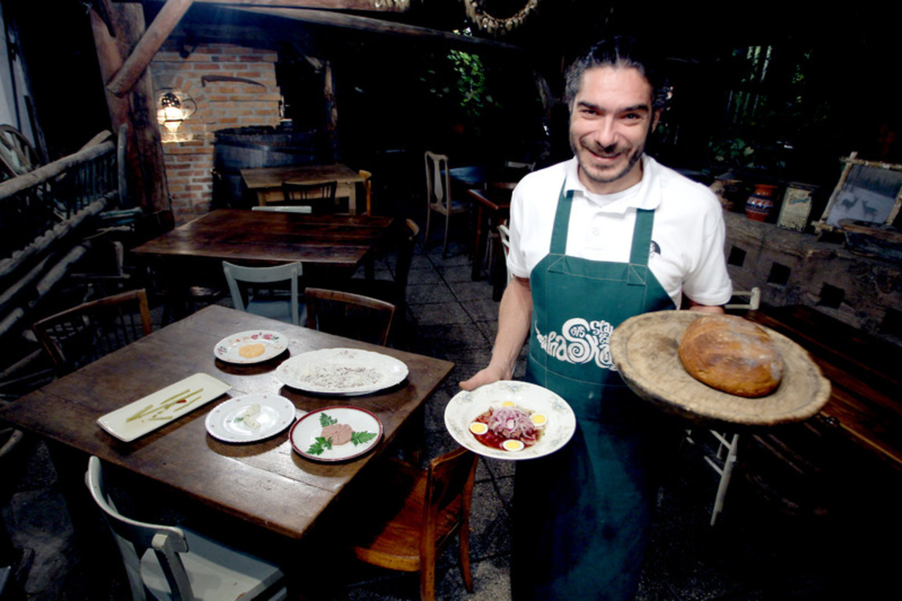
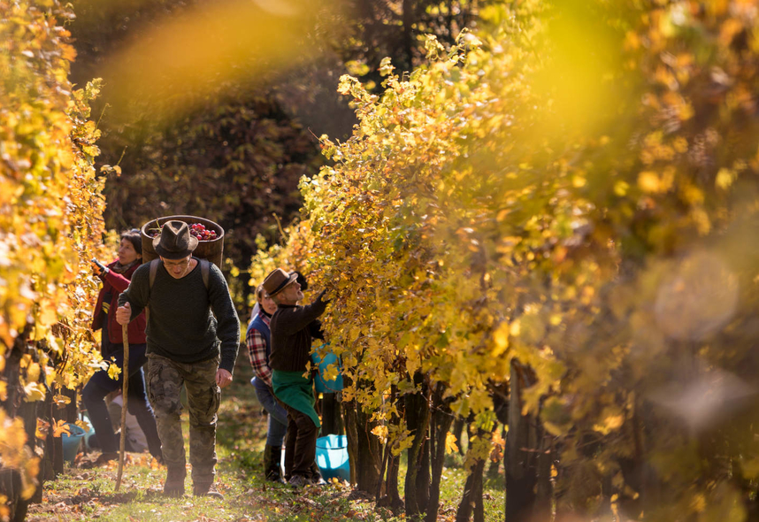
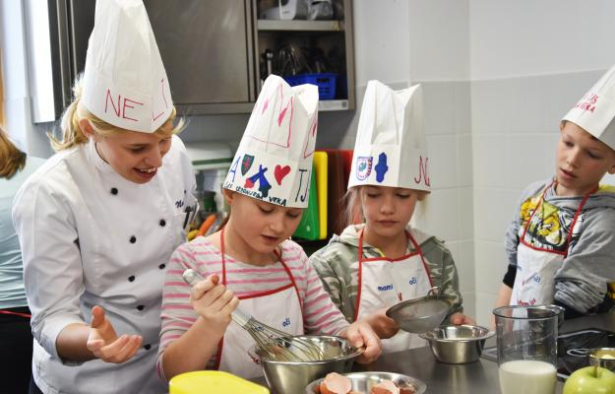
Crucial generators of regional gastronomy tourism
Farmers and local
producers
Authentic food
business
Food traditions,
festivals
Food education

Slide 16
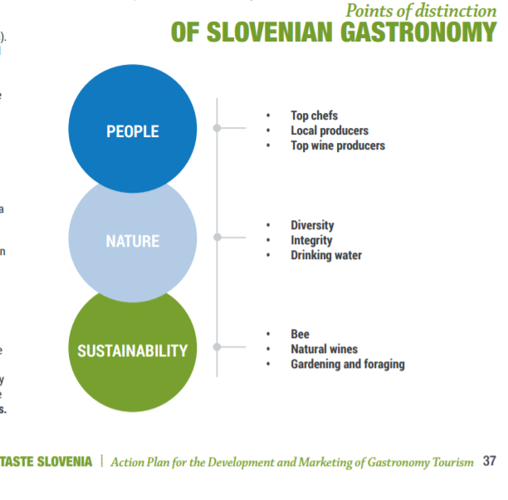
Points of distinction of Slovenian gastronomy
Pay attention to Slovenia's gastronomy points of distinction that show implementation of all crucial gastronomy stakeholders in gastronomy tourism.

Slide 17
Trends in gastronomy tourism
Culinary safari
Wild food (fruits and veggies) hunting
Apitourism
Didactic gastronomy
Cook it raw
Learning to cook "old school"
Interactive dining
Promotion of informal dining & gastronomy experience (EatWith)
The Covid 19 epidemic has improved online gastronomy offer that promotes not only the take-away and delivery sector, but also provides many possibilities for online tastings and workshops.

Slide 18
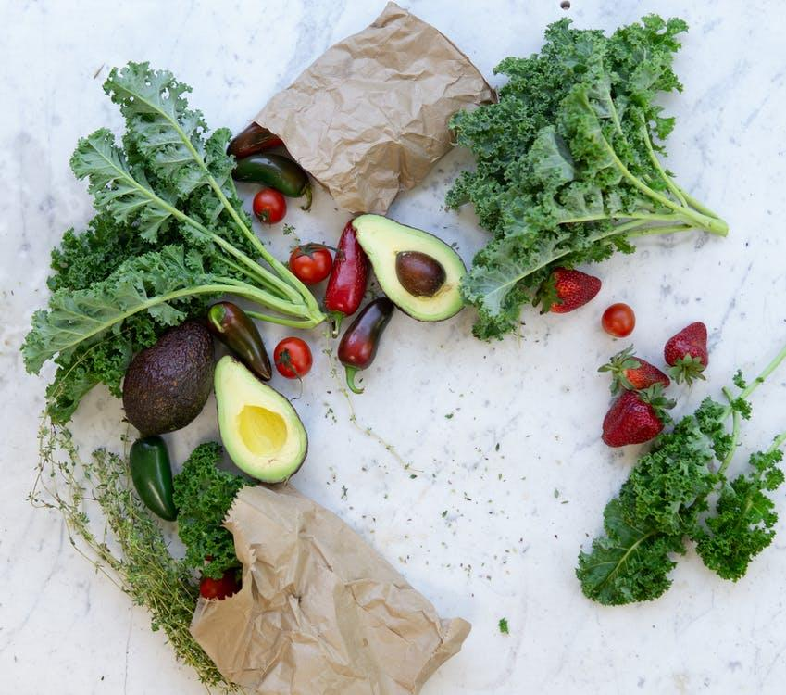
2 Wellness cuisine
Eating for a better future

Slide 19
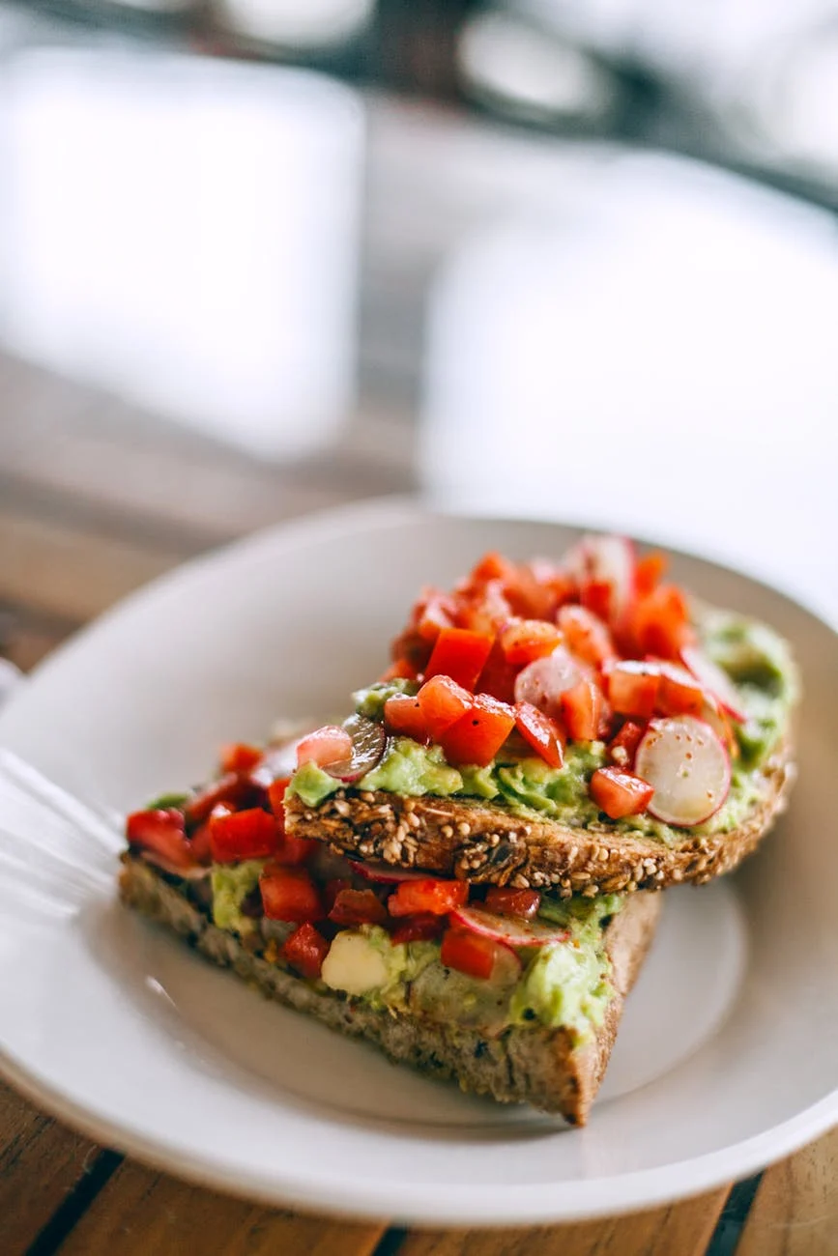
What is wellness cuisine?
Not only:
vegetarian
meatless
boring
light, but...

Slide 20
The pillars of wellness cuisine
LOCAL FOOD PRODUCTS CHAIN
TASTE THE MICRO- SEASON
RE-THINK YOUR COOKING
FOOD SHOULD IMPROVE OUR HEALTH
LOCAL
SEASONAL
SUSTAINABLE & CREATIVE
HEALTH FRIENDLY

Slide 21
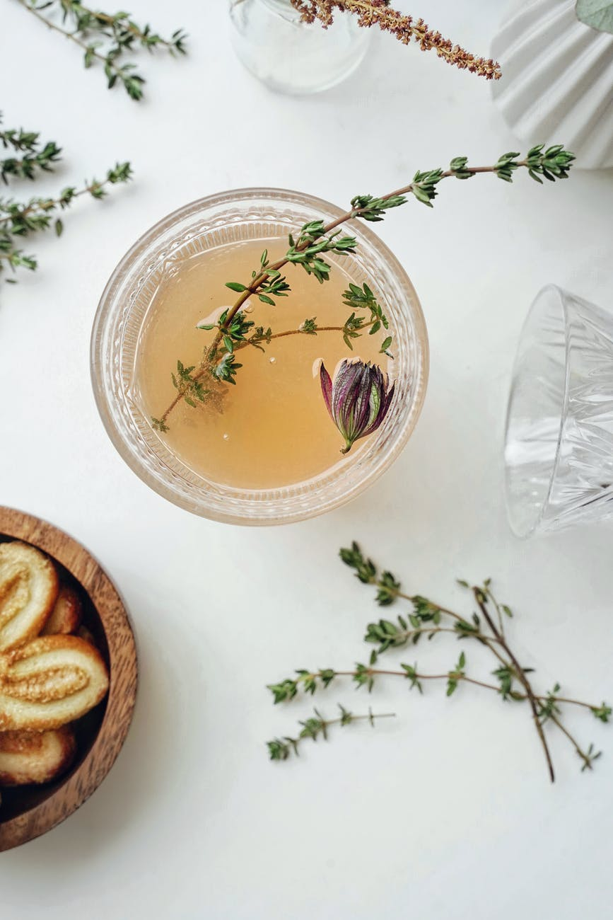
IMPROVE HEALTH
SUSTAINABLE FOOD CHOICE
PREVENT ILLNESS
WELLBEING FOOD MARKET
SUPERFOOD
ORGANIC
SAFE FOOD PREPARATION
SMART CHOICE
SMART LOCAL CHOICE
SMART SAFE CHOICE

Slide 22
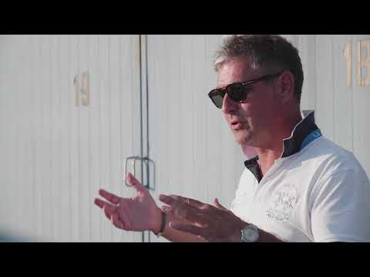
FROM FISH TO THE WHOLE DAY UNIQUE EXPERIENCE
FONDA SUSTAINABLE SEABASS FARM

Slide 23
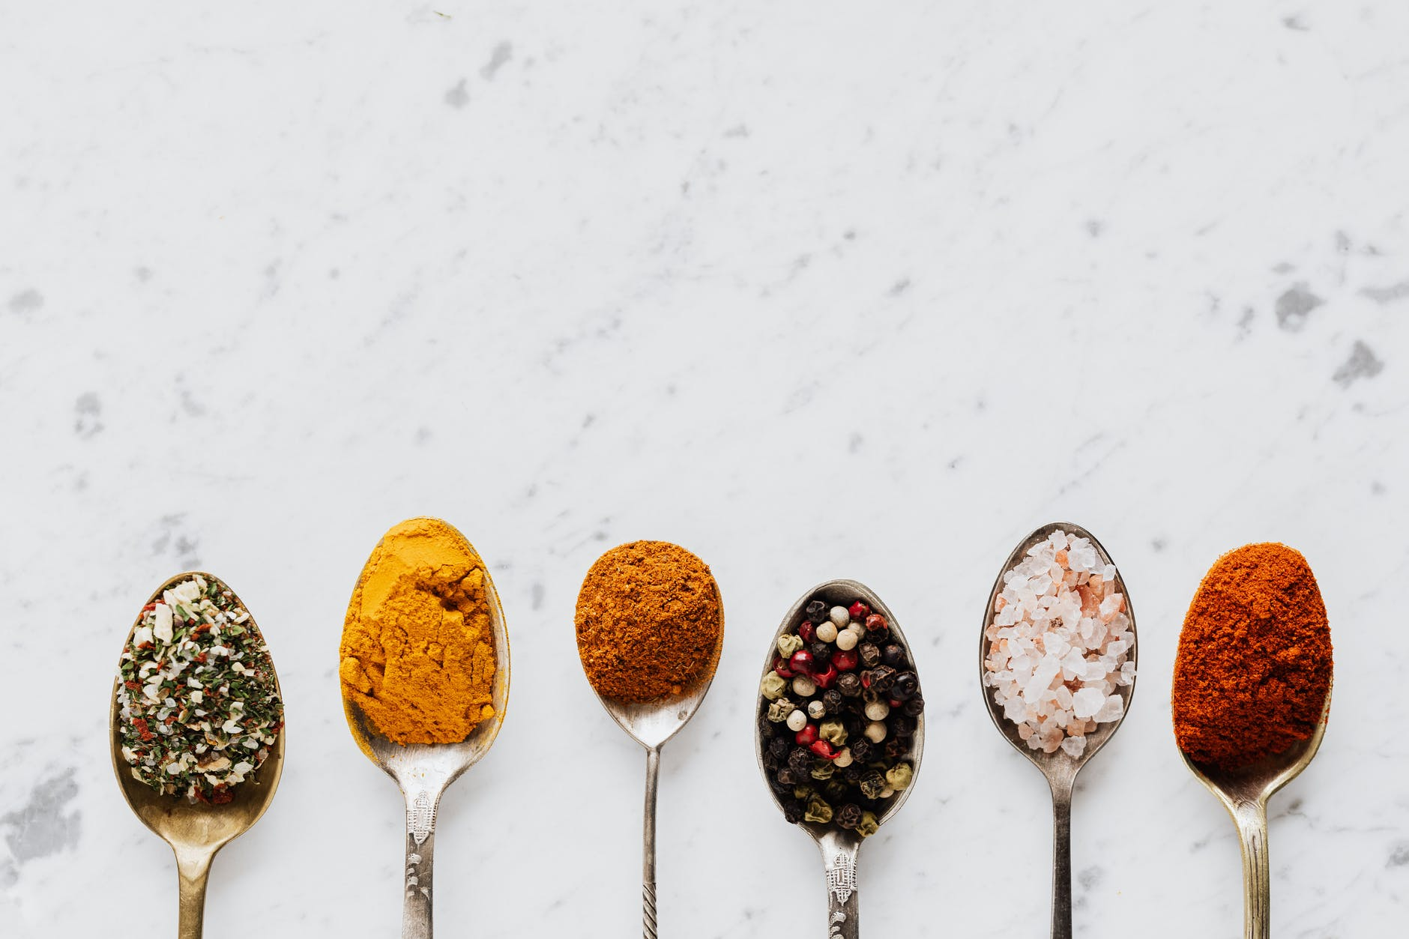
HOW TO DETECT WELLNESS CUISINE IN A DESTINATION?
ev

Slide 24
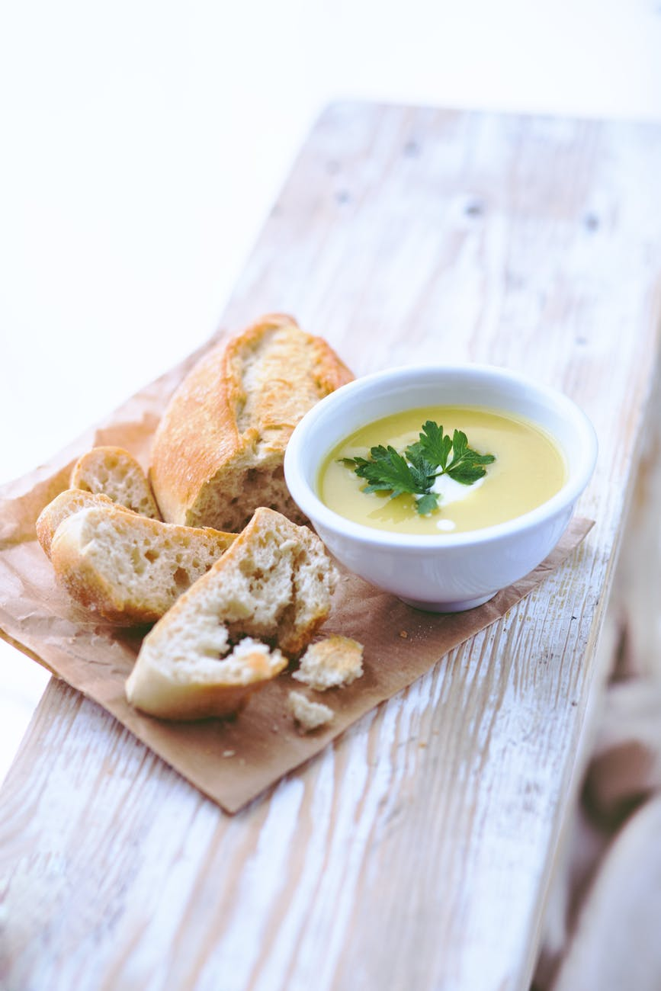
1. Finding an interesting food tradition in destination
Your selection of food tradition should embrace the main food philosophy of the destination. In Slovenia, the potatoes are main food ingredients. Potato soup is therefore a legend.

Slide 25
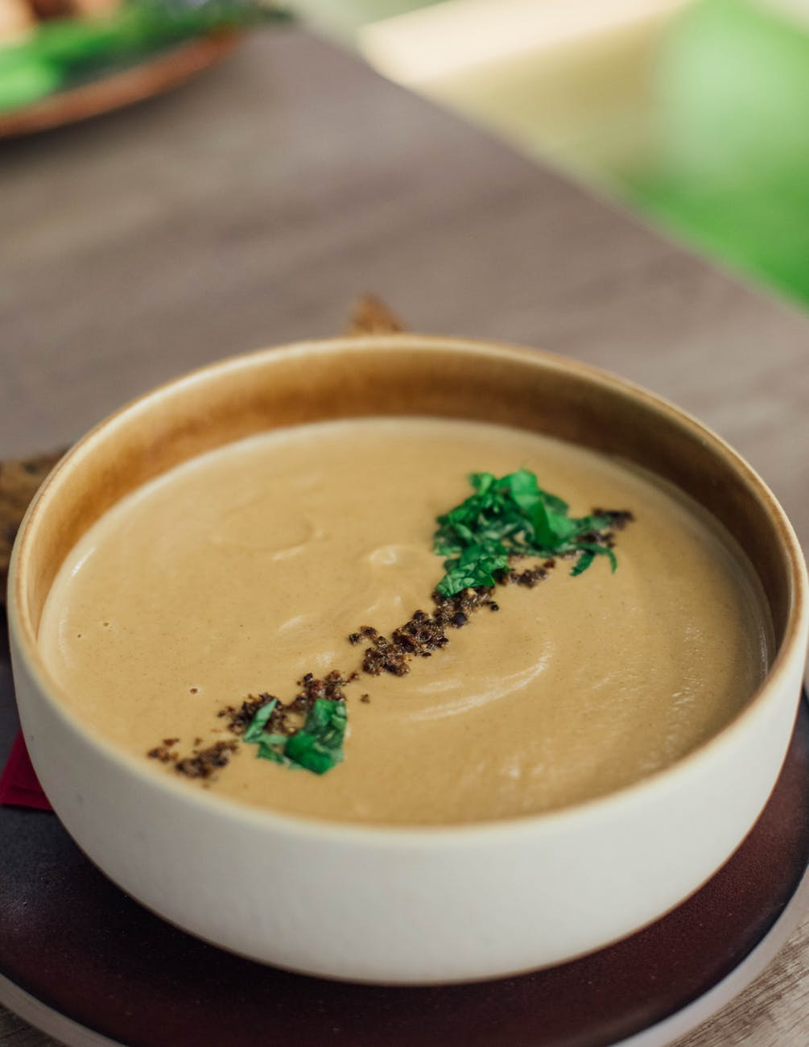
2. Maximising the seasonal impact
Let the dish speak the language of the season. Potato soup can be a summer dish when using young potatoes and seasonal herbs.

Slide 26
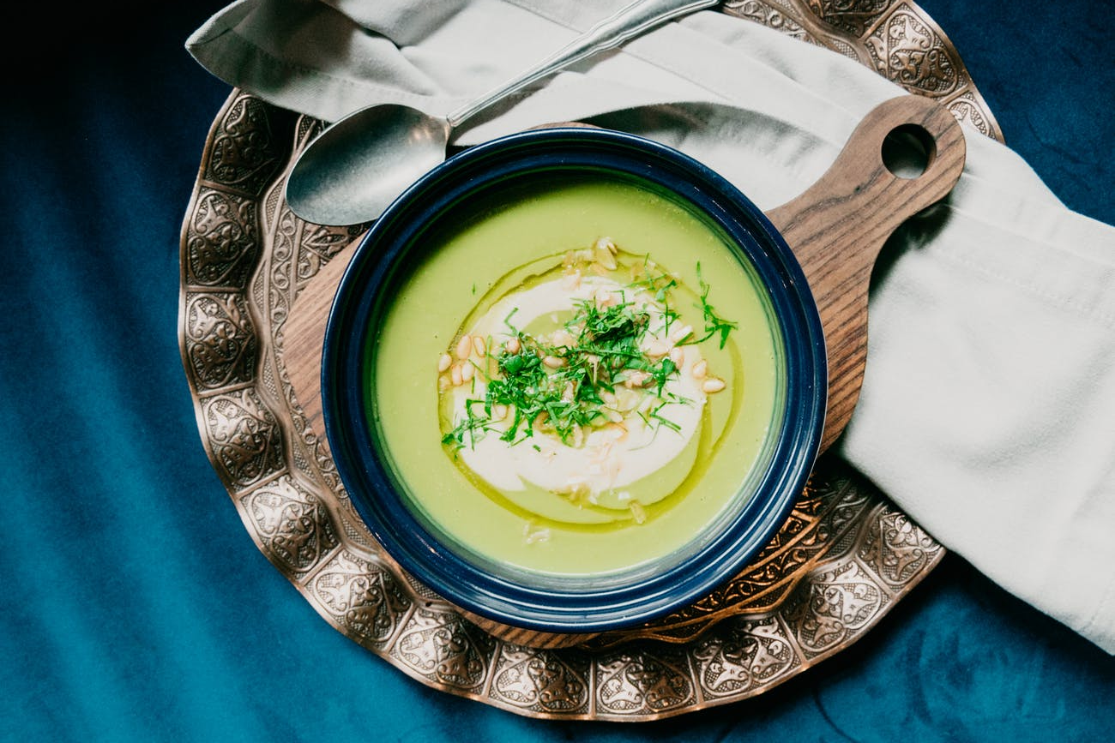
4. Boosting the creativity
Try to find interesting cooking techniques that enrich the flavour and the gastronomic experience. The potatoes for this soup have been roasted in the soil.

Slide 27
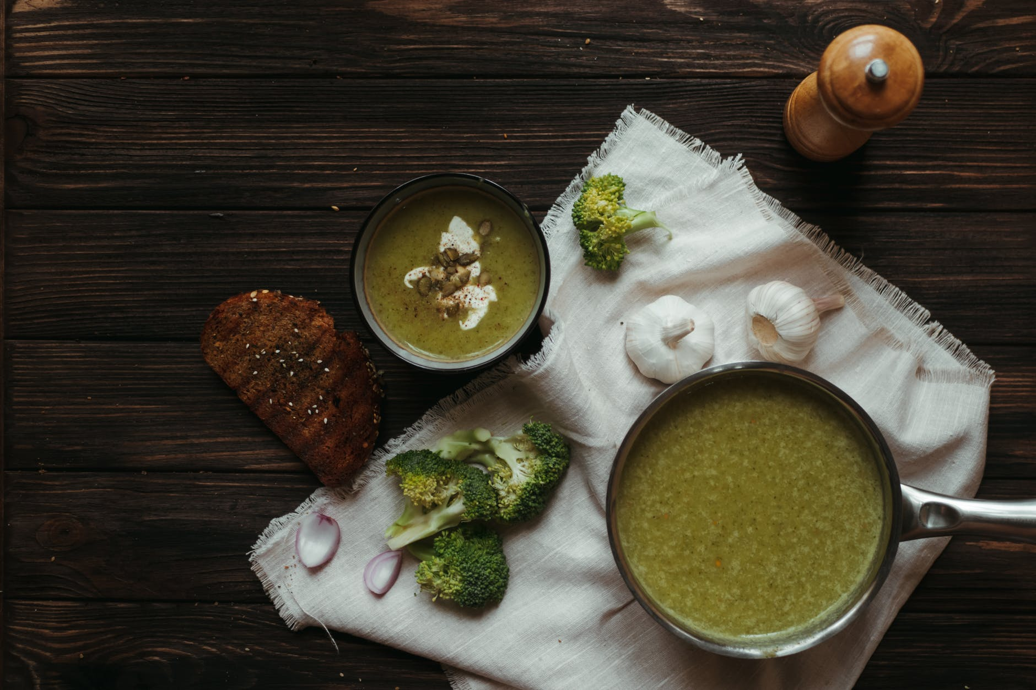
5. Implementing the health boosting products
Try to find the way to promote healthy eating and implementing vegetables and super food products. In this potato soup, broccoli was added.

Slide 28
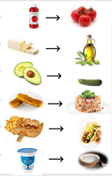
Processed foods
Fresh ingredients
From scratch
Bio/eco products
6. Modification of traditional recipes
Animal fats
minimizing
High-quality vegetable fats
Foods with a high carbon print
Local and seasonal foods
Foods with a min. sustainable footprint
Food preparation
Less frying and cooking at high temperature
Increase the raw product share
Creativity
The dish stimulates all the senses
The culinary experience leaves a lasting memory imprint
Story
The dish is backed by a good story
The story connects the entire wellness area

Slide 29
7. Modification of wellness dishes
Modification is changing the nature of a dish for the needs of specific marketing
Dishes can be modified – changed with different purposes and goals
Most often we want to modify it to bring the offer closer to the needs of guests
Guests often request modification due to diverse dietary profiles (diet, religion, philosophical reasons)

Slide 30
3. STORYTELLING IN CULINARY
TOURISM
Taste the story

Slide 31
WHY DO WE NEED A STORY TO PROMOTE CULINARY TOURISM
Stories are an effective tool in developing and marketing destinations,
products and attractions.
They bring guests closer to the uniqueness of the experience associated with emotions.

Slide 32
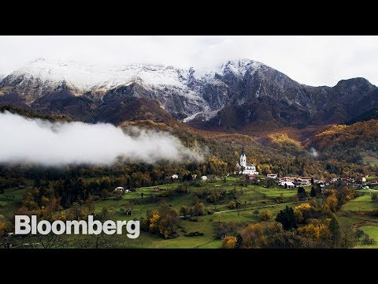
IMPROVE THE ENTREPRENEURSHIP WITH THE LOCAL FOOD STORY

Slide 33
What are the outcomes of a good food story?
INCREASED SATISFACTION
MEMORABLY
CREATIVITY
ENTREPRENEURIAL OPPORTUNITY
DESTINATION
TANGIBILITY
TOURIST
IDENTITY
COMPETITIVE ADVANTAGE
IN – DEPTH EXPERIENCE
ENCOURAGING DREAMS
BUILDING ORGANISATIONAL

Slide 34
WHY STORYTELLING IS MORE TRUSTWORTHY THAN PRESENTING DATA?

Slide 35
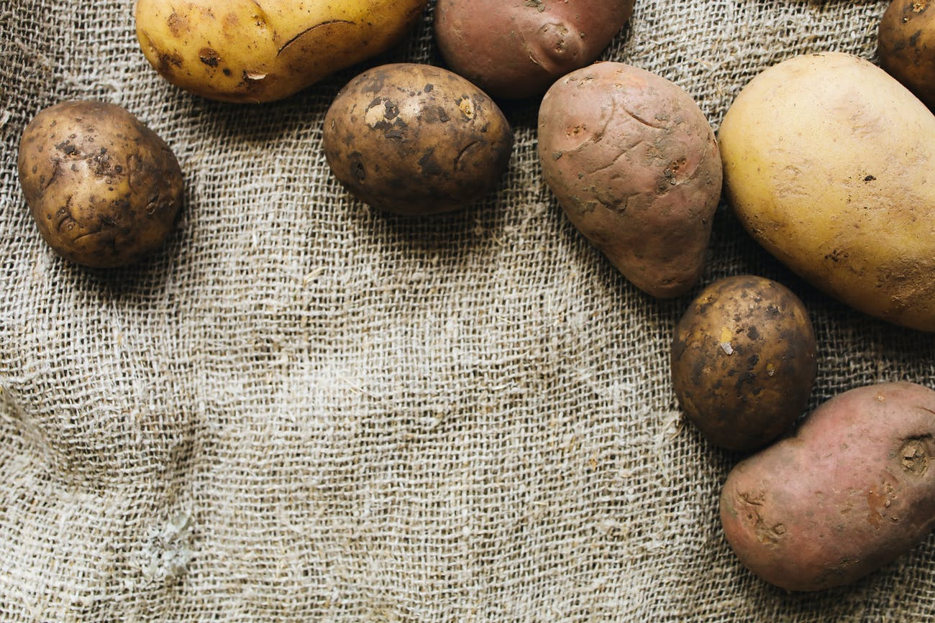
PROVIDING A GOOD FOOD STORY

Slide 36
What does a good food story need to include?
1. Message
2. Conflict
3. Characters
4. Structure

Slide 37
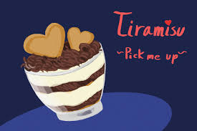
Rethinking the message
a. Message
Forming the message
Message is the heart of story
Message = moral or ideological act
In the story of Italian tiramisu, the key message is that it is a dessert that lifts the body and spirit.
Tirami su: pick me up

Slide 38
Conflict can be positive or negative
b. Conflict
Conflict provides the tension
Do not over do the conflict
Keep it simple
Sometimes the end of a story can be open, as this leaves the interpretation to the individual. We still don’t know if the formation of the steak tartare is really the fault of lining the saddle of the Tatars with meat, which enabled a more comfortable ride, or whether there is a conflict elsewhere.

Slide 39
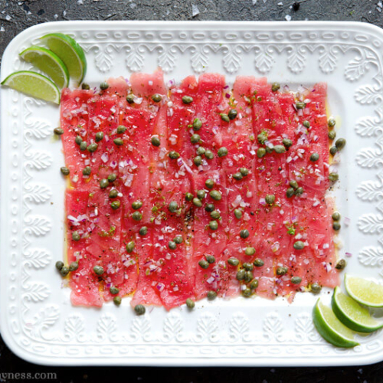
Characters helps to make the story alive
c. Characters
Good stories inclueds heros and antiheros
Create the tension between hero and antihero
A firm, a product an element can also be used as a character
The leading character in the story of the carpaccio is a Venetian lady who had to eat raw red meat due to anemia. An important character in the story is also the painter Vittore Carpaccio, who used an intense red colour in his paintings, which reminded the author of the dish so much of him.

Slide 40
d. the structure 1/2
Key element of the story.
The opening- highlight – the ending
Surprise element
What is the moral of the story
Viennese croissants – Kipferl took shape after the crescent, which was a symbol of the Ottoman flag of the aggressor, which the Viennese managed to defeat in the 17th century.

Slide 41
e. the structure 2/2
introduction
solution
The ploth
The twist
The heart
highlight

Slide 42
CHECK OUT THE STORY OF THE FAMOUS SACHER TORTE
The culinary icon of Vienna

Slide 43
The structure of the Sacher torte story
INTRODUCTION
CONFLICT
MAIN ACT
PEAK
TWIST
SOLUTION
In the year 1832, Austrian Duke Wenzel von Metternich organizes a gala dinner with the desire to present a new dessert.
When the chief confectioner falls ill, this burden falls on the shoulders of the apprentice Franz Sacher.
Franz takes a proven recipe for a chocolate cake and transforms it in his own way – using apricot jam for the filling.
The guests are extremely enthusiastic, and young confectioner becomes an urban icon.

Slide 44
FOOD STORY NO-NO*S
Promoting generic food products without origins
Being disrespectful to local traditions and sustainability
Forgetting the hospitality perspective
Lack of creativity
Negative emotions toward food
Copy paste

Slide 45
FOOD STORIES TO REMEMBER
Let's find out more about the best food stories from Slovenia

Slide 46
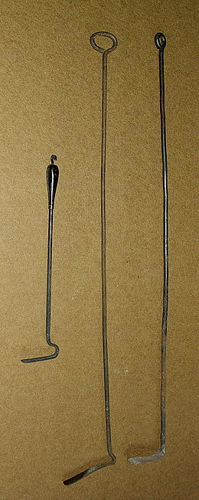
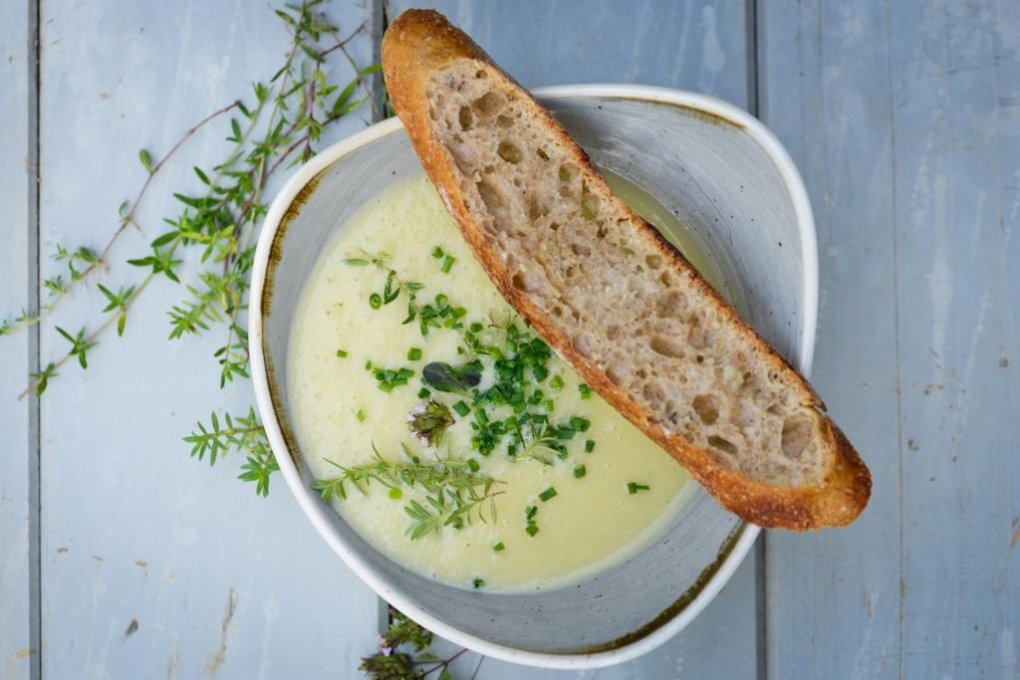
Iron soup, also called "širhakl" soup
During the industrial boom in the city of Maribor (Slovenia), simple potato soup was an everyday dish of the working population. Potatoes with some spices were enriched in the soup only by fried onions which squeaked in contact with the soup. Just as the iron scraper (širhakl) after cleaning the hot stove squeaks when sinked into a bucket of cold water.
*ŠIRHAKL (coll.) = iron charcoal scraper

Slide 47
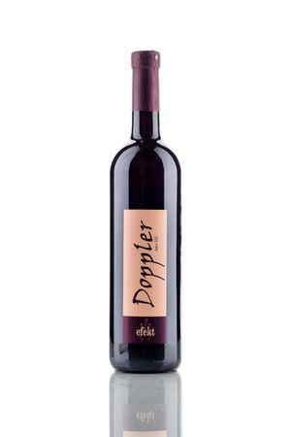
Wine with "Effect“
Doppler family from Zg. Kungota in Slovenia has been producing wine for several generations. During World War II, the grandfather was arrested by German soldiers for collaborating with partisans and sent to a concentration camp. Despite the inhumane conditions, the grandfather survived. When he returned to Slovenia, the family doctor instructed him to drink a glass of homemade wine a day to improve his health. However, in order for the wine to have the desired effect, it is better to drink two.
Doppler => doppelt (Ger.) = double (Eng.)

Slide 48
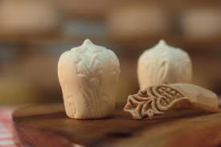
TRNIČ cheese
Is a love story from the Slovenian Velika planina mountain. According to tradition, shepards gave cheese TRNIČ in the autumn, at the end of the pasture, as a proof of love and fidelity, the promises of marriage, to their chosen ones, wives and girls. The shape of TRNIČ was inspired by a very special part of the female body.
https://www.youtube.com/watch?v=swdGkYIhFkU

Slide 49
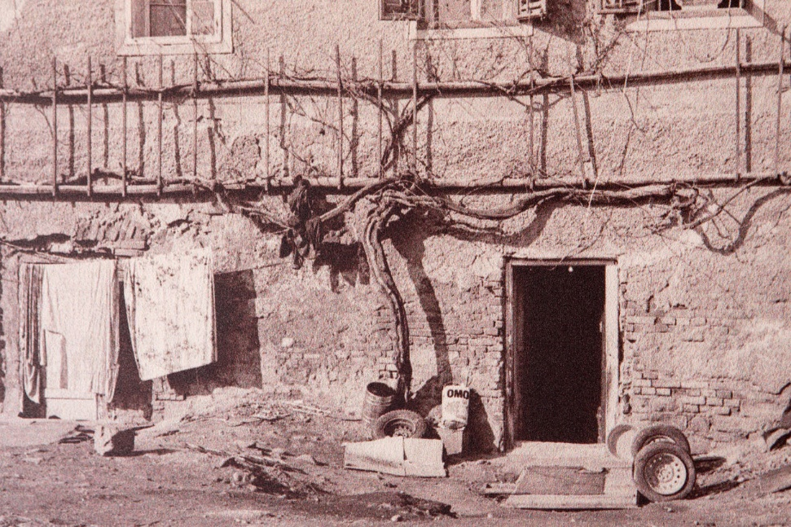
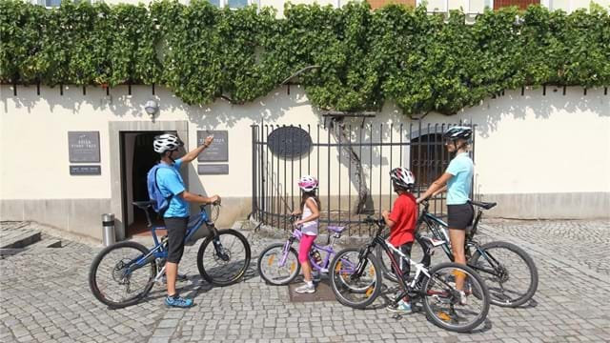
Maribor- the oldest vine in the world
"Žametovka" was planted in front of the house in the city of Maribor at the end of the Middle Ages. It was almost destroyed because of the many fires and other problems. Then, forgotten and in poor condition, it was recognised as a world heritage site and rehabilitated at the end of 20th Century. Today it can regenerate the grapes from which protocol wine is produced in the city of Maribor and also became a main city tourist attraction.
check-out the video: https://www.youtube.com/watch?v=gSCw40PVur8

Slide 50
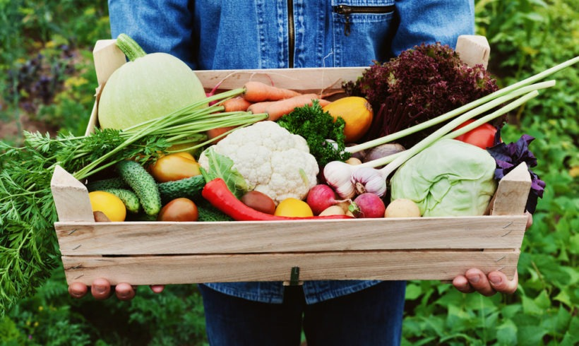
Sustainable food story
nature
economy
people
health
tradition

Slide 51
Case study – An Olympic example for sustainable food and catering standards
The organizers of the London 2012 Olympic Games led the way by committing to serve healthy and sustainable food for the 14 million meals served at the Games. The organizers have set out their commitment to serve British and seasonal food, healthy options, animal products from higher-welfare systems such as RSPCA Freedom Food, verifiably sustainable fish, and Fairtrade products, and to reduce packaging and food waste.
source: https://www.agreenerfestival.com/wp-content/uploads/pdfs/GOOD_FOOD_stallholder_guide.pdf

Slide 52
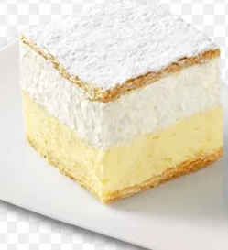
HOW TO PROMOTE
DESTINATION‘S
"MUST TASTE" OFFER?
Less is more
Standardise dishes
Focused Culinary marketing of destination
The dish is in the DNA of a community
The original recipe for the dish is clear
Acknowledgement of tradition
The dish can be served in all seasons
All season eats
The pricing is clear
Price

Slide 53
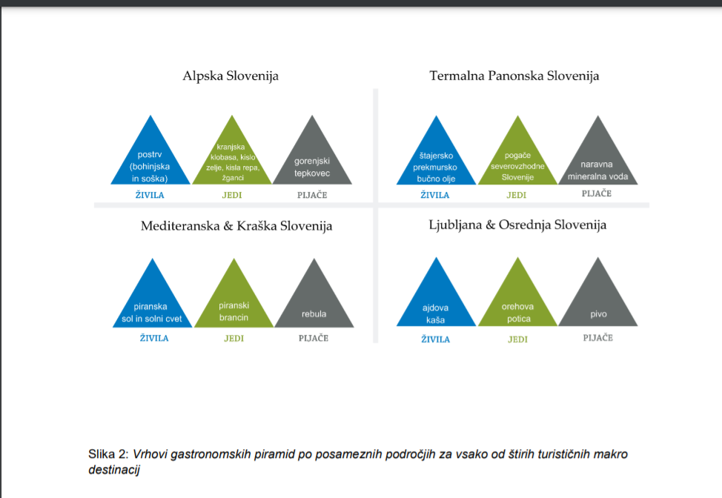
The picks of gastronomy piramyd for Slovenia alpine region.
HOW TO PROMOTE
DESTINATION‘S
"MUST TASTE" BUCKET LIST?
trout
polenta
Formation of destination gastronomy pyramid picks by experts from ethnology and gastronomy field of expertise.
sauerkraut
Kranjska sausage
pear schnapps

Slide 54
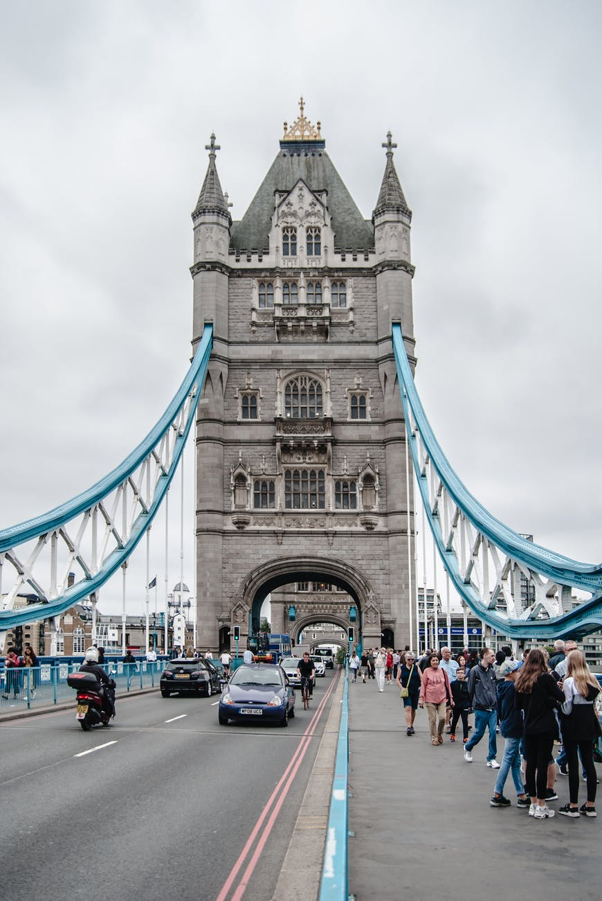
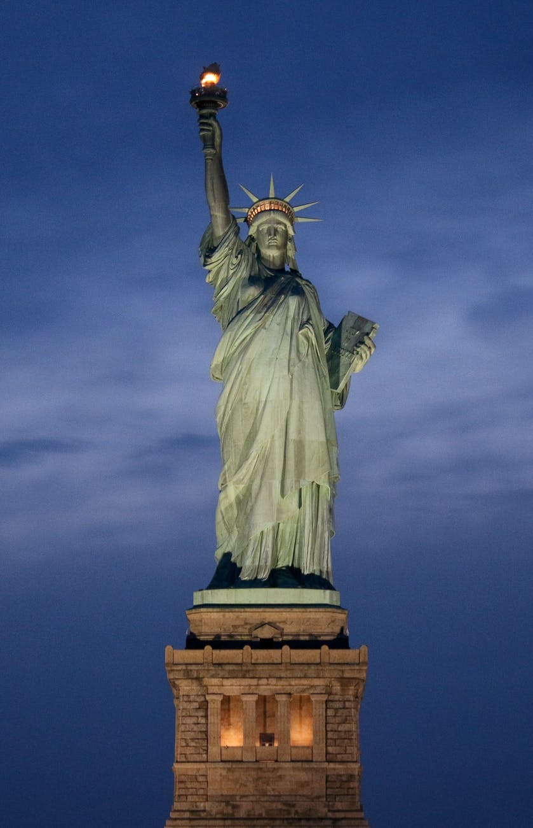
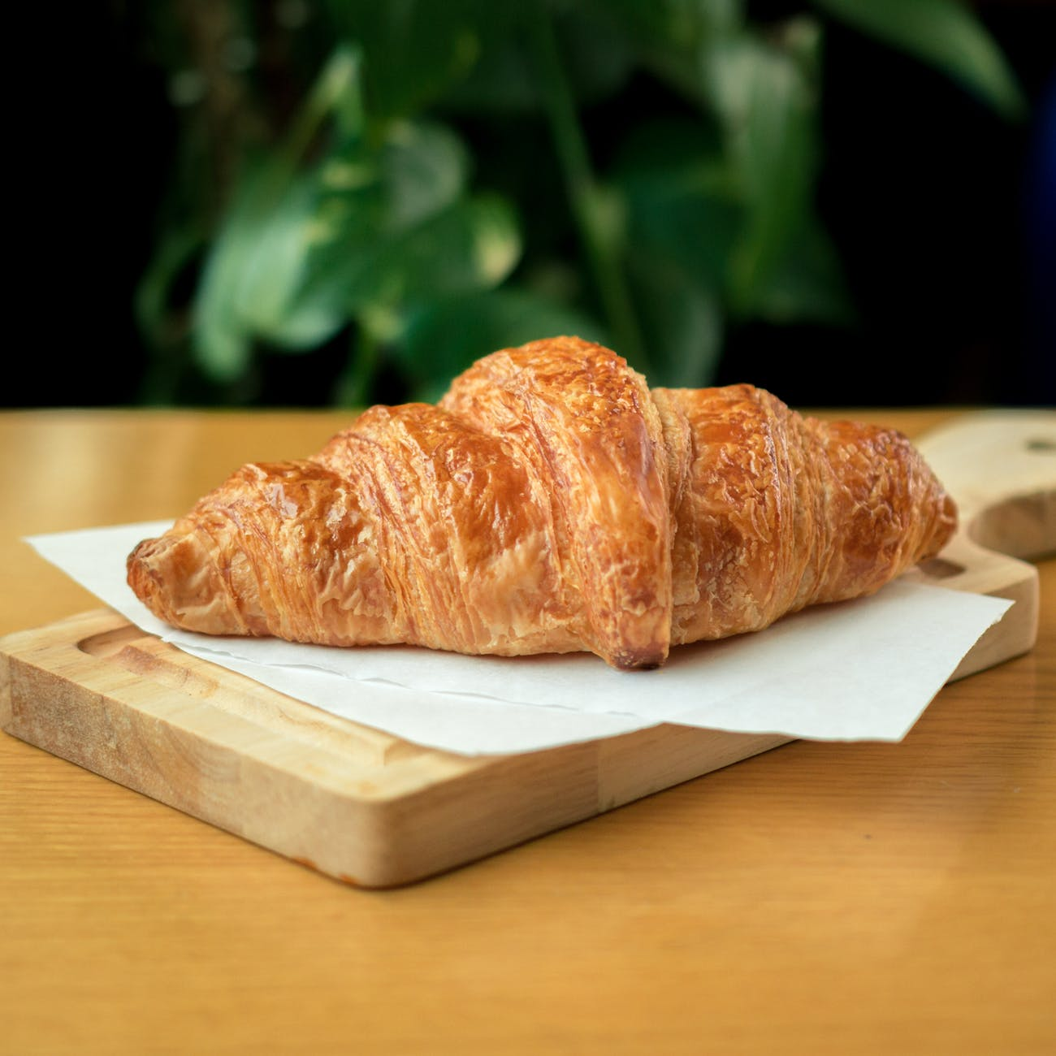
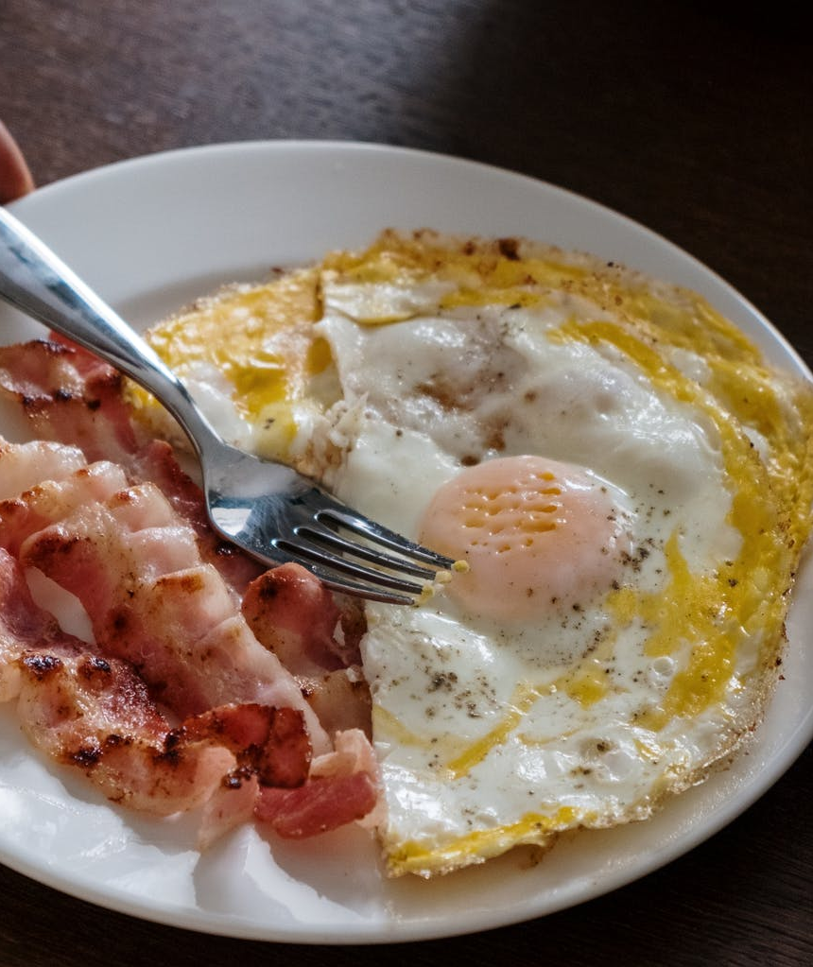
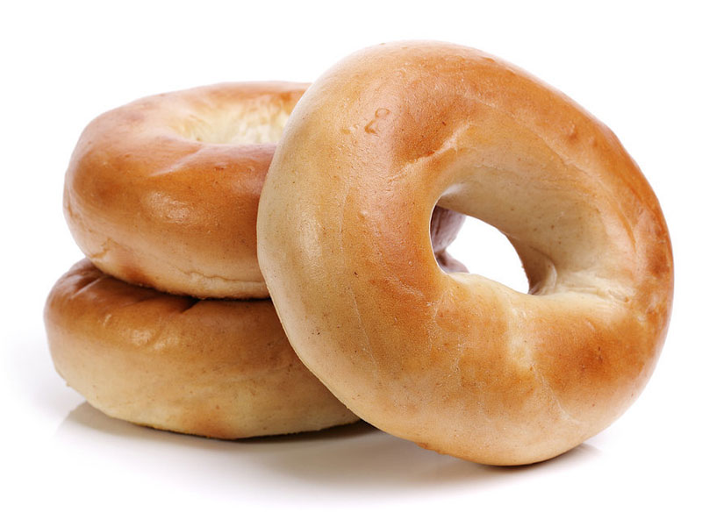
DESTINATION "MUST EAT" BUCKET LIST – TASTING THE SUPERSTAR

Slide 55
Further reading
Using culinary experiences to increase tourism at a destination
The Story Behind Amsterdam’s Food Evolution
Color Cuisine
Top Culinary tourism trends 2021

Slide 56
Assignment
1. Scan your region for authentic gastronomy experience.
2. Find a product or service that implements some of the gastronomy trends.
3. Produce a script for storytelling using tips in chapter 3 (Storytelling in culinary tourism) to promote your gastronomy product.
Which trends can you underline in your case of study?
Are there any elements of sustainability in your offer?
Does your offer help to promote the destination?
Have you used all the elements of a good food story?

Slide 57
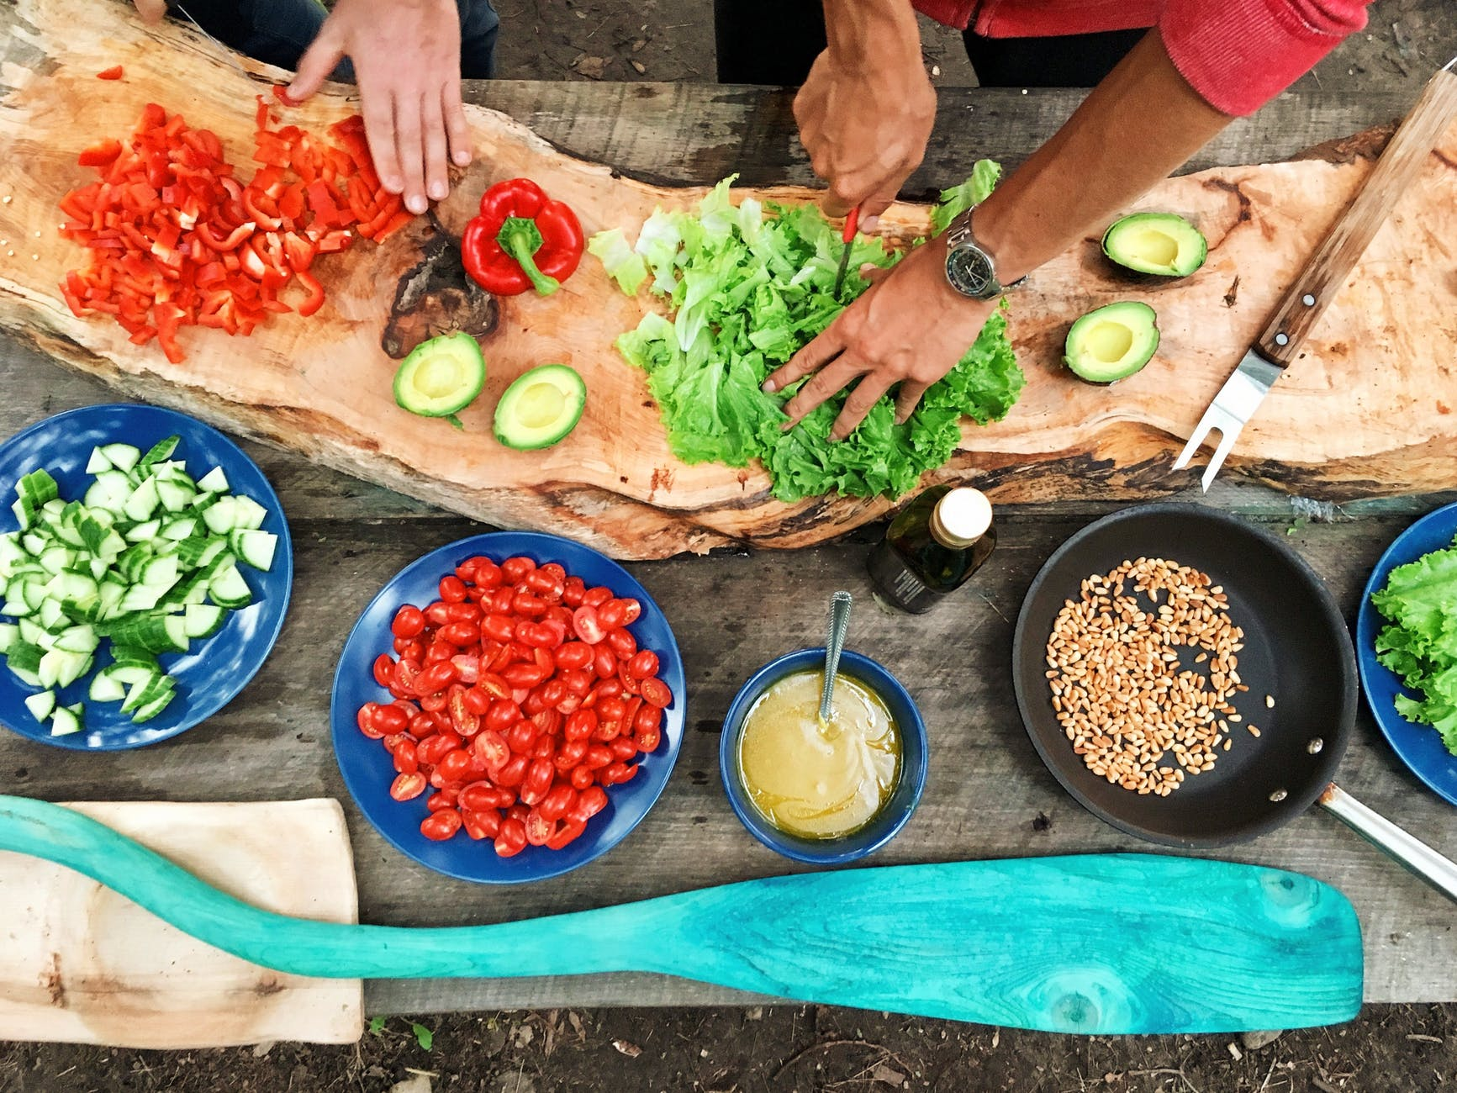
Module Summary

Slide 58
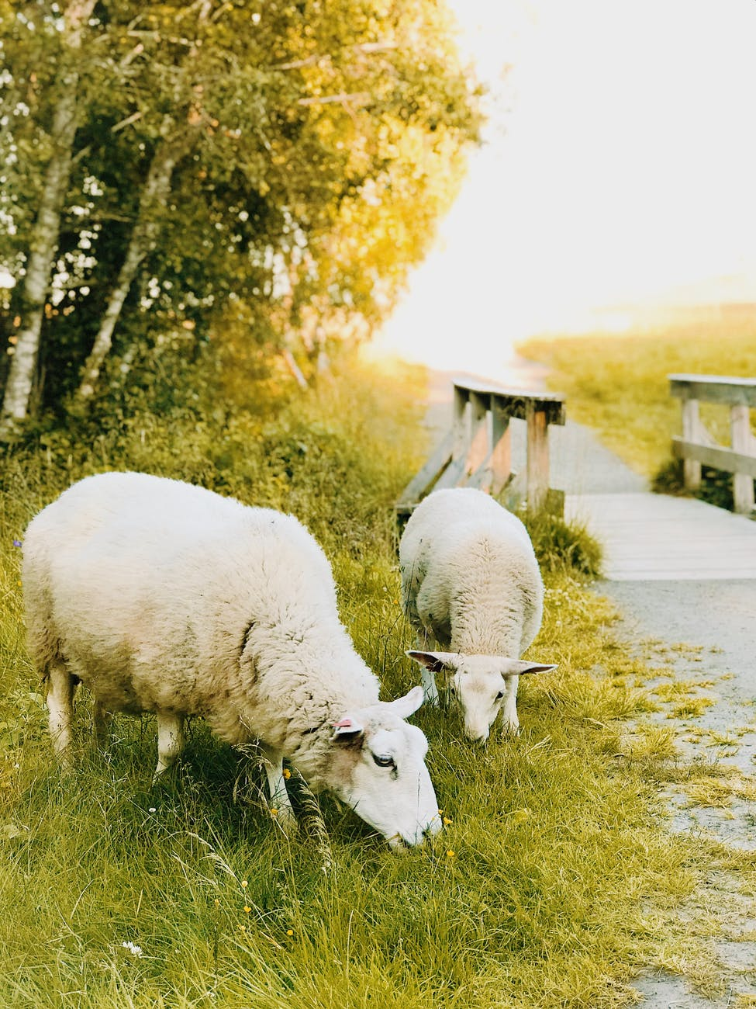
In this module we have learned:
Gastronomy tourism can also be named food or culinary tourism.
53 % of leisure travelers are food travelers.
Culinary tourism is the act of traveling for a taste of place in order to get a sense of place.
Culinary tourism has positive impacts in all levels of economy and society, sustainability is therefore of high importance.

Slide 59
In this module we have learned:
Wellness cuisine implements all pillar of wellness philosophy.
Wellness cuisine improves local and seasonal food experience.
All kind of dishes and drinks can be modified in wellness manner and for wellbeing purposes.

Slide 60
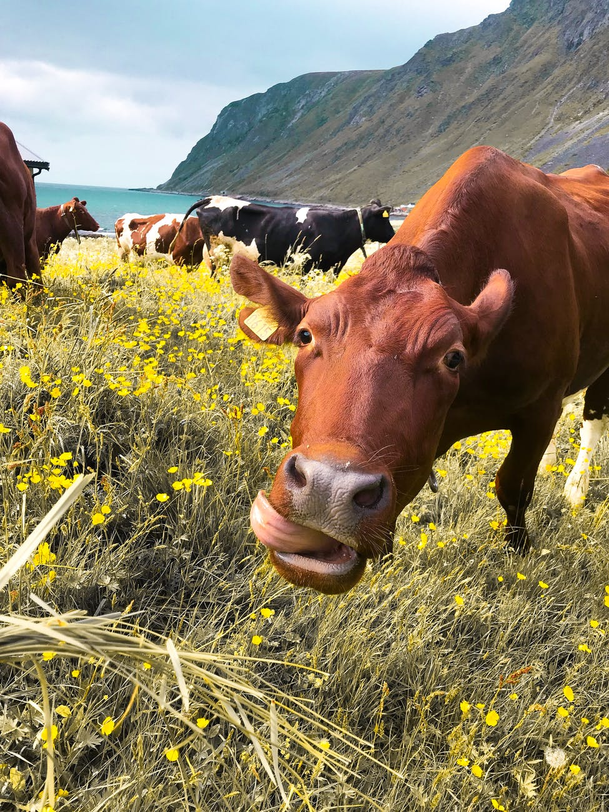
In this module we have learned:
Storytelling is crucial in a food or beverage experience because it allows us to connect on an emotional level with the experience. Hearing the stories of the producers, owners, local heroes, and so on, allows us to walk away with a memory, not just a meal.
Promotion of destination "must taste and must drink" helps tourist to understand the culinary highlights.
Must taste and must drink of the destination has to be selected and promoted wisely.

Slide 61
The roadmap
I. Introduction to Wellness and Wellbeing
II. Wellbeing in a New Era
III. The Experience Economy
IV. Engineering Wellbeing Experiences
V. Customer Journey Mapping
VI. Storytelling in Culinary Tourism
VII. Setting up a Wellbeing Business
VIII. Branding for Wellbeing
IX. Digital Marketing

