Slide 1
Customer Journey Mapping
Module 5

Slide 2
“
Welcome to DETOUR’s Wellbeing Tourism online training course.
”

Slide 3
The roadmap
I. Introduction to Wellness and Wellbeing
II. Wellbeing in a New Era
III. The Experience Economy
IV. Engineering Wellbeing Experiences
V. Customer Journey Mapping
VI. Storytelling in Culinary Tourism
VII. Setting up a Wellbeing Business
VIII. Branding for Wellbeing
IX. Digital Marketing

Slide 4
Module Introduction
Creating wellbeing tourism experiences can be challenging, especially in these troubling times where even the smallest detail matters. Good design is strongly supported in the understanding of the experience through the customers’ eyes, feeling what they feel, seeing what they see, thinking what they think and doing what they do. This principle will easily bring awareness and insight about critical points throughout the experience that might need to be changed, improved or monitored.
This part of the course aims to provide practical tools for creating human-centred experiences that can leverage wellbeing and satisfaction. It aims to contribute to the creation of more meaningful and better quality tourism experiences.

Slide 5
Learning Goal
To acknowledge empathy as a critical trait to understanding the experience through the customers’ eyes and designing human-centred experiences.

Slide 6
Learning Objectives
To recognize Customer Journey Mapping as a customer-centred experience design tool.
To distinguish the different steps for creating Customer Journey Maps.
To understand what are personas and empathy maps.
To identify touchpoints and moments of truth.
To create Customer Journey Maps.

Slide 7
Content & Resources
Content
5.1. Customer Journey Maps
5.2. CJM in Practice
i. Buyer Personas
ii. Empathy Maps
iii. Touchpoints and Moments of Truth
Resources
a. 3 support videos
b. 1 case study
c. 7 articles for additional reading
d. 1 assignment
e. 1 template

Slide 8
5.1.
Customer Journey Maps

Slide 9
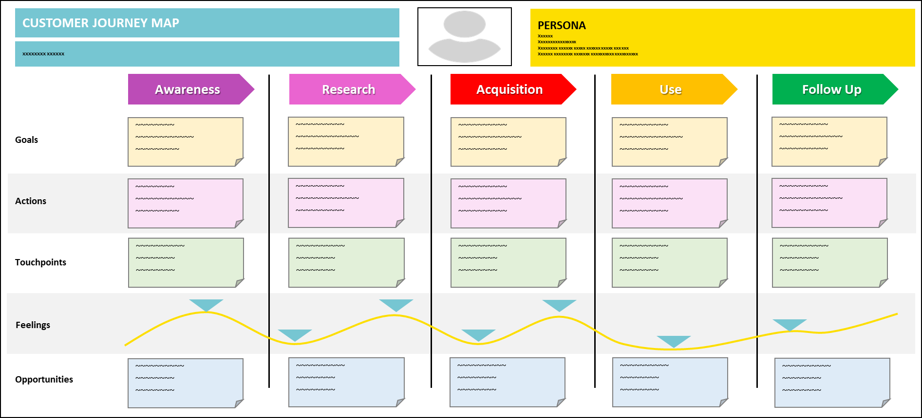
Customer Journey Maps
WHAT
Visual “story” of the customers interaction with a company.
WHY
Understand customers’ behaviour.
HOW
Analysing the experiences from the customers’ point-of-view.
WHEN
When there is no comprehensive understanding of how customers are experiencing your offering.
Notes:
WHAT
Archetypal representation of the steps a customer goes through in order to achieve certain goals or satisfy specific needs (e.g., a chocolate massage).
Identification of the touchpoints where customers interact with the company, and their feelings when doing so.
WHY
Capture iconic experiences customers have.
Understand customers’ behaviour.
Identify gaps in the customer experience.
HOW
Interviewing customers.
Reading other customer journey maps.
WHEN
When you need to prepare new marketing strategies and improve the customer experience.

Slide 10
Support Video #1
About customer journey maps and why to use them
https://youtu.be/VAAz_llXgn0

Slide 11
5.2.
CJM in Practice

Slide 12
CJM in Practice
Define the Scenario
What is going to be mapped?
Identify the
Buyer Persona
Whose experience is being mapped?
Research
What is happening? How? Why? When?
Identify
Key Steps
What steps does the customer have to undergo?
Map Touchpoints
Where and how does the customer interact with the company?
Outline the Journey
How does the experience unfold?

Slide 13
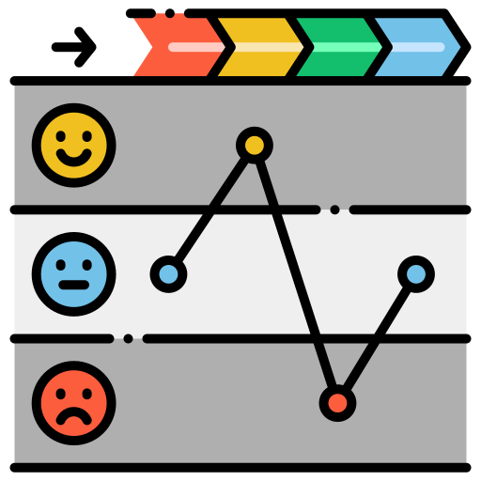
#1: Define the Scenario
Scope
Defining the scope means creating specific boundaries for the analysis. It describes a specific situation in which a certain customer (that has individual expectations about the journey) is trying to accomplish something.
&
What do you want to map?
Why do you want to map it?
What are the goals/benefits of product?
How much detail do you want/need?
Goals
Notes:
Customer journey mapping is a very helpful technique. However, it requires having a clear understanding of the situation to be mapped out:
You may be wanting to design a high-end map that describes an end-to-end experience, which is great to have a generic overview of the typical costumer journey, or, instead, you may be wanting to create a detailed map that is focussing on a particular stage of the journey, which offers deep insight on that specific part of the process.
You can also opt for mapping a real situation for an existing product, identifying and documenting existing problems and relevant solutions, or you can be designing an anticipated situation for a product that does not exist yet (i.e., conceiving new experiences), which will give and idea of the ideal scenario to be achieved.

Slide 14
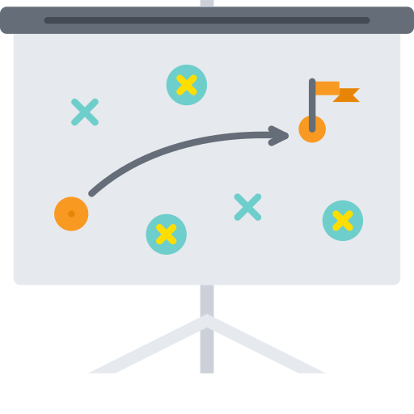
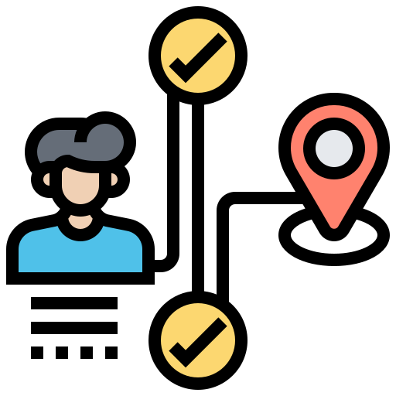
#1: Define the Scenario - Examples
Examples:
End-to-end: the complete travel experience, starting in the moment the traveller feel the urge to travel and ending in the moment the traveller arrives home → Holidays in Iceland.
Detailed experience: a specific experience of an outdoor adventure company, starting in the welcoming of the customer and ending in the moment of “goodbyes” → Guided walk up Ben Nevis (Scotland).

Slide 15
#2: Identify the Buyer Persona
A persona is a fictional portrait that is used to represent a specific group of people (like a market segment).
Customer journey maps tell stories, while personas help defining the profile of the stories’ main actors.
They help keeping the focus on the experience of one specific customer.
Focus on “real” people!
Notes:
Personas are not stereotypes (i.e., preconceived ideas), but rather archetypes (i.e., ideal representation of the customer), reflecting common patterns of behavior, needs, and emotions, motivations, frustrations, expectations and preferences. Their personal characteristics give sustenance to the background story, since they make analysts focus on people instead of abstract descriptions.
Personas help creating empathy and stepping into the customer’s shoes, which is a critical element for the appropriate application of Customer Journey Mapping and for any design initiative. They support the understanding of human behavior and facilitate the creation of buy-in when presenting conclusions and solutions.

Slide 16
#2: Identify the Buyer Person - Example
John Doe
Age: 36
Status: Married, 2 kids
Occupation: Creative Director
Education: Graphic Design
Expectations
Relaxation
Sense of escape
Convenience
Beautiful scenery
Wildlife
Storytelling
Food experiences
Good design
Bio: John is a creative person that leads a team of graphic designers. He has a very busy life in a urban setting, hopping between different projects everyday. He travels a lot, but seldomly to relax and enjoy the experience. He likes do discover new cultures, food, music and stories. He also enjoys soft-paced activities in nature, like hiking, sightseeing and wildlife photography.
Travel Style
Active
Passive
Nature
Urban
Organized
Spontaneous
Saving
Spending
Hedonic
Eudemonic

Slide 17
Support Video #2
Creating Buyer Personas
https://youtu.be/d4jPp2NdDYY

Slide 18
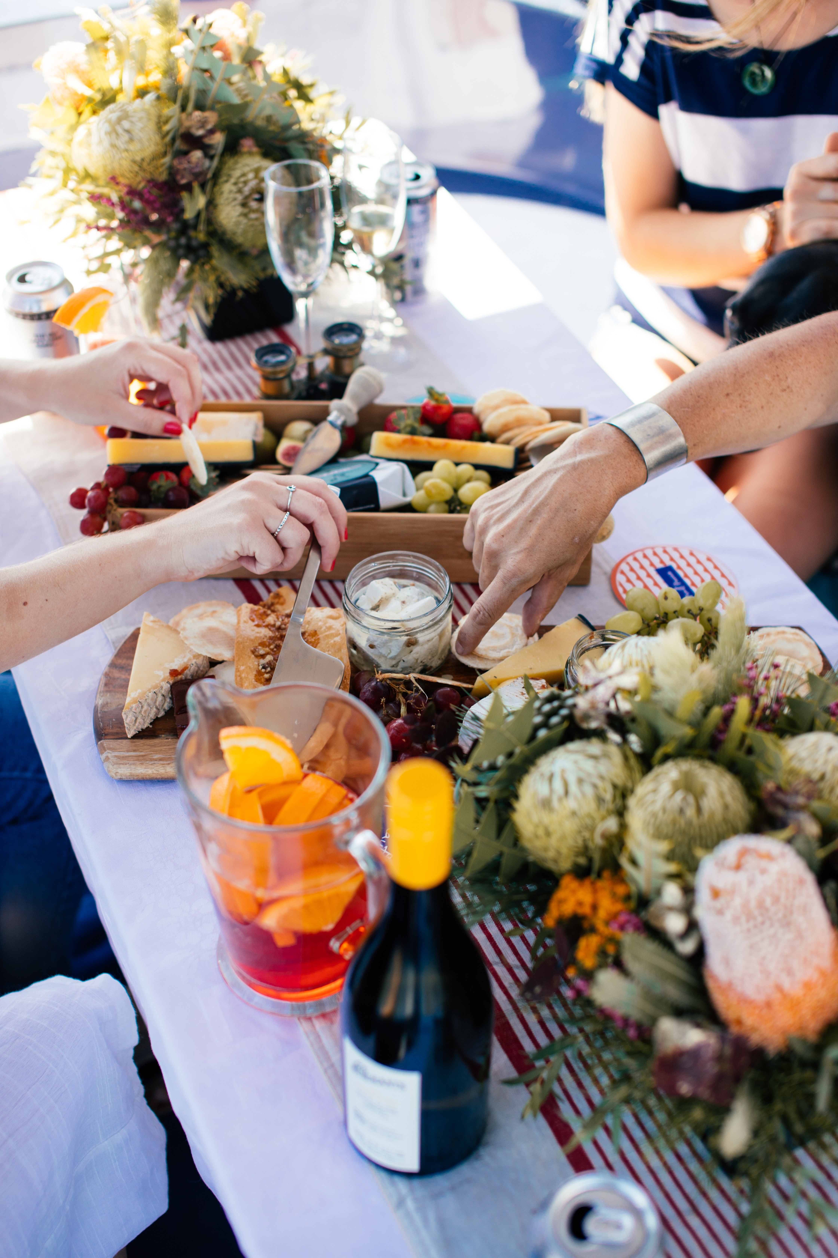
#3: Research
Gathering Data
Observe customers’ behaviours
Undergo through the customer experiences.
Interview customers.
Talk to employees in specific tasks (e.g., guides).
Tasks and stages
Actions
Touchpoints
Emotions
Pains and frustrations
Identifying
Notes:
Customer journey maps are based on evidence and on specific situations. It requires seeing what the customers sees and does, and it also requires talking to people to understand what they say and feel throughout the experience.
When gathering data for creating customer journey maps, we should be trying to identify:
What happens...
What the customer does/has to do…
How the customer feels…
What the customer expects/wants…
How the customer interacts with the company…

Slide 19
#3: Research – Empathy Map
Do customers verbalize everything that they think?
What customers say out loud
(quotes are nice!)
Says
Thinks
Customers’ emotional states: use an adjective + a short sentence to explain
Every action the customer physically takes
Feels
Does
Notes:
Empathy is vital for developing human-centred businesses and experiences. Therefore, the empathy map is a very useful tool to generate a deep understanding of customers behaviours . Interviewing them is a great way for building these maps.

Slide 20
#4: Identify Key Steps
Awareness
Research
Acquisition
Use
Follow Up
The customer discovers the product…
… and becomes interested.
The customer decides to buy the product…
… compares prices and decides to pay.
The customer will be sharing the experience…
… with friends, family and the online community.
The customer starts researching about the product…
… and finds information.
The customer is consuming the product…
… and evaluates its use value.
Notes:
→ Key steps represent goal-oriented stages that the customer undertakes throughout the journey. The type and detail of the key steps will depend on the overall scale of the scope that has been defined for the Customer Journey Map.
→ There are five typical steps in a Customer Journey: awareness, research, acquisition, use, and follow up. They can be adjusted, changed or eliminated, while others can be added. It all depends on the nature (e.g., travel, shopping, gas station), type (e.g., booking a flight online, vs. booking a flight with a travel agency) and scale of the experience (e.g., the whole travel experience vs. the travel booking experience).
→ Hint: After identifying the crucial part of the experience, we only need to understand what happens before and after it.
Awareness: the customer discovers the experience/product and becomes curious about it (or even attracted to it). It may happen in social media, booking platforms, OTA, brochures, travel agencies, ...
Research: the customer searches for more information about the product and compares it with other possibilities. Online research in vital in tourism today.
Acquisition: the customer makes the decision of buying the product and carries out the necessary tasks (e.g., booking, payment).
Use: this is the core of the experience, when the customer is consuming the product. Many companies may want to zoom in this stage and mapped it out, including welcoming, briefing, activities, debriefing and goodbyes.
Follow up: after the experience, the relationship between the customer and the company will be evolving and hopefully leading to advocacy and loyalty. Word of mouth, either person to person or online, is key for tourism companies.

Slide 21
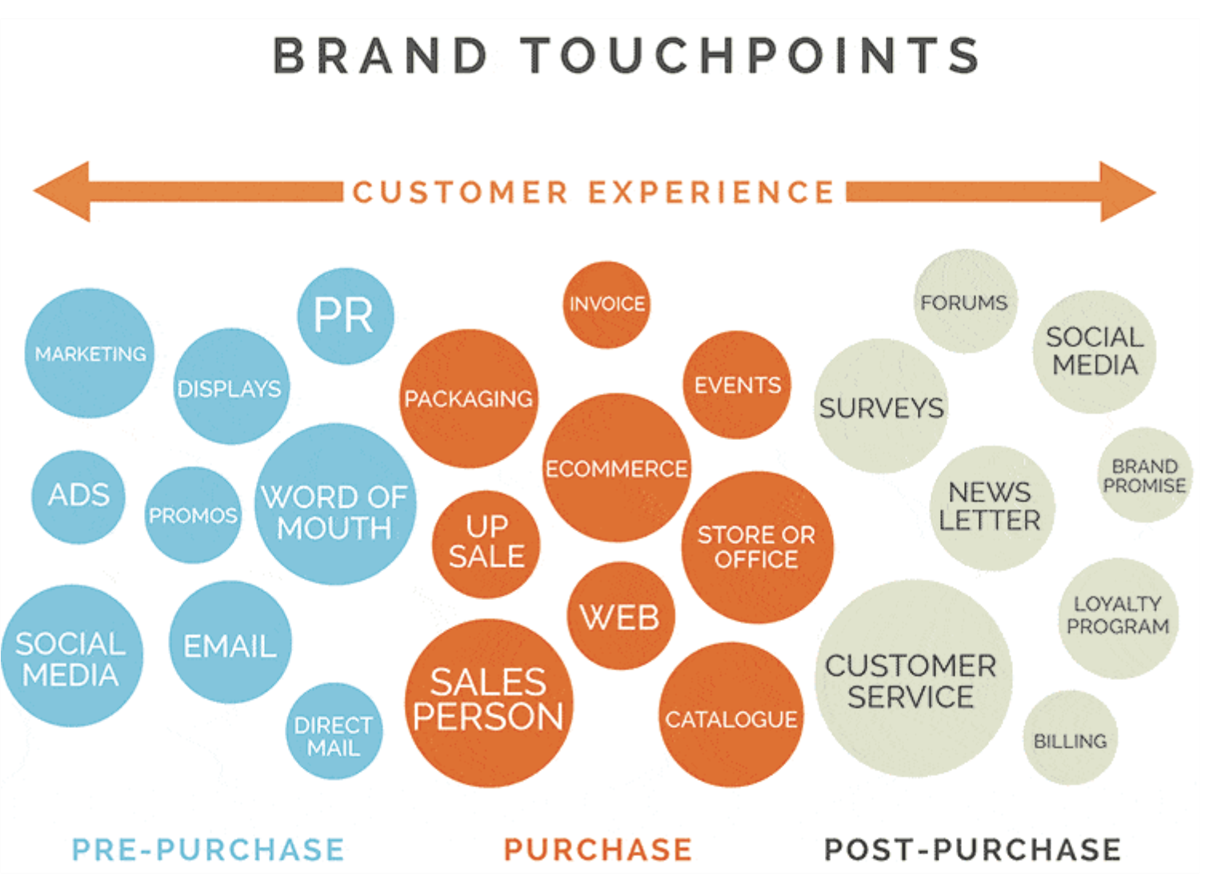
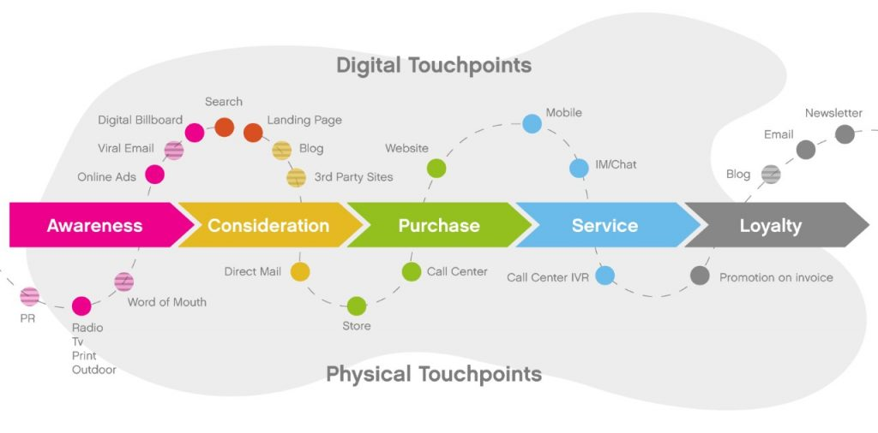
#5: Map Touchpoints
Touchpoints are every point of contact between the costumer and the organization/brand.
Source: www.grohawk.com/what-are-customer-touch-points/
Source: www.sentisum.com/library/customer-touchpoints
Notes:
Touchpoints include moments and interactions that happen online, offline, in person, over the phone, through intermediaries, before, during or after the experience. They range from the brand’s logo to the actual experiences/product and each one of them has customer emotions associated. The goal is that every interaction in every touchpoint be as positive as possible.
Mapping touchpoints serves to acknowledge the moments of truth and build a well-rounded sense of how the customer feels in every moment of the experience. It provides insight for comparing the actual experience to the desired experience, enabling the identification of opportunities for improvement and experience optimization (through the customers’ eyes).

Slide 22
#5: Map Touchpoints – Moments of truth
The points of the journey that have the most influence in the customer’s impression of a brand / organization / experience, either positively (Moments of Glory / Magic) or negatively (Moments of Pain / Misery).
Zero
MoT
First
MoT
Second
MoT
Third/Ultimate
MoT
Simulus
News
Trends
Daily need
Research online
Consideration to purchase
Experience
Shared Experience
Notes:
Zero MoT: research conducted online when the customer acknowledges a need/problem.
First MoT: the first time (seconds) a potential customer comes into contact with the product/brand.
Second: MoT: when the customer purchases and uses the product and the ongoing relationship that builds hereafter, based on the promise of the brand value and on the customer’s senses.
Third/Ultimate MoT: the customers start providing feedback and reactions to the product/brand and sharing the experience

Slide 23
Support Video #3
Customer Touch Points
https://youtu.be/NaJjn25hTXU

Slide 24
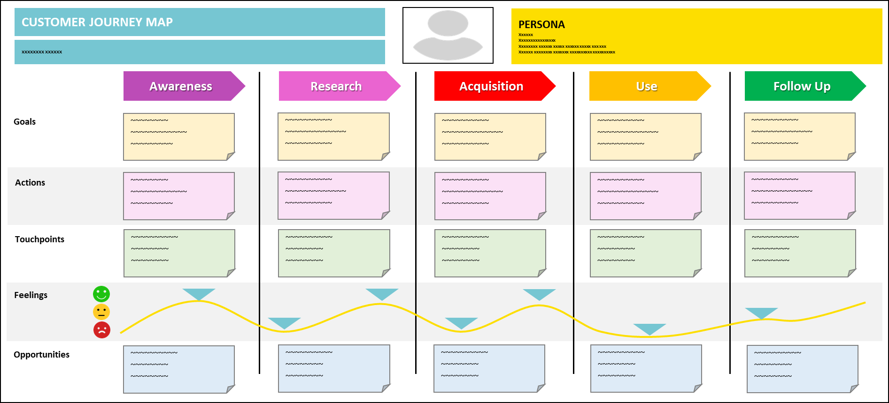
#6: Outline the Journey
The main actor of the story
The chapters of the storyline
The scope of the story
The features being analysed throughout the customer journey
Notes:
At this stage of the process, the main step of the experience are known, and the touchpoints in each of them have been mapped out. The goal now is to organize them, outlining the story that is being told, and producing its visual representation.
A Customer Journey Map can be created in many different ways. Usually, the top of the page presents the scope and the persona. An horizontal line will display the main steps of the experience. Below, other lines can be created in order to analyse the different parts of the experience. These can be customized according the type of experience that is being mapped out. Some examples are:
Goals: What the customer wants to achieve in every step.
Actions: What the customer does to achieve the desired goals.
Touchpoints: How the costumer is interacting with the company.
Emotions/Feelings/Thoughts: unveils the customer’s emotional journey (what is the customer feeling in every moment). It can be represented by figures or text.
Opportunities: serves to identify pain points and ways to improve the experience and the customer’s interactions with the company. It can cover marketing features, touchpoints, tasks, etc.

Slide 25
Case Study – Online Travel Agency
The context: Regina is a passionate traveller that regularly books all-inclusive tours in online travel agencies. She usually conducts a thorough research comparing multiple itineraries before booking a tour. Due to her busy life, she uses her mobile phone to do the research and eventually book the tours during train commutes at the end of the day. Her experience with this process makes her very demanding with the user interface and navigation. She enjoys reading reviews from other people and looks for as much information as possible when preparing the tour. Still, she only speaks English, which hinders communication when travelling. Memorabilia is an important part of the experience for Regina, and she collects as much as possible for as little as possible, which includes taking her own photos.

Slide 26
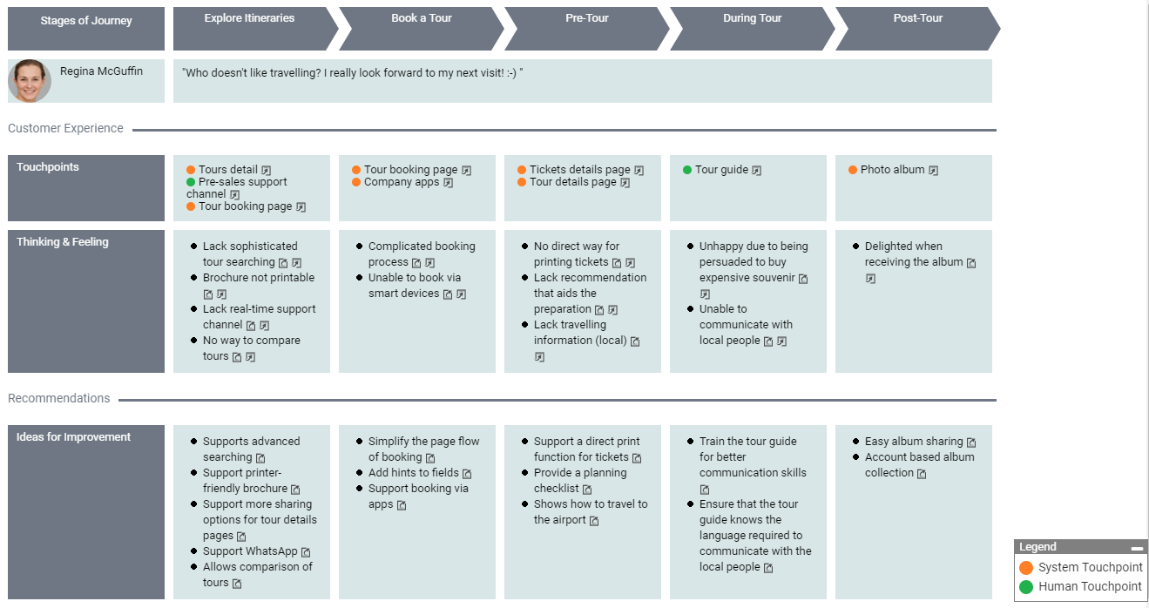
Case Study – Online Travel Agency
Source: https://online.visual-paradigm.com/pt/diagrams/templates/customer-journey-mapping/online-travel-agency/

Slide 27
Digging Deeper

Slide 28
Moments of Truth in Hospitality
[CLICK HERE]
Further Reading
Creating Buyer Personas for the Travel Industry
[CLICK HERE]
The many ways of mapping the customer journey
[CLICK HERE]
Customer Journey Mapping: Your Definitive Guide
[CLICK HERE]
The difference between a journey map and a service blueprint
[CLICK HERE]
How to create customer personas for your tourism brand
[CLICK HERE]
The Moment of Truth - Build Desirable Relationships with Users and Customers
[CLICK HERE]

Slide 29
Assignment
Using the template, build one Customer Journey Map for an existing service in your company.
Use an high-end perspective to outline an end-to-end experience or a zoomed-in perspective to map a specific wellbeing experience from your portfolio.
You can use data available online (and from your own experience) for your research, but try to fill the Empathy Map.
Map every touchpoint and identify moments of truth, considering the Experience Economy Principles.
List opportunities for improvement and articulate the narrative to present it to your team.

Slide 30
Customer Journey Map Template
CUSTOMER JOURNEY MAP
PERSONA
____________________________________________________________________________________________________________
Awareness
Research
Acquisition
Use
Follow Up
Goals
Actions
Touchpoints
Feelings
Opportunities

Slide 31
Module Summary
Module V. Customer Journey Mapping

Slide 32
In this module we have…
… presented the Customer Journey Mapping as a customer-centred experience design tool, that creates a visual representation and storyline of the customer’s interactions with the company.
… established the different steps for creating Customer Journey Maps, namely defining the scenario; identifying the buyer persona; gathering data; identifying key-stages of the experience; mapping touchpoints; and outlining the journey.

Slide 33
In this module we have…
… used personas as archetypal representations of the customer segment, that enable empathy building and the collection of evidence base on the needs of real people.
… become aware that empathy maps are useful tools for understanding what customers are feeling, thinking, doing and saying in what regards experiences or specific touchpoints.

Slide 34
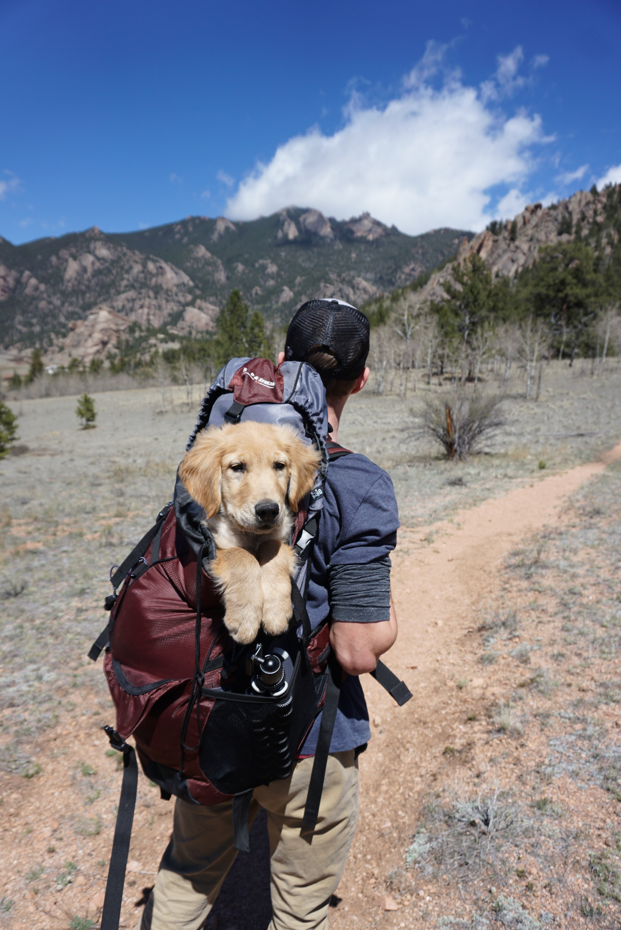
In this module we have…
… acknowledged that touchpoints are all points of interactions between the customer and the company and that they include moments of truth.
… learned how to create Customer Journey Maps for specific experiences and specific customers, outlining the storyline of the journey, specifying the goals, actions and emotions of the customer, plotting touchpoints and analysing opportunities for improvement.

Slide 35
The roadmap
I. Introduction to Wellness and Wellbeing
II. Wellbeing in a New Era
III. The Experience Economy
IV. Engineering Wellbeing Experiences
V. Customer Journey Mapping
VI. Storytelling in Culinary Tourism
VII. Setting up a Wellbeing Business
VIII. Branding for Wellbeing
IX. Digital Marketing

Slide 36
Thank You
Any Questions?
www.detourproject.eu
Detour on Facebook
@WellbeingTourismDestinations
#detourdestinations #erasmusplus #detour #wellbeing
Icons: www.flaticon.com

