Slide 1
Engineering Wellbeing Experiences
Module 4

Slide 2
“
Welcome to DETOUR’s Wellbeing Tourism online training course.
”

Slide 3
The roadmap
I. Introduction to Wellness and Wellbeing
II. Wellbeing in a New Era
III. The Experience Economy
IV. Engineering Wellbeing Experiences
V. Customer Journey Mapping
VI. Storytelling in Culinary Tourism
VII. Setting up a Wellbeing Business
VIII. Branding for Wellbeing
IX. Digital Marketing

Slide 4
Module Introduction
What is traveling about: going to a new place or getting away from a place? Modern living has become so fast-paced and packed with challenges, work and stress that travelling is increasingly more a way of seeking the wellbeing that is hard to achieve on a daily basis. Travellers are looking for new experiences that bring personal growth and a renewed sense of purpose to their lives.
In this module, resorting to modern scientific concepts from various fields – including Psychology, Anthropology and Sociology – and to ancient practices, some techniques and tools will be explored as means for creating experiences that can ultimately lead to tourists enjoyment, life satisfaction, sustained wellbeing and self-actualization.

Slide 5
Learning Goal
To explore different techniques that by themselves or combined can create wellbeing tourism experiences with deep personal meaning and provide sustained life satisfaction.

Slide 6
Learning Objectives
To recognize tourists’ current need to escape their everyday lives, relax and be transformed.
To interpret the nature of the optimal experience.
To recognize the rite of passage as a way of creating liminoid experiences and memorable moments.
To use storytelling as tool to create immersive experiences.
To describe mindfulness as a means for achieving sustained wellbeing.
Notes:
People are looking for more for wellbeing experiences during their travels. Different techniques can be used – on their own or combined – to design innovative experiences with memorable and meaningful moments and deep emotional connection. Hence, the aims of this part of the module are:

Slide 7
Content & Resources
Content
4.1. The need to escape
4.2. The Optimal Experience
4.3. Liminality
4.4. Storytelling
4.5. Mindfulness
Resources
a. 6 support videos
b. 5 case studies
c. 10 articles for additional reading
d. 1 assignment

Slide 8
4.1.
The Need to Escape

Slide 9
The Need to Escape and Relax
What do we want?
Travel and tourism is more about getting away from a place, rather than go to a place. It is often negating the predictability, the tedium and the routine experiences, responsibilities and even relationships from our day-to-day lives.
The Global Wellness Institute (GWI) states that wellness tourists are motivated by desire for healthy living, disease prevention, stress reduction, management of poor lifestyle habits, and/or authentic experience.
What is wellbeing?
Why do we travel?
Notes:
Studies from Sociology have pointed out that postindustrial society’s dissatisfaction with mundane and rational daily life has led people to seek hedonic experiences. This dissatisfaction is as much self-directed (e.g., identity, stress, work overloads, loneliness) as it is socially-directed (e.g., anomie and the impacts of materialism and capitalism).
Travelling is seen increasingly more as an opportunity for wellbeing. Transformative travel is on the rise, bringing along an increasing focus on physical, spiritual and mental wellbeing that is accompanied by a reconnection with nature and the search for an opportunity to “hit the reset button” – repurpose life, embrace the true self and achieve personal growth.
Although experiences lack tangibility, people greatly desire them because the value of experiences lies within themselves, where it remains long afterwards, generating a sense of wellbeing.

Slide 10
The Need to Escape and Relax
Relax
… let go and…
Escape
… detach and…
We need to…
… seek…
Authenticity
… protect and nurture our…
… understand our own…
Health
Identity

Slide 11
The Need to Escape and Relax
Escapism
To escape one’s ideas of self (frustration and disappointment).
To get away from the pressures and routines of one’s home society.
To escape a “world” where the person feels alienated from.
Relaxation
To recover from work stress.
To slowing down from the daily pace of life.
To find places and environments that promote rejuvenation.

Slide 12
The Need to Escape and Relax
Authenticity
To search for more authentic experiences (existential; genuine).
To search for things that are missing in the one’s life.
To benefit from the freedom of anonymity.
Identity
To create a stronger and sustained sense of self.
To develop a life narrative that is built by experiences.
To achieve self-realization and personal development.

Slide 13
The Need to Escape and Relax
Health
To keep fit, learn health eating and receive body treatments.
To promote mind-body balance, psychological and emotional health.
To reach heightened spiritual states and connection to others, the world and the meaning of life.
“The problem arises when people are so fixated on what they want to achieve that they cease to derive pleasure from the present.”
Mihalyi Csikszentmihalyi (1990)

Slide 14
Support Video #1
How to relax | 8 relaxation tips for your mental health
https://youtu.be/cyEdZ23Cp1E

Slide 15
4.2.
The Optimal Experience

Slide 16
The Optimal Experience: Pleasure or Enjoyment?
Pleasure (homeostatic experiences)
Enjoyment
or
Feel good | Short-lived
Fulfilment & Meaning| Enduring Memories
The feeling of contentment that we reach when biological needs (e.g., hunger, thirst or refreshment) are satiated.
It is characterized by a forward movement: a sense of novelty, of accomplishment, and of achieving something unexpected.
Examples: sleeping; eating a delicious meal; having sex; getting a massage; laying in the sun.
Examples: learning a new skill; having a good debate; climbing a mountain; baking a special meal.
Notes:
Pleasure:
Seeking pleasure is a reflex response built into our genes for the preservation of the species. It does not contribute to personal growth.
We can experience pleasure without any investment of psychic energy (attention).
Enjoyment:
Derived from achieving something more than the momentaneous satisfaction of a need (surpassing one’s limits, challenges, barriers).
Happens only as a result of unusual investments of attention (in realistic goals) and when skills match the opportunities for actions (challenges).

Slide 17
The Optimal Experience: Pleasure or Enjoyment?
Pleasure (homeostatic experiences)
Enjoyment
or
Pleasure is an important component in the quality of life, but by itself does not bring happiness. […] When people ponder further about what makes their lives rewarding, they tend to move beyond pleasant memories and begin to remember other events, other experiences that overlap with pleasurable ones but fall into a category that deserves a separate name: enjoyment.
Notes:
To improve life one must improve the quality of experience.
Experiences that give pleasure can also give enjoyment.

Slide 18
The Optimal Experience: Flow
Investing our energy/attention to achieve something worthwhile leads to the
Optimal
Experience
It is the holistic sensations that people feel when they act with total involvement.
Flow
When in the state of flow, we are our most creative, happy and productive selves.
Therefore, being able to experience flow recurrently improves our quality of life and general wellbeing.
Notes:
Theory of Flow has been proposed by Mihaly Csikszentmihalyi.
Flow is a particular state of mind.
It is the state in which people are so involved in an activity that nothing else seems to matter; the experience itself is so enjoyable that people will do it at great cost, for the sheer sake of doing it.
In these moments we feel in control of our actions, masters of our own fate, and we feel a sense of exhilaration, a deep sense of enjoyment that is long cherished and that becomes a land mark in memory for what life should be like.
It ranges from ‘deep flow’ (complex activities) to ‘micro flow’ states (trivial, simple, low skill activities). How enjoyable an activity is depends ultimately on its complexity.
It can be achieved in a great number of ways, including reading, meditating, thinking, hiking, climbing, swimming, dancing, writing, painting, baking, playing chess or even socializing.

Slide 19
The Optimal Experience: The flow channel
High
The transcendent and intrinsically rewarding state of flow only occurs when skills match the challenges of a given activity.
Anxiety
Challenges
Flow
Boredom
Low
Low
High
Skills
Notes:
The best moments usually occur when a person’s body or mind is stretched to its limits in a voluntary effort to accomplish something difficult and worthwhile.
Optimal experience is thus something that we make happen. It requires active involvement, either physical or mental.
For that reason it involves an interplay between skill and challenge:
when challenges exceed the participants’ skills, anxiety is experienced;
conversely, when skills exceed the challenges, the result is a state of boredom.

Slide 20
The Optimal Experience: Achieving flow
Characteristics of the Flow Experience:
1. A challenging activity that requires skills
2. The merging of action and awareness
3 & 4. Provide clear goals and feedback
5. Concentration on the task at hand
6. The paradox of control
7. The loss of self-consciousness
8. The transformation of time
Notes:
1. A challenging activity that requires skills: the experience usually occurs when we confront tasks we have a chance of completing. Enjoyment only appears at the boundary between boredom and anxiety, when the challenges are just balanced with the person’s capacity to act.
2. The merging of action and awareness: we must be able to concentrate on what we are doing, channeling our complete attention and involvement on the activity in such a way that actions become spontaneous and automatic (i.e., turn off mobile phones and external distractions!).
3 & 4. Provide clear goals and feedback: the concentration is usually possible because the task undertaken has clear goals and provides immediate feedback - people know what to do and can immediately evaluate the efficacy of their actions.
5. Concentration on the task at hand: people experience complete focus on the task, leaving no room in the mind for irrelevant information. One acts with a deep but effortless involvement that removes from awareness the worries and frustrations of everyday life.
6. The paradox of control: people experience a sense of control, which in reality is the lack of a sense of worry about losing control; the absence of the fear to fail; or fewer perceived risks.
7. The loss of self-consciousness: people have a sense of transcendentalism and the concern for self disappears, yet paradoxically the sense of self emerges stronger after the flow experience is over.
8. The transformation of time: the sense of the duration of time is altered. Time no longer seems to pass the way it ordinarily does. It adjusts to the rhythm of the activity.

Slide 21
The Optimal Experience: Flow in tourism
Enjoyment
Engagement
Meaningfulness
Novelty
Attention
Appraisal
Provide immediate feedback
(e.g., right, wrong, taste, technique, smell)
Remove external distractions
(e.g., turn off the mobile phone)
Flow
Provide the right stimuli
(e.g., guided visit + wine tasting crash course)
Experience:
Visiting a winery
State clear goals
(e.g., guessing the right wine following the wines’ description)
Identify the specific task to be undertaken
(e.g., blind wine tasting)
Notes:
Although flow is reported to be described by everyone in the exact same way, there are many ways to achieve flow. In tourism, adventure activities have been widely related to flow, but other activities can also lead tourits to this pyshcological state, including creative, cultural or mindfulness activities, like paiting a ceramic jar, visiting a museum or meditating in the beach.
The flow state is a result of enjoyable engagement that is intrinsically motivated, i.e., it derives from an internal motivation. It is also a state that can only be achieved individually. All that can be done is to create the appropriate conditions that can create flow. After that, each individual’s behaviour will determine if flow is achieved or not. Engagement, enjoyment (either from the hedonic or eudaimonic perspective), meaningfulness and novelty are traits of an experience that can mobilize the participants’ attention and appraisal leading to flow.
To create the appropriate conditions that bring all the characteristics of flow to the surface, it is important to
Remove external distractions, in order to make participants’ focus on the activity.
Provide the right stimuli: to remove internal distractions (e.g., negative thoughts or emotions, like fear, anxiety or stress); to create the right ambience/aesthetic environment (that facilitate the transition into the experience); to trigger the participants’ intrinsic motivation
Identify the specific task to be undertaken: to reinforce the concentration on each task and avoid mind wandering to other tasks. The tasks should challenging enough to push the participants’ limits, but not too challenging or it will lead to frustration an anxiety.
State clear goals: clarity of the goal to accomplish will make the brain direct full concentration to the task that leads to that specific objective, while allowing the participants’ to understand how far they are from accomplishing it.
Provide immediate feedback: sometimes “feedback” is an immediate result of the activity (e.g., hit the centre of a target with a bow and arrow) and if the guide provides feedback, flow can be broken. Other times, verbal or visual feedback is needed and provides the “validation” of the participants’ efforts and may prolong the flow state.

Slide 22
Support Video #2
Flow by Mihalyi Csikszentmihalyi
https://youtu.be/8h6IMYRoCZw

Slide 23
4.3.
Liminality

Slide 24
Liminality
The urge to escape, the desire to be transformed and the need to strengthen self-identity create the opportunity for “rites of passage” and liminoid experiences.
Rite of Passage
Liminality
Separation
Reintegration
Original
State
New
State
Transformation
Notes:
In it traditional form, a Rite of Passage is a ceremonial event, deeply enveloped in meaning and cultural significance, that marks a change (or transformation) of an individual’s social status within a Society or organized group of people (e.g., the Spartan’s Rite of Passage from boy to man).
In modern societies, when the “ritual” has similar characteristics but it is optional and does not involve a resolution of a personal crisis (e.g., travelling) it is called a liminoid experience.
Rites of Passage include three main stages:
Separation: withdrawal from the current state or place and preparation to enter another state or place. It demands detachment from the old role/identity.
Liminality: a moment or a period of time between the two stages, where the transformational experience occurs. It comprises learning something new and undergoing hard challenges and trials to prove that one is be worthy off a new status.
Reintegration: the rite is completed and the passage to another state is consummated, granting a new status to the person, as well as some symbolic insignia, token or name

Slide 25
Liminality: The “limen”
Limen:
liminal space or liminal point
Space and time between two states of existence
Liminality
Separation
Reintegration
Original
State
New
State
Childhood
Spartan Agoge
Adulthood
Single
Marriage
Married
Student
Graduation
Graduate
Notes:
In Psychology & Physiology the limen is the point at which a sensation becomes strong enough to be perceptible. In Social Anthropology, it is the space and time (threshold) between two states of existence. In the liminal space, one is no longer in the original state and is yet to achieve the new state. The liminal space can vary in duration: it can be short, like a ceremony, or long, like an training program.
Liminal spaces are fantastic opportunities to grow, learn and transform. Because you are neither “here” nor “there”, you have “lost” your previous identity (the original state) and your are now looking for ways to achieve your new identity (the new state). You are open to stimuli that can shape your new self and help you learn new abilities and behaviours.
That is why travel has a huge potential for transformation and it is often seen as a modern rite of passage: every traveller will emerged transformed after each travel.

Slide 26
Support Video #3
Liminal Space
https://youtu.be/arsnnuyjL5g

Slide 27
Liminality: opportunities in wellbeing tourism
Liminality
Original
State
Separation
Reintegration
New
State
Tourists
Enjoy the
experience
Disturbed
Travel
Return home
Happy
The role of the Providers
Provide the experience
Attraction
Conversion
Memorable moment
Capitalize
Notes:
Travel and tourism have been recognized as a type of liminoid experience in modern societies. Recent trends create the perfect background to exploit that condition:
Escapism: creates the opportunity to build new worlds and stories that enhance the experience.
Transformation: strengthens the potential for a true “rite of passage” that creates memorable moments.
Self-expression: enables the possibility of bringing out the true self and facilitates co-creation.
The tourist: Undertakes the journey for transformation, from the routine (ordinary world) into a new (extraordinary reality)
The provider: Creates the experience, the liminal world and the transformation context.

Slide 28
Liminality: the tourist experience
Liminality
Original
State
Separation
Reintegration
New
State
Tourists
Tired
Dissatisfied
Unbalanced
Traveling to new destinations to escape
Wellbeing experiences
Relaxing
“Feel good”
Renewed purpose
Returning home.
Personal transformation.
Happier.
Productive and creative.
The role
of the
Providers
Notes:
Tourists
→ Original state:
Tired, stressed out and disappointed.
Dissatisfied and frustrated.
Unbalanced and unhealthy.
Separation:
Traveling to new destinations to escape, depart, and detach from the structure and stress of everyday life and their social and professional context.
→ Liminality:
Immersing in wellbeing experiences.
Disconnecting and relaxing.
Learning how to “feel good” and enjoy life.
Finding a renewed purpose
Reintegration:
Returning home.
Interiorizing the personal transformation.
→ New State:
Feeling happier.
Being more productive, creative, satisfied and sociable.

Slide 29
Liminality: the tourist experience
Liminality
Original
State
Separation
Reintegration
New
State
Tourists
The role of Providers
Tourists’ motivations
Attracting customers
Customer conversion
Framing the experience
The moment of transition
Creating transformative experiences
Creating the conditions for flow
Using storytelling to enable new worlds
The moment and the form of transition
Creating “symbols” of the transformation
Nurture enduring memories
Leverage feedback
Notes:
Providers
→ Original state:
Understanding tourists’ motivations.
Attracting customers.
Separation:
Customer conversion (i.e., purchase).
Framing the experience and the transformative ritual –build up the motivation.
Establishing a moment of transition into the experience (leaving the “ordinary” world).
→ Liminality:
Creating transformative experiences: relaxing and purposeful, enabling personal growth, self-development and new roles.
Creating the conditions for flow, exploring tourists’ motivations to undergo transformation.
Using storytelling to enable new worlds where tourists are ‘escaping’ to, as well as a personal narrative of achievement and overcoming ordeals.
Reintegration:
Establishing the moment and the form of transition into the new state and back to the “ordinary” world.
Creating “symbols” of the transformation (e.g., memorabilia).
→ New State:
Nurture enduring memories and transformation.
Leverage feedback, word of mouth and social media reviews.

Slide 30
Case Study – The Hawaiian Lei Tradition
The History of the Hawaiian Lei and the Custom of Aloha
The lei custom was introduced to the Hawaiian Islands by early Polynesian voyagers, who took an incredible journey from Tahiti, navigating by the stars in sailing canoes. Leis were constructed of flowers, leaves, shells, seeds, nuts, feathers, and even bone and teeth of various animals. In Hawaiian tradition, these garlands were worn by ancient Hawaiians to beautify themselves and distinguish themselves from others. With the advent of tourism in the islands, the lei quickly became the symbol of Hawaii to millions of visitors worldwide. Today, visitors can easily bring back the nostalgia of old Hawaii by ordering a traditional flower lei greeting for their arrival at the airport. Greeters welcome visitors with a warm “aloha” and adorn them with beautiful fresh leis. It’s a wonderful way to begin a Hawaiian vacation.
Source: https://hawaiiflowerlei.com/lei-history/

Slide 31
4.4.
Storytelling

Slide 32
Storytelling
Transmitting memorable messages
Stimulating imagination
Creating new worlds
Storytelling
The art of telling stories
Marketing
Embellishing experiences
Structuring
meaningful experiences
Notes:
Storytelling is the art of telling a story, stimulating the listeners’ imagination and transmitting a powerful and memorable message. It is a great way to create new worlds where tourists will be entering to escape their mundane world, to reconnect with their true identity and to, hopefully, emerge transformed.
In light of today’s need to escape, relax and rejuvenate during holidays, being able to build meaningful experiences through storytelling can become an important competitive advantage. The Hero’s Journey (or monomyth) is a type of structure that can serve to outline a transformational experience and create a story where the tourist is the main character.
Storytelling can also be used in marketing. It is a great way for communicating a brand’s personality, producing viral content and stimulating brand awareness.
It can also be used to improve, enhance or embellish an experience, like telling a joke, describing historical events or narrating myths and legends.

Slide 33
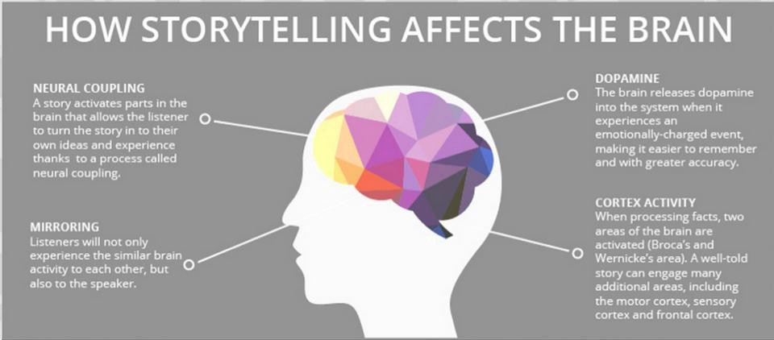
Storytelling: The power of good storytelling
It gets people emotionally connected (story, characters, others).
It is a powerful tool for transmitting a message, knowledge and meaning (i.e., learning).
It makes people focussed, involved and engaged.
It motivates and inspires people.
It stimulates imagination.
Source: https://blog.micro-documentaries.com/2015/07/quick-shares-the-science-of-storytelling/

Slide 34
Storytelling: Main elements of a story
Character(s)
(who)
Fantasy characters / Important people in History
The tourist in the experience (!)
Setting
(where and when)
Imaginary worlds / The real world
The stage of the experience
The trigger of the plot
The motto/theme of the experience
Conflict
Message
(why)
“Moral of the story”
Memorability and personal meaning
Notes:
Characters make stories come alive. Each character has a role and a purpose, while the main character is vital to create an emotional connection with the audience.
The setting is the background and the stage of the story, locating it in time and space. The setting and its description (detailed or broadly described) serves to set the mood and the ambience of the story.
The conflict (and its obstacles) is what makes people engaged on the story, building tensions and suspense. The challenge that is presented to the main character drives the journey. It must be difficult to overcome, demanding the character’s transformation.
The message is the main idea underlying all the narrative, which is usually enveloped in deep meaning. It is the concept that people should be taking away from the story. Therefore, it must be memorable and strong, leaving its mark on the listeners’ minds.

Slide 35
Storytelling: Crafting the story
Plot (what):
The connected events that create the narrative
The tasks, events and activities of the experience
Plot points:
Events with direct impact on the story
Key activities that deeply mark the experience
Structure (how):
Organization of the events in the story
The itinerary of the experience
Notes:
The plot is a series of connected events that create the narrative, having an underlying cause-effect process that leads to critical events.
Plot points are events of the plot that directly impact on how the story unfolds. These events establish turning points where the story or the character move in a different direction.
The structure is the organization of the events in the story, defining their order, how they are presented and how they connect different parts of the story. The structure serves to identify the moments for presenting the plot, building up the tension, peaking the tension and resolving the conflict.

Slide 36
Storytelling: Typical Three-Act Structure
Beginning
0 - 25%
Middle
25% - 75%
End
75% - 100%
Introduction:
context
characters
conflict (plot point 1)
Rising action:
action: trying to solve the conflict
action → more conflict → more action…
acknowledgement of the need to change (plot point 2)
Resolution:
climax (peak of tension)
falling action
catharsis
Notes:
There are many different story structures. Choosing which structure to use depends on the goal of the story and on the message to be transmitted. The most basic is the Three-Act Structure, which can be quite useful for short stories and content marketing. The Hero’s Journey (or monomyth) structure can be an interesting way for outlining an experience.
Beginning: setting the context of the story and presenting the extraordinary moment that changes the ordinary living.
The characters are introduced. They are described in order to create empathy.
The problem/conflict that drives the story and pushes the main character to the journey is introduced through an inciting incident (catalyst or “call to action”). This plot point marks the transition into act 2.
→ Middle: impossible challenges arise, but someone or something makes everything possible (usually with a cost associated)
The “adventure” begins and the character faces more obstacles (rising action). The conflict grows and gets more detailed.
The character acknowledges the need to transform to overcome the conflict.
End: the conflict is solved (for better or for worse)
The character faces the roots of the problem and is placed before the “final crisis” of the story.
The moment of peak tension (climax) takes place and the fundamental premise of the story is tested.
Finally, the conflict is resolved and the effects that it has on the characters is disclosed. All the elements of the story come together and the full message becomes clear.

Slide 37
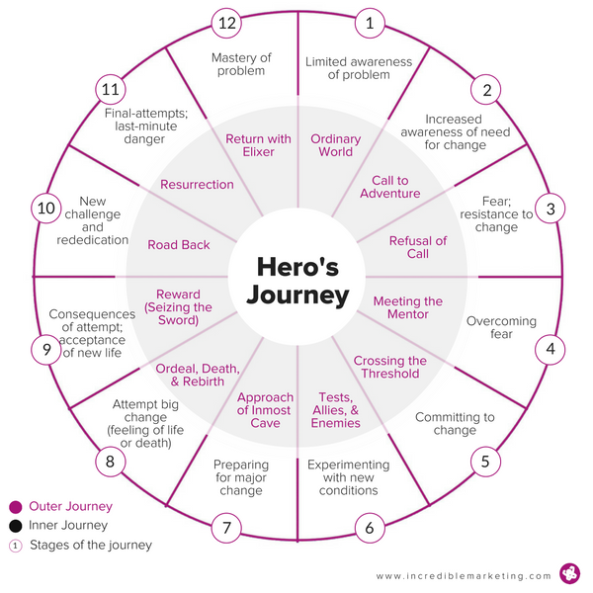
Storytelling: The Hero’s Journey
Great for framing transformational travel.
It resembles a “rite of passage”.
Strengthens the tourist’s personal narrative.
Places the tourist in the role of the hero.
May originate excellent material for:
Scripting the route/experience
Content marketing
Digital word-of-mouth (social media, blogs)
Notes:
The Hero’s Journey (originally created by Joseph Campbell) is a classic story structure that can be used to create powerful and meaningful experiences for transformational travellers and “staging” their rite of passage into a new personal condition.
In this type of narrative the character (the tourist!) ventures into a different world, faces a (personal) challenge and triumphs by emerging transformed by the experience.
The character leaves the ordinary world… faces a challenge in an extraordinary setting… and triumphs by emerging transformed.
Tourists depart from their home country… embrace an experience in a foreign country… and returns home happy and regenerated.
It has been used as:
a model for creating books and films;
a tool for coaching and clinical psychology;
a journey outline for cancer treatments;
a “script” for content marketing and testimonials;
a framework for travel experiences.

Slide 38
Storytelling: Telling the Story
Know your audience.
Capture the audience right from the start.
Give personality to the characters.
Use your voice carefully.
Control your face.
Use gestures.
Use “visual language”.
Find the appropriate pace.
Create moments of silence.
Cut off unnecessary details.
The Golden Rule
“Show, don’t tell”.
Notes:
Know your audience: You can adjust your language or how the plot unveils and use precise metaphors to make the audience relate with the story, create empathy and have a more accurate understanding of its message.
Capture the audience right from the start: ask a question or make a super statement that hooks the audience. They will want to know the answer: it will force them to focus their attention on the story and on how it develops.
Give personality to the characters: use different accents, speech patterns, different voices and even particular gestures for each character. It will make them come “alive”!
Use your voice carefully: Adjust the tone, the volume and the pace of your voice to each part of the story or to each character: accelerate, aggravate and speak louder to build tension; slow down, be calmer and soften the volume to release the tension.
Control your face: facial expressions are vital to disclose emotions. They should match what you are saying and almost be able to tell the story by themselves in specific moments.
Use gestures: your hands and your body are also important to tell the story, provide a sense of action and movement. But don’t overdue!
Use “visual” language: Vividly describing the setting, the characters and all other elements, using adjectives and sensation engaging words, will stimulate the audience’s imagination, making people more engaged and absorbed.
Find the appropriate pace: finding the proper balance is vital. Don’t make it feel rushed, but don’t take longer than necessary. Play with tension and pauses accordingly
Create moments of silence: pauses are great to make the audience regroup and agitate their mind, but also to build cliffhangers and suspense.
Cut off unnecessary details: Cutting the fat out will make it more fluid and will present the audience exactly what it needs to know. This is a vital task to avoid getting people overwhelmed or bored and keeping their full attention.
The Golden Rule: instead of resorting to passive exposition and provision of information, use a discourse that makes the listener experience the story through sensory details, actions and feelings. It will create a sense of setting and make the story more immersive and engaging, as it makes the listeners active characters of the story, using their imagination to picture what is happening.
Example of “tell”: It was cold and snowy.
Example of “show”: As the snowflakes were gently falling down, she pulled up the collar of her coat and reached for her gloves.

Slide 39
Support Video #4
How To: Tell A Great Story— 5 storytelling tips
https://youtu.be/UE3OufWmnMY

Slide 40
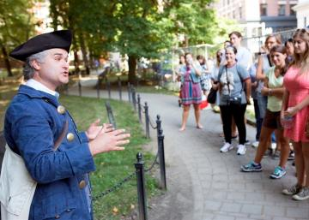
Case Study – The Freedom Trail
«Walk Into History®» and experience more than 250 years of history on Boston’s iconic Freedom Trail®— the 2.5-mile red line leading to 16 nationally significant historic sites, each one an authentic treasure. Preserved and dedicated by the citizens of Boston in 1951, the Freedom Trail is a unique collection of museums, churches, meeting houses, burying grounds, parks, a ship, and historic markers that tell the story of the American Revolution and beyond. Today the Freedom Trail is a world-renowned, signature tourist experience attracting over 4 million people annually to visit Boston's precious 17th-, 18th- , and 19th-century sites.
Follow the footsteps of America’s founding fathers on the Freedom Trail!
Source: www.thefreedomtrail.org
Notes:
The Freedom Trail takes the opportunity to retell the stories that made history in the City of Boston (USA). The richness of the experience creates the right ambience, placing tourists right where the action took place. Beyond buildings, decoration, and props, there are professional players who bring history to life portraying Bostonian characters. The whole experience is programmed in detail, including a numbered sequence of attractions to visit, but it opens up the possibility for tourists to choose their starting point. The lively streets are filled with other interesting projects that have leveraged the Freedom Trail’s storytelling, including shops, educational programmes, lectures and cultural events.

Slide 41
Case Study – Storytelling in Marketing
Thomas Cook: The Man Who Always Wakes Up in a Different Bed
https://youtu.be/Rdt8prgUNYE

Slide 42
4.5.
Mindfulness

Slide 43
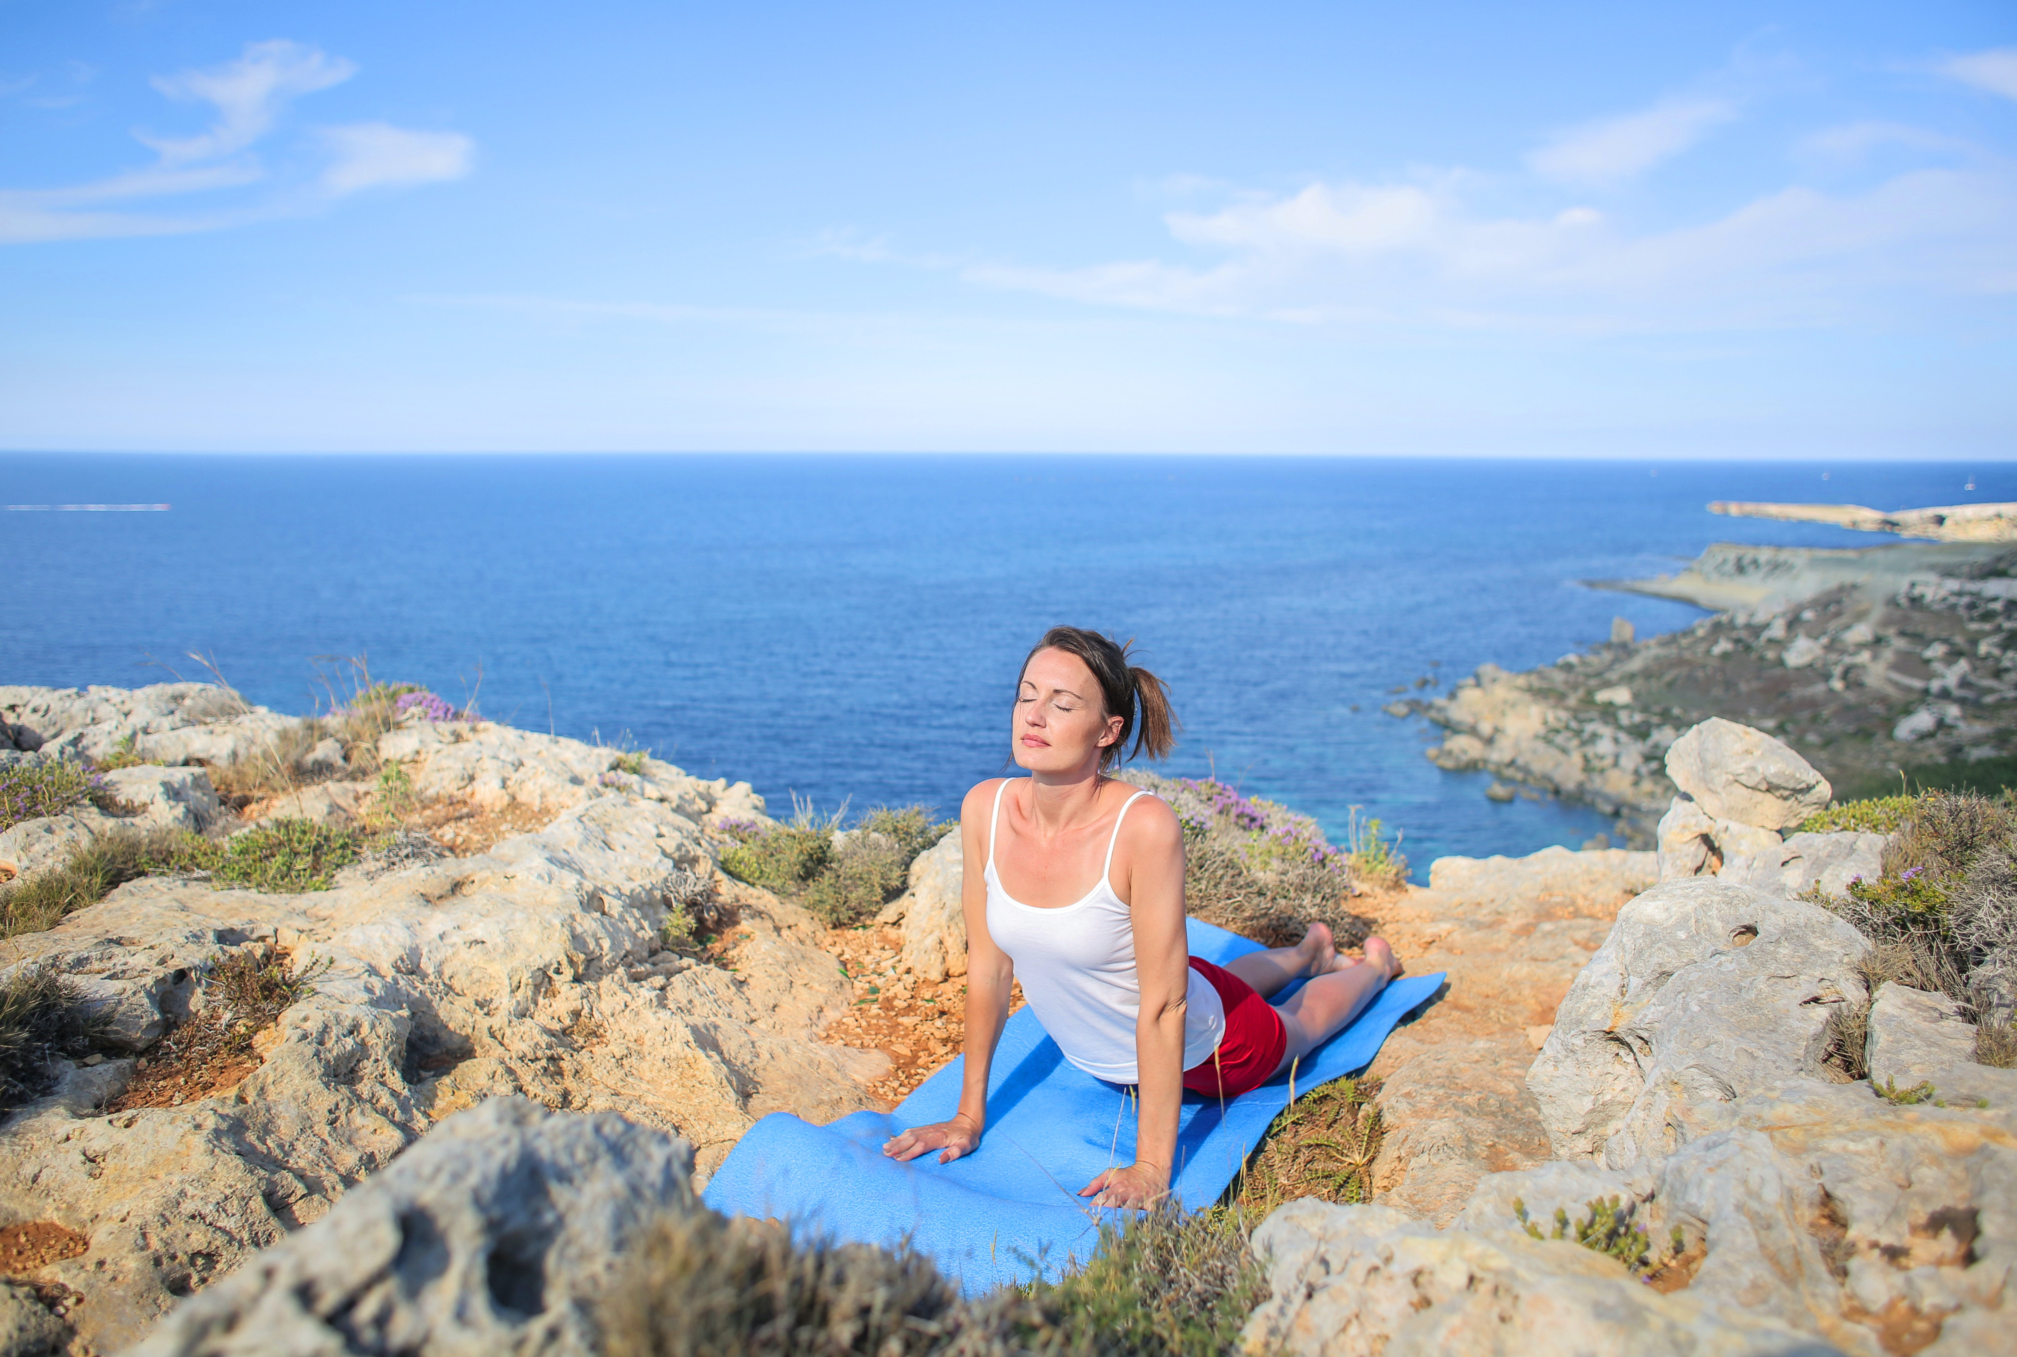
Mindfulness
Definition (Mirriam-Webster online dictionary)
The practice of maintaining a nonjudgmental state of heightened or complete awareness of one's thoughts, emotions, or experiences on a moment-to-moment basis
Three-key attributes:
Focus on the present
Being aware of the inner experience
No judgement
You must be completely awake in the present to enjoy the tea.
Thích Nhất Hạnh
Notes:
Mindfulness has its origins in spiritual and religious eastern traditions. Current western practices are mostly influenced by Buddhist and Hindu traditions. They find particular strong roots in the Buddhist concept of Sati (the first step into enlightenment) and in the practice of yoga (whose origins seem to coincide with Hinduism).
More recently, Jon Kabat-Zinn, a PhD in Molecular Biology, a renown scientist and a professor of Medicine, has explored a new approach mindfulness from a different angle, taking away its original “mystic” and religious connotations, while bring it into modern Ocidental medical practices. He combined Zen Buddhism and yoga practices with scientific findings to create programs that help people cope with stress, anxiety, pain and illness. Among other initiatives, he created the Mindfulness Based Stress Reduction (MBSR) program and funded the Stress Reduction Clinic and the Center for Mindfulness in Medicine, Health Care, and Society at the University of Massachusetts Medical School. He firmly believes in the power of mindfulness to improve quality of life and stress reduction.

Slide 44
Mindfulness
Mindfulness has been associated with sustained positive emotions, recovery from negative emotions, improved social behaviour, and calmness.
Activities that facilitate mindfulness:
Spending time in nature
Walking/hiking in tranquil places
Contemplation
Meditation
Enjoying food
Yoga
Martial arts
Writing a journal

Slide 45
Support Video #5
Your Thoughts are Bubbles - Jon Kabat-Zinn
https://youtu.be/w8Nsa45d0XE
Notes:
https://youtu.be/tyhUezc6lKs

Slide 46
Mindfulness: Two perspectives
Meditative Mindfulness
Socio-cognitive Mindfulness
Theoretical origins
Buddhist philosophy
Western social psychology
Definitions
(awareness)
Awareness of being aware
↘ Being aware of awareness
Conscious awareness
↘ Being aware of contexts and information
Psychological constructs
Purposeful monitoring
↘ Bare attention through senses
Present-oriented awareness
↘ Being in the present
Non-judgemental awareness
↘ Detachment from one’s thoughts
↘ Acceptance of present emotions
Seeking multiple perspectives
↘ Attention to the setting
Active engagement in the present
↘ Focus on the present
Awareness of cognitive distinctions
↘ Refinement and questioning
↘ Differentiation of newer experiences
Adapted: (Chen, Scott & Benckendorff, 2017)
Notes:
Summary presented by Chen, Scott & Benckendorff (2017) → full reference: Chen, L., Scott, N., Benckendorff, P. (2017). Mindful tourist experiences: A Buddhist perspective. Annals of Tourism Research, 64, 1-12. doi: https://doi.org/10.1016/j.annals.2017.01.013

Slide 47
Mindfulness: Two perspectives (continued)
Meditative Mindfulness
Socio-cognitive Mindfulness
Processing mode
Meditative processing of experiencing
Cognitive processing of conceptualising
Mental state
Openhearted presence with acceptance
Novelty seeking and alertness
Outcomes (benefits)
Mental health
Relaxation
Goal-oriented learning
Competence
Adapted: (Chen, Scott & Benckendorff, 2017)
“Meditative mindfulness is the awareness that emerges through paying attention on purpose, in the present moment, and non-judgmentally to the unfolding of experience, moment to moment”
Jon Kabat-Zin
Notes:
Summary presented by Chen, Scott & Benckendorff (2017) → full reference: Chen, L., Scott, N., Benckendorff, P. (2017). Mindful tourist experiences: A Buddhist perspective. Annals of Tourism Research, 64, 1-12. doi: https://doi.org/10.1016/j.annals.2017.01.013

Slide 48
Mindfulness: Benefits
Mindfulness meditation
changes the brain
Inhibit:
Focus on the past or future
Planning and organising
Mind wandering and daydreaming
Rumination
Stimulate areas related to:
Focus on the present
Action
Attention during demanding tasks
Awareness of the moment
Reduced rumination and worry
Less stress, anxiety, fear
Avoid the “auto-pilot behaviour”
Fight depression
Increased relaxation, creativity, empathy, confidence
Vivid attention
Clarity of values and life direction
Better memory and learning
Notes:
Mindfulness meditation changes the brain, namely the regions involved in attention, emotion and self-awareness. It simulates the activation of the task-positive network (TPN) of the brain, which competes with the default-mode network (DMN).
Less activation of the DMN → less negative emotional states
More activation of the TPN → more positive emotional states

Slide 49
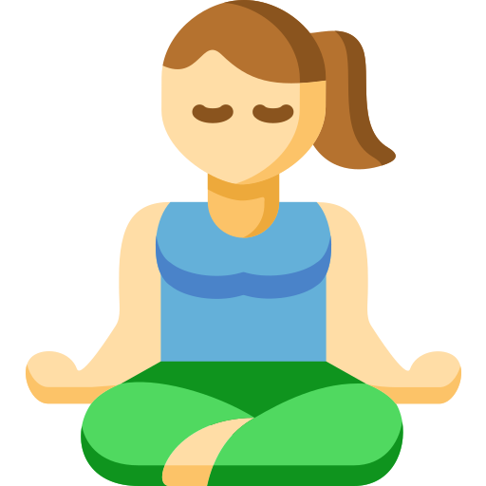
Mindfulness: In practice
Regenerative travel
Transformational travel
Creative tourism
Wellness tourism
Voluntourism
Slow Adventure
Spiritual tourism
Culinary & Wine tourism
Backpacking
Health tourism
Starting the practice…
1. Find time and space for mindfulness meditation
2. Bring attention to the
present
3. Let go any type of
judgement
4. Acknowledge your mind wandering
Notes:
1. Find time and space for mindfulness meditation: it requires dedicated practice and therefore you need to be comfortable and in an appropriate time and space.
2. Bring attention to the present: the goal of mindfulness is to pay attention to the present continuously. This can be facilitated by keeping the mind focused on an “object” of attention (e.g., your breathing; your senses).
3. Let go any type of judgement: non-judgement means to let go the mind’s automatic filtering of the experience (good, bad, neutral) and just feel the moment.
4. Acknowledge your mind wandering: Understand that your mind might start wandering and other thoughts might show up. Just acknowledge this and bring your mind back to the present.
Fits well with many different types of travel and tourism.

Slide 50
Mindfulness: Tourist experiences
Antecedents
Triggers of meditative mindfulness
Episodes
Constructs of tourist
mindful experience
Consequences
Benefits of meditative mindfulness
Travel-induced relaxation
Relaxed state
Aesthetic appreciation
Beauty in wonder
Beauty in impermanence
Beauty in authenticity
Atmosphere of tranquillity
Absence of noise
Absence of normal light
Curiosity
Novel stimuli
Absence of cognitive stimuli
Paying attention to the experience
Sensory awareness
Relaxed attention
Living in the present
Being in the moment
Not worrying about the past or future
A sense of timelessness
Non-elaborative awareness
Bare perception
Non-conceptual insight
Psychological benefits (Mind)
Affective
Mental ease
Psychological wellbeing
Cognitive
Response flexibility
Openness
Retrospective memory
Physical benefits (Body)
Physical relaxation
Physical resilience
Notes:
Framework for meditative mindful tourist experiences presented by Chen, Scott & Benckendorff (2017) → full reference: Chen, L., Scott, N., Benckendorff, P. (2017). Mindful tourist experiences: A Buddhist perspective. Annals of Tourism Research, 64, 1-12. doi: https://doi.org/10.1016/j.annals.2017.01.013
Buddhist conceptualisations of meditative mindfulness have been applied and explored in tourism contexts, through the Experience Economy perspective. They contribute to the liminal nature of travel and the creation of spiritual experiences to tourists who seek to escape their stressful world and calm their minds. These experiences are reported to be deeply imprinted as vivid memories and seem to generate a type of flow.

Slide 51
Mindfulness: Simple activities
1. Meditation
2. Meditative walking/hiking
3. Body Scan
4. Raisin Exercise
5. Contemplation
6. Hearing the Silence
7. Smell of Nature
5. Feel the Breeze
Notes:
Meditation (focus on your breathing and the movements of your stomach)
Meditative walking/hiking (mindfully walking down a trail)
Body scan (becoming aware of the sensations throughout your body)
Raisin Exercise (enjoy food in silence and with your eyes closed)
Contemplation (observe the scenery, like the rippling in a lake)
Hearing the silence (silently hear the sounds of nature)
Smell of nature (quietly smell flowers or feel the smell of the woods)
Feel the breeze (stop to feel the breeze and its effect on your skin)

Slide 52
Support Video #6
Mindfulness in Austria’s Nature
https://youtu.be/PPq6IIIXZlU

Slide 53
Case Studies
Slow Adventuring
WINE BLISS – mindfulness and the MOTNIK wine (Klet Brda, Slovenia)
https://youtu.be/Lh-kSwcA1FU
Minuvida (Azores)
https://youtu.be/2HeHfZOhskM
https://youtu.be/kM_JCRWcjwk

Slide 54
Digging Deeper

Slide 55
Further Reading
How to promote your tourism company through storytelling
[CLICK HERE]
8 Ways To Create Flow According to Mihaly Csikszentmihalyi [CLICK HERE]
10 Powerful Reasons Why People Love to Travel
[CLICK HERE]
﻿Rites of passage in a world that is not flat
[CLICK HERE]
How to Create Your Own Rites of Passage
[CLICK HERE]
Why you must nail storytelling in tourism
[CLICK HERE]
Finding Flow [CLICK HERE]
The Hero’s Journey: A Human Framework for Building Modern Travel Brands
[CLICK HERE]
22 Mindfulness Exercises, Techniques & Activities For Adults
[CLICK HERE]
Getting started with mindfulness
[CLICK HERE]

Slide 56
Assignment
Looking back to the experience you have redesigned based on the Experience Economy, complement it using one, some or all the features below:
How can you create the proper setting for your customers to reach flow?
Can you create a rite of passage for your customers, allowing them to escape into a liminoid experience and build meaningful and memorable moments?
What stories can you add to the experience and how and when will you tell them to create more immersive experiences?
Where does mindfulness fits all this? Is it the core of the experience?

Slide 57
Module Summary
Module IV. Engineering Wellbeing Experiences

Slide 58
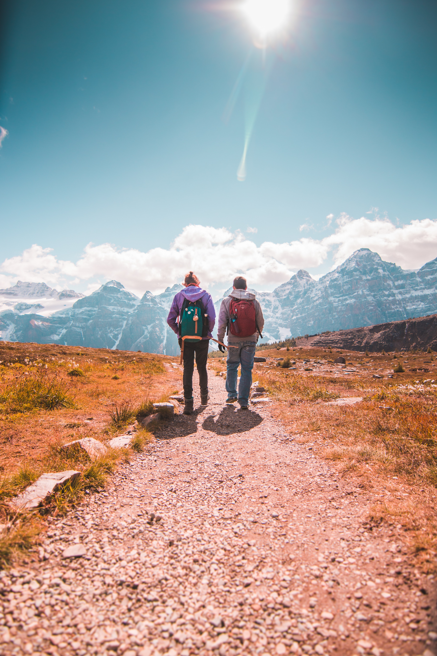
In this module we have…
… recognized tourists’ current need to escape the routine and stress of their everyday lives, looking for relaxation, personal transformation and repurpose life and stronger self-identity.
… explored the nature of the optimal experience and how it connects to pleasure and enjoyment, highlighting flow as a powerful means for achieving wellbeing.

Slide 59
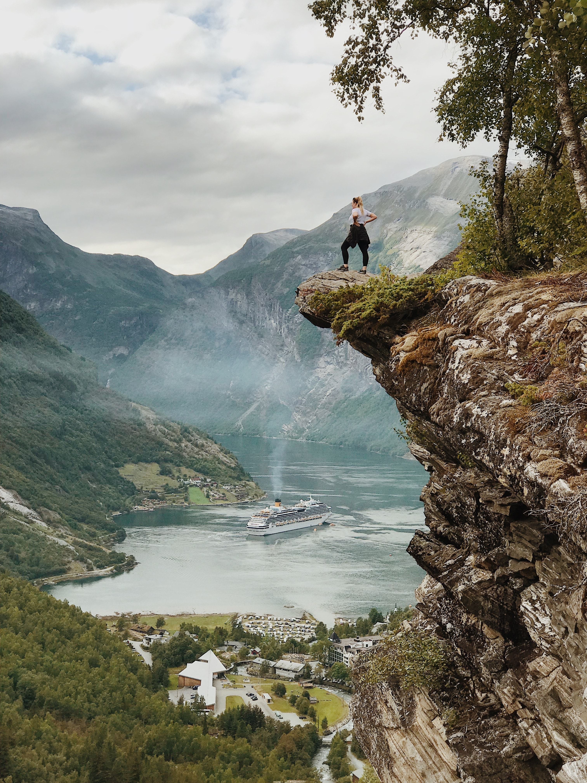
In this module we have…
… understood the concept of liminality and the opportunity to apply the structure underlying rites of passages to tourist experiences in order to create memorable, meaningful and transformative moments.
… acknowledged storytelling as useful tool to create more immersive experiences, transmit powerful messages and establish deep emotional connections between the teller and the customers.

Slide 60
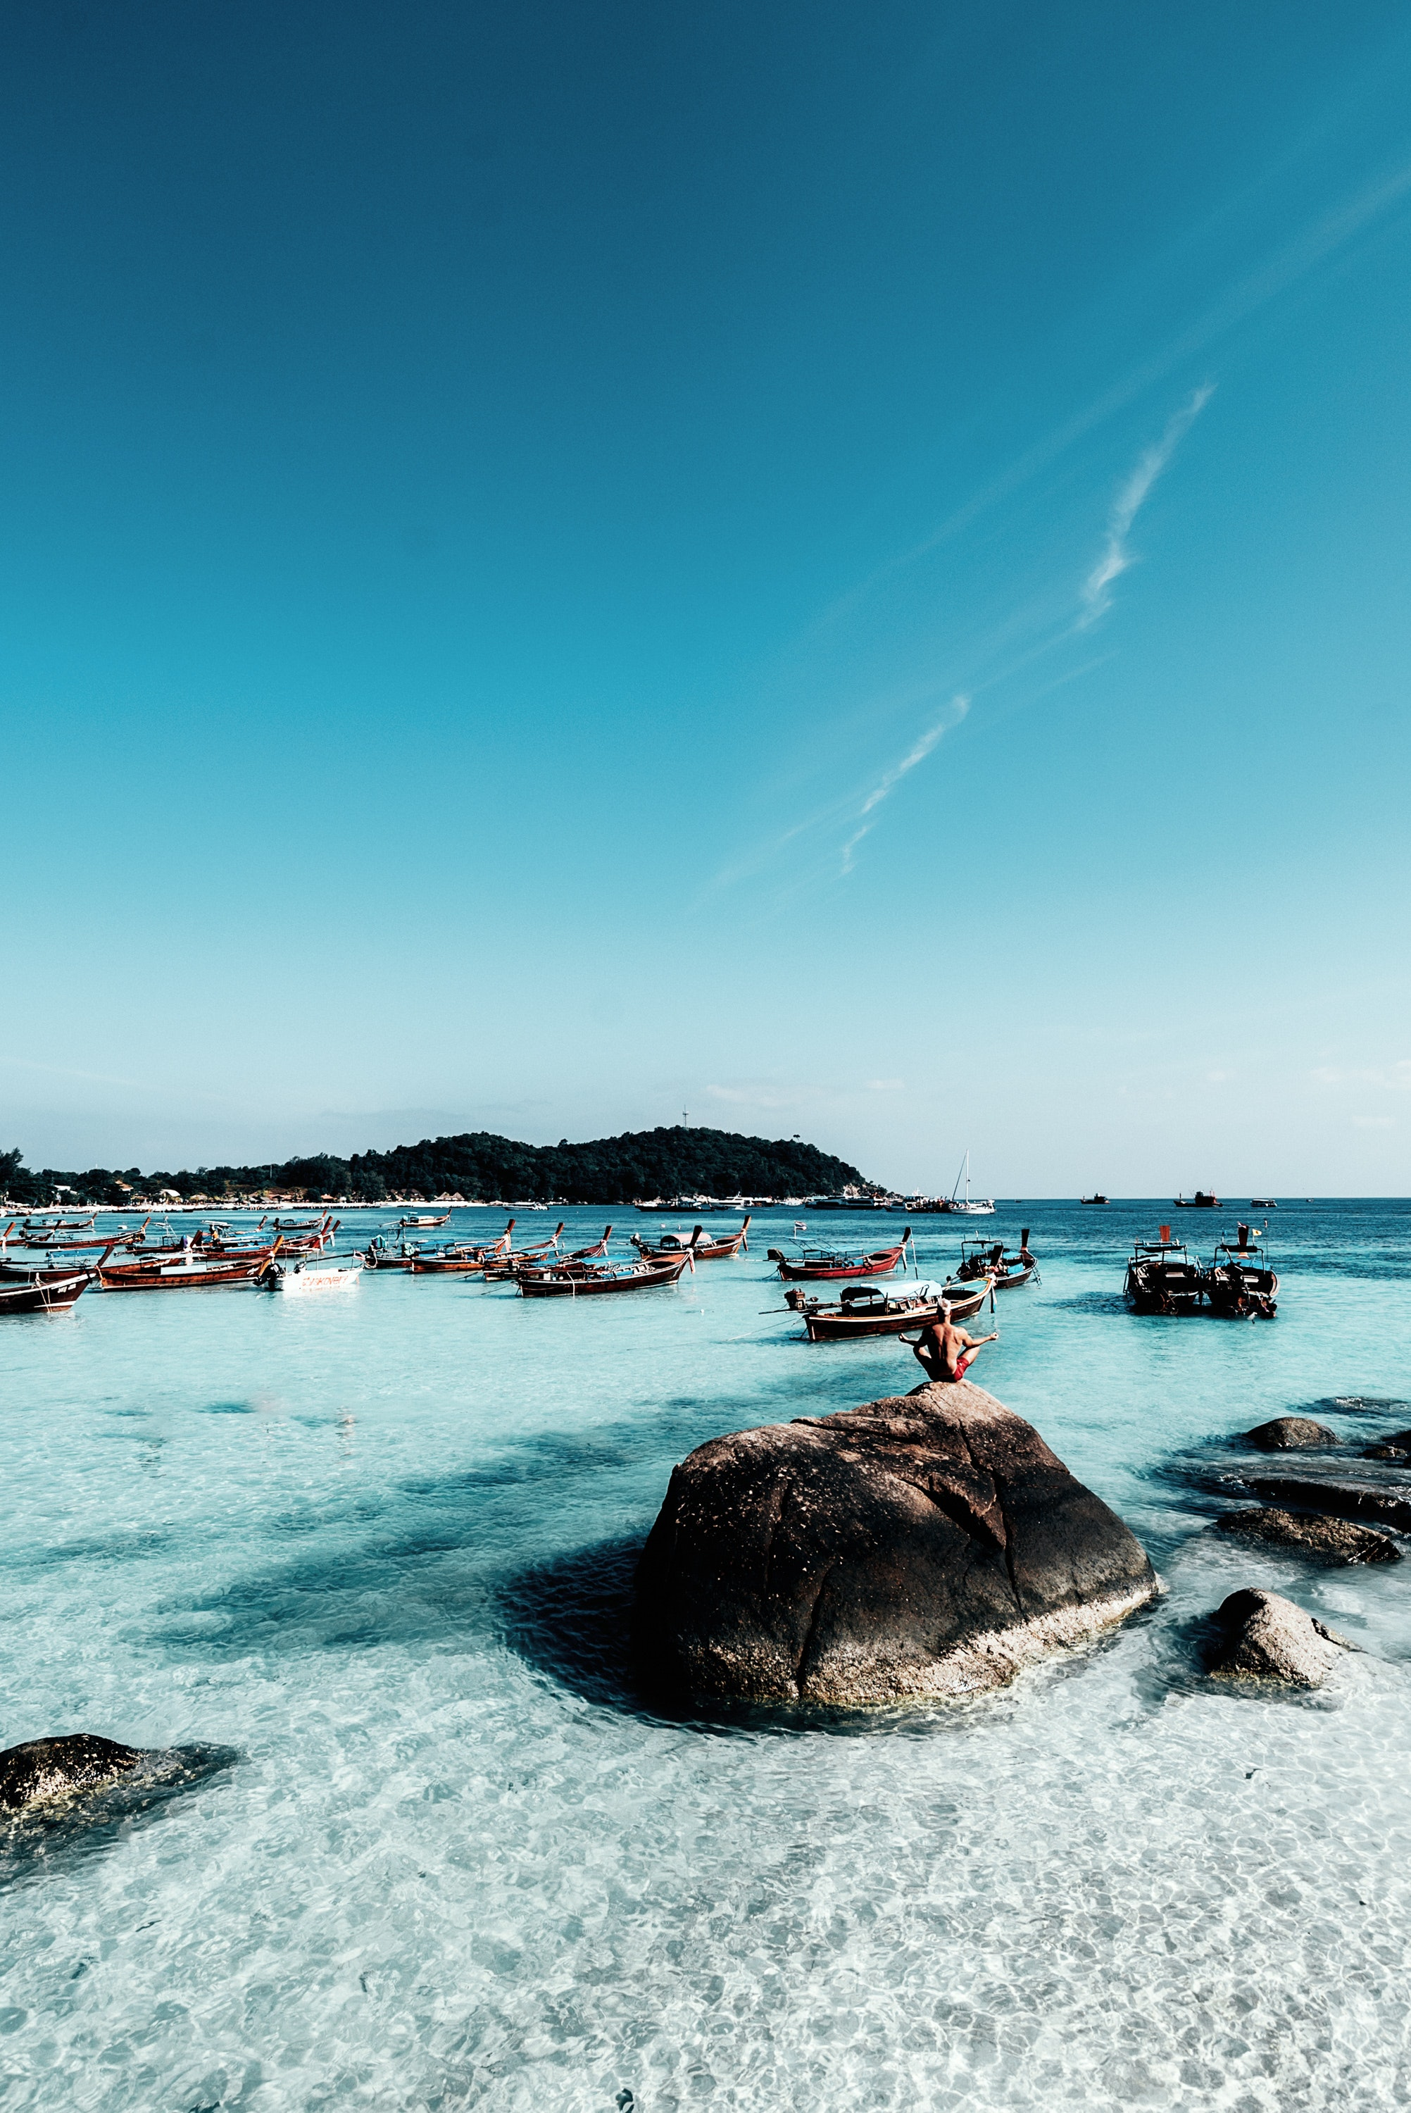
In this module we have…
… explored mindfulness as a means for achieving sustained wellbeing and positive emotions, as well as the non-judgemental enjoyment of the moment that leads to special kind of flow and vivid memories.

Slide 61
The roadmap
I. Introduction to Wellness and Wellbeing
II. Wellbeing in a New Era
III. The Experience Economy
IV. Engineering Wellbeing Experiences
V. Customer Journey Mapping
VI. Storytelling in Culinary Tourism
VII. Setting up a Wellbeing Business
VIII. Branding for Wellbeing
IX. Digital Marketing

Slide 62
Thank You
Any Questions?
www.detourproject.eu
Detour on Facebook
@WellbeingTourismDestinations
#detourdestinations #erasmusplus #detour #wellbeing
Icons: www.flaticon.com

