Slide 1
The Experience Economy
Module 3

Slide 2
“
Welcome to DETOUR’s Wellbeing Tourism online training course.
”

Slide 3
The roadmap
I. Introduction to Wellness and Wellbeing
II. Wellbeing in a New Era
III. The Experience Economy
IV. Engineering Wellbeing Experiences
V. Customer Journey Mapping
VI. Storytelling in Culinary Tourism
VII. Setting up a Wellbeing Business
VIII. Branding for Wellbeing
IX. Digital Marketing

Slide 4
Module Introduction
Tourism is all about experiences, but today travellers are demanding something more. As life in developed economies is increasingly more complex, stressful and unbalanced, people are searching for meaningful moments during their travels that can transform them in some way. Travel has become a form of personal development and growth, a search for the true self-identity and authenticity that is swallowed by the automatic pilot of their frantic living.
This module focuses on the Experience Economy, a concept first presented by Joseph Pine and James Gilmore in 1998. It acknowledges experiences as the fourth economic offering and provides the leads to creating immersive, meaningful and memorable moments.

Slide 5
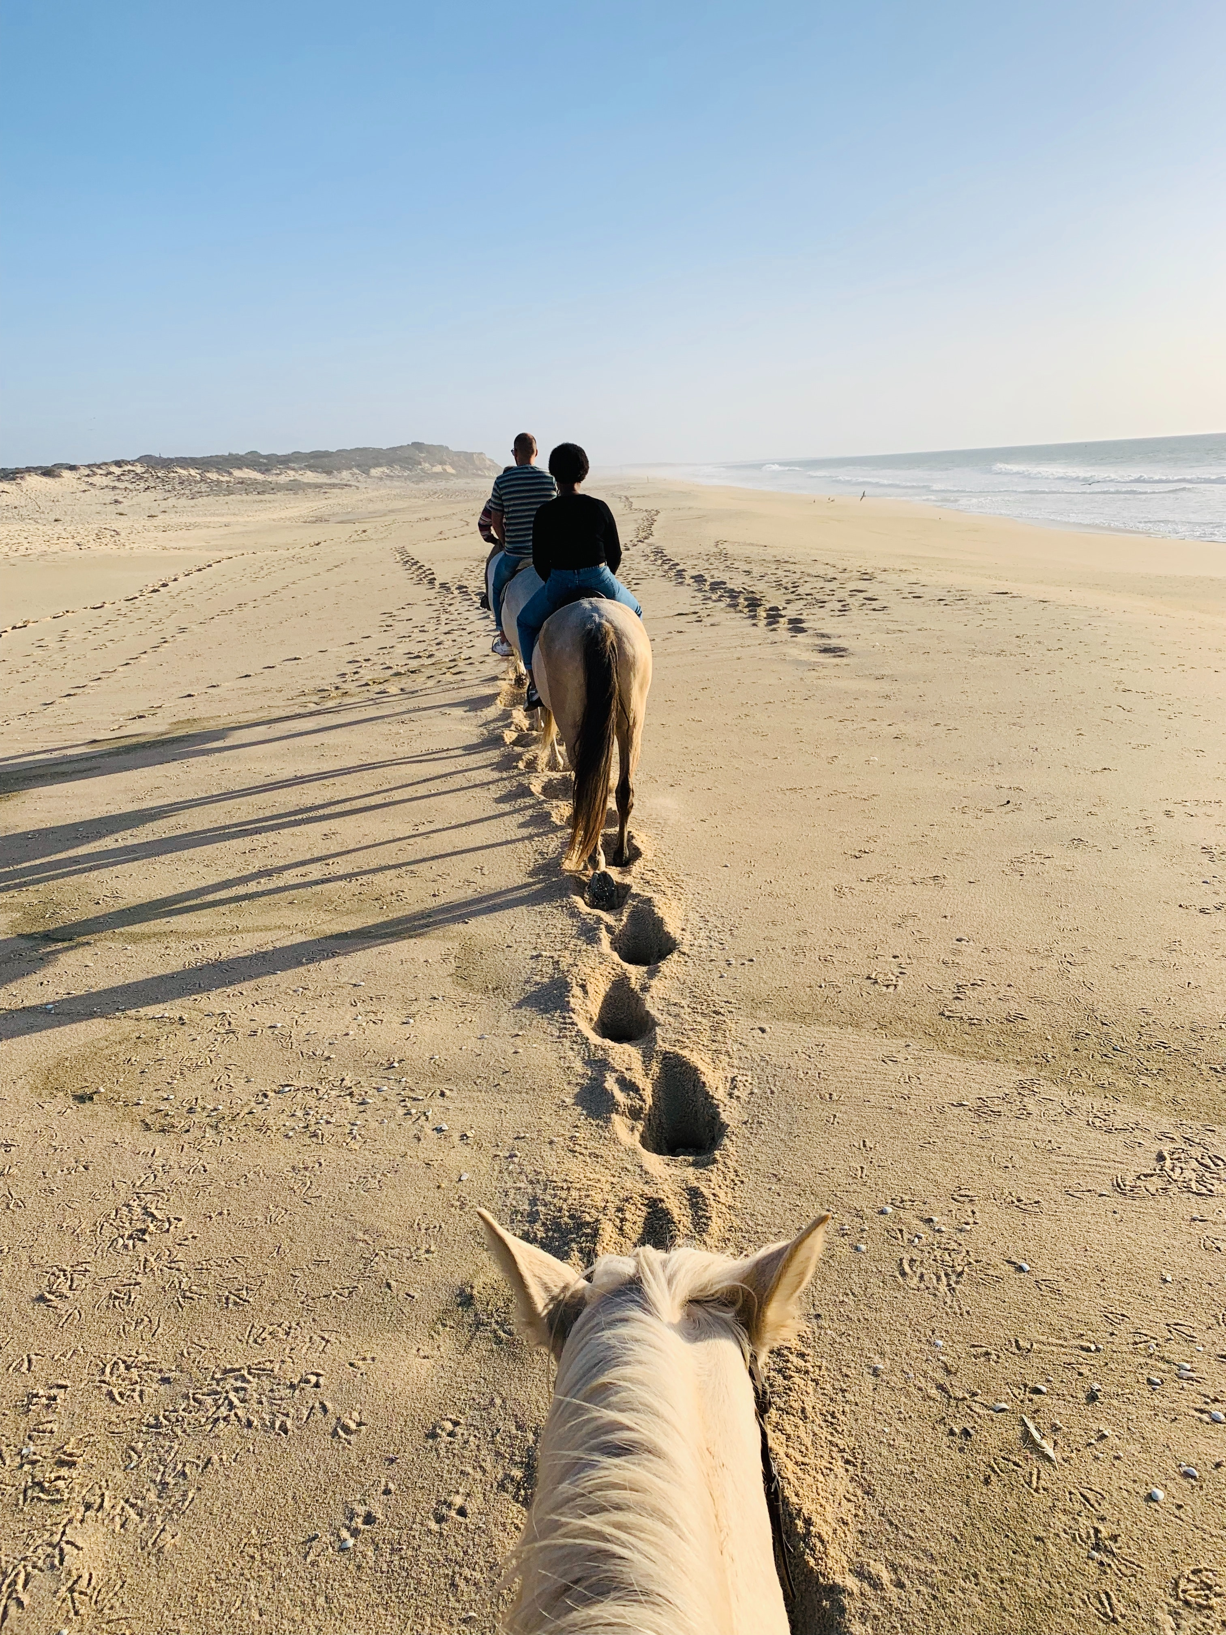
Learning Goal
Learning Goal
To understand the Experience Economy as a construct for creating engaging and memorable experiences that add value to traveling and that can lead to individual transformation.

Slide 6
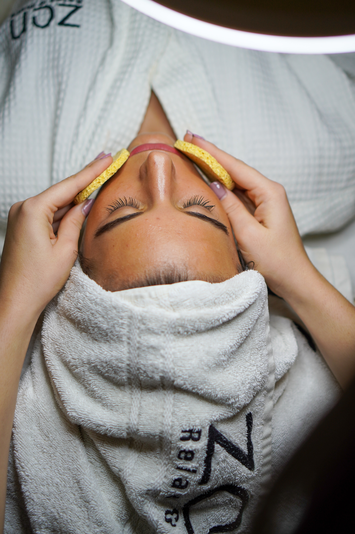
Learning Objectives
To locate experiences in the progression of economic value.
To distinguish the four realms of experience.
To recognize the experience design principles.
To understand the need to go beyond the experience.
To design tourism experiences for the Experience Economy.
Notes:
With recent changes in Society, people, and in particular Millennials, are increasingly more interested in acquiring experiences instead of buying things as part of their wellbeing. Tourism experiences can be especially powerful when engineered using the Experience Economy principles. Hence, the goals for this part of the module are:

Slide 7
Content & Resources
Content
3.1. The Value of Experiences
3.2. Four Realms of Experiences
3.3. Experience Design Principles
3.4. Going Beyond the Experience
Resources
a. 3 support videos
b. 3 case studies (with videos)
c. 7 articles for additional reading
d. 1 assignment

Slide 8
3.1.
The Value of Experiences

Slide 9
The Value of Experiences
Progression of Economic Value
Differentiated
Transformations
Relevant to
Guide
Experiences
Stage
Competitive Position
Services
Needs of Customers
Deliver
Goods
Make
Commodities
Extract
Undifferentiated
Irrelevant to
Market
Pricing
Premium
Notes:
Experiences are seen as the fourth economic offering in the progression of economic value, after commodities, good and services. Each successive offering greatly increases in value and incorporates the preceding economic offerings. Therefore, experiences are more valuable than services, but they comprise services when they are provided. Transformations are the ultimate economic offering, which are afforded by experiences.

Slide 10
The Value of Experiences
Example:
Initially, birthday cakes were baked from scratch (by a family member) using commodities (sugar, butter, eggs, milk, flour, etc.), which would cost less than 30 cents. After that, cakes were baked using mainly goods, like packaged cake mixes that could be bought for around 3,00 €. Then, local bakeries and supermarkets created the possibility of supplying freshly baked (and customizable) cakes, and families stopped baking. It would cost them around 30,00 €. More recently, many families began outsourcing the entire party, including the cake, paying 300,00 € or more.

Slide 11
Economic Distinctions
Economic offering | Commodities | Goods | Services | Experiences | Transformations
Economy | Agrarian | Industrial | Service | Experience | Transformation
Economic function | Extract | Make | Deliver | Stage | Guide
Nature of offering | Fungible | Tangible | Intangible | Memorable | Effectual
Key attribute | Natural | Standardized | Customized | Personal | Individual
Method of supply | Stored in bulk | Inventoried after production | Delivered on demand | Revealed over a duration | Sustained through time
Seller | Trader | Manufacturer | Provider | Stager | Elicitor
Buyer | Market | Customer | Client | Guest | Aspirant
Factors of demand | Characteristics | Features | Benefits | Sensations | Traits
Coffee beans
Packaged Roasted Coffee Beans
Cup of hot coffee
Ambience surrounding a cup of hot coffee
Coffee brings creativity and romantism to life
0,02 €/cup
0,30 €/cup
1,00 €/cup
5,00 €/cup
??? €/cup

Slide 12
Support Video #1
The Experience Economy: Riding a rising tide
https://youtu.be/N0mfjXPUr6c

Slide 13
3.2.
Four Realms of Experience

Slide 14
Four Realms of Experience
Bring the experience into the mind from a distance
Absorption
Customers personally affect or influence the performance
Entertainment
‘Being entertained’
Education
‘Learning something new’
Optimal
Experience
Effects
Passive Participation
Active Participation
Esthetics
‘Indulged in environments’
Escapism
‘Diverging to a new self’
Customers do not directly affect of influence the performance
Becoming physically (or virtually) part of the experience
Immersion
Notes:
Staging experiences is about engaging customers. It can be achieved by combining the level of guest participation (passive – active) and the kind of connection (or environmental relationship) that unites customers with the event or performance (absorption – immersion). The combination between these two features generates four possible realms of experience: Entertainment, Education, Esthetics and Escapism.
Enhanced and more compelling experiences are created by combining elements from different realms. The richest experiences bring together aspects and elements from the four realms, creating a distinct sense of place where guest want to spend more time (sweet spot) .

Slide 15
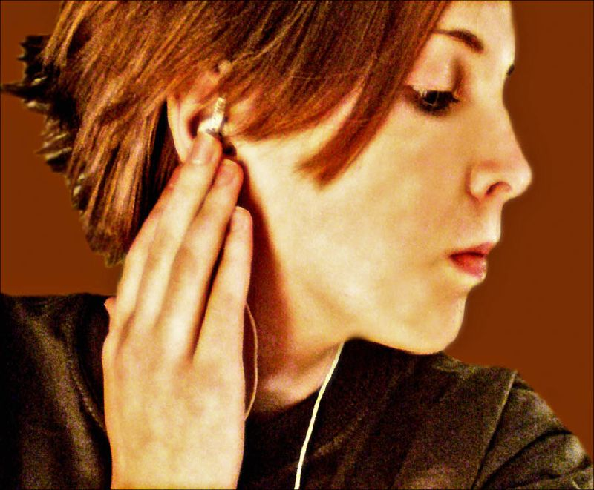
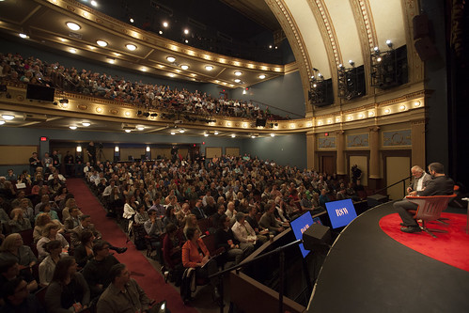
Four Realms of Experience: The Entertainment
“Passive absorption of experiences through the senses”
Examples
Listening to music
Watching TV
Guest Participation:
Passive
Connection:
Absorption
Viewing a performance
Essence:
Enjoy
Retrieved from: www.photopin.com
Design questions:
What entertainment would help guests “to enjoy” the experience better?
How can the guests’ time be made more fun and more enjoyable?
Notes:
Tourists will be engaged by performances. Shows, cultural events and festivals are important elements for entertaining attendees, while telling jokes and anecdotes can be part of experiences that mix components of other realms of experience (ex.: telling a joke during a mountain hike when stopping for a short resting period). Art, music, cultural heritage, attractions and even some shops are features that leverage the entertainment realm.

Slide 16
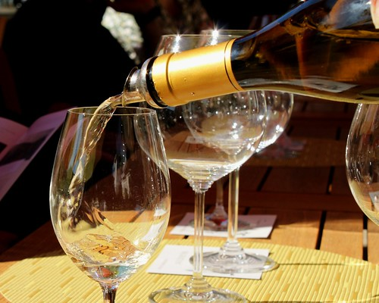
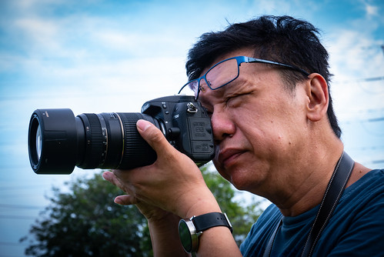
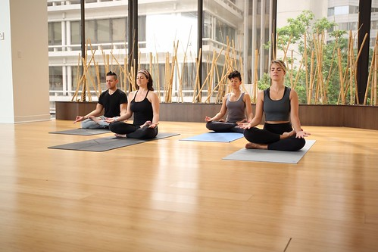
Four Realms of Experience: The Educational
“The guest absorbs the events unfolding before him. […] Education involves the active participation of the individual”
Examples
Wine tasting events
Attending a photography workshop
Guest Participation:
Active
Connection:
Absorption
Taking yoga lessons
Essence:
Learn
Retrieved from: www.photopin.com
Design questions:
What do we want our guests “to learn” from the experiences?
What interaction or activities will help engage them in the exploration of certain knowledge and skills?
Notes:
Tourists will be engaged by performances. Shows, cultural events and festivals are important elements for entertaining attendees, while telling jokes and anecdotes can be part of experiences that mix components of other realms of experience (ex.: telling a joke during a mountain hike when stopping for a short resting period). Art, music, cultural heritage, attractions and even some shops are features that leverage the entertainment realm.

Slide 17
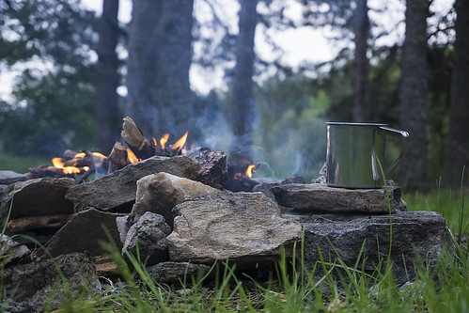
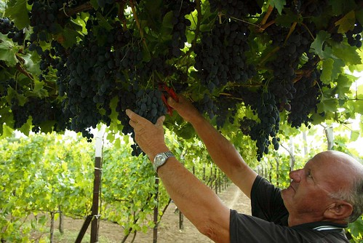
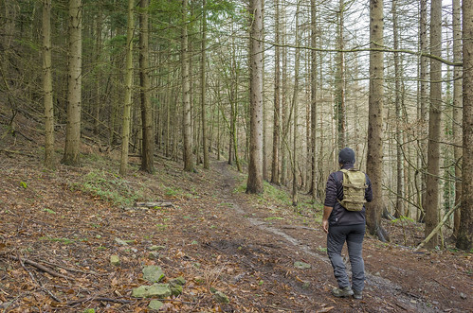
Four Realms of Experience: The Escapist
“Guests of escapist experiences are completely immersed in them as actively involved participants”
Examples
Cooking a meal in a campsite
Harvesting grapes
Guest Participation:
Passive
Connection:
Immersion
Hiking in the woods
Essence:
Go and Do
Retrieved from: www.photopin.com
Design questions:
What should we encourage guests to do if they are to become active participants?
What would cause them “to go” from one sense of reality to another?
Notes:
In the realm of escapism, tourists are seeking activities, moments and feeling that differ from their daily experiences. They are embarking in a journey that allows them to “step away” from their usual settings into new places and activities that are worthy of their time. In doing so, they also look for active engagement in those activities, becoming an actors able to affect their performance in that experience. Slow adventure is predominantly of an escapist nature.

Slide 18
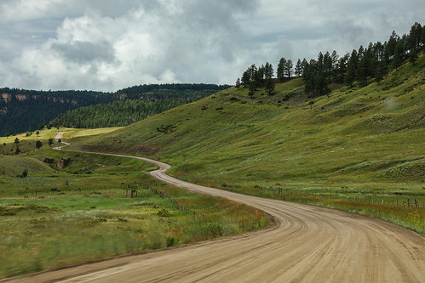
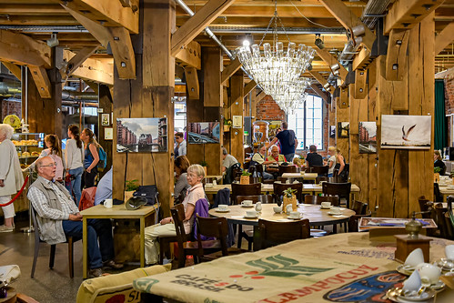
Four Realms of Experience: The Esthetic
“Individuals are immersed in an event or environment but have little or no effect on it”
Examples
Driving through rural roads
Chatting in a garden
Guest Participation:
Passive
Connection:
Immersion
Eating at a themed café
Essence:
Go and Do
Retrieved from: www.photopin.com
Design questions:
What can be done to enhance the esthetic value of the experience?
What would make the guests want to come in, sit down, and just hang out?
Notes:
Esthetic experiences are great for creating positive memories. They result from the atmosphere the guest is experiencing. Therefore, it is important to find ways for creating more inviting and comfortable environments, where people like to be for a while. Tours that include driving or walking through picturesque villages, orchards, standing in sightseeing points or admiring typical architecture are some examples. Hotels, boutique cafés, restaurants and shops have invested is esthetic experiences.

Slide 19
3.3.
Experience Design Principles

Slide 20
Experience Design Principles
THEME-ing (Experience Design Principles):
Theme the Experience
Harmonize Impressions with positive cues
Eliminate Negative cues
Mix in memorabilia
Engage the five senses
“Experience orchestration has become much a part of doing business as product and process design.”

Slide 21
Experience Design Principles
The process for designing compelling experiences:
1
Develop a list of impressions the client should take away from the experience.
2
Find themes and story lines that tie the impressions together in one cohesive narrative.
3
Winnow the impressions to a manageable number.
4
Focus on the animate and inanimate cues that could connote each impression.
5
Meticulously map out the effect each cue will have on the five senses.
6
Add memorabilia to the total mix.
Notes:
Highlight the most meaningful that are at the core of the experience.
Think creatively to search for different perspectives and solutions.
Focus on those impressions that truly denote the cogent theme.
Accentuate the positive and eliminate the negative.
… without overwhelming the guest with too much sensory input.
… extending the experience in the customer’s mind over time.

Slide 22
#1: Theme the Experience
Themes tell stories, even if not intended. Therefore, a theme should be:
acting as the dominant idea, organizing principle, or underlying concept for every element in the experience
and
driving all the design elements and staged events of the experience toward a unified storyline that wholly captivates the customer.
“Theming means scripting a story that would seem incomplete without guests’ engagement in the experience”

Slide 23
#1: Theme the Experience
5 principles for developing compelling and captivating themes:
1) Create a reality different from everyday to establish a sense of place and alter the guests’ sense of reality.
2) Alter the guests’ sense of reality by affecting the experience of space (e.g., layout, decoration, design), matter (e.g., alternative sizes, shapes, substance of things that work together to enhance the experience) and time (e.g., altered sense of the future, journey through time, manipulation of the past, special dates and eras).

Slide 24
#1: Theme the Experience
5 principles for developing compelling and captivating themes:
3) Use engaging storytelling as the vehicle to script themes and unveil its story, integrating space, matter and time into a cohesive realistic whole.
4) Create multiple places within a place to strengthen themes.
5) Choose appropriate themes that fit the character of the enterprise staging the experience.

Slide 25
#2: Harmonize Impressions with Positive Cues
Impressions: The “takeaways” from the experience.
What do customers should have topmost in their minds when they leave the experience?
How should guests be describing the experience?
Cues: Signals found in the environment or in the behaviour of workers, that create a set of impressions.
Enhance the experience
Support the theme
Sustain impressions
“The cues trigger impressions that fulfil the theme in the customer’s mind (…). Unplanned or inconsistent visual or aural cues can leave the customer confused or lost”

Slide 26
#2: Harmonize Impressions with Positive Cues
Types of Cues
Mechanics (inanimate): Hints or signals generated by things that stimulate the senses (sights, smells, tastes, sounds, and textures).
Examples: Landscaping; graphics; scents; recorded music; handrail surfaces.
Humanics (animate): Hints or signals that emanate from people. They are the basis of scripted interactions (or the choreography of desired behaviours) that employees should be carrying out when encountering customers.
Examples: smiling; having fun; using interjections like Yeeehaaa!

Slide 27
#3: Eliminate Negative Cues
Minor cues can impair any experience and their accumulation will have a deep impact in the impression caused on the customers’ mind.
The experience should be as seamless as it can be, finding the right balance for harmonizing cues, messages and stimuli.
“Ensuring the integrity of the experience requires more than layering on positive cues. Experience stagers must also eliminate anything that detracts from fulfilling the theme”
Notes:
Each experience need to be carefully prepared.
Depending on the experience, the slightest negative suggestion might cause devastating effects (e.g., mobile phone is constantly vibrating on a table during a mindfulness session).

Slide 28
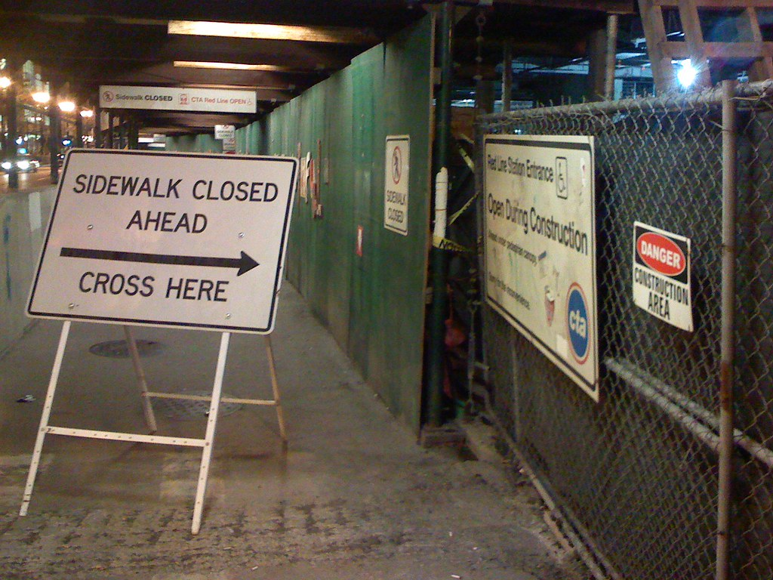
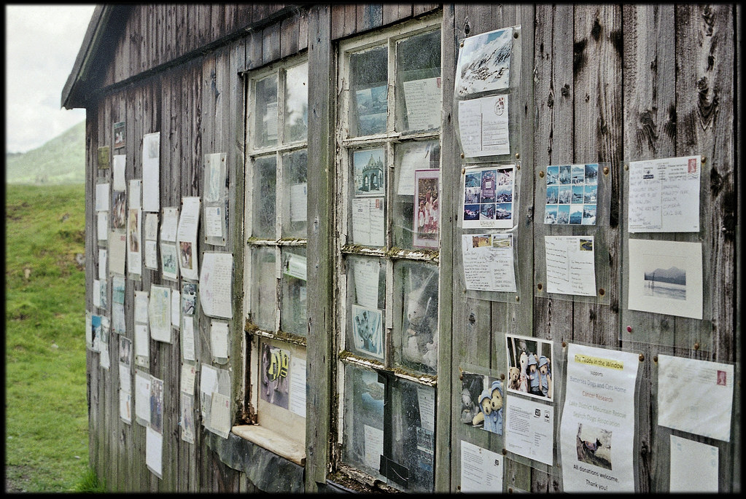
#3: Eliminate Negative Cues
Examples of what to avoid:
Littering the customer experience with meaningless or trivial messages.
Stepping out of the character while onstage.
Neglecting “role-appropriate” clothing and behaviour.
Overservicing (in the name of customer intimacy).
Service industry intrusions.
Cluttering messages and signs.
Interrupting front-desk interactions with customers.
Using negative language (e.g., don’t step on the flowers).
Retrieved from: www.photopin.com

Slide 29
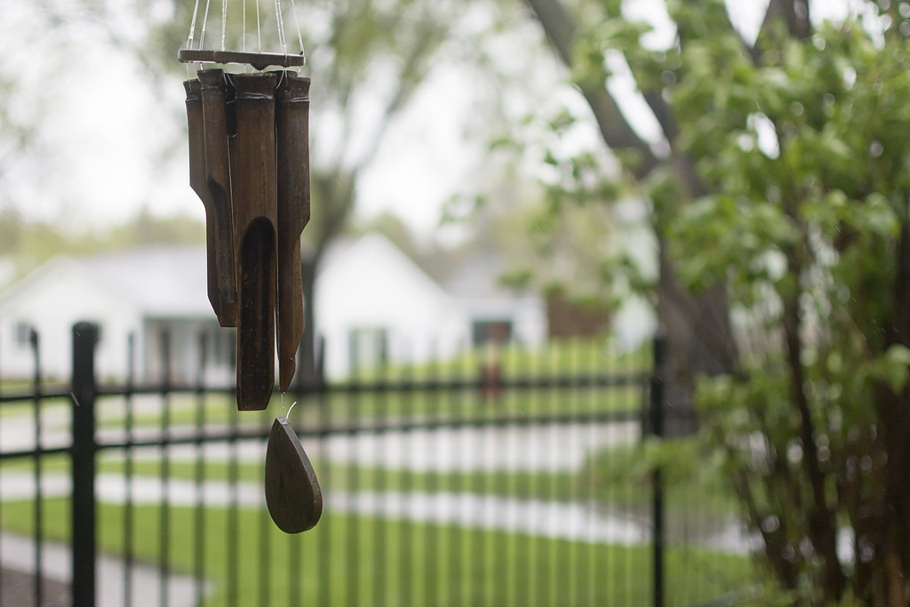
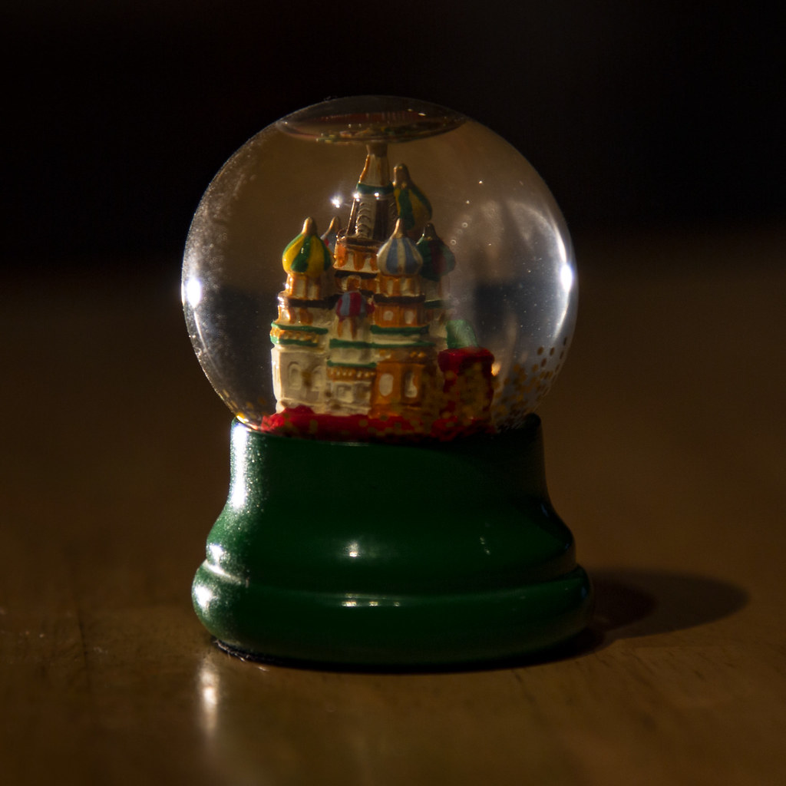
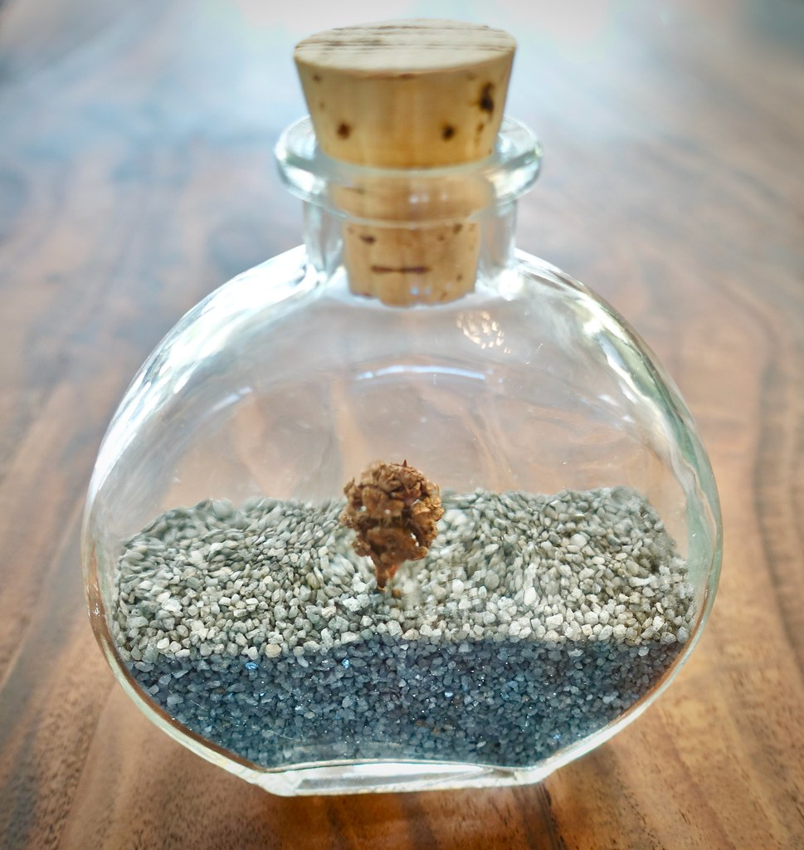
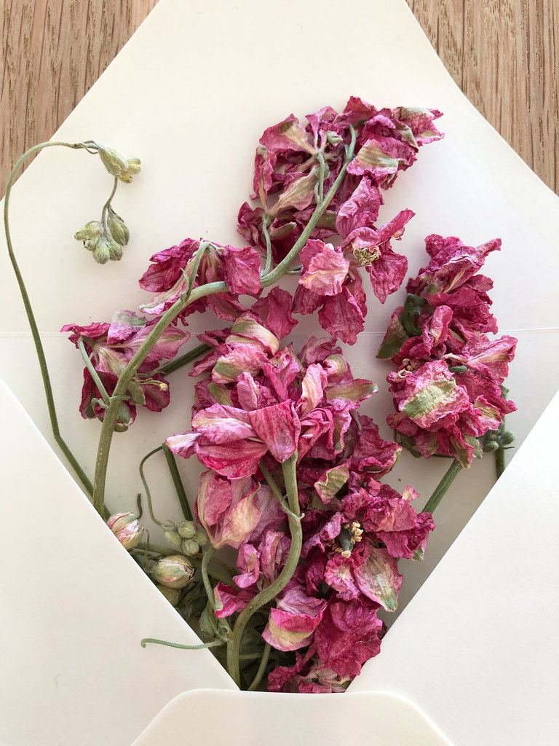
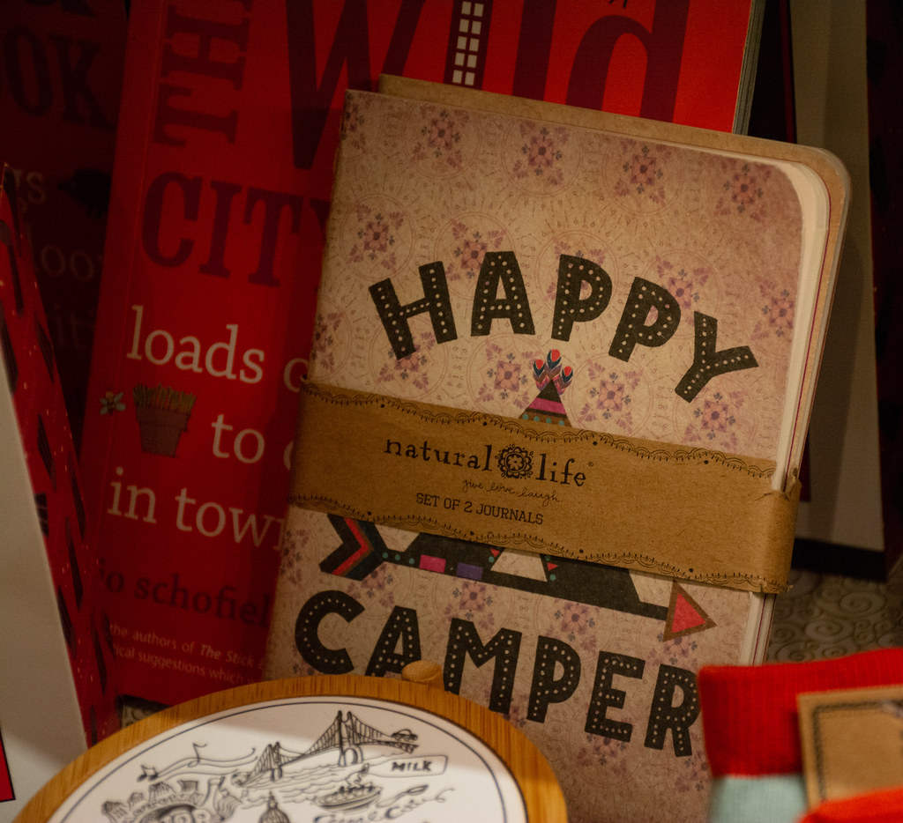
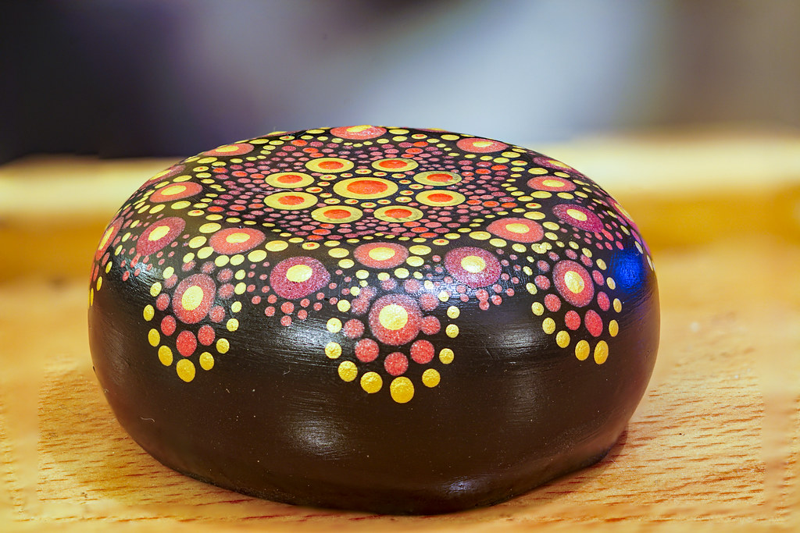
#4: Mix in Memorabilia
“They purchase such memorabilia as tangible artifacts of the experiences they want to remember”
Properly mixing memorabilia is a way of extending the experience far beyond the moment where it ends.
It can create moments where the experience is instantly relived in the guest’s mind.
It is also a means for entice new customers.
Retrieved from: www.photopin.com
Notes:
Memorabilia are among people’s most cherished possessions, to which they attribute much more value than their manufacturing cost. Therefore, customers frequently pay premiums for these items, because the price point functions less as an indicator of the cost of the goods than the of the value the buyer attaches to remembering the experience.

Slide 30
#4: Mix in Memorabilia
Why do people keep memorabilia?
They represent cherished experiences.
We desire to show others what we have experiences.
We (secretly) take joy in creating envy in others.
Approaches to using memorabilia:
Selling items associated with and experience.
Giving away items that are used during the experience.
Giving away items complementary to the experience.
Notes:
Opportunities:
Creatively develop new forms of memorabilia.
Create memorable “signature moments” for mixing memorabilia.
Cross-selling, upselling and impulse purchases

Slide 31
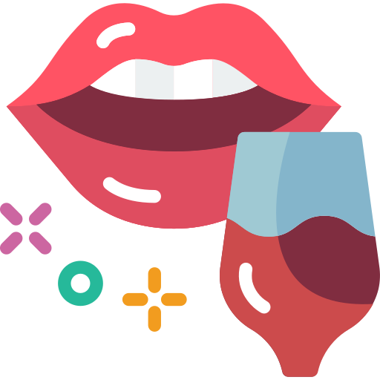
#5: Engage the Five Senses
“The more effectively an experience engages the senses, the more memorable it will be”
Notes:
Sensation stimulation turns the most simple and bland services into engaging experiences. Filling the experience with sensations that make sense is a way to support the theme of the experience and even enhance it, because it produces effects on the mind through the physical senses.

Slide 32
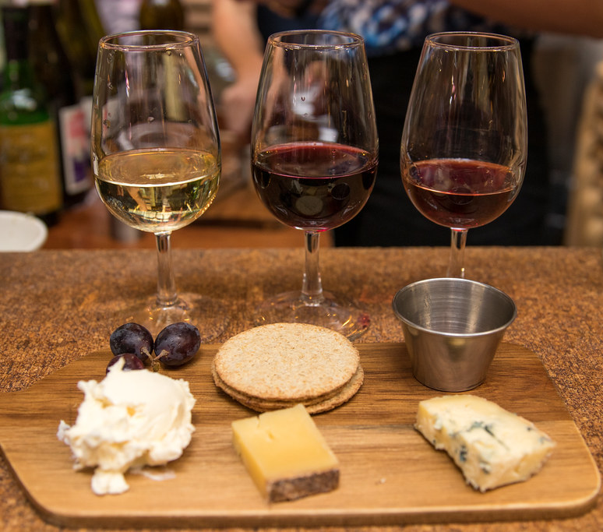
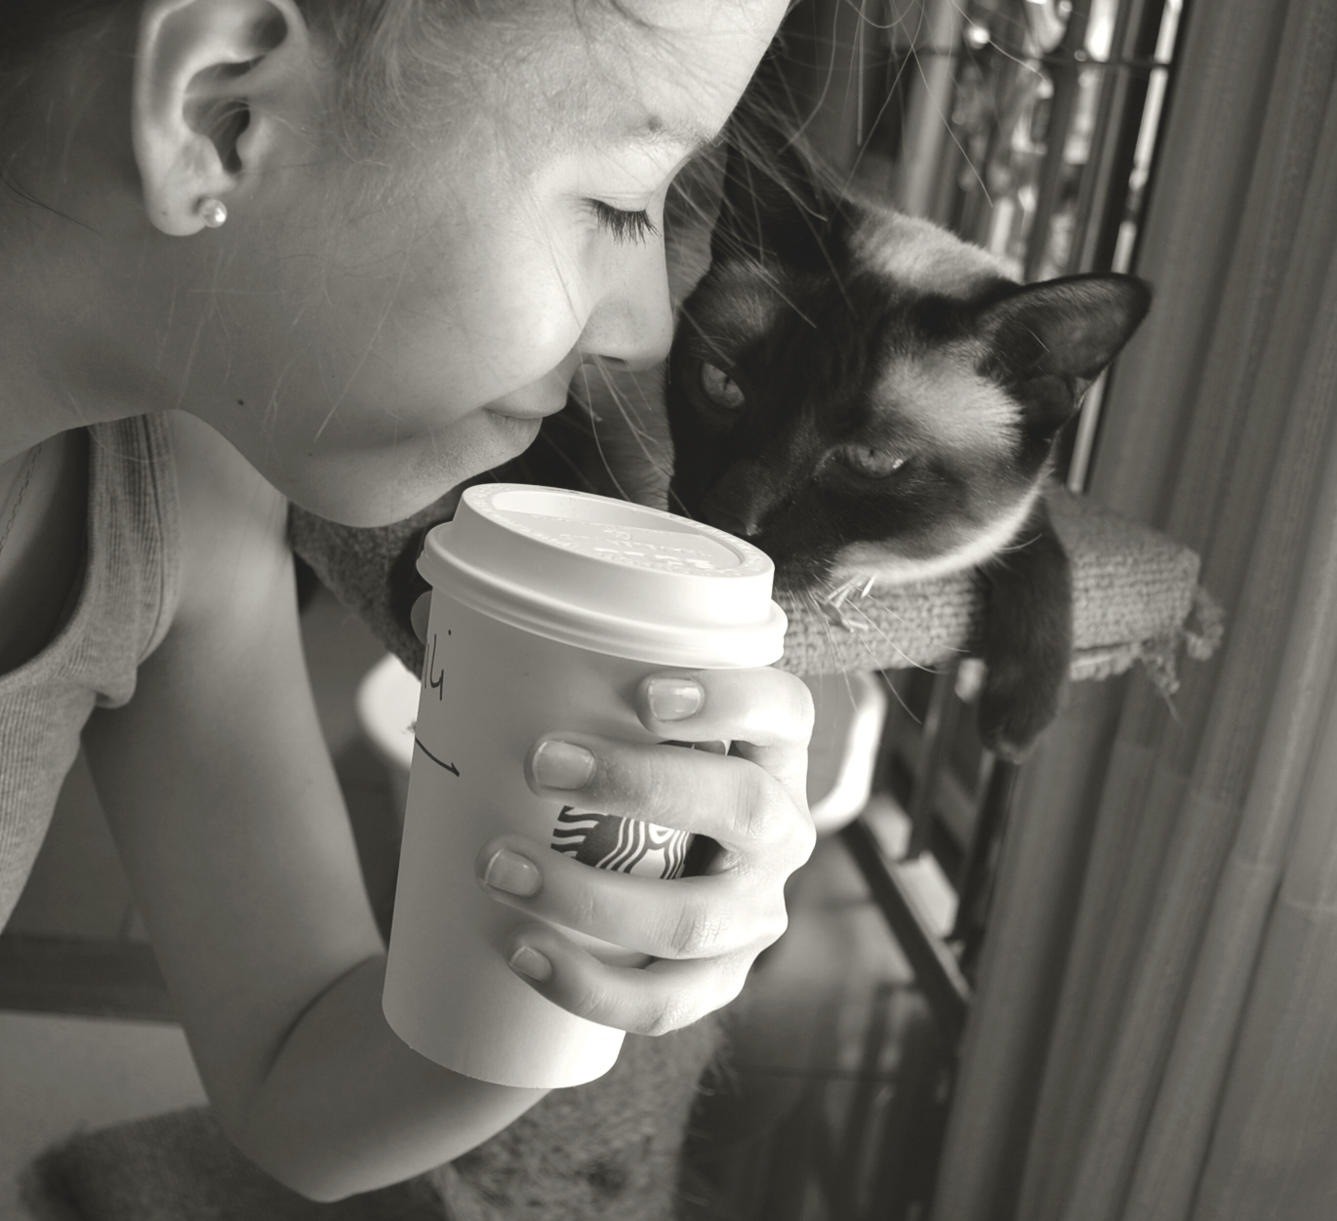
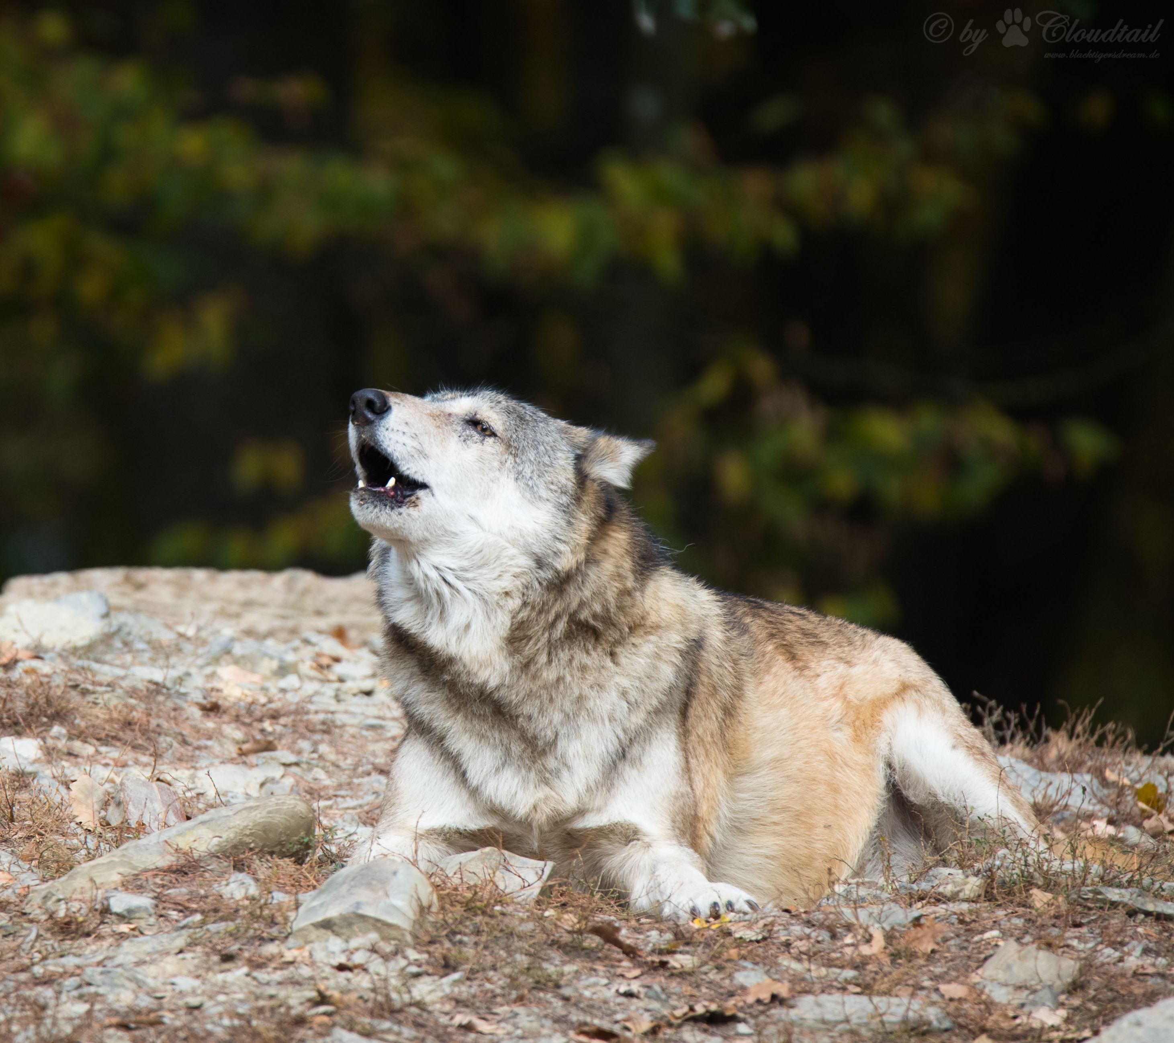
#5: Engage the Five Senses
Retrieved from: www.photopin.com
Taste
Serving food and/or drink is the easiest way to create an engaging experience. It can be at its core, like wine tasting in a cellar, or as a complementary moment, like a cup of hot tea after snowshoeing.
Notes:
Yet, it is important to know how to affect the senses and what the effect is going to be. Not all sensations are good ones and some combinations don’t work. In the same way that some cues are enough to heighten an experience through a single sense, a single sensation can also completely compromise an experience.

Slide 33
#5: Engage the Five Senses
Smell
The smell can really enhance the experience, but it can also trigger powerful memories long after it ends. The smell of hot coffee or freshly baked bread in a supermarket aisles are great examples.
Retrieved from: www.photopin.com
Hearing
Sound is great for setting the mood of the environment (ambience). Relaxing music fill the hotels lobbies, while wild animal sounds can mimic the jungle, rainforests or savannahs.

Slide 34
#5: Engage the Five Senses
Sight
Sight stimulation can be done in several ways. From costumes to photos, from props to smiles. Colourful cakes or colourful displays of fruits and vegetables in a marketplace easily catch ones eye.
Retrieved from: www.photopin.com
Touch
There are incredible opportunities to create stimuli for touch, although it may not seem evident in all situations. Using warm towels in a spa or velvet texture on seats can make the difference.

Slide 35
Support Video #2
Designing Tourism Experiences for Smiles and Delight
https://youtu.be/xGkkUQib_Lw

Slide 36
3.4.
Going Beyond the Experience

Slide 37
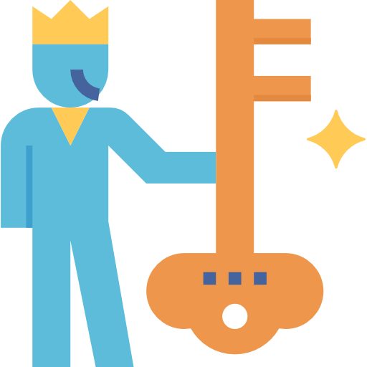
Going Beyond the Experience
The Trap of Commoditization
Avoid through…
Mass
customization
Easy
& Different
Experiences can become commoditized.
Life-Transforming Experiences
“Tourism companies will likewise get into the personal and family transformational business, for as a psychologist Jeffrey A. Kotler points out, «Travel offers you more opportunities to change your life than almost any other human endeavour»”
Notes:
The Trap of Commoditization: When offerings become so similar to one another that they are only distinguished by price, they become commoditized. Therefore, competition is based on price and not on added value features.
Experiences can become commoditized: They can become marginally less enjoyable (in repeating visits) until the guest loses interest.
Customization is a way to avoiding commoditization.
Mass customization: Mass customization is giving everyone exactly what they want but at a price they are willing to pay. It is efficiently serving the customers uniquely.
Easy & Different: Experiences are the easiest economic offering to customize: no experience is equal to the other.
Life-Transforming Experiences: Experiences need to be customized, which will create transformations.

Slide 38
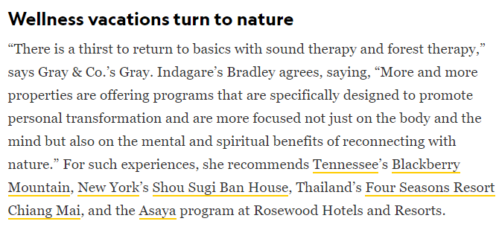
Going Beyond the Experience: Tourism Trends
These are 2020’s top travel trends: ‘microcations’, carbon offsetting, and more
Transformed by Travel: Nine Stories
The Rise of Transformative Travel - Shifting Toward Meaning, Purpose, and Personal Fulfillment
Global Wellness Tourism Economy – November 2018
Research Reveals Adventure Travelers Primarily Motivated by Transformation

Slide 39
Going Beyond the Experience: Guiding Transformations
“All transformations occur within the very being of the customer and so, in the end, must be made by the customer”
Determine
and guide
transformations
Depict and stage experiences
Devise and deliver services
Develop and make goods
Discover and extract commodities
Notes:
The progression of economic value implies that providers also evolve and adjust the way they work in order to satisfy the customers’ needs. Nevertheless, transformations occur at an individual level and people cannot be forced to change. Providers (or transformation elicitors) can, at best, bring about the right situation under which the proper change can occur, meaning staging the right experiences that involve the right services, that involve the right goods, that involve the right commodities.

Slide 40
Going Beyond the Experience: Guiding Transformations
Guiding Transformations
Stage
experience(s)
Diagnose
aspirations
Follow
Through
To what customers aspire?
How can they be guided?
What experience(s) will bring the transformation?
How can guests be changed?
Sustain the transformation through time
Notes:
Guiding transformations means determining exactly the right set of life-transforming experiences required to guide aspirants in achieving their goals. However, guests aspiring for transformations often do not know or cannot articulate their hopes and dreams.

Slide 41
Going Beyond the Experience: Guiding Transformations
“The most engaging life-transforming experiences centre on the sweet spot composed of multiple elements from all realms”
Experiences
Entertainment: can alter our view of the world
Educational: can make us rethink how we fit into the world
Escapist: can boost our personal capabilities and characteristics to new levels
Esthetic: can imbue a sense of wonder, beauty, and appreciation

Slide 42
Support Video #3
Going beyond the experience
https://youtu.be/4B1FQzw1VRA

Slide 43
Case Studies
Inspiring Experiential Travel in Queensland
Creating Experiences Explained (Northern Ireland)
https://youtu.be/uB4RlS46LAs
How to create immersive storytelling experiences
(Yas Abu Dhabi Waterworld – Legends of Arabia)
https://youtu.be/HLy2MZy3Fcg
https://youtu.be/CwLkqILkuSo

Slide 44
Digging Deeper

Slide 45
Further Reading
The rise of the Experience Economy
[CLICK HERE]
‘Transformative travel’ is the industry’s latest twist on making vacations more meaningful
[CLICK HERE]
Welcome to the Experience Economy
[CLICK HERE]
Tapping into the 'Experience' Economy
[CLICK HERE]
The experience economy will not fully recover – consumers will pay to perform in future instead
[CLICK HERE]
NOwnership, No Problem: An Updated Look At Why Millennials Value Experiences Over Owning Things
[CLICK HERE]
Transformational Travel: From Experiences to Transformation
[CLICK HERE]

Slide 46
Assignment
Picking on an existing product from your portfolio (or thinking about a whole new product), analyse it according the Experience Economy concepts:
Is it possible to create a sweet spot where the experience comprises elements from all the four realms?
What is its theme and storyline?
What impressions to you want people to take away from it? What positive cues make it possible? Which negative cues should be eliminated?
Can you mix in memorabilia for memorable moments?
Which sensorial stimuli will the experience provide?

Slide 47
Module Summary
Module III. The Experience Economy

Slide 48
In this module we have…
… acknowledged experiences as the fourth economic offering in the progression of economic value, that increase the value for the customer and represent an opportunity for business competitiveness.
... distinguished the four realms of experience - entertainment, educational, escapist, and esthetic - using guest participation and environmental relationship.

Slide 49
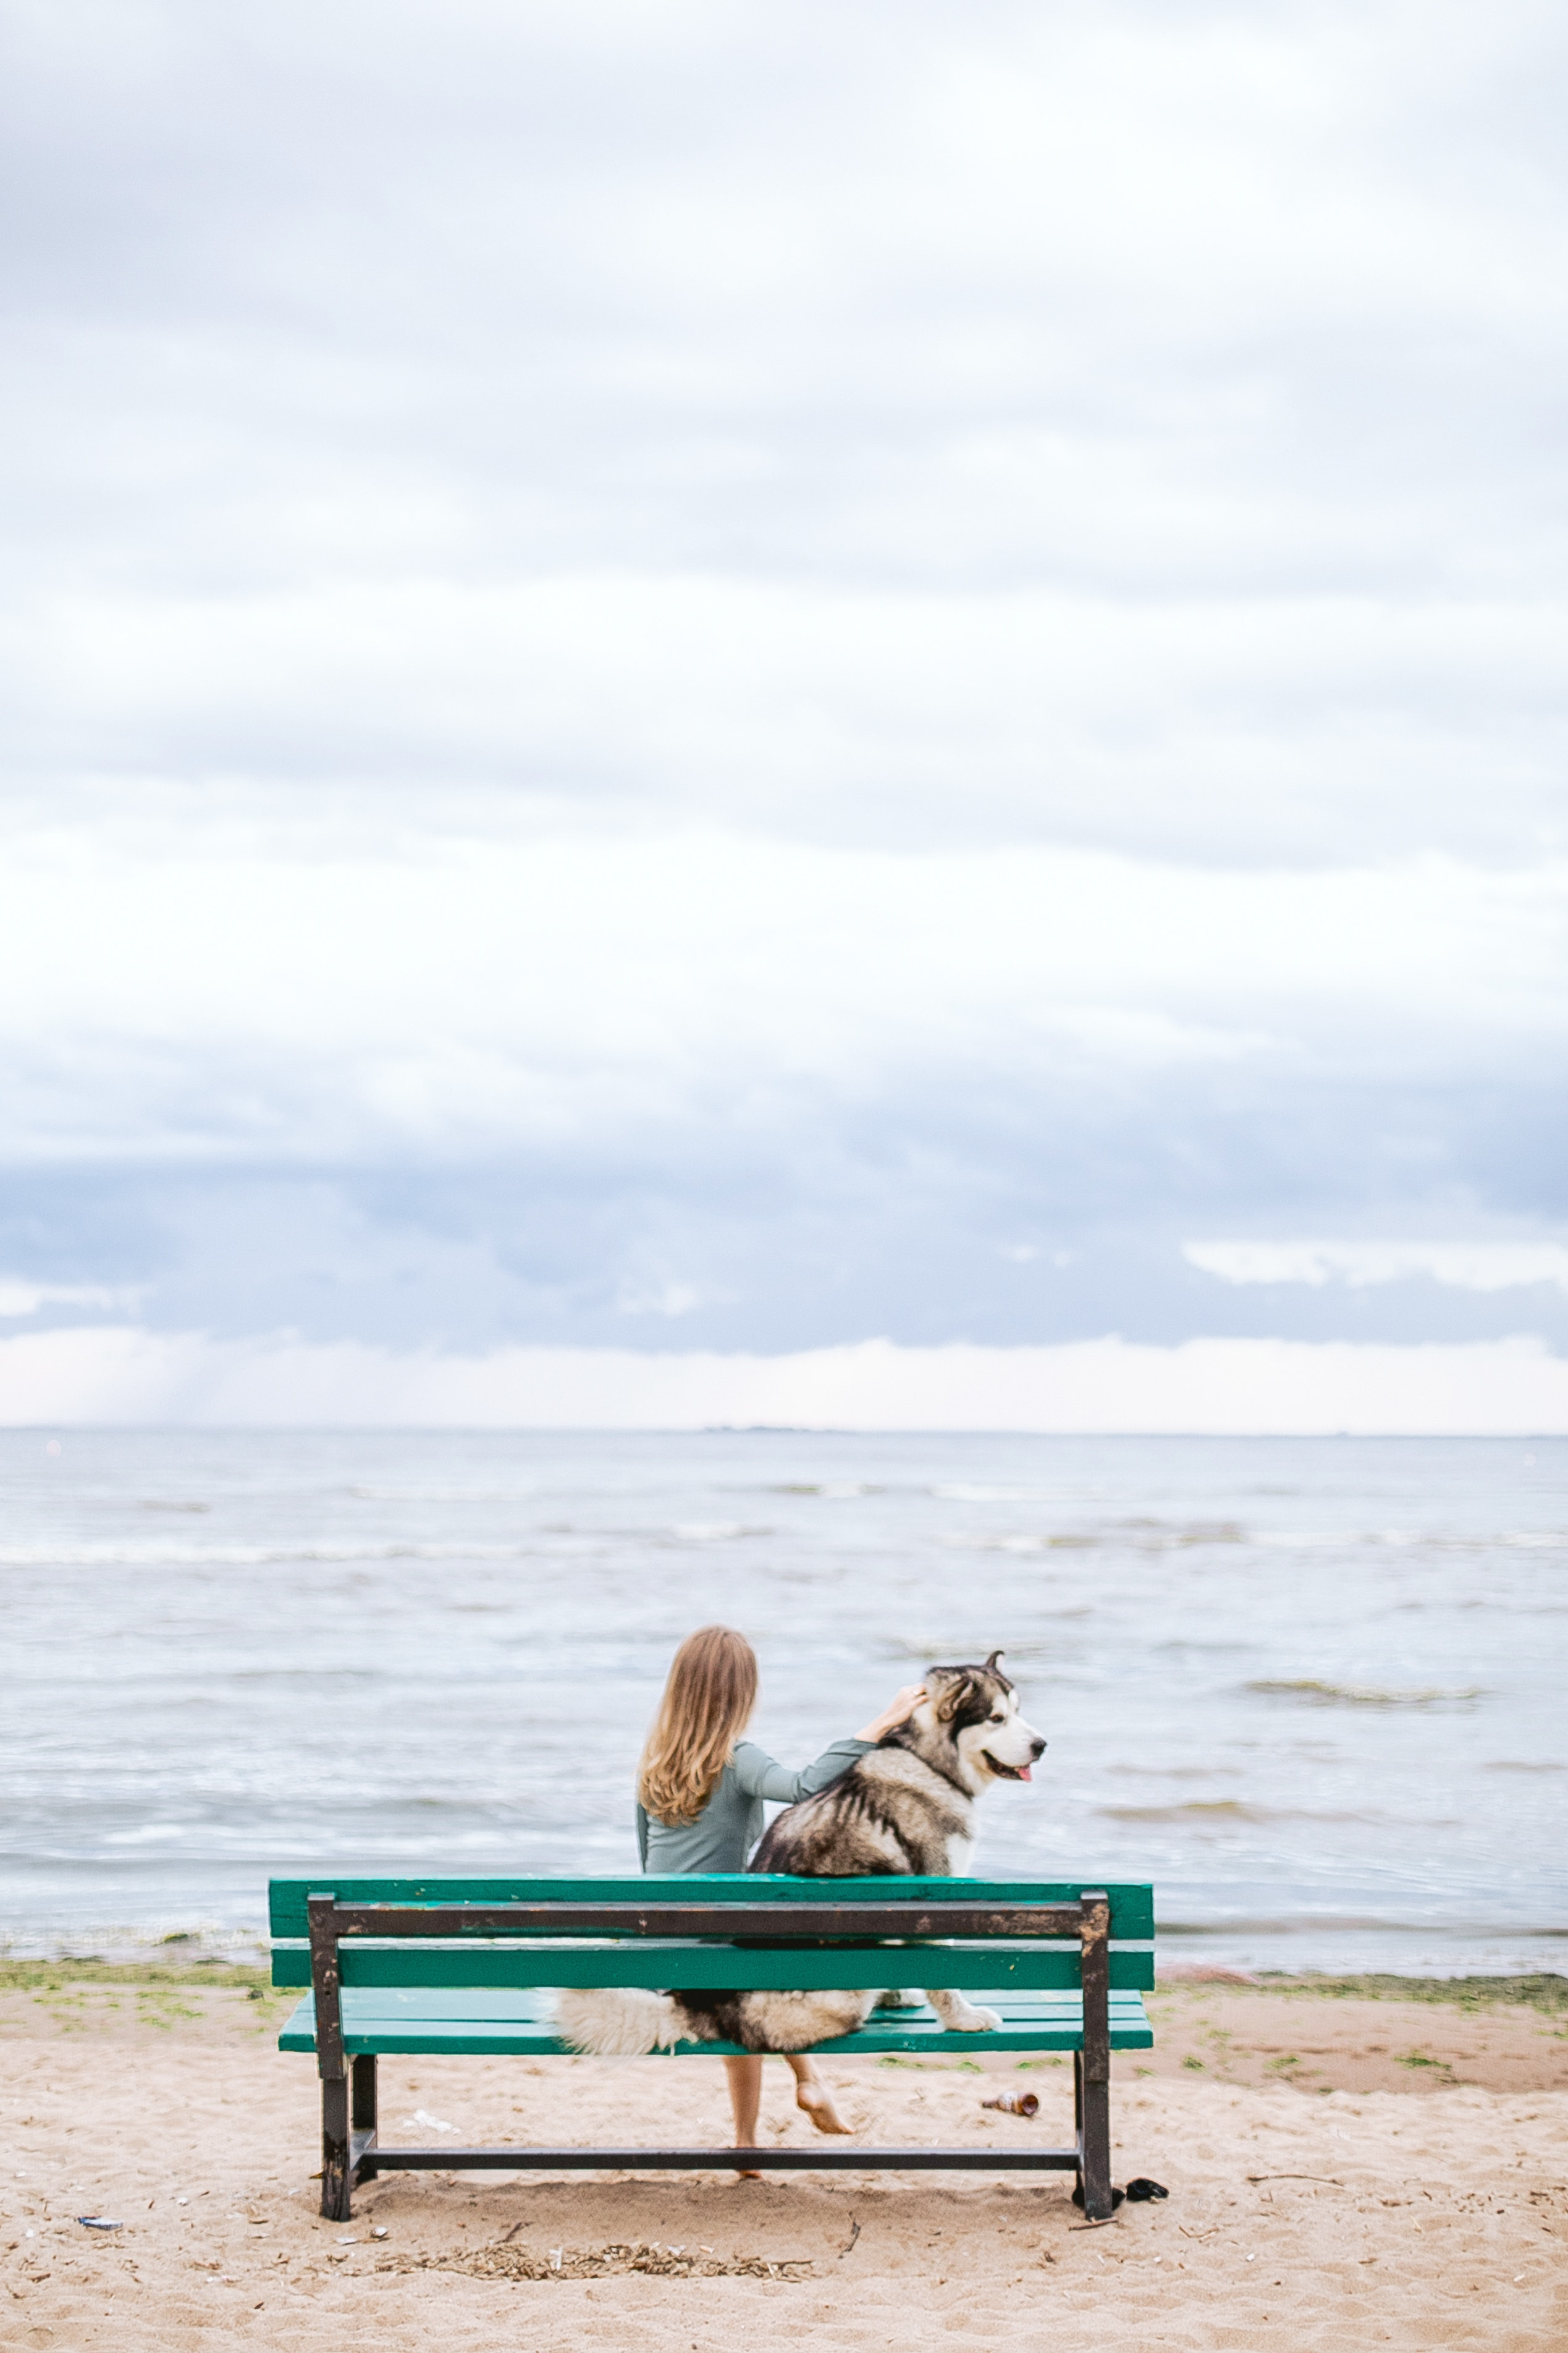
In this module we have…
… explored the five experience design principles, namely defining a theme, creating positive cues, eliminating negative cues, mixing in memorabilia, and engaging the five senses.
… comprehended the need to go beyond the experience, aiming for transformations, which is a trending purpose for millennials and travellers.

Slide 50
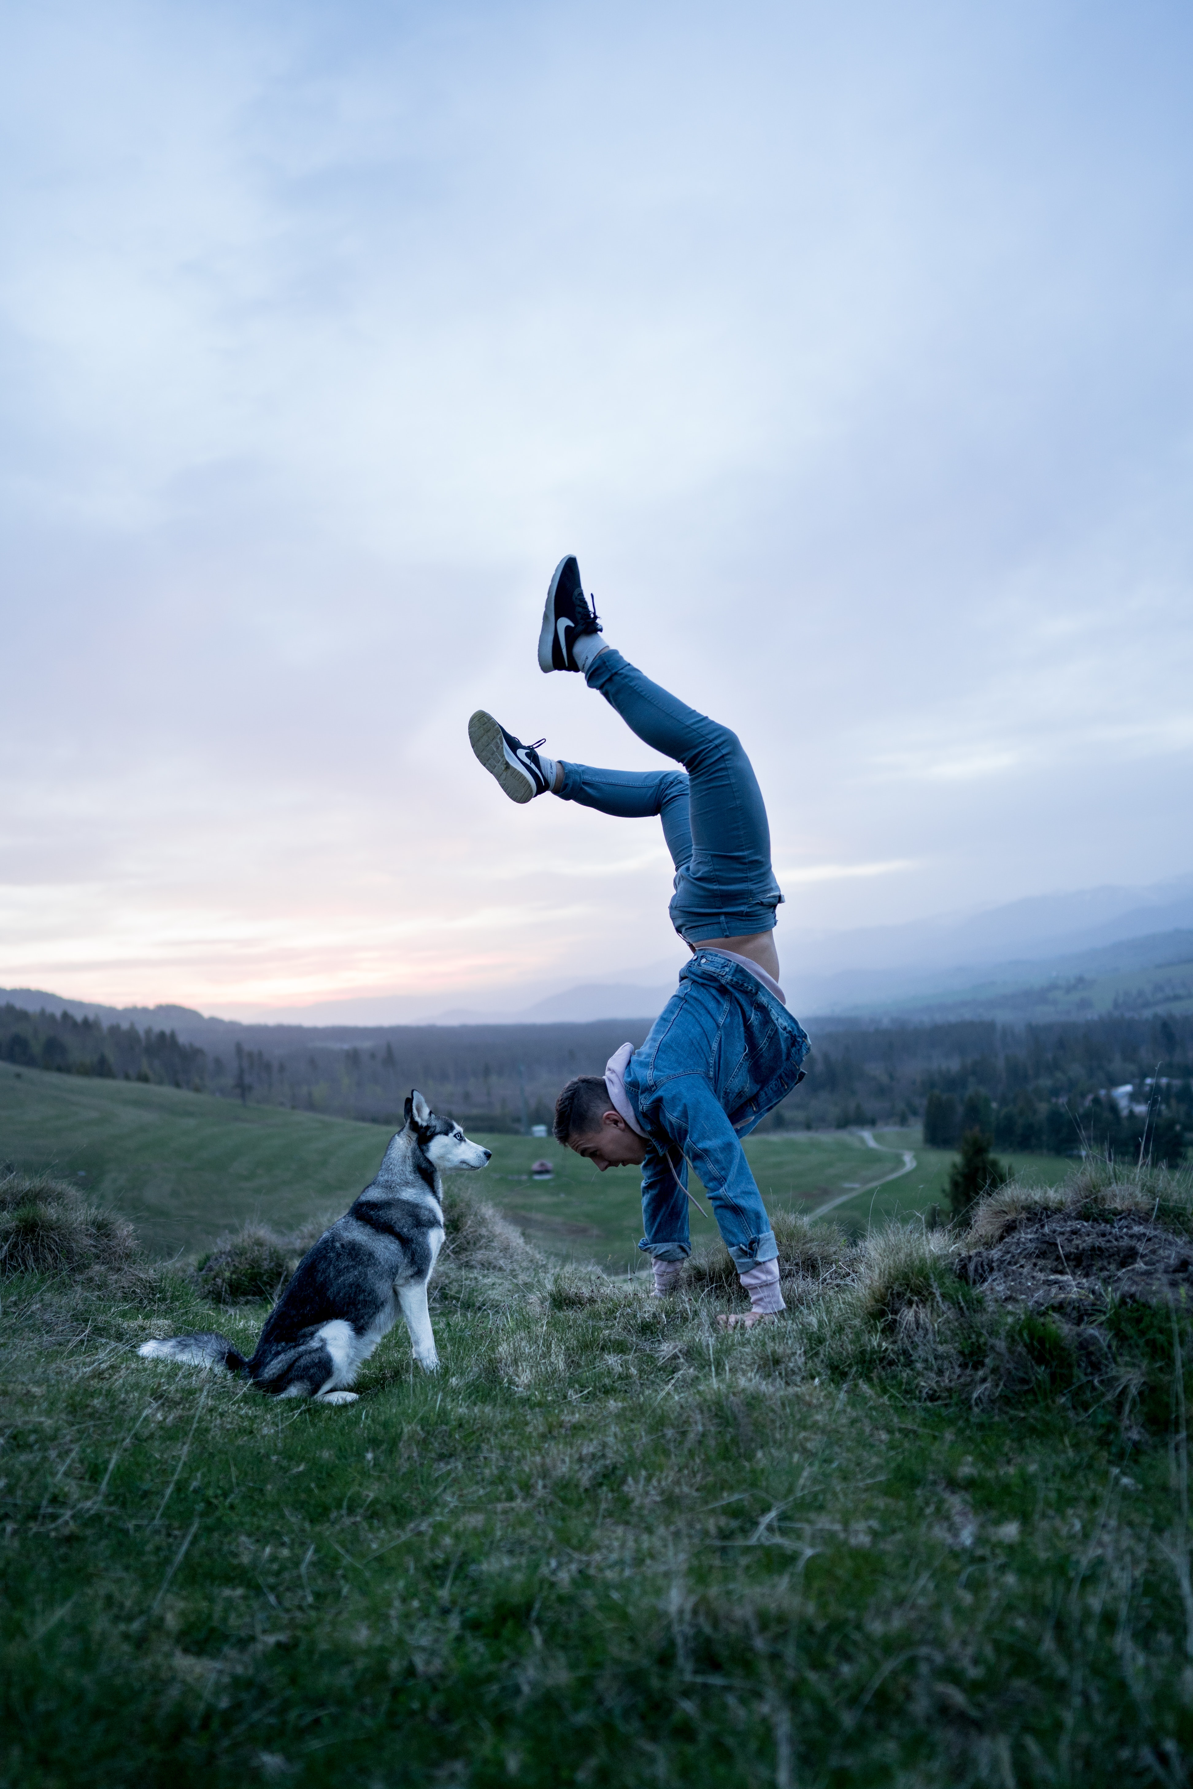
In this module we have…
… seen how the Experience Economy is being developed in tourism to create inspiring and immersive experiences that exceed customers expectations and provide long lasting memories.

Slide 51
The roadmap
I. Introduction to Wellness and Wellbeing
II. Wellbeing in a New Era
III. The Experience Economy
IV. Engineering Wellbeing Experiences
V. Customer Journey Mapping
VI. Storytelling in Culinary Tourism
VII. Setting up a Wellbeing Business
VIII. Branding for Wellbeing
IX. Digital Marketing

Slide 52
Thank You
Any Questions?
www.detourproject.eu
Detour on Facebook
@WellbeingTourismDestinations
#detourdestinations #erasmusplus #detour #wellbeing
Icons retrieved from: www.flaticon.com
Icons: www.flaticon.com

