Slide 1
Wellbeing in a New Era
Module 2

Slide 2
“
Welcome to DETOUR’s Wellbeing Tourism online training course.
”

Slide 3
The roadmap
I. Introduction to Wellness and Wellbeing
II. Wellbeing in a New Era
III. The Experience Economy
IV. Engineering Wellbeing Experiences
V. Customer Journey Mapping
VI. Storytelling in Culinary Tourism
VII. Setting up a Wellbeing Business
VIII. Branding for Wellbeing
IX. Digital Marketing

Slide 4
Module Introduction
We are constantly changing and the recent Covid-19 pandemic has brought additional challenges, questions and ways to look into life. New trends are emerging, many of which related to health and safety, but technology and the digital world also have an important role to play. How will this affect tourism and the pursuit of happiness? Will people be looking for pleasure or fulfilment? A deeper look into wellbeing tourism experiences will shed some light into critical features that improve tourists’ happiness and provide new ways to move forward, leveraging current trends. Finally, the spotlight will be on welcoming techniques in order to make visitors feel accepted. This will set the tone for the next modules and the creation of meaningful wellbeing experiences.

Slide 5
Learning Goal
To acknowledge the factors that affect wellbeing and happiness in today’s world and how to leverage them in tourism.

Slide 6
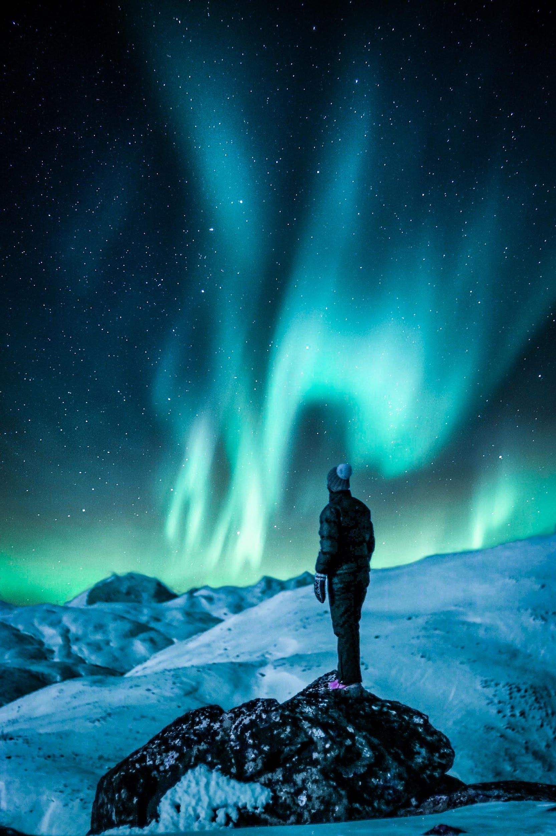
Learning Objectives
To interpret the current wellbeing and tourism trends.
To outline the different perspectives on happiness and wellbeing.
To understand happiness and wellbeing in tourists’ experiences.
To recognize the importance of welcoming.
To identify meet & greet good practices.

Slide 7
Content & Resources
Content
a. Wellbeing & Travel Trends
b. Happiness & Wellbeing
c. Welcoming Visitors
Resources
a. 4 support videos
b. 3 case study
c. 8 articles for additional reading
d. 1 assignment

Slide 8
2.1.
Wellbeing &
Travel Trends

Slide 9
A New Era in Tourism
Digital
Wellbeing
Covid-19
Smart tourism solutions.
Online tools to search, book, share and review travels.
Mobile & gadgets and Internet of Things (IoT).
People are constantly connected.
Healthy eating, fitness and mindfulness are major concerns during travel.
Digital detox.
Mind, body and soul.
Relax and escape.
Cleanliness and hygiene are top priorities.
Smaller groups, safer experiences.
Building trust and high professional standards.
Nature & the outdoors.

Slide 10
Wellbeing Trends
Searching the word “wellbeing”
on Google 2004-2021
Insights
Search has increased from 2011 on (financial crisis).
Low peaks are on Christmas weeks.
Highest peak during the coronavirus global lockdown (May 2020).

Slide 11
Wellbeing Trends
1. GREEN PRESSURE In 2020, consumers move from eco-status to eco-shame.
2. BRAND AVATARS Human brands take powerful new form.
3. METAMORPHIC DESIGN Consumers demand relevance as a service.
4. THE BURNOUT Smart brands rush to help those burned by the pressures of modern life.
5. CIVIL MEDIA Why the future of social is meaningful connections.
2019
BURNOUT
occupational phenomenon
(International Classification of Diseases)
5 Trends to
watch in 2020
Source: https://trendwatching.com/quarterly/2019-11/5-trends-2020/
Notes:
Burnout: feelings of energy depletion or exhaustion; increased mental distance from one’s job, or feelings of negativism or cynicism related to one's job; and reduced professional efficacy.
https://www.who.int/news/item/28-05-2019-burn-out-an-occupational-phenomenon-international-classification-of-diseases

Slide 12
Wellbeing Trends
“21 meaningful, trend-driven innovation opportunities for 2021”
(3 mention wellbeing and personal transformation)
Source: https://info.trendwatching.com/21-trends-for-2021
Notes:
+trends 20
4. THE BURNOUT
Smart brands rush to help those burned by the pressures of modern life.

Slide 13
Wellbeing & Travel Trends
More conscious-decision.
Positive impact on locals.
Reduced environmental impact.
Embracing slow travel.
Voluntourism (1 or 2 days during travel).
Selective restrictions to travelling.
Limits on mass tourism destinations.
Hotels will be back.
More intimate, meaningful, and soulful trip experience.
Fear of travelling is “forgotten”.
Skift Megatrends:
Looking Ahead to 2025
14 megatrends are listed.
One of them is:
Travel’s New Cadence Is More Deliberate, Introspective and Soulful
Notes:
Skift Megatrends: Looking Ahead to 2025 (https://skift.com/2021/01/13/skift-megatrends-2025-download-your-copy-now/)

Slide 14
Wellbeing & Travel Trends
Adapted: https://www.tripadvisor.com/Covid19WhitepaperMay2020
Value for money
Help the community
Cleanliness
Destinations
Relaxation
Keep up-to-date
Brands
Accommodations
Safety
Word-of-Mouth
Flexibility
Marketing
Restaurants
Tours & Attractions
Transparency
Small groups
Differentiation
Trust & Confidence
Notes:
Tripadvisor’s white paper “Beyond Covid-19: The Road to Recovery for the Travel Industry” lists a number of specific actions to different sectors to support tourism recovery. Even though some are imminently conjunctural, other are clearly deep trends that will be affecting the whole tourism industry on the long term.
Destinations: 1. Focus efforts at a domestic level initially / 2. Promote attractions where consumers can practice social distancing / 3. Build confidence in cleanliness / 4. Help consumers relax again
Accommodations: 1. Safety, flexibility and transparency are key to rebuilding traveler confidence / 2. Take the time to reset and prepare / 3. Differentiation is vital 4. Throw out the rule book
Tours & Attractions: Publish your protocols / Offer private or small group options / Flexibility is key
Restaurants: 1. Focus on marketing / 2. Stay ahead of business updates / 3. Consider ways to continue diversifying your business / 4. Ask diners to tell your story
Brands: 1. Creative should reflect the moment / 2. Value for money / 3. Consumers are looking for the “helpers”

Slide 15
Support Video #1
Travel Trends after Coronavirus
https://youtu.be/xaO3SoJkXSc

Slide 16
2.2.
Happiness
and
Wellbeing

Slide 17
Happiness and Wellbeing
Ethics
Beliefs
Meanings
Culture
Values
Religion
Expectations
What is Happiness
Subjective Wellbeing
What is Wellbeing?
The way people experience the quality of their lives, including happiness
How is it achieved?
Consequences
and Benefits?
Past, Present, Future?
What factors lead to it?
Individual vs. Community?
Health?
Notes:
Understanding happiness and wellbeing is quite hard. Positive Psychology is the study of positive human functioning, subjective wellbeing and happiness, aiming to improve Quality of Life.
It is a modern view on Psychology that is focussed on improving the “positive side of life” and its benefits, rather than “dealing” with problems and negative conditions. It aims to optimize the subjective wellbeing. Understanding this take on Psychology can be quite helpful when dealing directly with people and aiming to optimize their positive experiences, which is the case of tourism.

Slide 18
Support Video #2
The science of Subjective Well Being, a.k.a Happiness.
https://youtu.be/PPbjK3MmjL0

Slide 19
The Pursuit of Happiness
Hedonism
Two philosophical perspectives
Eudaimonism
Pleasure, comfort and enjoyment.
Pursuing complex goals which are meaningful to the individual and society.
Presence of positive effect, absence of negative effect.
The positive effect may be absent, at least temporarily, while effort is applied to pursue fulfilling goals.
Examples in Tourism
A day at a paradise-like beach, with nice sunny weather.
Dedicating some days (or the whole travel) to plant tree or teach in remote rural villages

Slide 20
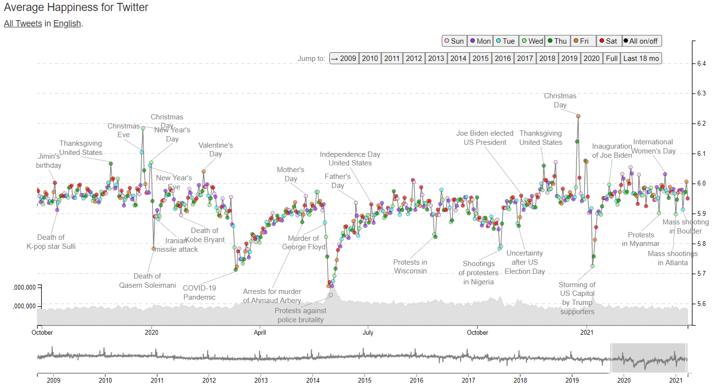
The Hedonometer
Measuring happiness of large populations based on social media data.
Source: http://hedonometer.org/timeseries/en_all/
Features
Events
Words
Inspiration
Trends
Key-moments
Notes:
The Hedonometer is a research project that aims at measuring people’s happiness throughout time. It is based on people’s online expressions, capitalizing on data-rich social media. It is measuring how people present themselves to the outside world.
This tool can be an interesting way to understand what makes people happy and how they react to certain words and events. It can be useful to adjust communication, but also to prepared experiences.

Slide 21
Tourists’ happiness
Tourists’ happiness is about having:
Positive emotions + Engagement + Meaning
Anticipation
Positive emotions
On-site experiences
Engagement
Reflections
Meaning
Joy
Interest
Contentment
Love
Fulfilment
Flow
Mindfulness
Authenticity
Significant travel events
Periods of struggle during the holidays
Personal meaning derived from holiday experiences
Adapted: Filep and Deery (2010)
Notes:
Filep, S. and Deery, M. (2010). Towards a Picture of Tourist’s Happiness: An Insight from Psychology. Tourism Analysis, 14 (4), 399-410.
Joy: play; pushing the limits; being creative
Interest: urge to explore; new information and new experiences; expand the self
Contentment: sit back and savour current life circumstances
Love: experiencing joy, interest and contentment

Slide 22
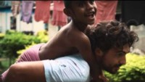
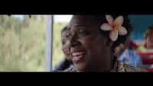
Case Study – Tourism Fiji
Bringing real Fiji happiness to the world.
Tourism Fiji - Where Happiness Finds You
https://youtu.be/gdLGZQnhLRs
Ever felt so happy you wanted to burst into song? You will when you visit Fiji.
https://youtu.be/mOa6cIwMa8A
https://youtu.be/g3bBBrI2A2w

Slide 23
Wellbeing in Tourism
Short-term
Medium-term
Long-term
Permanent, Optimum
Hedonic wellbeing, Subjective list
Eudaimonic +
Hedonic wellbeing
Eudaimonic wellbeing, Objective list, Existential authenticity
Utilitarian wellbeing (maximized Quality of Life and authentic happiness)
Sun, sea & sand tourism
Stag & Hen parties
Cultural tourism + nightlife
Volunteer tourism + beach relaxations
Volunteer tourism
Retreat tourism
Retreat tourism
Spiritual pilgrimage
Sustainable ecotourism
Ethical indigenous tourism
Source: Smith and Diekmann (2017)
Notes:
A Spectrum of Wellbeing and Examples of Types of Tourism: Smith, M.K. and Diekmann, A. (2017). Tourism and wellbeing. Annals of Tourism Research, 66, 1-13.

Slide 24
Wellbeing in Tourism
Pleasure and hedonism (i.e., having fun) and rest and relaxation
Altruistic activities
and sustainability
Meaningful experiences
Integrative Wellbeing Tourism Experience
(e.g., education, self-development or self-fulfilment)
(e.g., being environmentally-friendly or benefiting local communities
Notes:
Smith, M.K. and Diekmann, A. (2017). Tourism and wellbeing. Annals of Tourism Research, 66, 1-13.
The “optimum” kind of wellbeing-enhancing experiences merges 1) pleasure and hedonism; 2) meaningful experiences; and 3) altruistic activities. This is very difficult to achieve in a single trip, because tourists have different needs at different times which are dependent on numerous factors. Still, it is not impossible with careful planning or by selecting a pre- or co-created package, which opens up new business possibilities and opportunities.

Slide 25
Wellbeing in Tourism
Why is this important?
Because it influences tourists’:
Decisions
Expectations
Unspoken and unconscious desires, wants and needs
Experiences
Satisfaction
What’s in it for me?
Positive word-of-mouth
Better reviews and ratings
Increase the perceived-value
Stronger brand
More business opportunities

Slide 26
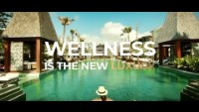
Case Study – ACCOR
Well-being is more than just a trend
https://youtu.be/scJifQA2rjw

Slide 27
2.3.
Welcoming
Visitors

Slide 28
Welcoming visitors
How to make tourists experience
WELLbeing?
Make them feel
WELLcome!
It sets the tone for the rest of the experience

Slide 29
The importance of Welcoming
For THEM
For YOU
Feeling accepted and expected
Feeling more at ease and comfortable
Triggering positive emotions
Feeling appreciated, special and unique
Increasing satisfaction
The feeling of making the right choice
Building a good first impression
Gaining trust and becoming a reference
Improving your brand’s image
Improving the destination’s image
Nurturing long relationships
Stimulating word-of-mouth
Notes:
Welcoming is all about building relationships. Willingly accepting the visitors and making them understand that you are genuinely interested sets the ground for long lasting relationships. They feel that someone is caring for them and that they are on the right place to be enjoying the experience. For that reason they might want to come back, repeat the experience, have other experiences and recommend you on reviews or to their families and friends.

Slide 30
Support Video #3
100% Pure New Zealand: Kia ora
https://youtu.be/zVDu0tJHTnY

Slide 31
Meet & Greet
Appearance
Eye Contact
The first impression matters!
6
tools
to greeting your
visitors
Smile
Attitude
Empathy is the key!
Body language
Speaking
Notes:
Your first gesture, look, word and attitude matter. “First impressions are lasting impressions”.
Appearance: Convey professionalism. You should be dressed according to your company’s values and brand’s essence. You might need to wear suit & tie for 5-star hotels, but you might need to wear hiking apparel for adventure companies. Still, keep it tidy and coherent. Someone who cannot take care of himself/herself, will create the impressions that will not be able to take care of others.
Eye contact: keeping steady eye contact will help you show confidence and build trust. However, do not seem overbearing or inappropriate.
Smile (and keep smiling!): it means “welcome” and that is what your visitors want to know right from the start. It helps you connect. A smile must be honest and sincere, showing openness, kindness and availability.
Body language: your posture and gestures “speak” volumes about you, your company and your mind (feelings and emotions). You should be showing openness and engagement, removing “barrier” between you and your visitors. Lean in (not awkwardly), nod your head, keep you head up and use open hand gestures. Don’t be slouch and avoid defensive positions and gestures, like folded arms, authoritarian postures (hands on hips), tense face expressions or looking into your phone, computer or other distracting element.
Attitude: keep a positive attitude and tone of voice. Express interest in your visitors’ information, conversation, problems or enthusiasm. Keep the interaction highhearted, but professional, so people may feel comfortable.
Speaking (& Language): use an articulated, clear and paced speech. Don’t rush, use slang or unnecessary (filler) words. Enunciate every word clearly. Remember that many visitors many not speak your language or may have a limited understanding of the language you are using to communicate (e.g., English or French). Avoid technical jargon or explain it whenever you have to use it.

Slide 32
Good Practices
Say “Hello”.
Identify yourself. Say your name.
Use the visitor’s name (if possible).
Offer help.
Keep good notes (a good memory helps).
Summarize the conversation.
Make them want to come back.

Slide 33
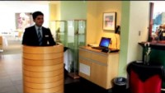
Support Video #4
Hospitality How to – Greeting
https://youtu.be/xmyOSfzv4-0

Slide 34
Creative welcoming for wellbeing
Leave a welcome note/card. Personalization and your handwriting will give a special touch!
For late arrivals to an accommodation, leave a basket of fresh bread, snacks and fruits. Home made treats are fantastic.
For late arrivals to a restaurant, offer on-the-house small appetizers (to starving diners).
Have small gifts for children (snacks, games, coloring books and pencils, treats,…)
Offer drinks on a celebration.
Provide Season’s greetings (a snack is good here too!).

Slide 35
Creative welcoming for wellbeing
Fresh flowers are great for welcoming (give directly to your guest or leave in their rooms).
Have a pin, sticker, badge or something similar to welcome people into your experiences.
Write a short note with a personal destination guide and schedule for events.
Consider special amenities or equipment, like incense burners, yoga mats, mosquito spray, sunscreen, beauty masks, safety masks,
A cup of warm tea or a glass of lemon-flavored fresh water can make all the difference, on cold or hot days.
Provide the “tip of the day”: a special meal or drink on offer, an event, a historical fact, a mindfulness session nearby, a discount opportunity at local souvenir stores…

Slide 36
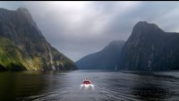
Case Study – 100% Pure New Zealand
100% Pure New Zealand: A Welcoming Journey
https://youtu.be/Atf_Af1q_5w

Slide 37
Digging Deeper

Slide 38
Further Reading
World Happiness Report
[CLICK HERE]
The Power of Welcome… Hospitality Beyond Property Borders
[CLICK HERE]
How to integrate wellness into hospitality for guest satisfaction and owner return
[CLICK HERE]
Happiness in a Tourism Context
[CLICK HERE]
Global Wellness Trends Report: The Future of Wellness 2021
[CLICK]
Body language
[CLICK HERE]
The importance of a welcome
[CLICK HERE]
The Art of Welcoming
[CLICK HERE]

Slide 39
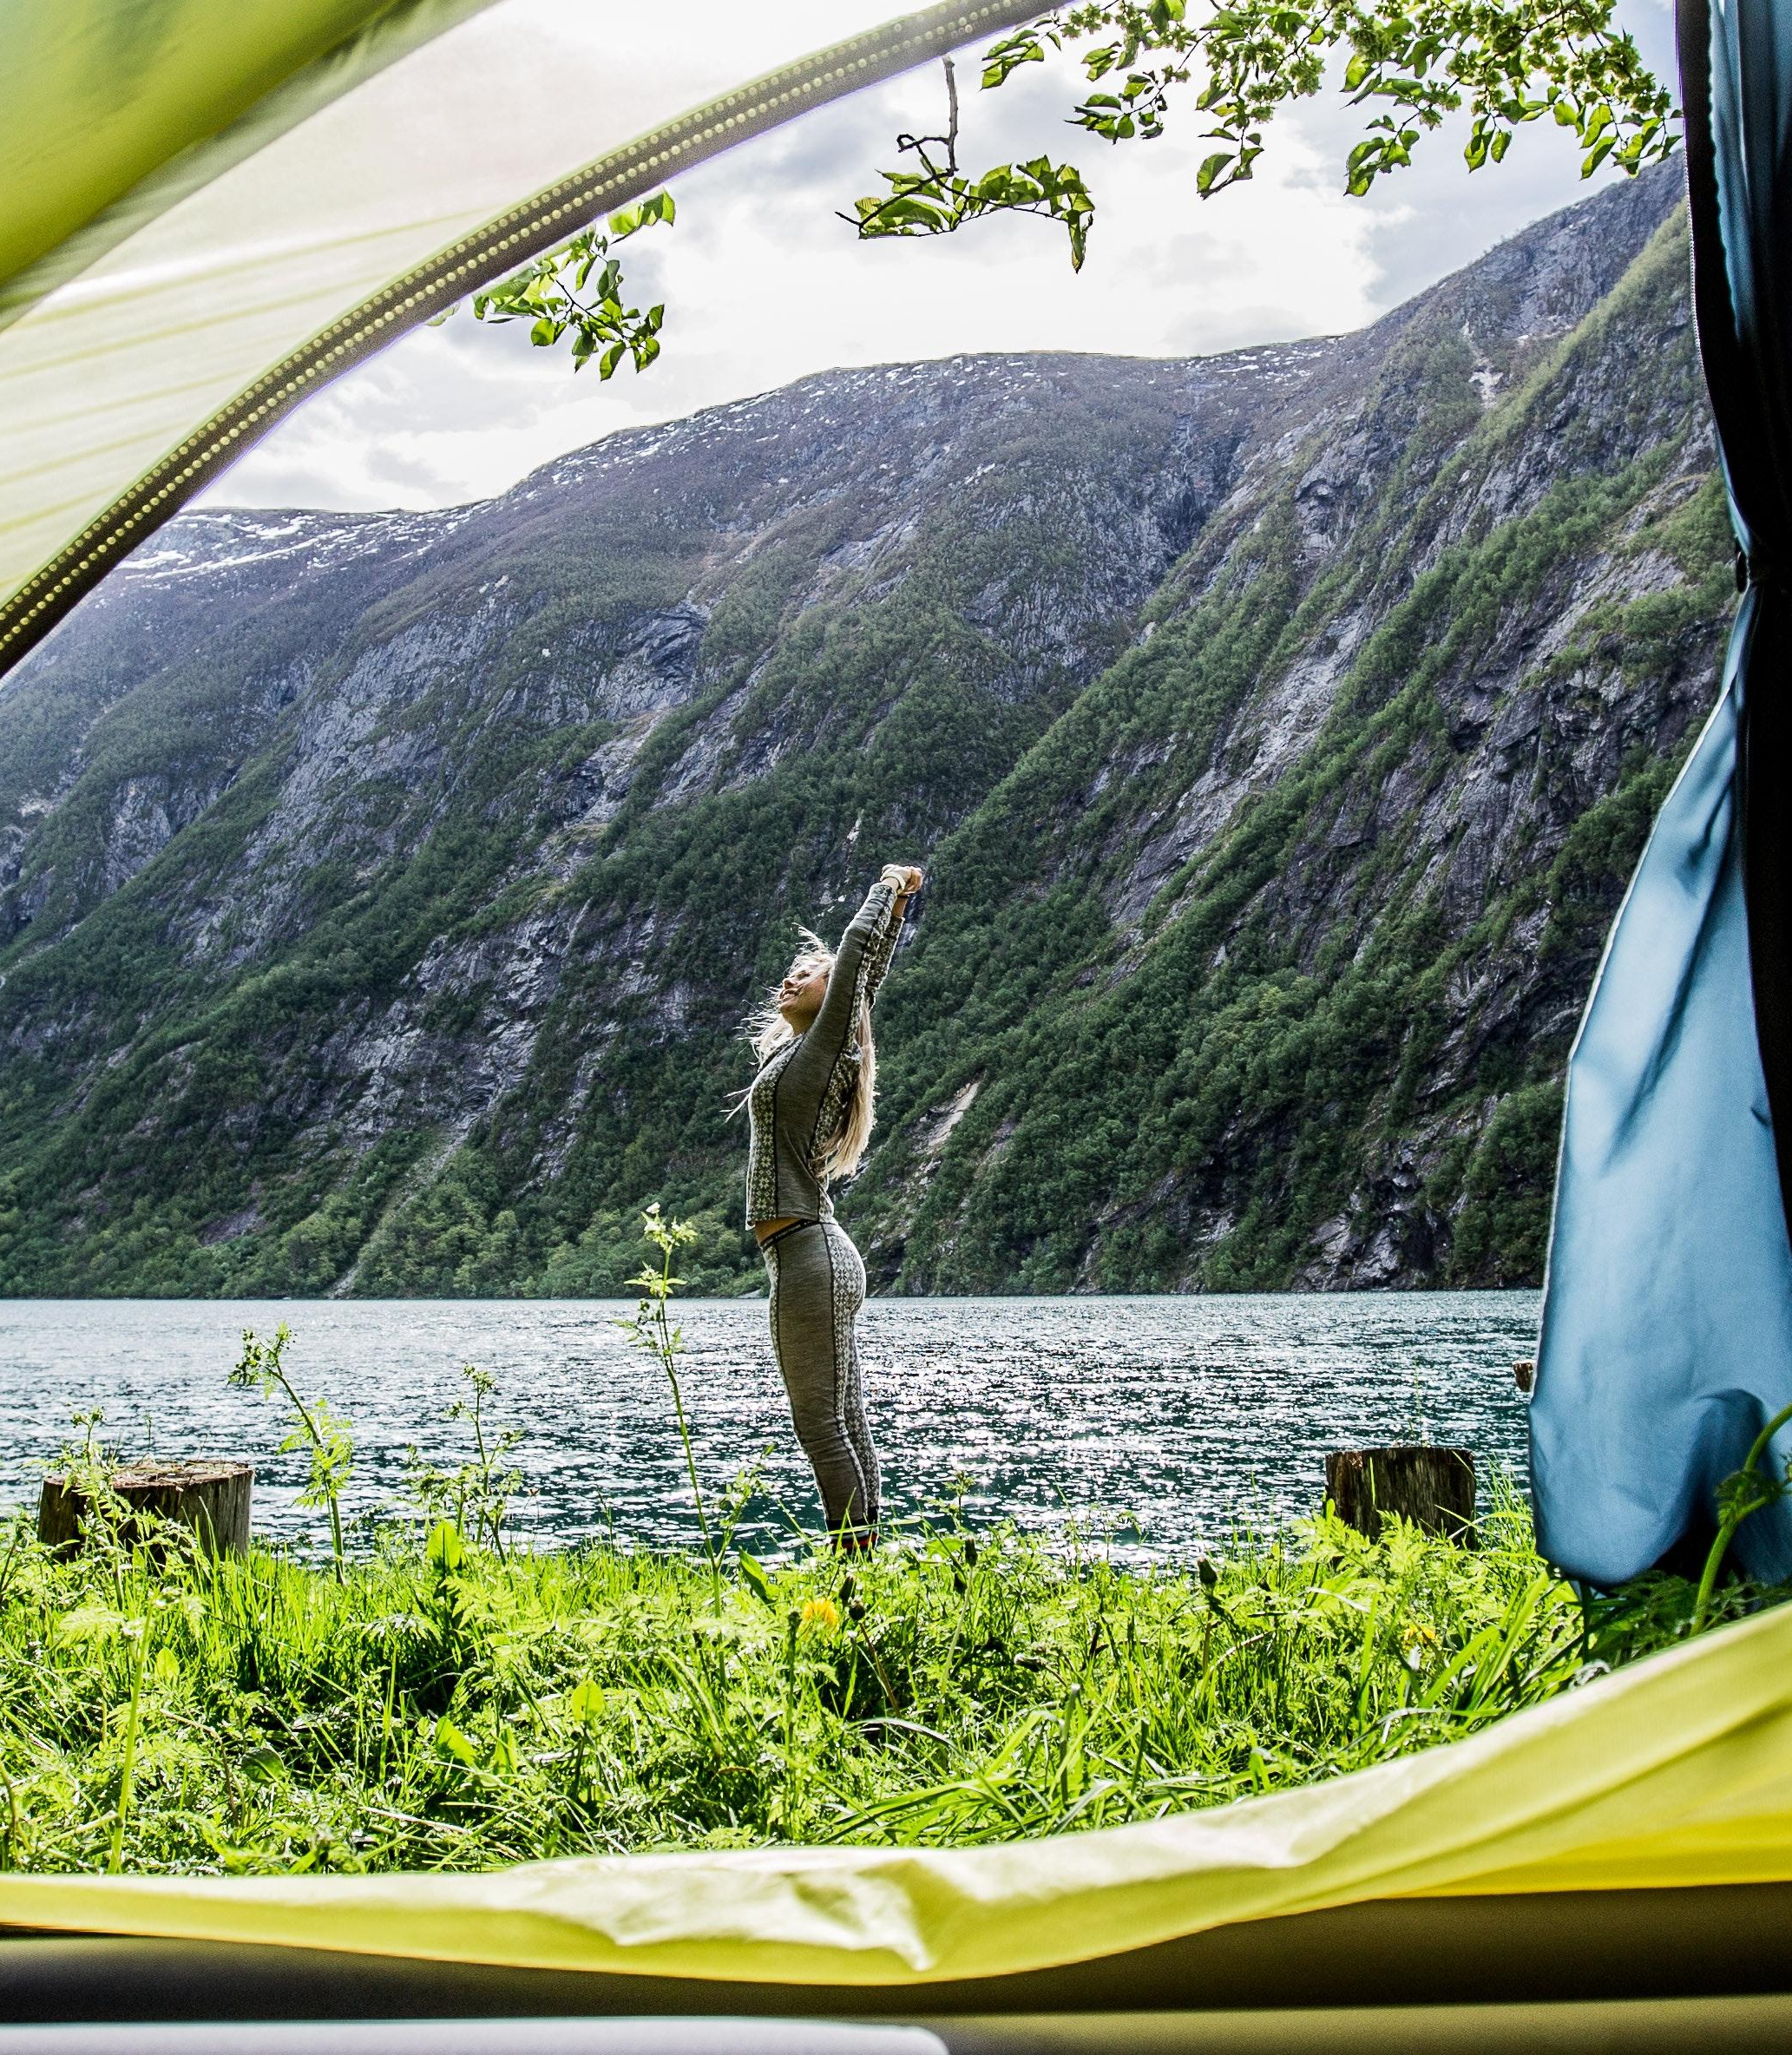
Assignment #1
Identify 5 trends in wellbeing and tourism that can be leveraged on your business.
How can you incorporate those trends in specific experiences, products or services?
How will they increase your customers happiness and satisfaction?
Will they facilitate your welcoming?

Slide 40
Module Summary
Module II. Wellbeing in a New Era

Slide 41
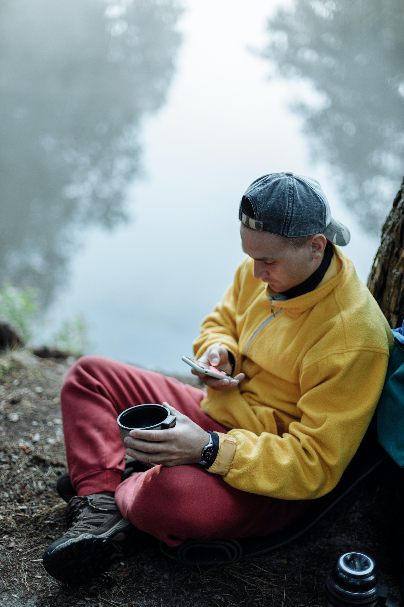
In this module we have…
… acknowledged the main trends that are driving wellbeing and tourism in a scenario where the digital world is dominating and Covid-19 has brought new challenges and new ways to look into life, health and safety.
… outlined how difficult it is to define happiness and wellbeing, but that Positive Psychology approach is focussed on optimizing each individual’s subjective wellbeing and experiences.

Slide 42
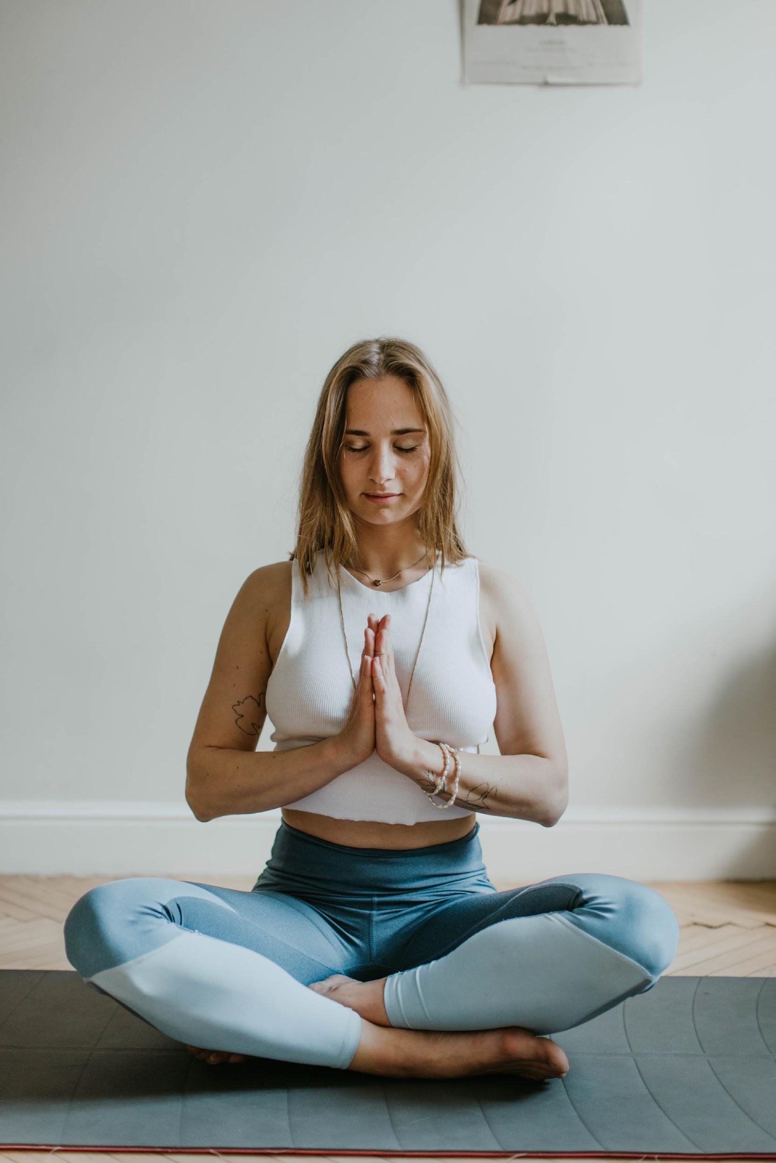
In this module we have…
… learned that there are two main philosophical currents that lead the pursuit of happiness – the hedonic and the eudaimonic – and one is based on pleasure while the other aims for fulfilment and meaning.
… become aware that tourists’ happiness is derived from a balance between hedonic and eudaimonic factors, which affect their emotions, engagement and reflections, as well as by the type of wellbeing experiences they participate in.

Slide 43
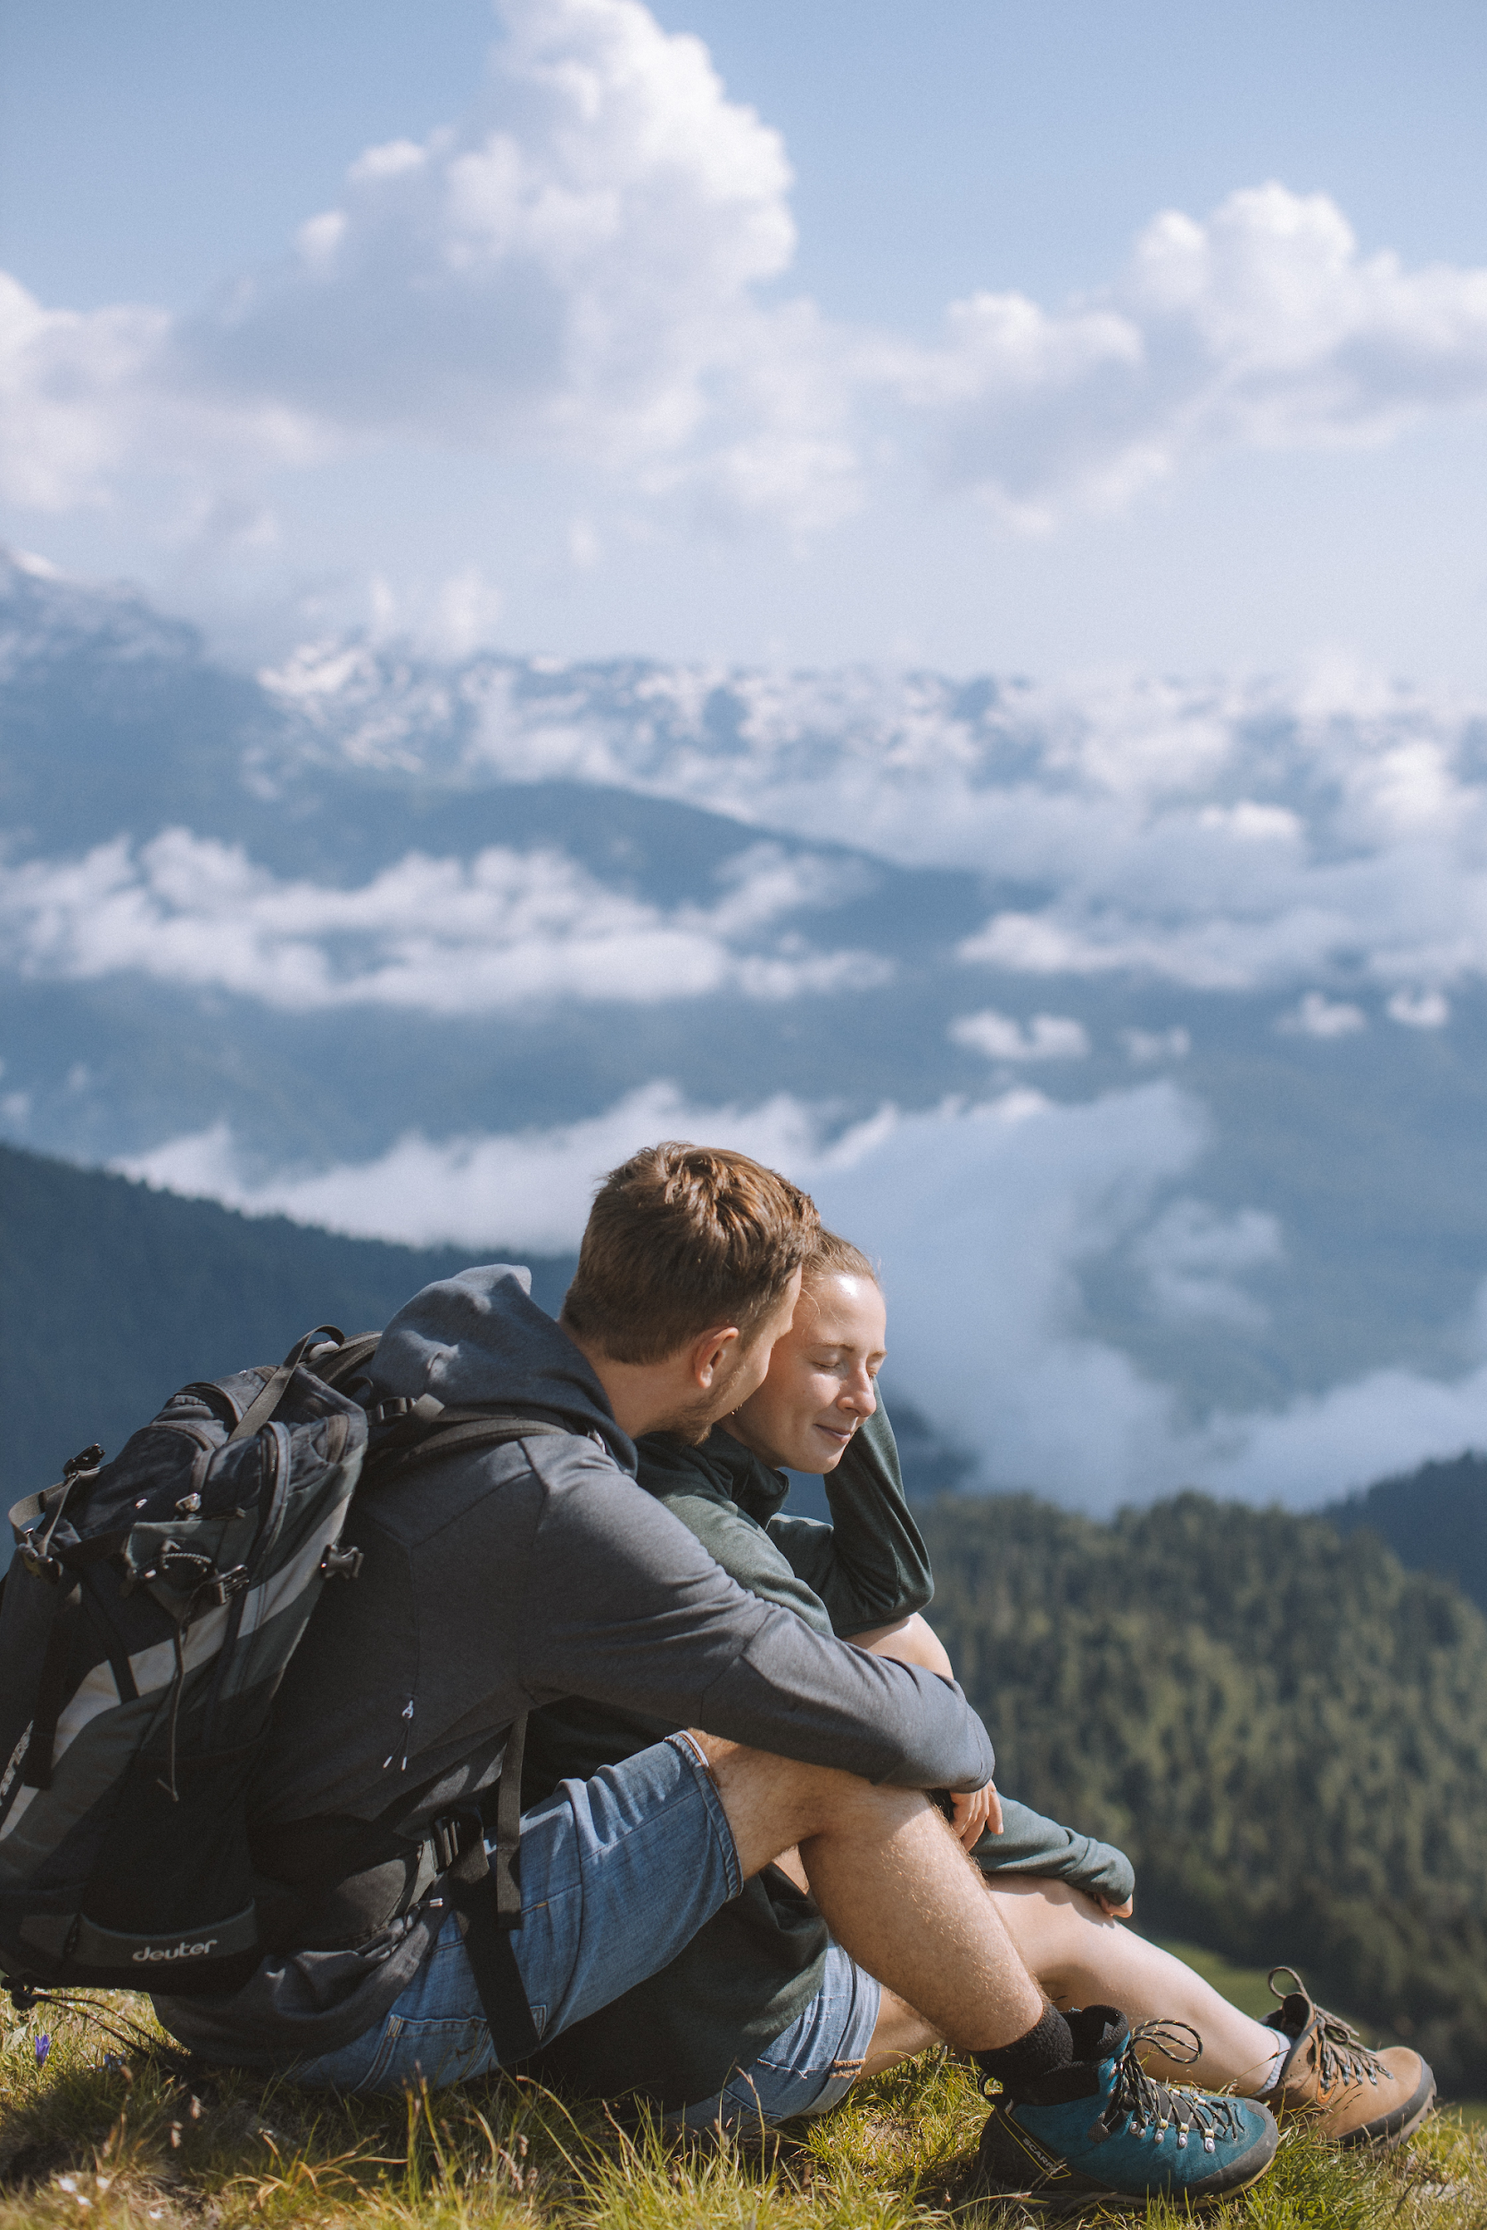
In this module we have…
… recognized the importance of welcoming as way of building strong first impressions, setting the tone for the rest of the experience and building long lasting relationships with visitors.
… explored several meet & greet tools and good practices in order to make visitors feel welcomed and connect with the host.

Slide 44
The roadmap
I. Introduction to Wellness and Wellbeing
II. Wellbeing in a New Era
III. The Experience Economy
IV. Engineering Wellbeing Experiences
V. Customer Journey Mapping
VI. Storytelling in Culinary Tourism
VII. Setting up a Wellbeing Business
VIII. Branding for Wellbeing
IX. Digital Marketing

Slide 45
Thank You
Any Questions?
www.detourproject.eu
Detour on Facebook
@WellbeingTourismDestinations
#detourdestinations #erasmusplus #detour #wellbeing
Icons: www.flaticon.com

