Slide 1
Introduction to Wellness and Wellness Tourism
Module 1

Slide 2
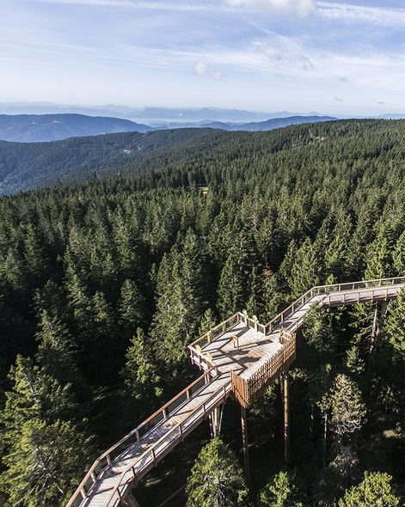
The roadmap
I. Introduction to Wellness and Wellbeing
II. Wellbeing in a New Era
III. The Experience Economy
IV. Engineering Wellbeing Experiences
V. Customer Journey Mapping
VI. Storytelling in Culinary Tourism
VII. Setting up a Wellbeing Business
VIII. Branding for Wellbeing
IX. Digital Marketing

Slide 3
The roadmap
I. Introduction to Wellness and Wellness Tourism
1.1. Wellness
1.2. Tourism
1.3. Destination
1.4. Sustainability
II. Wellbeing in a New Era
III. The Experience Economy
IV. Engineering Wellbeing Experiences
V. Customer Journey Mapping
VI. Storytelling in Culinary Tourism
VII. Setting up a wellbeing business
VIII. Go-to-market in the Digital World

Slide 4
Introduction to Module 1
Tourism and wellness have become a necessity of our everyday life. Concern for health and well-being was further emphasized by the Covid 19 pandemic, which set clear boundaries for the developed world and tourism as we knew it, and also showed us how it has become an integral part of our lives. After Corona pandemics is over, the world will change, as will tourism and the importance of health care. Cooperation and networking will play an even more important role at making a destination successful, and above all, safe in the broadest sense of the word. Safety and security ensure sustainability; and sustainability in turn is ensured by taking into account all involved stakeholders : nature, the economy and the people - those who live and create in the destination, as well as those who visit them as tourists.

Slide 5
Learning Objectives
Getting to know the basic characteristics of wellness and tourism.
Fusion of the above as important trend of the future.
Taking into account sustainable principles.
Offering opportunities to develop a variety of leisure experiences as well as new business opportunities.

Slide 6
Learning Objectives 1/2
Get to know the basic characteristics of wellness, tourism and wellbeing
Understand the need for well-being and its integration into all aspects of an individual's life, including tourism
Explore the possibilities of cooperation in creating experiences within the wellness tourism

Slide 7
Learning Objectives 2/2
Define the importance of a sustainable approach in the development of the destination offer and in everyday life
Encourage change in the light of sustainability and well-being activities
Develop high added-value content and experiences - fostering guests' personal involvement, emotions and memories

Slide 8
Content & Resources
Content
a. Tourism: introduction
b. Wellness: introduction
c. Ddestination management: networking as the key to the success
d. Sustainability: “green is the new gold“
Resources
a. 6 videos
b. 5 case studies
c. 10 articles for additional reading
d. 1 assignment

Slide 9
1.1.
WELLNESS
Wellness is the realization of a healthy lifestyle and the path to oneself.
Notes:
Photography source: happy-and-healthy-life.jpg (615×280) (homehealthbeauty.in)

Slide 10
Defining wellness
“Wellness is a state of complete physical, mental, and social well-being, and not merely the absence of disease or infirmity.”
The Global Wellness
Institute defines wellness as the active pursuit of activities, choices and lifestyles that lead to a
state of holistic health.
‎‎
Dr. Donald B. Ardell, a pioneer of modern wellness, says true wellness is expressed in an exciting enthusiasm for life. It is based on the daily new joy of one's own existence, one's own creation and work, and the use of one's own body, senses and mind. Wellness is a daily "work" on itself that is richly rewarded.
Notes:
There are many definitions of this term, depending on which part of the world the term is defined in. The general definition in the online dictionary (Merriam-Webster) defines wellness as "the quality of health or the state of good health as an actively sought goal". One could say that the above is in one way or another common to all definitions, regardless of whether they understand wellness as part of the tourist offer or daily activities. Different parts of the world can also highlight the importance of individual components in different ways, but the term wellness is understood as the balanced activity of all components.

Slide 11
WELL-being
Fit-NESS
Modern
Wellness
Concept
WELLNESS
Wellness is a modern word with ancient roots. As a modern concept, wellness has gained on importance since the 1950s, 1960s and 1970s, when the writings and leadership of an informal network of physicians and thinkers in the United States largely shaped the way we conceptualize and talk about wellness today. (GWI)
Notes:
The term wellness was first used in literature in 1654 and already meant health and well-being more than three hundred years ago. In the early days of the preventive medicine movement in the USA, the term became increasingly popular in the 1950s, first in professional circles, then increasingly also in public. In particular, the works and publications of Halbert Dunn, John Travis, Donald Ardell and Gerhart Hettler developed a wellness movement in the USA. Since the 1970s, state and private sector institutions have discovered a tried and tested means of reducing lifestyle-related health care costs in the wellness concept. Since the beginning of the 1990s, the term wellness has also gained popularity in Germany, although its use often shows little or no references to its origin and actual meaning. Nevertheless, in its core message today and in the future, it remains above all a synonym for a positive understanding of health, in the sense of the World Health Organization and salutogenesis research. (Das Wellness-Lexikon des Deutschen Wellness Verbands)
Travis was the first doctor to open a wellness center based on Dunn's ideas, where people were led to the wellness path without the usual medical tools and made experts of their own (the empowerment approach). Principles for Travis's work were:
Self-responsibility as the key to wellness.
Perception of people as clients rather than patients.
The path to wellness leads through self-knowledge.
Learn to recognize his feelings and feelings and to be able to express them effectively.
Gain new experiences and try out practical ways to develop further.
Build self-acceptance and self-worth.

Slide 12
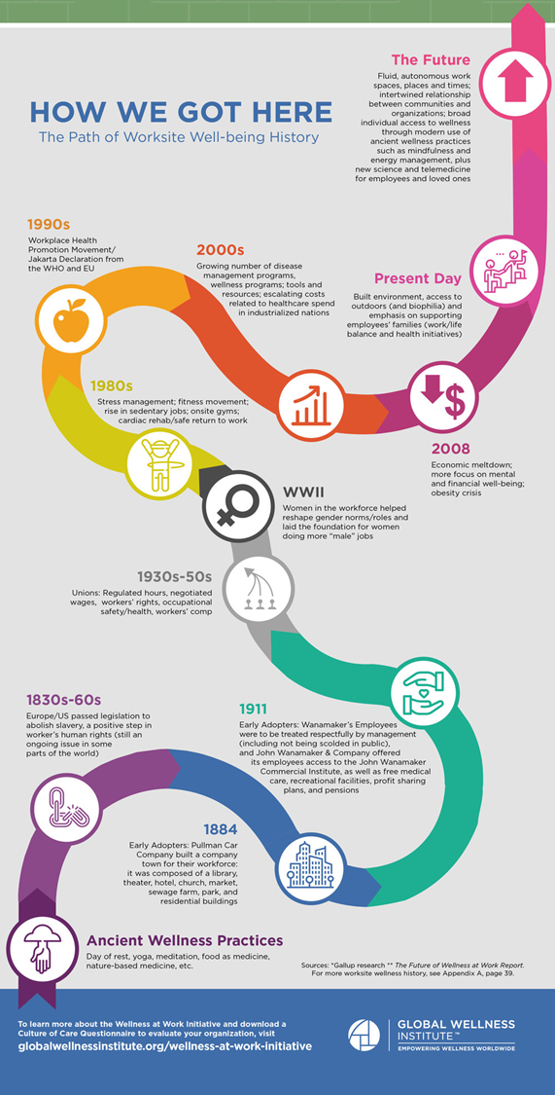
Case study – Wellness development
The desire for well-being, health and a balanced life is the desire of every human being. How the mentality and realization of this goal has developed can be seen by looking at history. At the same time, we can better understand the possibilities for the development of wellness in the present and, taking into account trends, in the future as well.
More at: History of Wellness and Short History of Wellness

Slide 13
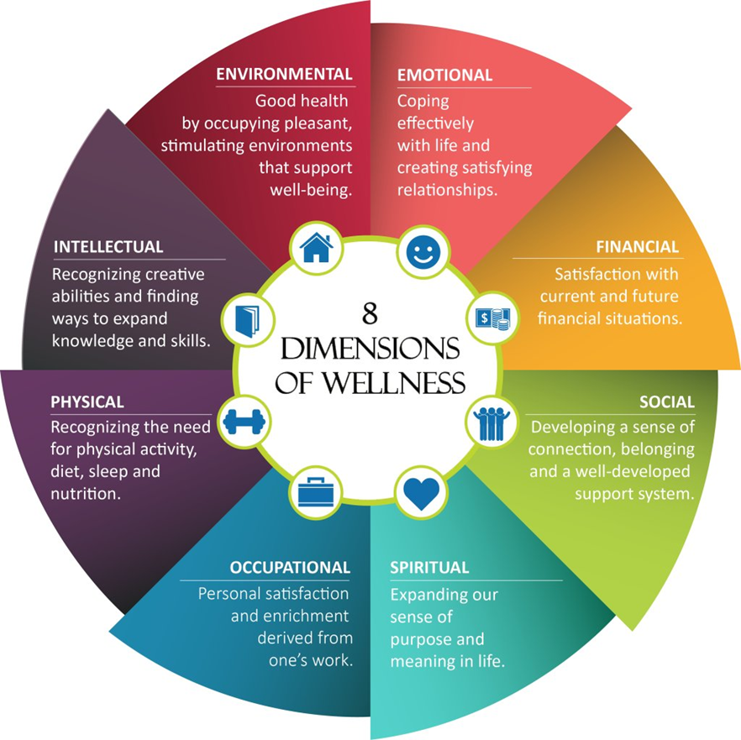
USA Dimensions of Wellness
https://pbs.twimg.com/media/Dd4V4k-VAAA0AAk.jpg:large

Slide 14
REAL Wellness model
(Wellness Verband Deutschland)
https://www.wellnessverband.de/themen/wellness/donald_b_ardell_real_wellness.php
REAL wellness should encourage and guide people to think and function rationally, to live exuberantly, to maintain physical fitness, to dine wisely consistent with factual nutritional knowledge and to live as freely as possible. The latter means becoming liberated from cultural or circumstantial elements such as superstitions, irrational dogmas and other mental and social limitations that add constraints on personal liberties.

Slide 15
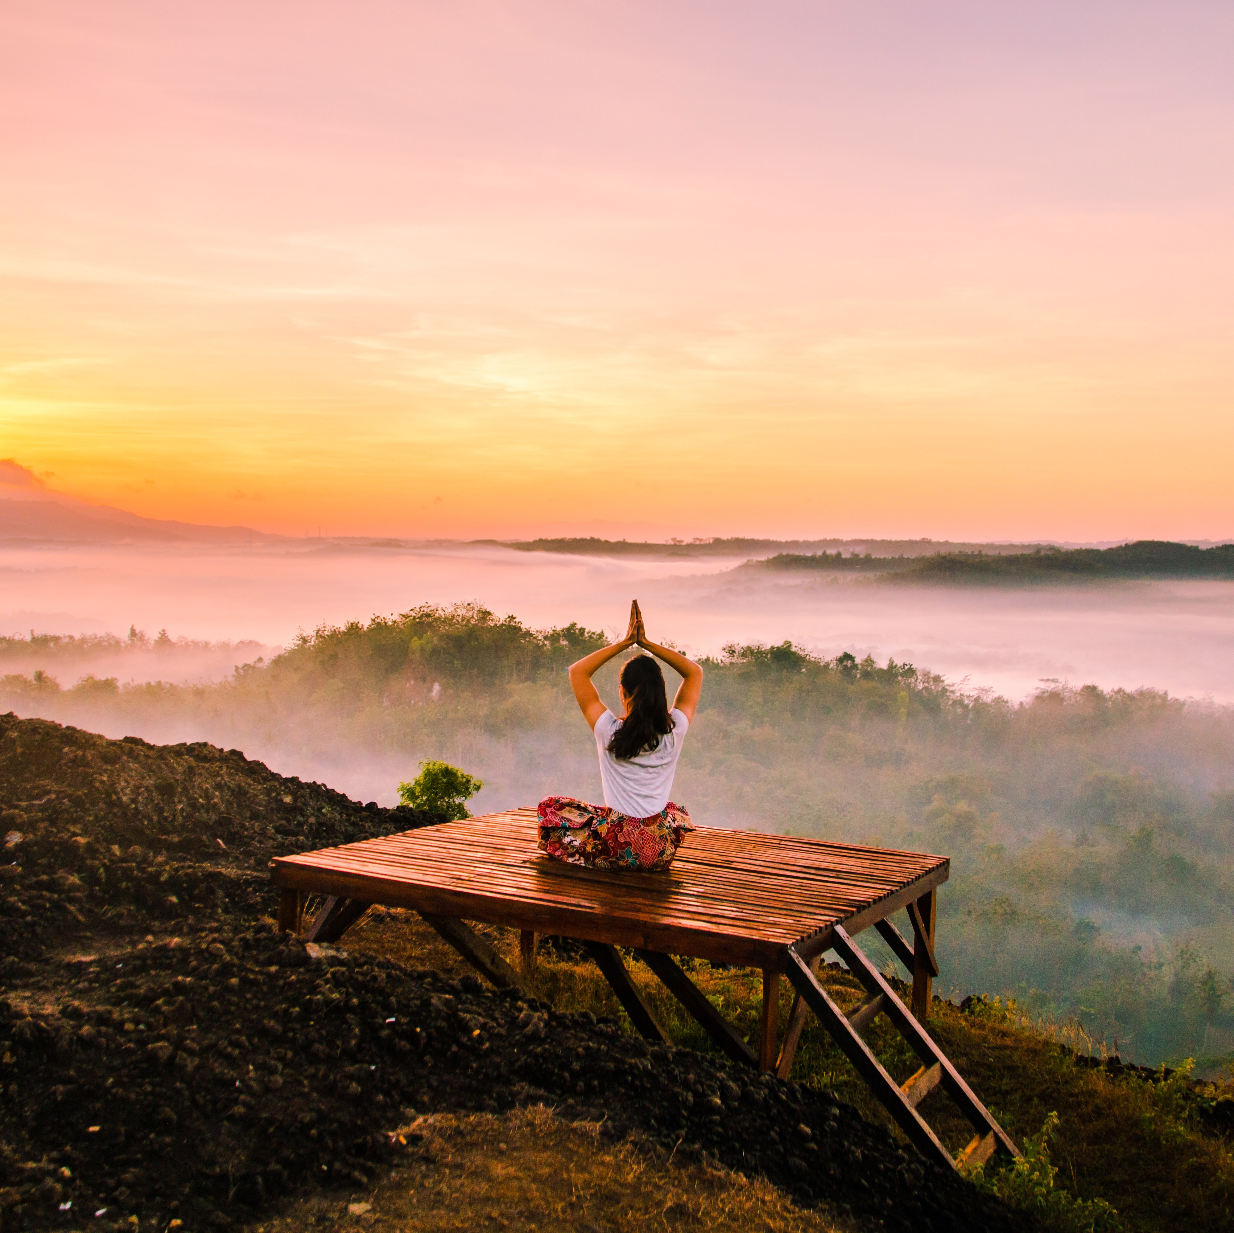
Happiness is not in having everything we want, but in knowing how to be content with what we have.
Wellness = work on yourself
The decision for wellness or a healthy lifestyle is the decision of each individual. The key factors for implementation are:
space and time
will and perseverance

Slide 16
1.2.
TOURISM
Tourism is travel and the most beautiful form of lifelong learning.

Slide 17
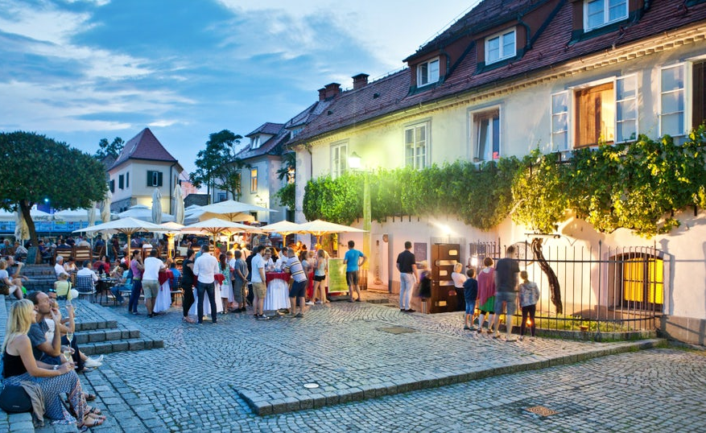
Tourism definition
EUROSTAT defines tourism as an „activity of visitors taking a trip to a destination outside their usual environment, for less than a year. It can be for any main purpose, including business or leisure..“
Notes:
Over the decades, tourism has experienced continued growth and deepening ‎diversification to become one of the fastest growing economic sectors in the world. ‎Modern tourism is closely linked to development and encompasses a growing number ‎of new destinations. These dynamics have turned tourism into a key driver for socio-‎economic progress. ‎(Home | UNWTO)
"Around the world, in countries at all development levels, many millions of jobs and businesses are dependent on a strong and thriving tourism sector. Tourism has also been a driving force in protecting natural and cultural heritage, preserving them for future generations to enjoy"
Mr. Zurab Pololikashvili SECRETARY-GENERAL OF THE UNWTO
Vir fotografije: 03ad01fd-fbea-4e26-b9f5-e8c8a2a2fded-stara-trta-5.jpg (994×538) (itinari.com)

Slide 18
Motivational factors for tourism
Internal factors arise, direct, and integrate a person’s behavior and influence his decisions for travelling.
External factors can influence tourists and pull them towards a certain motivation and subsequent decision.
Internal factors
External Factors
Intrinsic Motivation
Extrinsic Motivation
Attitudes of Tourist
Tourist’s Perception
Values or Beliefs
Personality of the Tourist
Place of Origin
Family and Age
Culture or Social Class
Market
Notes:
Intrinsic Motivation:
Attitudes of Tourist − Knowledge of a person, place, or objects, and feelings about the same.
Tourist’s Perception − By observing, listening, or getting knowledge
Values or Beliefs − which is acceptable personally or socially.
Personality of the Tourist − The nature and physique of a tourist
Extrinsic Motivation:
Place of Origin – cultural and social differences
Family and Age
Culture or Social Class
Market - Changes in value of currency, political situations, and economic well-being of the country influence the decisions of a tourist.

Slide 19
The role of tourism in the economy
Agriculture
Basic and tourist infrastructure are a condition for the development of the destination…
… the basis of gastronomy and providing culinary diversity …
Infrastructure
TOURISM
Trade
… providing various products…
…necessary for construction and maintenance…
Services
Construction
…
… ENABLING EXPERIENCES, CREATING MEMORIES…
Notes:
Tourism is an accelerator of economic development. In economic terms, it has two important tasks, as it affects the level of GDP (gross domestic product) and its re-spatial and sectoral division. Spatial division means division between countries, regions or places, and sectoral division between activities, industries and companies. Tourism as a social phenomenon is not based on a single economic activity, but as a mass phenomenon and as an economic activity, it relies on and connects many economic and non-economic activities. Tourist destinations must take into account the environment, and consequently develop and urbanize the development of tourism on the existing environment. They must take into account the wishes and needs of both residents and guests and tourism companies. They must provide security, communal infrastructure, education, health care and other activities that are also important for living in a place.

Slide 20
Impacts of tourism
TOURISM
Impacts the environment in two directions
ECONOMIC
NON-ECONOMIC
impact on GDP and its distribution
impact on employment
balancing the level of economic development between countries or regions
impact on the circulation of money and thus also on the income of non-tourism activities
impact on spatial valuation…
impact on peace and the spread of tolerance
impact on education, non-formal and / or formal
impact on recreational activities and health
ecological impact and care for the environment, which is a precondition for the development of many types of tourism….
Notes:
Tourism affects the economic development of the country, its foreign exchange and balance of payments and international trade, the development of various economies, non-economic activities, recruitment and evaluation of space…. In economic terms, tourism has two important tasks, as it affects the level of GDP (gross domestic product) and its spatial and sectoral division. Spatial division means division between countries, regions or places, and sectoral division between activities, industries and companies. The various economic impacts of tourism reflect its economic functions. In addition to these economic impacts, tourism also has non-economic advantages, which are mainly reflected in the quality of life, expanding cultural horizons and learning foreign languages ​​and other knowledge exchange, impact on the country's reputation, political life, valuation and preservation of heritage, broadening horizons, acceptance of diversity…
The peaceful impact of tourism is reflected in the expansion of the threshold of tolerance while learning about different cultures, religions and people. The spread of tolerance also directly strengthens world peace.
Impact on education, as travel broadens the cultural horizons of the individual and represents an interesting form of informal (or even formal) acquisition of new knowledge and experience.
Impact on recreational activities and health - tourism promotes relaxation, recreation, leaving the place of everyday life and escape from everyday life, stress and due to various activities has a positive effect on health.
The ecological impact of tourism is reflected in the growing concern for the environment, which is a precondition for the development of many types of tourism.

Slide 21
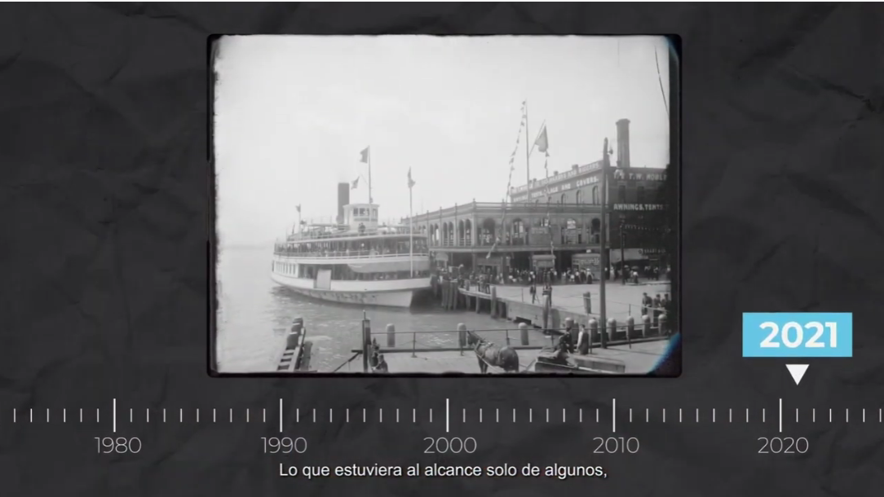
Video #1 : Tourism through history
UNWTO
#RESTARTTOURISM
https://youtu.be/ET6m3mVRjKg

Slide 22
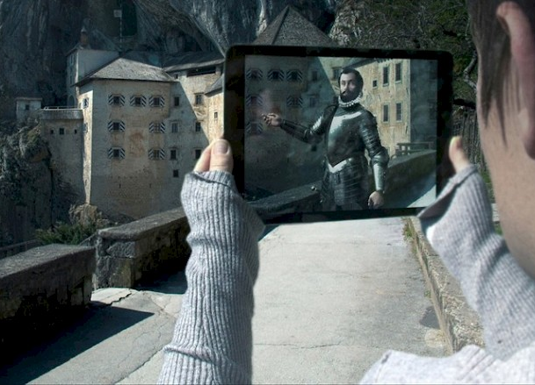
is independent, curious, active…
seeks quality experiences through authentic stories that can only be experienced in the destination in question and not anywhere else, but certainly in a creative, not always or everywhere the same way.
Sustainable, supports local people by buying local products, Looking for local food, new flavors and culinary experiences
Participates in the creation of individual products in terms of gaining new experiences through interesting stories of local masters
also uses virtual and augmented reality (VR and AR) to get to know time and the world.
The modern tourist
Notes:
The modern tourist does not buy holidays, sightseeing, trips, food, but buys experiences. The stronger and more authentic the experiences, the greater the impression the destination will make on the tourist. Experiences work on an experiential and emotional level and shape the individual. And the modern tourist is looking for experiences that impress him, influencing his perception of the world, getting to know himself in terms of change - transformation (it changed me, it affected me, I experienced it, tried it,.) . The stories emphasize experiences, make them attractive and actively involve the tourist in the events. Modern technology, virtual reality, augmented reality, with which it is possible to travel through time and participate in stories and experiences, also play an important role in storytelling and creating experiences.
The modern tourist before Covid was a "glocalist" who understood the world as a whole and felt at home anywhere, but as a tourist he respected and enjoyed local cultures, values, customs and other elements of locality (authenticity). In the post-Covid era, however, the local has become a new global, as travel is limited to discovering the region or nearby destinations due to the epidemiological situation at the global level. At the forefront is security, sustainable behavior and discovering the stories and experiences of the region.
Digitization and use of modern technology is the red thread of communication and shopping routes in tourism. This affects greater independence in the organization of travel and opens up opportunities for more successful direct shopping of individual services and experiences in the destination.
Photo source: https://www.radio-odeon.com/site/assets/files/13623/00-obogatenaresnicnost2104.800x0.jpg

Slide 23
Current trends in tourism
1. Safety and Security
2. Individual travel
3. Sustainable travel
4. Visiting secondary destinations
5. Traveling with an impact on the individual
6. Smart destinations
7. „Bleisure“ travel
More about current trends in tourism here.
Notes:
Given the current global epidemiological developments, the most important thing for tourists are safety and security in the broadest sense and ensuring safety in accordance with the epidemic standards. This trend will continue to have a strong impact on the tourism market. This is one of the reasons why more attractive trips will be closer to home or visiting nearby destinations. There will be fewer flights, shorter trips, followed by a re-concentration of time on one longer trip. More sought after will be destinations that have not yet been visited en masse (i.e. secondary destinations, or those that have been in second place so far and did not represent the primary attraction). People will be looking for authentic, local products and services. The trips will be sustainable and in cooperation with the local environment. In them, tourists will look for meaning in order to transform (what someone has experienced, an individual experience has had an impact on perception, thinking, feeling). Digitization and personalization in smart destinations. An increase in bleisure travel combining business and leisure travel (Business + Leisure = Bleisure).

Slide 24
Case study: Tourists seek EXPERIENCES
Explore nature in Iceland
Scotland in kilts
Experience & research your ancestry in Scotland | VisitScotland
Feeling life in the Azores
The Top 5 Destinations in Iceland | Guide to Iceland
Azores Videos | Visit Azores

Slide 25
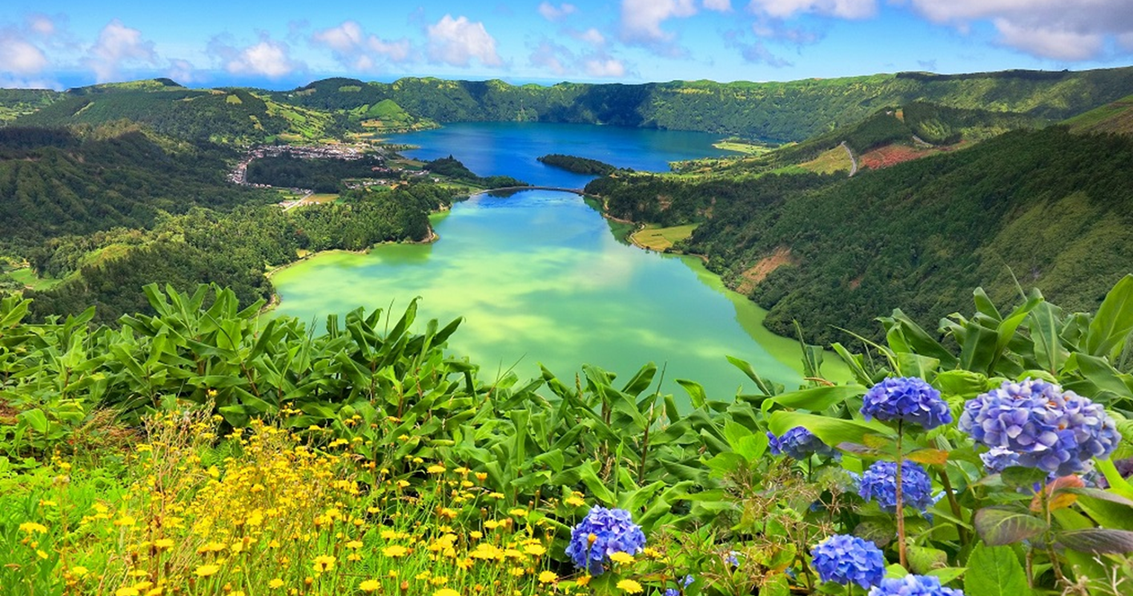
1.3.
DESTINATION
…is a complete system in which the elements of the tourist offer intensively participate and influence the individual elements of the tourist demand.
Notes:
Regardless of the attractiveness and organization of the offer, destinations can also differ depending on which segment of guests mostly visits them, which means that the destination is adapted primarily to the needs of each type of guest. So we know e.g. destinations for families, destinations for seniors, for active vacationers, adrenaline athletes, gourmets, "all inclusive" guests…However we want to share tourist destinations, they always have some common features such as real estate, connection with the population and quality assurance. This means that a tourist must be physically present in order to experience the destination, so he must travel there. The tourist destination is usually inhabited by the local population, who use the same services as tourists, so there may be conflicts between these two groups in case of imbalance (especially during the increased tourist visit - season). In order to prevent conflicts between locals and tourists and to ensure the quality of services in an individual tourist destination and the long-term success of the area, sustainable planning is crucial for the development of each destination for both groups of people (residents and tourists) .
Photo source: AZORES - Bing images

Slide 26
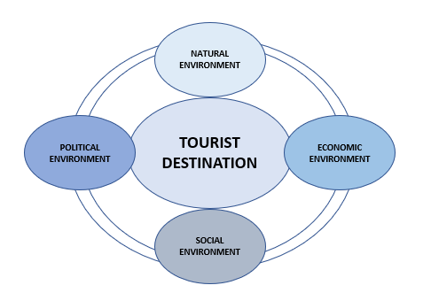
How does the destination work?
The destination management or destination organization is responsible for marketing, development of the offer, connection of providers and ensuring the quality of services and thus achieving the success of the operation of the destination in all respects.
Destination stakeholders are all those who are directly or indirectly related to the life and work of the destination.
For the destination to work successfully, different environments need to connect.
Notes:
Destination stakeholders come from the public, private and civil sectors (eg visitors, providers, locals, social and natural environment). Destination management must therefore represent the meeting point of development interests of all stakeholders, operating in the environment and coordinate their interests, as well as direct and promote the harmonious, sustainable development of tourism and its marketing.
By connecting and cooperating with the subjects of the tourist destination, the destination management must enable both, the tourist economy and civil society to implement their interests and development more easily . Cooperation with organizations and related institutions can influence the more efficient design of both regional and national programs in the field of tourism and, above all, the destination's involvement in major marketing and development activities in the field of tourism and tourism-related activities.
Each stakeholder within the destination has its own interests, desires and expected benefits.

Slide 27
Trends that also affect the
development of tourist destinations
The importance of safety and standards
Discovering destinations at home and in nearby region
Space as a value, an advantage of boutique, not mass destinations
The importance of destination management, establishing a safe, trustworthy brand with character
Direct reservations, departure from reservation portals
Notes:
Society is constantly changing and changes that are reflected in the living environment, values ​​and ways of communication, also affect our purchasing behavior, expectations and choice of tourist destinations or travel destinations. The key trend in all areas is safety and health, and recently also the emphasized value of the family. The epidemic further emphasized the importance of health and well-being. From the global, the world is turning to the local. Short supply chains, local food, local resources, involvement and participation of the local population are important and increasingly valued… The local community and participation in it is important. There are more and more activated individuals and groups who point out that it doesn’t matter how we live, but what happens in society. Given that a lot of work is done remotely, the use and trust in digital has increased, online shopping is very widespread ... However, the situation also forces people to be more prudent, responsible (even when shopping). Spontaneity in travel and leisure has been replaced by planning and adapting to conditions and opportunities. All this must be taken into account when establishing a local tourist offer, services and creating experiences. These changes also significantly affect the communication and marketing of the offer and the establishment of successful sales channels and building relationships with various publics and, of course, guests.
Photo source: AdobeStock_91237724-scaled.jpeg (2560 × 1280) (srip-turizem.si)

Slide 28
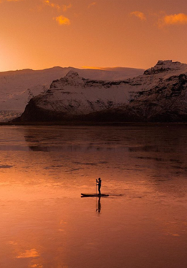
Trends that also affect the
development of tourist destinations
Digitization and personalisation of the offer
The importance of health and well-being
Authentic, local, sustainable - short chains, local food, local resources are valued and desired
A journey with meaning - a personal transformation and contribution to the local environment

Slide 29
Wellness Destinations
TOURISM
WELLNESS
WELLNESS TOURISM
The Global Wellness Institute defines wellness as the active pursuit of activities, choices and lifestyles that lead to a state of holistic health.
Notes:
Photo source: AZORES - Bing images

Slide 30
Types of wellness tourists
SECONDARY
PRIMARY
WELLNESS TOURISTS
according to the strength and intertwining of wellness motives and needs
A tourist who seeks to maintain wellness while traveling or who participates in wellness experiences while taking any type of trip for leisure or business.
A tourist whose trip or destination is primarily motivated by wellness.

Slide 31
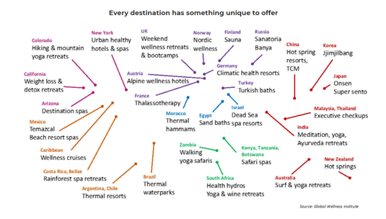
Wellness Destinations
Unique and authentic experiences can be built upon indigenous healing practices, ancient-spiritual traditions, native plants and forests, special muds, minerals, and waters, vernacular architecture, street vibes, local ingredients and culinary traditions, history and culture... Because each destination is different, there is always something unique to offer wellness travelers.
Notes:
Every destination has its own distinct flavors in relation to wellness, linked with its local culture, natural assets, foods, etc.
Some travelers may be satisfied with a generic massage, exercise class or smoothie. The more discerning and sophisticated wellness travelers—especially those in the millennial generation—are interested in what the destination offers that is different from someplace else.
Source: What is Wellness Tourism? - Global Wellness Institute

Slide 32
Green Destinations
Video #2 : 2020 Sustainable Top 100 Destinations
Certification through the Green Destinations Standard is the ultimate level of global recognition for destination quality and sustainable destination management.
Green destinations are also places with many quality opportunities for wellness activities. Because of the quality of the natural and social environment they are also healty living places for their inhabitants as well as wellness destinations for tourists.
https://www.youtube.com/watch?v=wyBhT7I5Wsg
Notes:
Certification through the Green Destinations Standard is the ultimate level of global recognition for destination quality and sustainable destination management.
Destinations that are in full compliance with the Global Sustainable Tourism Council (GSTC) Recognised Green Destinations Standard, will become Green Destinations Certified.

Slide 33
Wellness Tourism as a part of Wellness Economy
The Global Wellness Institute (GWI) defines the wellness economy as industries that enable consumers to incorporate wellness activities and lifestyles into their daily lives. The wellness economy encompasses 10 sectors, one of them is Wellness Tourism.
Notes:
The wellness economy is a colossal global industry, estimated by the Global Wellness Institute (GWI) as $4.2 trillion and representing roughly 5.3% of global economic output in 2017. Defined as industries that enable consumers to incorporate wellness activities and lifestyles into their daily lives, the wellness economy encompasses ten varied and diverse sectors (see figure). GWI first pioneered this concept and measured the wellness economy in the 2014 Global Wellness Economy Monitor. Since that time, the wellness economy grew from $3.4 trillion to $4.2 trillion, or by 5.8% annually. This growth rate is over five times as fast as global economic growth (1.1% annually) from 2013-2017.
Further reading: https://globalwellnessinstitute.org/industry-research/. and https://globalwellnessinstitute.org/wp-content/uploads/2019/07/Understanding-Wellness-Four-Global-Forces-Driving-the-Growth-of-the-Wellness-Economy_Rev6.pdf

Slide 34
Main TRENDS of Wellness economy growth 1/2
Population
Lifestyle and environmental disease
Loneliness and mental health
Population ageing
Environmental crisis
Pollution
Agriculture and food
Car dependence and unhealthy lifestyles

Slide 35
Main TRENDS of Wellness economy growth 2/2
Health systems
Failing health systems
Unsustainable economic costs
Turn from sick care to prevention
Demographic, value systems
Urbanization and middle class growth
Awareness and self-responsibility
Tehnology and connectivity

Slide 36
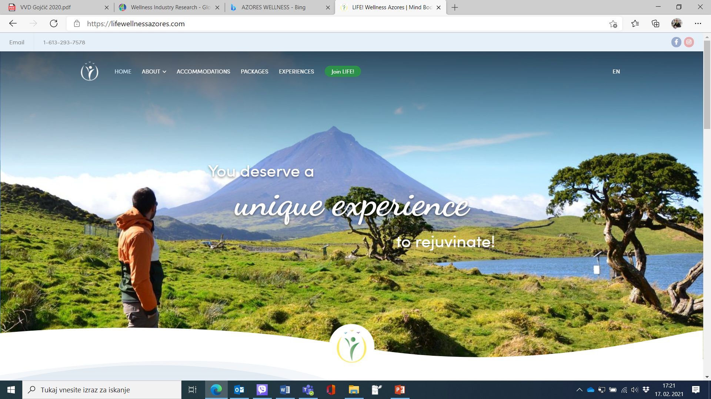
Case study – Unique experience to rejuvinate in the Azores
An example of unique wellness tourist experiences of the destination, AZORES, Portugal lifewellness

Slide 37
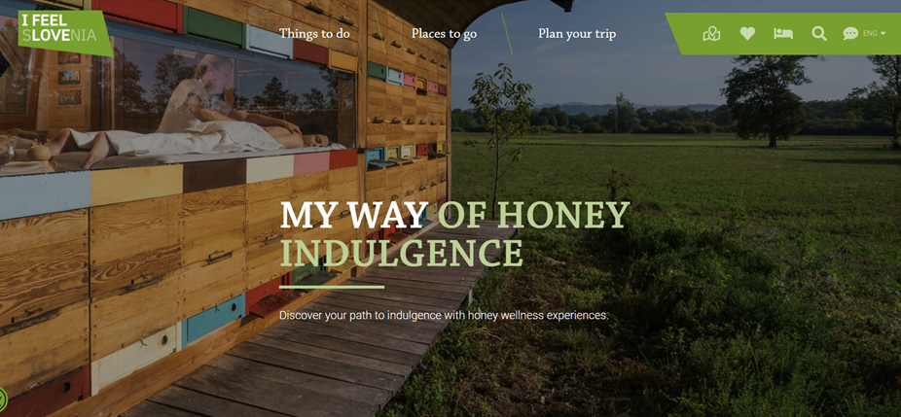
Case study – Boutique Wellness
Experience
in Slovenia
An example of an authentic wellness offer in a specific local environment: experiences with honey in Slovenia - Honey indulgence in Slovenia

Slide 38
1.4. SUSTAINABILITY
Sustainability is a complex concept. The most often quoted definition comes from the UN World Commission on Environment and Development: “sustainable development is development that meets the needs of the present without compromising the ability of future generations to meet their own needs.”
Notes:
Foto source: Giornata_della_Terra.jpg (960×500) (santamariaapparente.com)
Definition source: What is Sustainability? | UCLA Sustainability

Slide 39
Environments of cooperation in sustainable development
SOCIAL ENVIRONMENT
ECONOMIC ENVIRONMENT
NATURAL ENVIRONMENT
Notes:
The basic concept of sustainable tourism development refers to the environmental, socio-cultural and economic aspects of tourism development and requires a balance between them.
Sustainable development benefits current and future generations. It improves ecological and economic conditions, enables equality in development and maintains quality of life in the broadest sense.
Sustainable tourism must therefore:
optimize the use of environmental resources,
preserve key ecological processes and help preserve natural heritage and biodiversity.
respect the socio-cultural authenticity of the local destination,
preserve the built and intangible cultural heritage and traditional values, and
contribute to intercultural understanding and tolerance.
ensure long-term management and socio-economic benefits equitably distributed to all stakeholders, stable employability and earning opportunities, and social benefits for local communities, and contribute to poverty reduction.

Slide 40
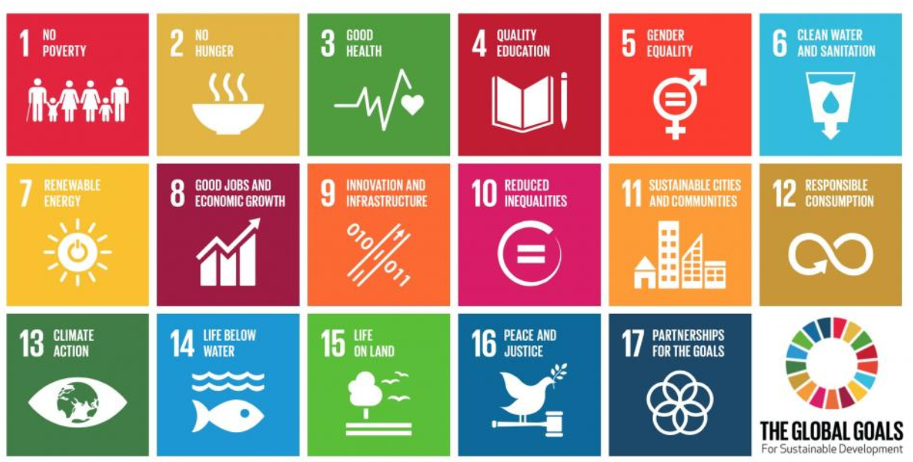
17 Global Sustainable Development Goals
Notes:
Source: https://www.un-page.org/page-and-sustainable-development-goals

Slide 41
Video #3 : The Global Goals for Sustainable Development
https://www.youtube.com/watch?v=o08ykAqLOxk&t=1s

Slide 42
Sustainable tourism takes full account of its current and future economic, social and environmental impacts, addresses the needs of visitors, industry, the environment and the host community
UNWTO
Notes:
According to UNWTO guidelines, destinations seeking sustainable tourism development are recommended to make optimal use of environmental resources, which are a key element in tourism development, while maintaining essential ecological processes and helping to preserve natural heritage and biodiversity. It is necessary to respect the socio-cultural authenticity of the host communities and to preserve their built and living cultural heritage, traditional values, and also in this way to contribute to intercultural understanding and tolerance. Successful, long-term economic operations need to be ensured, delivering socio-economic benefits to all stakeholders, distributed fairly, including stable employment and income opportunities, and social services for host communities. This attitude and development also contributes to poverty reduction.
Photo source: sustainable-tourism_1.jpg (750 × 500) (theplaidzebra.com)

Slide 43
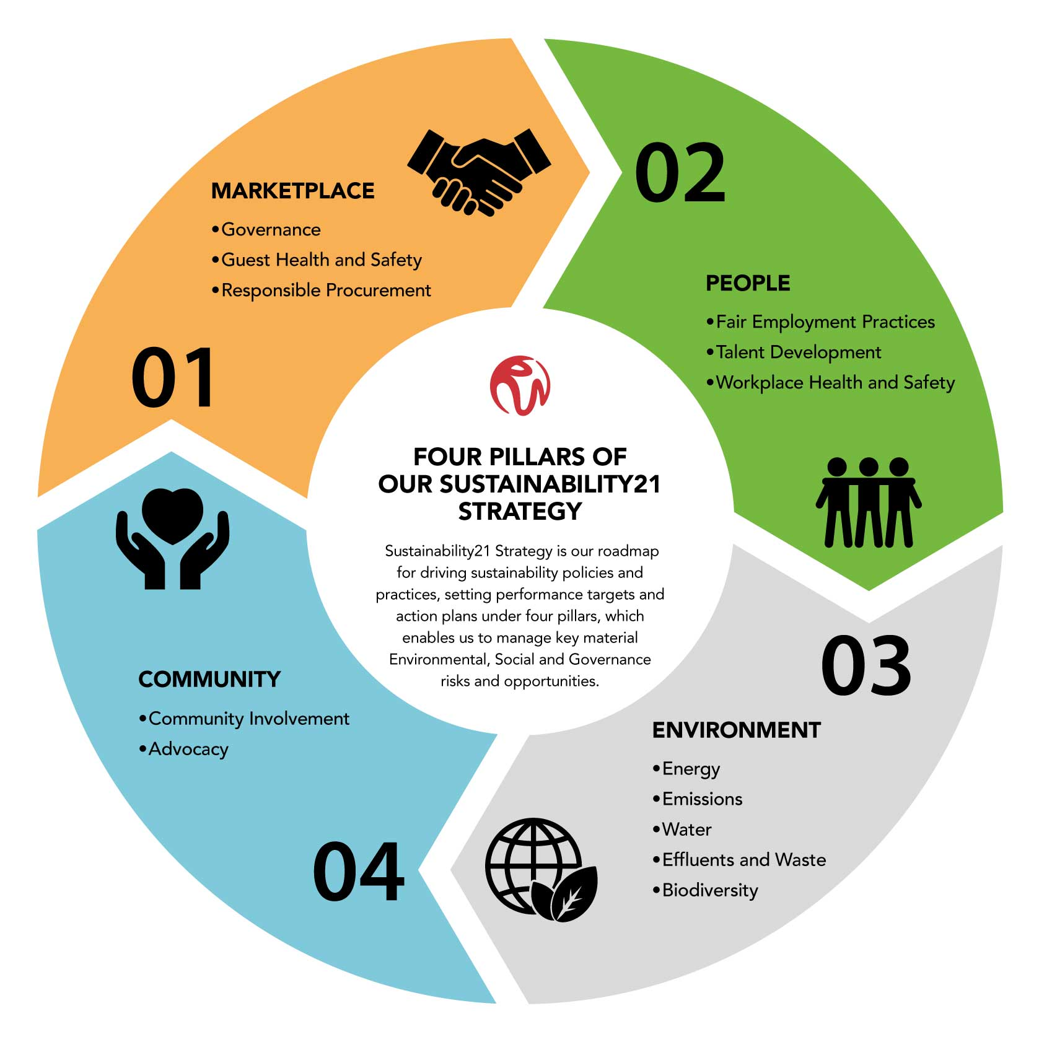
Guidelines for sustainable tourism development according to GSTC standards
The GSTC criteria are the result of global efforts to develop a common language on sustainability in tourism, which serve as global baseline standards for sustainable tourism.
Notes:
In 2007, the "Partnership for Global Sustainable Tourism Criteria" was established, bringing together the Rainforest Alliance, the United Nations Environment Program (UNEP), the United Nations Foundation and the United Nations World Tourism Organization. (UNWTO) together with a coalition of 32 reputable partners in the tourism industry. Their purpose was to adopt the general principles of sustainable tourism, to unify the common language of sustainable tourism. From this partnership, the Global Sustainable Tourism Council (GSTC) was born in 2010. Its task is to develop and manage global standards for sustainable travel and tourism (GSTC Criteria) and to provide international accreditation for bodies that certify areas or providers of sustainable tourism. The GSTC criteria are the result of global efforts to develop a common language on sustainability in tourism, which serve as global baseline standards for sustainable tourism. They are used for education and awareness-raising, policy-making for companies and government agencies and other types of organizations, for measuring and evaluating progress, and as a basis for certification. They are grouped into four pillars relating to secret management, socio-economic impacts, cultural impacts and environmental impacts (including resource consumption, pollution reduction, and biodiversity and landscape conservation).

Slide 44
Recycling waste
Small steps leading to LARGE CHANGES in everyday tourism practice
Discontinuing the use of disposable plastics
Use of soap dispensers
Bed linen for 1 week, towels for 3 days
Using local products
Travelling with less luggage
Less air travel
Carbon offset payment…
Notes:
https://www.bva-bdrc.com/projects/holiday-trends-2020

Slide 45
Sustainable destination
where the provider meets the needs of visitors, (tourism) industry, environment and local communities.
UNWTO and UNEP, 2005
Notes:
You can read more about sustainable destinations at Sustainability - ETC Corporate (etc-corporate.org)

Slide 46
69% of experts expect consumers to be more concerned about sustainability than they were before COVID-19.
51% of consumers chose “time for themselves” among the three main life priorities
EUROMONITOR INTERNATIONAL 2020
Notes:
More on sustainable tourism at: Sustainable & Responsible Tourism in Scotland | VisitScotland
Source: wpGCT21EN-v0.8.pdf (euromonitor.com)
Photo source: delavnica_trening_v_naravi_cas_zase.jpg (800×533) (zenskisvet.si)

Slide 47
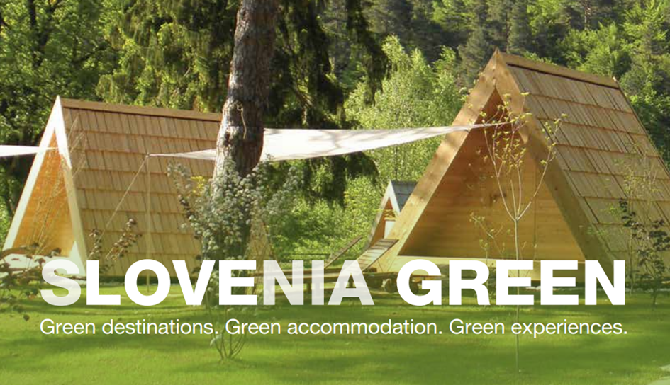
Case study – Green sheme of Slovene Tourism
Green destinations, accommodations and experiences need to be systematically promoted and their transformation guided. Slovenia has an internationally recognized and award-winning approach to systematically promoting the transformation of the tourist offer within the framework of the green scheme of Slovenian tourism. You can get to know the content of the scheme, certified destinations and providers better here.

Slide 48
Further Reading
Global guidelines for restarting tourism 2020 [CLIC HERE]
Responsible tourist mirrors the local inhabitants [CLICK HERE]
Wellness vs Wellbeing
[CLICK HERE]
7 ways wellness is changing the way we travel [CLICK HERE]
Sustainable destinations in Europe 2020 [CLICK HERE]
National Geographic Travel trends [CLICK HERE]
Standhill People‘s Market
[CLICK HERE]
Sustainable development objectives (SLO) [CLICK HERE]
ETC On sustainable tourism in europe [CLICK HERE]
Sustainable tourism Scotland [CLICK HERE]
Green sheme of Slovene Tourism [CLICK HERE]

Slide 49
Assignment
Based on the acquired contents of the module, consider how you can design or improve interesting tourist experiences for your guests, which will be sustainable and will take into account modern trends. You can help yourself with these cues:
What kind of (authentic) experience can we create from our offer, who can inspire it, what advantages do we have, what can we innovate, where can we be more creative?
Do we have a clear vision of who our experience will be for and when we can offer it?
What do we have and what else are we missing? How are we going to get to this?
Do we believe in ourselves and in our story? Do we know how to offer it appropriately and confidently?
How do we want our guests to remember us, to appreciate us?
What do we want in our work, what way of work perfects us – only a satisfied host can have satisfied guests.
What will be the first 3 concrete things we will accomplish in the short term?

Slide 50
Module Summary
“People do not buy goods and services.
They buy relations, stories and magic.”
Seth Godin

Slide 51
In this module we have learned:
Wellness as a holistic lifestyle that includes care for health, beauty, balance and harmony of thought, soul and feelings.
Tourism as an economic and social phenomenon that ensures the development of the economy and jobs, but also contributes to the protection of natural and cultural heritage and their preservation.
Motives and factors influencing the choice of travel destinations.
Tourism development trends and priorities for tourism recovery after the epidemic
Tourists are looking for experiences and stories.
Local is the new global
Notes:
Photo source: female-tourists-hand-have-happy-travel-map_1150-7411.jpg (626×417) (freepik.com)

Slide 52
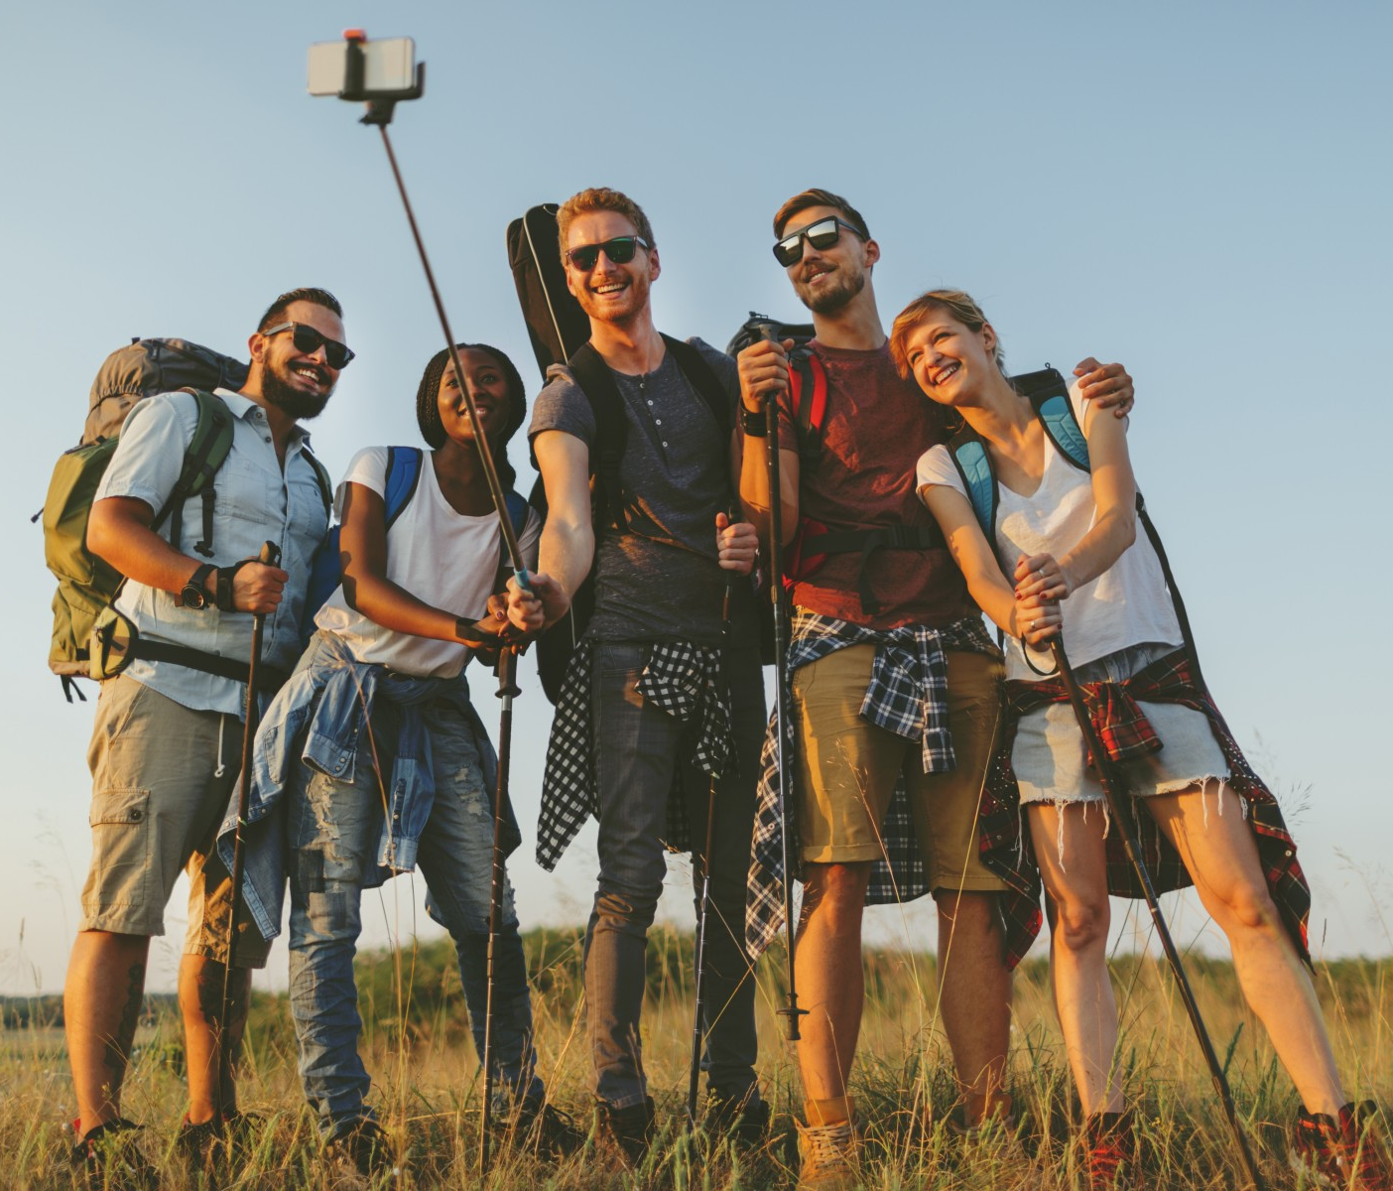
In this module we have learned
tourist destinations and trends in the development of the offer, which puts experiences and higher added value at the forefront for the destination to function successfully,
the natural, economic and social environment must be integrated
the success of the operation of the destination is taken care of by the destination management
sustainable development as the development of human society, which depletes and burdens natural resources, resources and enables their restoration

Slide 53
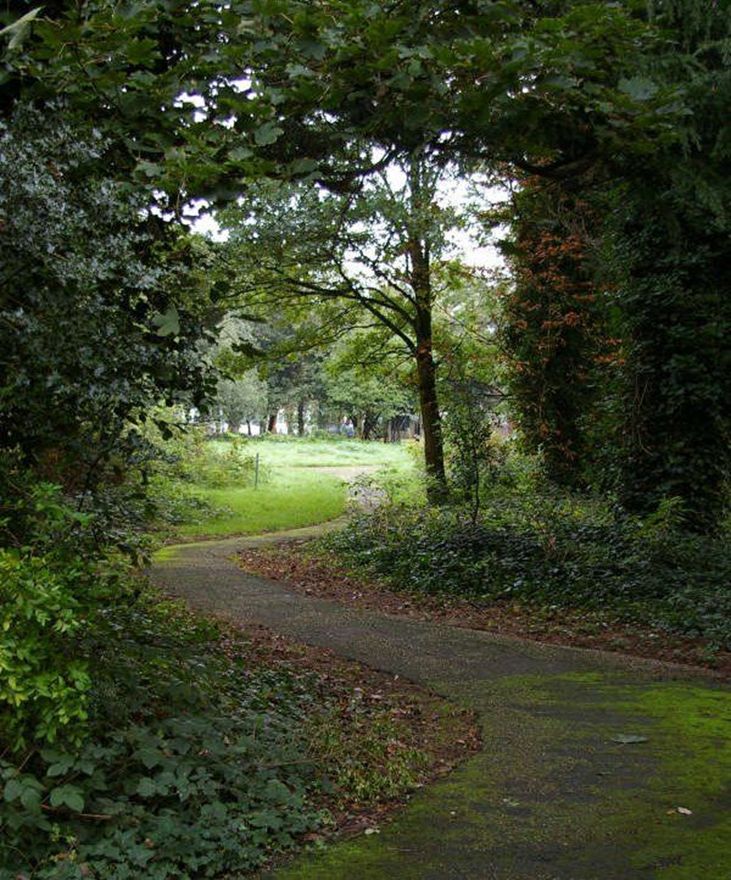
In this module we have learned
Sustainable tourism, taking full account of its current and future economic, social and environmental impacts, addresses the needs of visitors, industry, the environment and host communities
Small, sustainably oriented steps with which we can make big changes.
Guidelines for sustainable tourism development according to GSTC standards and the approach of systematic promotion of the transformation of the tourist offer within the Green Sheme of Slovene tourism. ‎

Slide 54
The roadmap
I. Introduction to Wellness and Wellbeing
II. Wellbeing in a New Era
III. The Experience Economy
IV. Engineering Wellbeing Experiences
V. Customer Journey Mapping
VI. Storytelling in Culinary Tourism
VII. Setting up a Wellbeing Business
VIII. Branding for Wellbeing
IX. Digital Marketing

Slide 55
Thank You
Any Questions?
www.detourproject.eu
Detour on Facebook
@WellbeingTourismDestinations
#detourdestinations #erasmusplus #detour #wellbeing
Icons: www.flaticon.com

